Slide 1
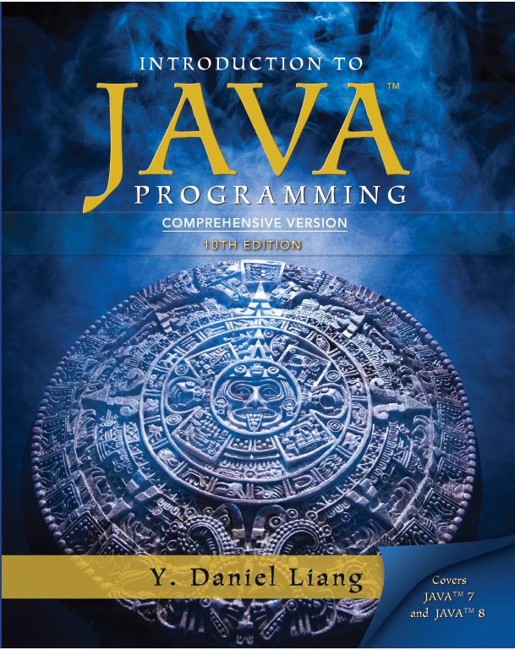
Introduction to Java Programming
Tenth Edition
Chapter 42
Testing Using JUnit
Slides in the presentation contain hyperlinks. JAWS user should be able to get a list of links by using INSERT+F7
Copyright © 2015 Pearson Education, Inc. All Rights Reserved

Slide 2
Objectives
42.1 To know what JUnit is and how JUnit works (§42.2).
42.2 To create and run a JUnit test class from the command window (§42.2).
42.3 To create and run a JUnit test class from NetBeans (§42.3).
42.4 To create and run a JUnit test class from Eclipse (§42.4).

Slide 3
JUnit Basics
JUnit is the de facto framework for testing Java programs. JUnit is a third-party open source library packed in a jar file. The jar file contains a tool called test runner, which is used to run test programs. Suppose you have a class named A. To test this class, you write a test class named ATest. This test class, called a test class, contains the methods you write for testing class A. The test runner executes ATest to generate a test report, as shown in Figure 42.1.

Slide 4
Obtaining and Running JUnit
You will see how JUnit works from an example. To create the example, first you need to download JUnit from http://sourceforge.net/projects/junit/files/. At present, the latest version is junit-4.10.jar. Download this file to c:\book\lib and add it to the classpath environment variable as follows:
To test if this environment variable is set correctly, open a new command window, and type the following command:

Slide 5
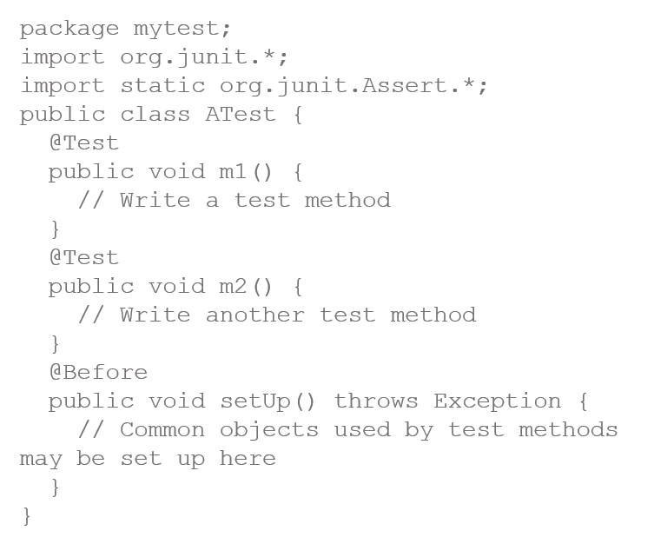
A JUnit Test Class
To use JUnit, create a test class. By convention, if the class to be tested is named A, the test class should be named ATest. A simple template of a test class may look like this:

Slide 6
Run the Test
A stream pipeline consists of a stream created from a data source, zero or more intermediate methods, and a final terminal method.

Slide 7
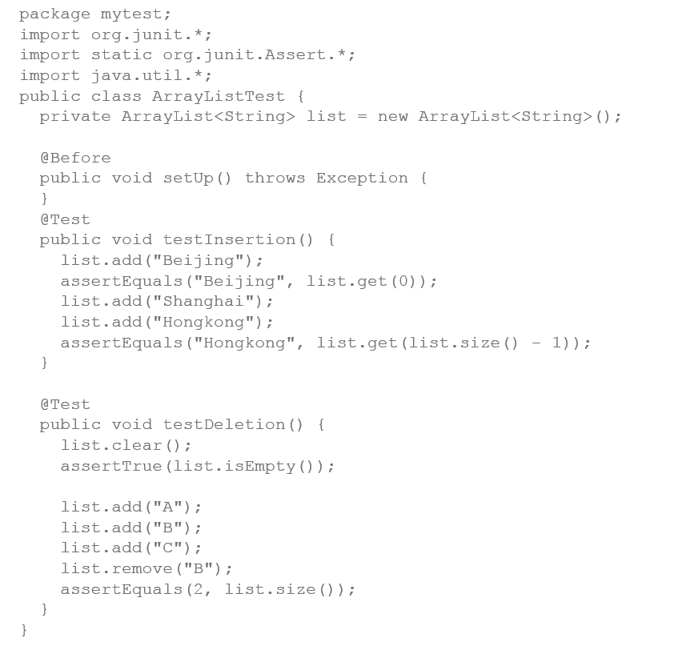
Test ArrayList
Listing 42.1 is an example of a test class for testing java.util.ArrayList.

Slide 8
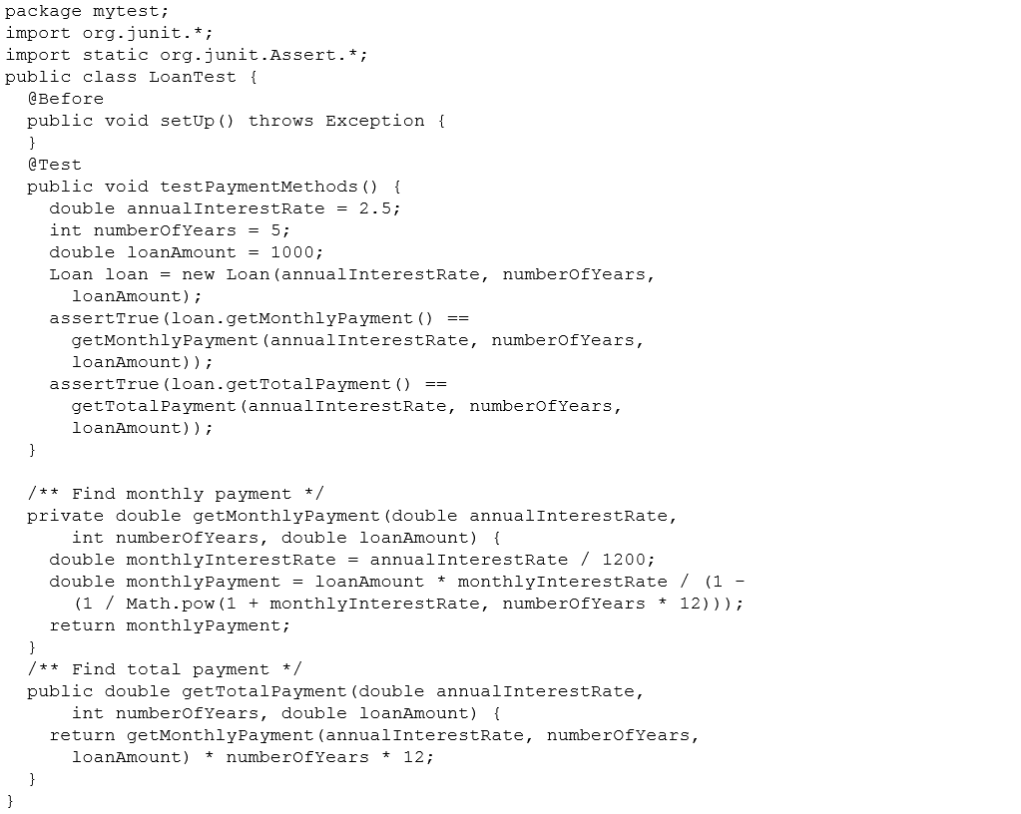
Test the Loan Class

Slide 9
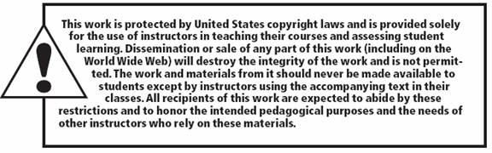
Copyright

