Slide 1
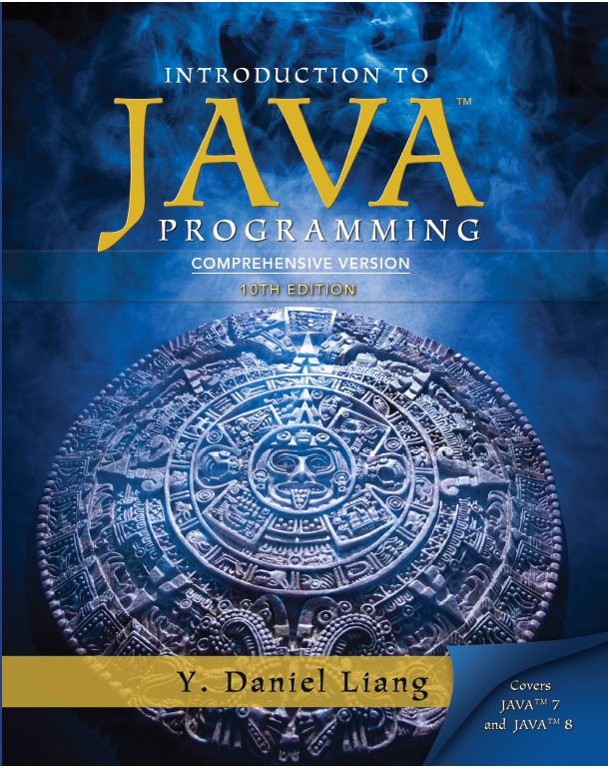
Introduction to Java Programming
Tenth Edition
Chapter 43
Aggregate Operations for Collection Streams
Copyright © 2015 Pearson Education, Inc. All Rights Reserved

Slide 2
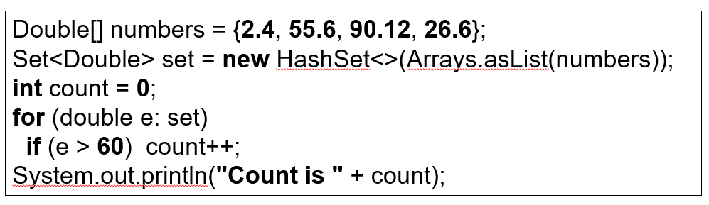

Motivations
The code is fine. However, Java provides a better and simpler way for accomplishing the task. Using the aggregate operations, you can rewrite the code as follows:

Slide 3
Objectives (1 of 2)
43.1 To use aggregate operations on collection streams to simplify coding and improve performance (§43.1).
43.2 To create a stream pipeline, apply lazy intermediate methods (skip, limit, filter, distinct, sorted, map, and mapToInt), and terminal methods (count, sum, average, max, min, forEach, findFirst, firstAny, anyMatch, allMatch, noneMatch, and toArray) on a steam (§43.2).
43.3 To process primitive data values using the IntStream, LongStream, and DoubleStream (§43.3).

Slide 4
Objectives (2 of 2)
43.4 To create parallel streams for fast execution (§43.4).
43.5 To reduce the elements in a stream into a single result using the reduce method (§43.5).
43.6 To place the elements in a stream into a mutable collection using the collect method (§43.6).
43.7 To group the elements in a stream and apply aggreate methods for the elements in the groups (§43.7).
43.8 To use a variety of examples to demonstrate how to simplify coding using streams (§43.8 ).

Slide 5
Stream
A collection stream or simply stream is a sequence of elements. The filter and count are the operations that you can apply on a stream. These operations are known as aggregate operations, because they are applied to a collection of data.

Slide 6
Stream Class (1 of 2)
An intermediate method transfroms a stream into another stream.
An terminal method performs an action and terminates a stream.
A static method creates a stream.

Slide 7
Stream Class (2 of 2)

Slide 8
Stream Pipeline
A stream pipeline consists of a stream created from a data source, zero or more intermediate methods, and a final terminal method.
Streams are lazy, which means that the computation is performed only when the terminal operation is initiated. This allows the J V M to optimize computation.
StreamDemo
Run

Slide 9
Functional Interface Arguments
Most of the arguments for stream methods are instances of functional interfaces. So the arguments can be created using lambda expressions or method references.

Slide 10
forEach Method
The lambda expression not only simplifies the code, but also the concept of the method. You can now simply say that for each element in the stream perform the action as specified in the expression.

Slide 11
The Sorted Method
is to sort the elements in their natural order and
sorts using the specified comparator.

Slide 12
The Filter Method
The filter method takes an argument of the Predicate<? super T> type, which is a functional interface with an abstract method test(T t) that returns a Boolean value. The method selects the elements from the stream that satisfies the predicate.

Slide 13
The max and min Methods
The max and min methods take an argument of the Comparator<? Super T> type. This argument specifies how the elements are compared in order to obtain the maximum and minimum element.

Slide 14
The anyMatch, allMatch, and noneMatch Methods
The anyMatch, allMatch, and noneMatch methods take an argument of the Predicate<? super T> type to test if the stream contains an element, all elements, or no element that satisfies the predicate.

Slide 15
The map Method
The map method returns a new stream by mapping each element in the stream into a new element. The map method takes an argument of the Function<? super T, ? super R> type to return an instance of the Stream<R>. The Function is a functional interface with an abstract method apply(T t) that maps t into a value of the type R.

Slide 16
IntStream, LongStream, and DoubleStream
Stream represents a sequence of objects. In addition to Stream, Java provides IntStream, LongStream, and DoubleStream for representing a sequence of int, long, and double values. These streams are also subinterfaces of BaseStream. You can use these streams in the same way like a Stream. Additionally, you can use the sum(), average(), and summaryStatistics()methods for returning the sum, average, various statistics of the elements in the stream. You can use the mapToInt method to convert a Stream to an IntStream and use the map method to convert any stream including an IntStream to a Stream.

Slide 17
IntStream, LongStream, and DoubleStream Examples
IntStreamDemo
Run

Slide 18
Parallel Streams
Streams can be executed in parallel mode to improve performance. The stream() method in the Collection interface returns a sequential stream. To execute operations in parallel, use the parallelStream() method in the Collection interface to obtain a parallel stream. Any stream can be turned to into a parallel stream by invoking the parallel() method defined in tbe BaseStream interface. Likewise, you can turn a parallel stream into a sequential stream by invoking the sequential() method.

Slide 19
Parallel Streams Example
ParallelStreamDemo
Run

Slide 20
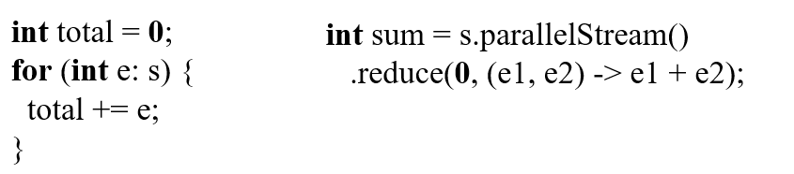
Stream Reduction Using the reduce Method
The reduce method makes the code concise. Moreover, the code is parallelizable, because multiple processors can simultaneously invoke the applyAsInt method on two integers repeatedly.
StreamReductionDemo
Run

Slide 21
Stream Reduction Using the collect Method
You can use the collect method to reduce the elements in a stream into a mutable container.
In the preceding example, the String’s concat method is used in the reduce method for
This operation causes a new string to be created when concatenating two strings, which is very inefficient. A better approach is to use a StringBuilder and accumulate the result into a StringBuilder. This can be accomplished using the collect method.
CollectDemo
Run

Slide 22
Grouping Elements Using the groupingby Collector
You can use the groupingBy collector along with the collect method to collect the elements by groups.
The elements in a stream can be divided into groups using the groupingby collector and then apply aggregate collectors on each group.
CollectGroupDemo
Run

Slide 23
Case Studies: Analyzing Numbers
AnalyzeNumbersUsingStream
Run

Slide 24
Case Studies: Counting the Occurrences of Each Letter
CountLettersUsingStream
Run

Slide 25
Case Studies: Counting the Occurrences of Each Letter in a String
CountOccurrenceOfLettersInAString
Run

Slide 26
Case Studies: Processing All Elements in a Two-Dimensional Array
TwoDimensionalArrayStream
Run

Slide 27
Case Studies: Finding the Directory Size
DirectorySizeStream
Run

Slide 28
Case Studies: Counting Keywords
CountKeywordStream
Run

Slide 29
Case Studies: Occurrences of Words
CountOccurrenceOfWordsStream
Run

Slide 30
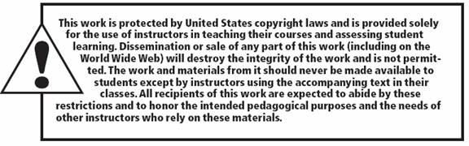
Copyright

