Slide 1
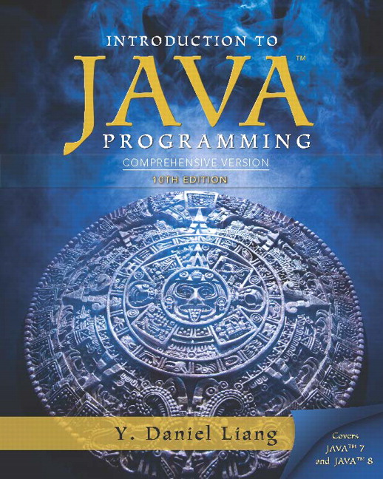
Introduction to Java Programming Comprehensive Version
Tenth Edition
Appendix F
Copyright © 2015 Pearson Education, Inc. All Rights Reserved
Notes:
If this PowerPoint presentation contains mathematical equations, you may need to check that your computer has the following installed:
1) MathType Plugin
2) Math Player (free versions available)
3) NVDA Reader (free versions available)

Slide 2
Number Systems (1 of 4)
Binary 0, 1
Octal 0, 1, 2, 3, 4, 5, 6, 7
Decimal 0, 1, 2, 3, 4, 5, 6, 7, 8, 9
Hexadecimal 0, 1, 2, 3, 4, 5, 6, 7, 8, 9, A, B, C, D, E, F

Slide 3
Number Systems (2 of 4)
Computers use binary numbers internally because storage devices like memory and disk are made to store 0s and 1s. A number or a text inside a computer is stored as a sequence of 0s and 1s. Each 0 and 1 is called a bit, short for binary digit. The binary number system has two digits, 0 and 1.
Binary numbers are not intuitive, since we use decimal numbers in our daily life. When you write a number like 20 in a program, it is assumed to be a decimal number. Internally, computer software is used to convert decimal numbers into binary numbers, and vice versa.

Slide 4
Number Systems (3 of 4)
The digits in the decimal number system are 0, 1, 2, 3, 4, 5, 6, 7, 8, and 9. A decimal number is represented using a sequence of one or more of these digits. The value that each digit in the sequence represents depends on its position. A position in a sequence has a value that is an integral power of 10. For example, the digits 7, 4, 2, and 3 in decimal number 7423 represent 7000, 400, 20, and 3, respectively, as shown below:
The decimal number system has ten digits and the position values are integral powers of 10. We say that 10 is the base or radix of the decimal number system. Similarly, the base of the binary number system is 2 since the binary number system has two digits and the base of the hex number system is 16 since the hex number system has sixteen digits.

Slide 5
Number Systems (4 of 4)
Binary numbers tend to be very long and cumbersome. Hexadecimal numbers are often used to abbreviate binary numbers. The hexadecimal number system has 16 digits: 0, 1, 2, 3, 4, 5, 6, 7, 8, 9, A, B, C, D, E, and F. The letters A, B, C, D, E, and F correspond to the decimal numbers 10, 11, 12, 13, 14, and 15.

Slide 6
Binary Numbers => Decimals
Given a binary number
the equivalent decimal value is
10 in binary
1000 in binary
10101011 in binary

Slide 7
Decimals => Binary
To convert a decimal number d to a binary number is to find the
binary digits..
such that
These numbers can be found by successively dividing d by 2 until the quotient is 0. The remainders are
For example, the decimal number 123 is 1 1 1 1 0 1 1 in binary. The conversion is conducted as follows:

Slide 8
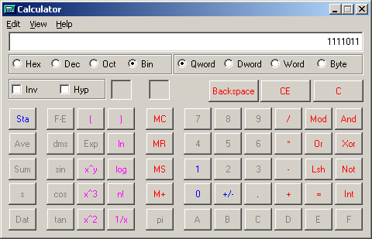
Windows Calculator
The Windows Calculator is a useful tool for performing number conversions. To run it, choose Programs, Accessories, and Calculator from the Start button.

Slide 9
Hexadecimals => Decimals
The hexadecimal number system has sixteen digits: 0, 1, 2, 3, 4, 5, 6, 7, 8, 9, A, B, C, D, E, and F. The letters A, B, C, D, E, and F correspond to the decimal numbers 10, 11, 12, 13, 14, and 15. Given a hexadecimal number
The equivalent decimal value is
7F in hex
FFFF in hex

Slide 10
Decimals => Hexadecimal
To convert a decimal number d to a hexadecimal number is to find
the hexadecimal digits
such that
These numbers can be found by successively dividing d by 16 until the quotient is 0. The remainders are
For example, the decimal number 123 is 7B in hexadecimal. The conversion is conducted as follows:

Slide 11
Hexadecimal ⬄ Binary
Binary | Hex | Decimal
0000 | 0 | 0
0001 | 1 | 1
0010 | 2 | 2
0011 | 3 | 3
0100 | 4 | 4
0101 | 5 | 5
0110 | 6 | 6
0111 | 7 | 7
1000 | 8 | 8
1001 | 9 | 9
1010 | A | 10
1011 | B | 11
1100 | C | 12
1101 | D | 13
1110 | E | 14
1111 | F | 15
To convert a hexadecimal number to a binary number, simply convert each digit in the hexadecimal number into a four-digit binary number.
To convert a binary number to a hexadecimal, convert every four binary digits from right to left in the binary number into a hexadecimal number. For example,

Slide 12

Copyright

