Slide 1
NodeJS in 15 minutes

Slide 2
NodeJS brief
Client Server Runtime Framework
Open Source
Free
Cross Platform

Slide 3
What is it?
Built on Chromiums V8 JavaScript Engine which is also open source
V8 is written in C++
Runtime is single threaded and I/O is non blocking
Important: your code is not non blocking
Event driven approach
Your code is written JavaScript

Slide 4
NPM
Out of the box NodeJS is barebones apart from the runtime
Common features are not included such as Gzip or Web Sockets
NodeJS has a package manager similar to Nuget, brew or gems: NPM
NPM is a command line tool: think UNIX

Slide 5
Installation
You can find the installation at https://nodejs.org/en/download/ or from apt-get
NodeJS will install NPM with it
You only need to install the framework on a server / middleware

Slide 6
Hello World Example
Source: console.log('hello world’);
To execute: node “1. Hello World.js”
Outputs: “hello world”

Slide 7
Web Request Example
var http = require('http');
var options = {
host: 'www.google.com',
path: ''
};
var callback = function(response) {
var str = '';
//data is gotten in chunks
response.on('data', function (chunk) {
str += chunk;
});
//whole stream was read
response.on('end', function () {
console.log(str);
});
}
http.request(options, callback).end();

Slide 8
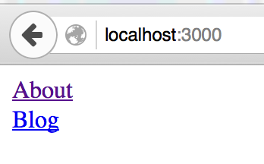
Web Server
One nice package in NPM is express
Express is a Web Application Server in NodeJS

Slide 9
Socket.io
Another powerful package
Transit layer for front end and middle layers
Client Server structure
Makes use of WSS, HTTP/S

Slide 10
What is NodeJS bad at
SQL
Caching
State
Monolith approaches
Content
CPU bound tasks

Slide 11
What is NodeJS good at
Subscription models
Distributed architecture
Proxies
Real time scenarios (push / hooks)

