Slide 1

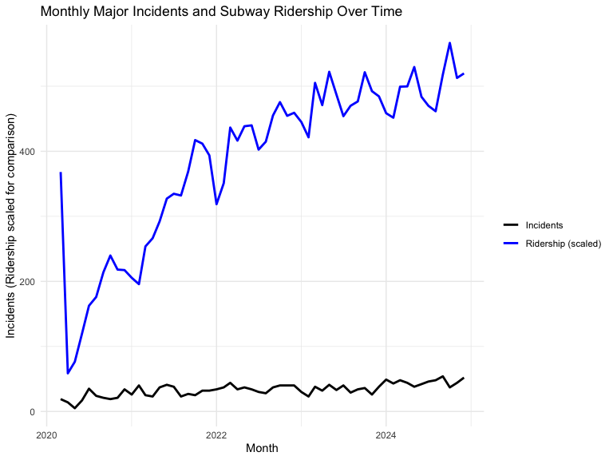
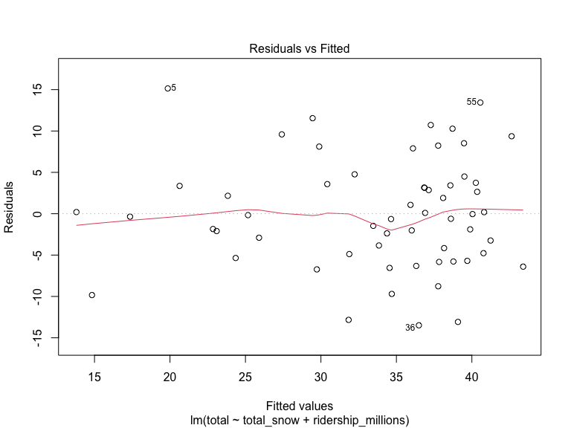
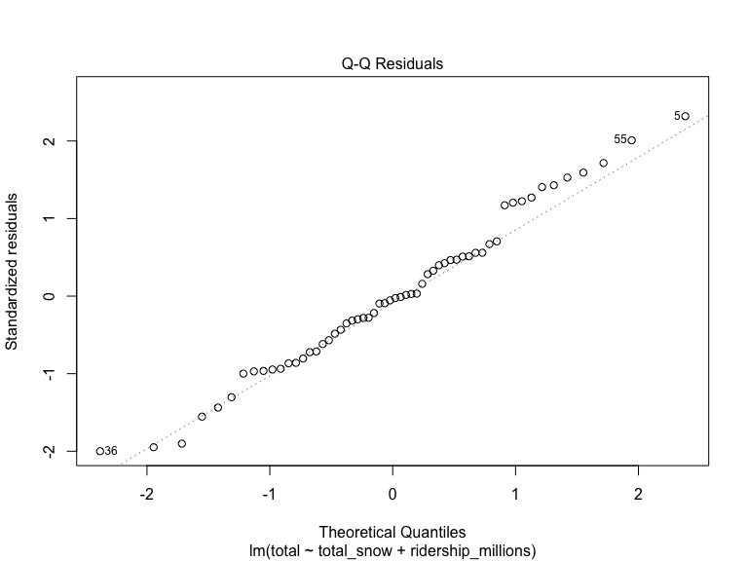
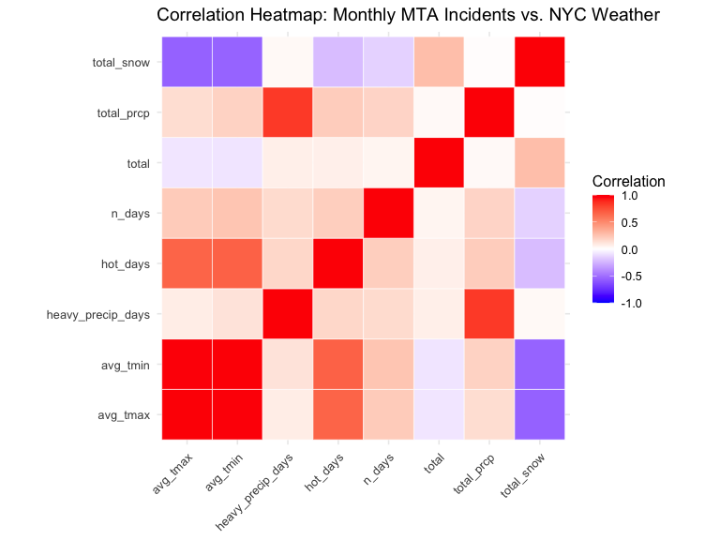
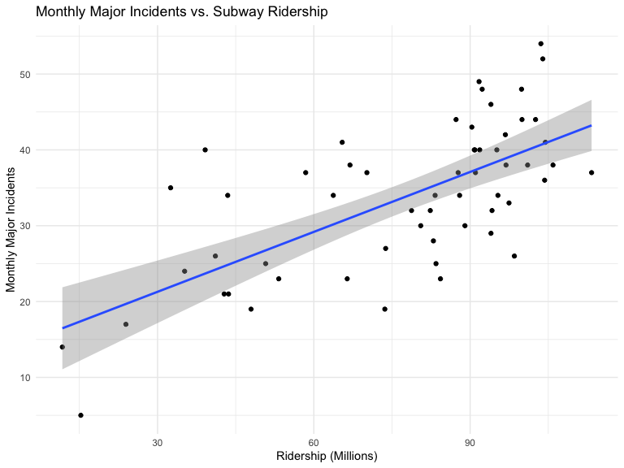
Modeling Monthly MTA Major Incidents Using Weather and Subway Ridership Andrew Chincea – School of Data Science and Analytics
Advisor: Dr. Soni
INTRODUCTION
RESULTS
Major incidents in the New York City subway system are defined as delays affecting 50 or more trains. This project investigates whether weather conditions explain variation in monthly incident counts, evaluates how much predictive power improves after incorporating subway ridership, and tests whether logarithmic transformations better capture the relationship between incidents, weather, and system usage.
Snowfall was the only consistently significant weather variable in the initial models, but weather-only specifications had very low explanatory power.
Adding subway ridership substantially improved fit. In the linear model with snow and ridership, both predictors were statistically significant.
Comparing the three specifications by AIC: linear = 392.13, log-response = 12.52, log-log = 5.40. The log-log model had the lowest AIC, indicating the best overall fit.
Both snowfall and ridership are positively associated with monthly major incidents, and the log-log relationship is more nearly linear than the untransformed one.
Diagnostics for the log-log model show improved residual behavior compared with the linear model, with no highly influential points and low VIF values.
METHODS
Combined MTA major incident data from 2015–2024 and aggregated to monthly totals.
Pulled NOAA NYC daily weather and engineered monthly features (snowfall, precipitation, temperature, hot days, heavy precipitation days).
Aggregated MTA subway ridership (2020 onward) to monthly totals and merged with the incident and weather data.
Built and compared regression models: weather-only, snow-only, log-transformed snow, and snow + ridership.
Compared linear, log-response, and log-log specifications using AIC and residual diagnostics to identify the best fit.
CONCLUSIONS
Weather alone explains only a small portion of variation in major incidents, even though snowfall is statistically significant. Adding subway ridership substantially improves model performance, showing that operational exposure is a major driver of incident frequency. The log-log specification provides the best overall fit by AIC, suggesting that monthly MTA major incidents are best described by a multiplicative relationship in which both system usage and weather intensity play important roles.

