Slide 1
Fraud Detection in Banking Transactions

Slide 2
Introduction
Financial fraud is a major challenge in banking, causing billions in losses annually
Both customers and institutions are harmed by evolving fraud tactics
Fraud detection is difficult as fraudsters adapt continuously
Traditional ML models struggle due to class imbalance (fraud cases are rare)
Project goal: develop a fraud detection model using FraudShield_Banking_DataFocus: improve recall for fraud cases while maintaining reasonable precision
*(Source: https://www.kaggle.com/datasets/zahranusratt/banking-fraud-detection-dataset)

Slide 3
Success Metrics
Business Metrics
Fraud Detection Rate (FDR) — Measures how effectively the system identifies actual fraudulent transactions.
False Positive Rate (FPR) — Shows how many legitimate transactions are incorrectly flagged as fraud.
False Negative Rate (FNR) — Indicates how many fraudulent transactions the system fails to detect.
Financial Loss Prevented — Represents the total monetary value saved by catching fraudulent transactions.
Cost of Fraud — Captures the financial impact of undetected fraud and related operational expenses.
Fraud‑to‑Review Ratio — Shows the proportion of true fraud cases among all transactions sent for review.
ROI of Fraud Detection System — Evaluates whether the fraud detection system generates more financial benefit than it costs.

Slide 4
Problem Statement
Key challenges identified in the dataset and current processes:
Fraud cases are extremely rare (~20:1 imbalance)
“47,573 normal vs. 2,423 fraudulent (~20:1 imbalance)”
Traditional ML models fail to detect fraud (recall = 0%)
High volume of missing data requiring robust preprocessing
Mix of numerical & categorical features complicates modeling
High-cardinality IDs risk overfitting

Slide 5
Project Goal
Primary Objective: Maximize fraud recall (catch more fraud) while maintaining acceptable precision.
Why recall matters: Missing a fraudulent transaction is far more costly than reviewing a legitimate one.

Slide 6
Model Breakthrough
After multiple failed attempts with Random Forest + SMOTE/ADASYN:
BalancedBaggingClassifier delivered the first meaningful results.
Initial recall: 23.52%
-After tuning: 57.16%
“Fraud recall: 57.16% (major improvement, > half of fraud cases detected)”

Slide 7
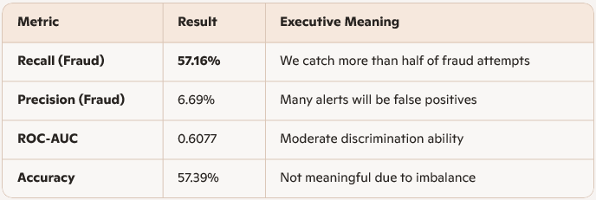
Final Model Performance
Key insight: The model is intentionally tuned to maximize fraud detection, accepting more false positives to reduce financial loss.

Slide 8
Financial Impact
Value Created
Detecting 57% of fraud reduces direct financial losses
Prevents downstream operational, legal, and reputational costs
Enables earlier intervention → lower recovery costs
Reduces fraud‑related customer churn
Cost Considerations
Increased manual review workload due to low precision
Infrastructure + model maintenance
Potential customer friction from false positives
ROI Equation
ROI = (Fraud Loss Prevented – Operational Review Cost – System Cost)
Even with low precision, the losses prevented from catching 57% of fraud typically outweigh review costs—especially in high‑value transaction environments.

Slide 9
Risks
Primary Risks Mitigated
Financial loss from undetected fraud
Regulatory exposure (AML/KYC compliance)
Reputational damage from customer fraud incidents
Operational inefficiencies in fraud investigation teams
Residual Risks
High false positives → customer dissatisfaction
Model drift as fraud tactics evolve
Need for continuous monitoring and retraining

Slide 10
Stretegic Recommendations
1. Deploy the Model as a Tier‑1 Fraud Filter
Use the BalancedBaggingClassifier as an early‑warning system to flag high‑risk transactions.
2. Implement a Tier‑2 Precision Layer
Add downstream models (e.g., XGBoost, Isolation Forest) to reduce false positives.
3. Introduce Cost‑Sensitive Thresholding
Optimize thresholds based on financial impact, not accuracy.
4. Invest in Feature Engineering
Future enhancements recommended in the document include:
“transaction velocity, spending anomalies per customer, and network-based features.”
5. Move Toward Real‑Time Scoring
Supports instant fraud blocking and customer protection.

Slide 11
Strategic Roadmap
Phase 1 — Immediate (0–3 months)
Deploy tuned model in shadow mode
Collect false positive/false negative analytics
Begin threshold optimization
Phase 2 — Enhancement (3–6 months)
Add advanced features (velocity, anomaly scores)
Introduce secondary precision model
Begin real‑time pipeline design
Phase 3 — Scale (6–12 months)
Full production rollout
Real‑time scoring integration
Continuous monitoring + retraining pipeline

Slide 12
Executive Summary
Fraud is a growing financial and reputational threat
Traditional models fail due to extreme class imbalance
BalancedBaggingClassifier delivers 57% fraud recall—a major breakthrough
ROI is driven by loss prevention, even with low precision
Strategic next steps can significantly improve precision and operational efficiency
Bottom line: This model provides a strong foundation for a modern, scalable fraud detection strategy.

Slide 13
End of Presentation

