Slide 1
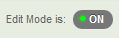
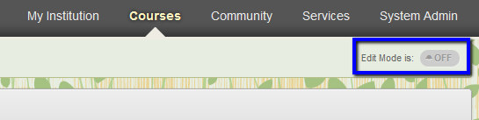


2v2 against tall guy
May 23, 2020
Say "I made a layup..."
20 points
70% FG%
7/10
50% 3-point %
2/4
10 rebounds
2 blocks
9 assists
3 steals
1 turnover
Log:
I made a jumpshot
I made a steal
I made a layup
I missed a 3-pointer
I made a steal
I made an assist

Slide 2
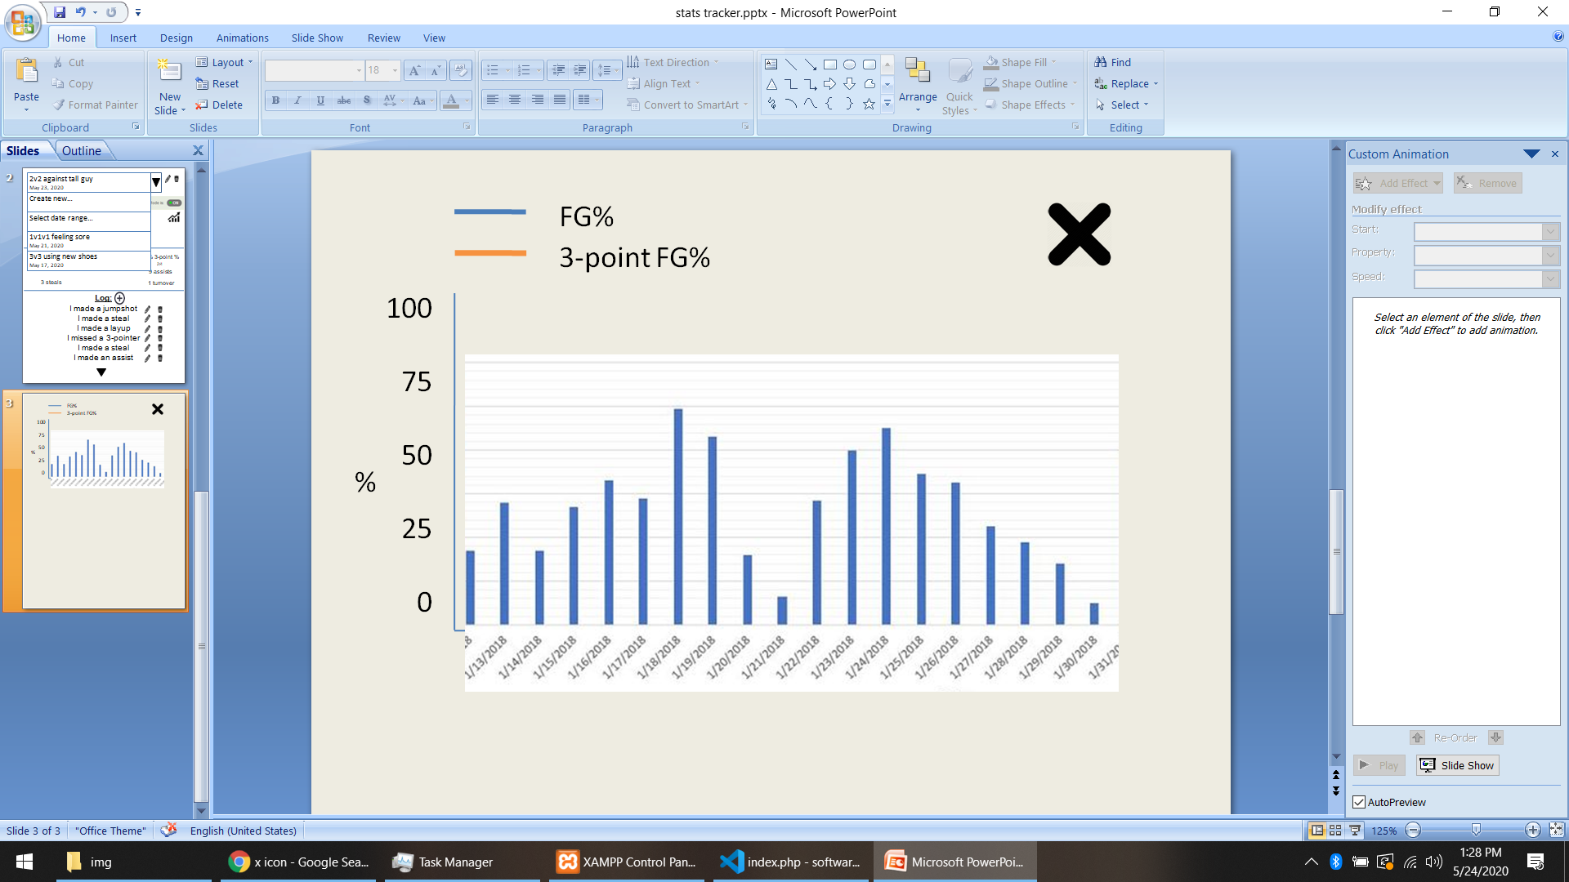
2v2 against tall guy
May 23, 2020
Say "I made a layup..."
20 points
70% FG%
7/10
50% 3-point %
2/4
10 rebounds
2 blocks
9 assists
3 steals
1 turnover
Log:
I made a jumpshot
I made a steal
I made a layup
I missed a 3-pointer
I made a steal
I made an assist

Slide 3
2v2 against tall guy
May 23, 2020
Create new game…
Select date range…
1v1v1 feeling sore
May 21, 2020
Say "I made a layup..."
20 points
50% 3-point %
2/4
3v3 using new shoes
May 17, 2020
70% FG%
7/10
10 rebounds
2 blocks
9 assists
3 steals
1 turnover
Log:
I made a jumpshot
I made a steal
I made a layup
I missed a 3-pointer
I made a steal
I made an assist

Slide 4



2v2 against tall guy
May 23, 2020
Say "I made a layup..."
20 points
70% FG%
7/10
50% 3-point %
2/4
10 rebounds
2 blocks
9 assists
3 steals
1 turnover
Log:
I made a jumpshot
I made a steal
I made a layup
I missed a 3-pointer
I made a steal
I made an assist

