Slide 1
Module 7: Final Project
Predicting House Sales Prices
Author: Andrew Buensalida

Slide 2
Introduction
In this project, I create 4 different regression models to predict housing prices.
- First I import data of house sale price and characteristics such as lot area, number of bedrooms, etc. from a csv file.
- Second visualize the data to better understand it.
- Third I create a small model that predicts 75% of the house sales price.
- Fourth, improving upon the previous model, I make the model bigger with 83% prediction power.
- Fifth, I tested the second model against data from jtest.csv.
- Sixth, I removed some unnecessary columns. The score for this third model did not change from the second model.
- Seventh, I increased the number of columns to be included in the model to 10. This increased the score slightly to 85%.

Slide 3
The Data
houseSmallData.csv is a mixture of strings and numbers about houses. It contains categorical data, which will not be used in the regression, and numerical data, which will be used. Categorical data include Street type, dwelling type, zoning classification, etc. Numerical data include number of bedrooms, ground floor area, year built, sale price, etc.

Slide 4
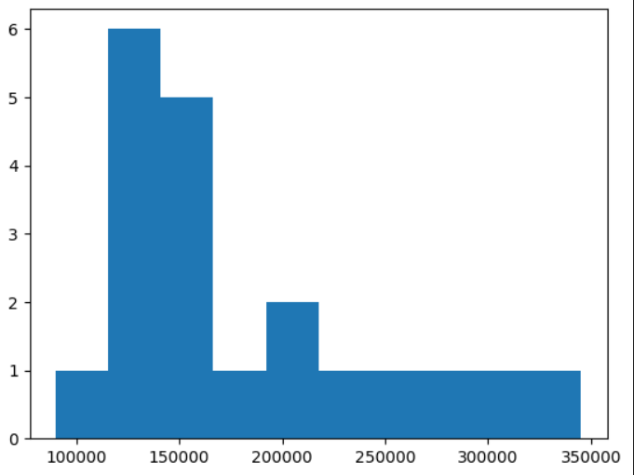
Data Exploration
This is a histogram of number of houses grouped by SalePrice. There are only 20 records in this model.

Slide 5
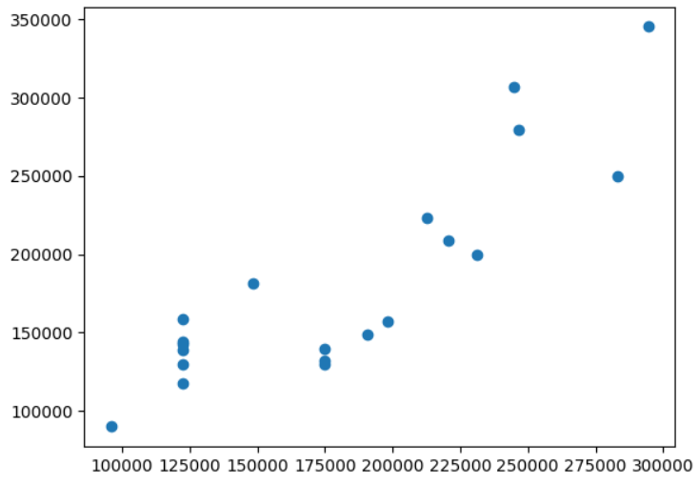
Data Exploration
Using the first model, this is a scatter plot of actual sales prices against predicted. The closer to a slope of 1 means it is a good predictor.

Slide 6
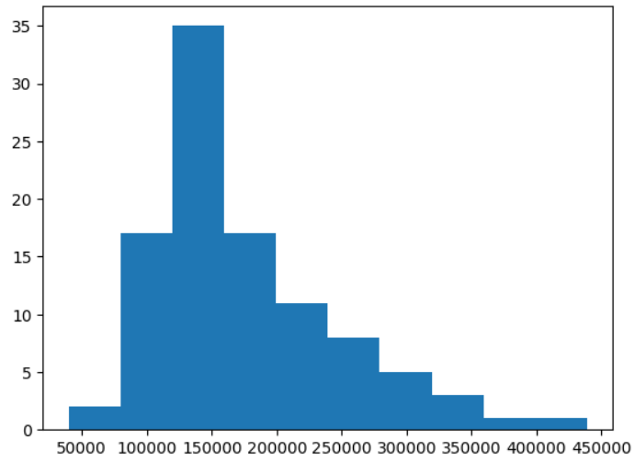
Data Exploration
For the second model, we use 100 records. Again we plotted a histogram of sales prices, and now it looks skewed to the left, which is a log normal distribution.

Slide 7
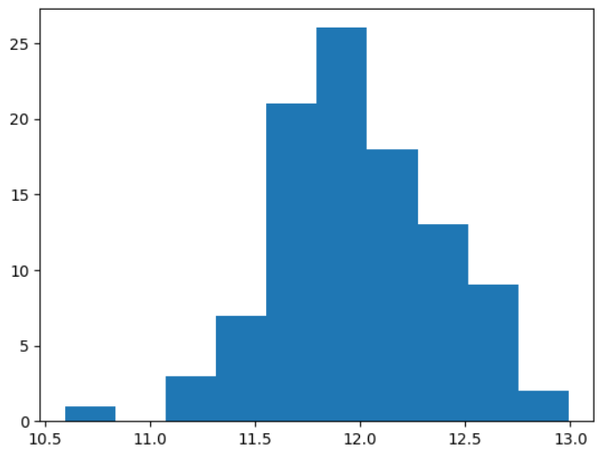
Data Exploration
Getting the logarithm of the sales prices produces a normal distribution for the histogram

Slide 8
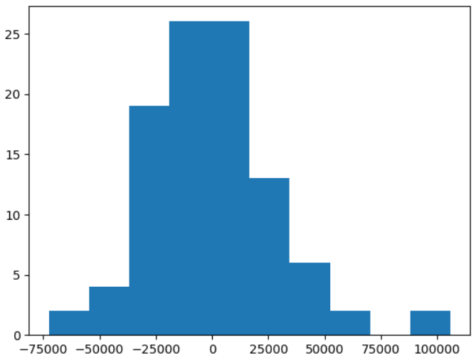
Data Exploration
This is a histogram of the difference between actual and predicted sales prices using the second model. We can see that the difference is mostly close to zero, which is a good sign that the model is accurate.

Slide 9
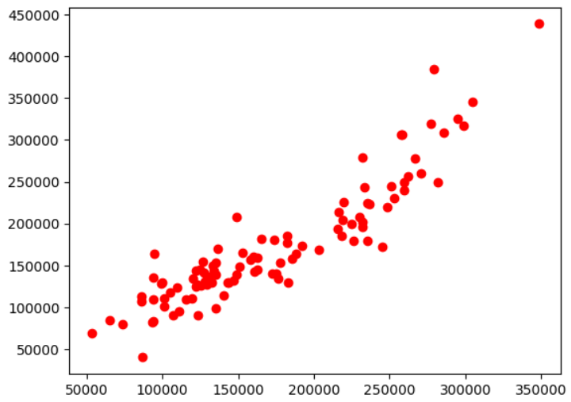
Data Exploration
This is a scatter plot of actual against predicted sales prices using model 2. It shows that it has a slope close to 1, which is a good indicator of prediction power.

Slide 10
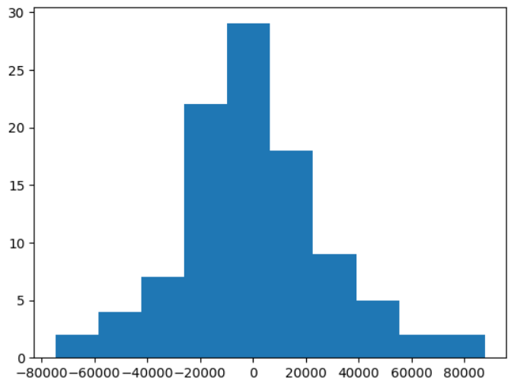
Data exploration
Using model 4, which is using 10 columns, it gives a histogram of the difference between predicted and actual sales prices that looks even more like a narrower normal distribution, which is a better indicator prediction power.

Slide 11
Data Preparation
As stated in the intro, the first model considered only 20 records and 2 columns.
The second model considered 100 records, removed columns containing nulls, and included 5 columns in the regression.
The third model is like the second model, but I removed even more unnecessary columns.
The fourth model included 10 columns, which was the most powerful at predicting. When it came to testing outside data however, I needed to fill the empty values with the mean for the whole column containing those empty values.

Slide 12
Correlation
The top 5 attributes of a house that predict sale price are:
- OverallQual 0.855061
- GrLivArea 0.735129
- GarageArea 0.688249
- GarageCars 0.663441
- YearBuilt 0.658636
A coefficient of greater than 0.70 is generally an indicator of a strong correlation. (https://www.nlm.nih.gov/oet/ed/stats/02-300.html#:~:text=As%20a%20rule%20of%20thumb,than%20%2D0.7%20are%20considered%20strong )

Slide 13
Project Description
The algorithm used to create the multiple linear regression model is scikitlearn’s linear_model.LinearRegression(). This model takes a dependent variable (sales price) and independent variables (area, year built, etc), and calculates an equation for a line.

Slide 14
Analysis and Results
In the 4th model (the model with the highest prediction power), I used these 10 variables: 'OverallQual', 'GrLivArea', 'GarageArea', 'GarageCars',
'YearBuilt', 'TotalBsmtSF', 'GarageYrBlt', 'FullBath', 'MasVnrArea',
'TotRmsAbvGrd'
I chose these variables because they have the highest correlation coefficient to sales price. It also intuitively makes sense because I would pay more for better overall quality, living area, garage area, etc. This model had a score of 0.85.
The second and third model, the ones with 5 columns, and dropped nulls, scored 0.83.
The first model, with 2 columns and 20 records, scored 0.75.

Slide 15
Verification
Model 2 has a score of 0.83 against training data, but for test data it decreased to 0.74.
Model 4 has a score of 0.85 against training data, but for test data it decrease to 0.75. Also, the test data had some empty values that had to be filled in with the mean. This is called imputation.

Slide 16
Conclusion
The model that performed the best was the 4th model, the one with the top 10 correlated columns, 100 training records, and no null columns. The score for this model is 0.85, meaning given these 10 variables, the model can predict 85% of the sale price. This is better than the 0.83 of Dr. Williams, which only used 5 columns. Since the scatter plot of prediction vs actual looks like it has a slope of 1, the model 4 is a good predictor. Basically having more columns, and more training records, and removing null columns made the model more accurate.
These variables make sense, since having a higher overall quality would seem to make the sale higher. Having a bigger living room area would also seem to make the sale higher, and so on.
In the future, I can include categorical columns such as dwelling type, zoning classification, neighborhood, etc. In order to do so, I would have to create dummy columns and treat each category as a 0 or 1.

Slide 17
References
“Finding and using health statistics.” National Library of Medicine. Access date May 14, 2024. https://www.nlm.nih.gov/oet/ed/stats/02-300.html#:~:text=As%20a%20rule%20of%20thumb,than%20%2D0.7%20are%20considered%20strong.
“Pandas DataFrame corr() Method” Geeks for geeks. Last Updated : 01 Dec, 2023. (https://www.geeksforgeeks.org/python-pandas-dataframe-corr ).
*Please add slides as required.

