Slide 1


市場規模
TAIWAN
KOREA
6.82 million people
30 million people
Middle to upper-class working professionals with fashion needs
TAM
3.61 million people
22 million people
Clothing Boutiques, Bridal Shops, and Working Professionals Looking to Enhance Their Dressing Experience
SAM
490,000 people
10 million people
According to the market research results
the proportion of people interested in the product
Based on market research results in Taiwan
SOM
Notes:
1.Demo
Design
Cad
2.先臺灣後日本，拐杖銷售額
上班族 平日上班

Slide 2
市場規模
TAIWAN
6.82 million people
Middle to upper-class working professionals with fashion needs
TAM
3.61 million people
Clothing Boutiques, Bridal Shops, and Working Professionals Looking to Enhance Their Dressing Experience
SAM
490,000 people
SOM
According to the market research results the proportion of people interested in the product
Notes:
1.Demo
Design
Cad
2.先臺灣後日本，拐杖銷售額
上班族 平日上班

Slide 3
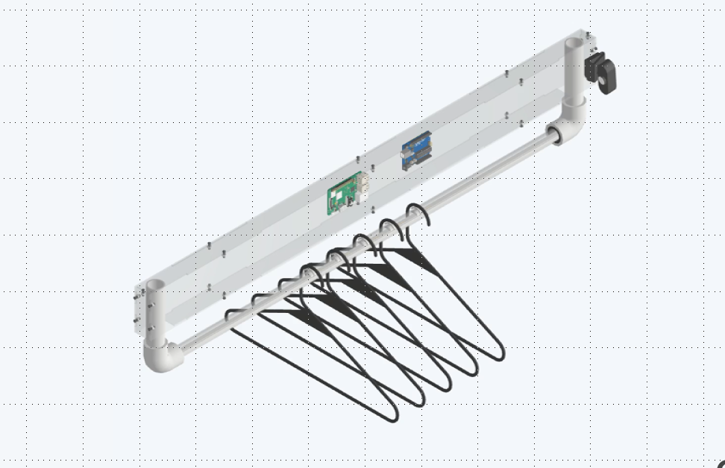
產品定價
Operating Costs
12100
Others
3000
Webcam
Acrylic Shell
Raspberry Pi
Pressure Sensor
(Number of Hangers)
PVC Pipe
Spray Paint
Wiring
4000
2000
2000
300*5
300
200
100
Other Materials
Research and Development Costs
1000
2000
Price
NT 32,700 ～ NT 38,150
Notes:
壓2000
線材 100
壓力感測器 300
樹梅派 2000
Webcame 4000
噴漆 200
pvc水管 300
衣架

Slide 4
