Slide 1
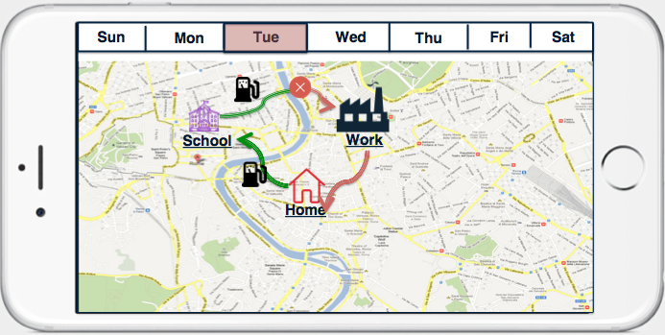
Analytics for Exxon Customers
Car Fuel Consumption Optimization
Similar to Google/Nest which optimizes the home’s temperature
This feature enables the mobile app users to monitor and optimize their fuel consumptions.
Exxon phone app and AppLink APIs will work together to find the driver’s commute habits per day/week/month and let the user to edit them if necessary. The app calculates how much the car can go with the current fuel level. It will update automatically.
Alternatively, the user shall be able to enter their regular commute habits for a week.
The user will also be notified about the gas stations on the road. They can choose which gas station they like or ask for Exxon app recommendations
In the future versions, the gas station recommendations can be based on regular traffic and/or gas price estimate.
The driver or whoever drives the car will receive reminders and notifications to get fuel at the selected gas station.
If the car commute changes, the driver will be provided with an updated plan to get fuel sooner or later.

Slide 2

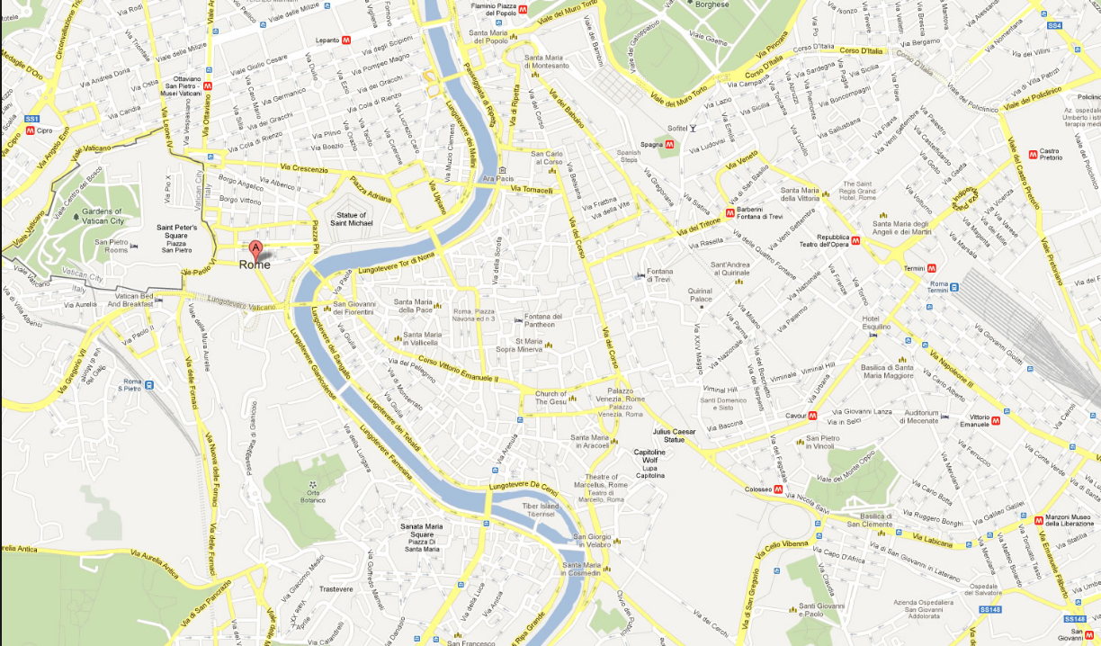
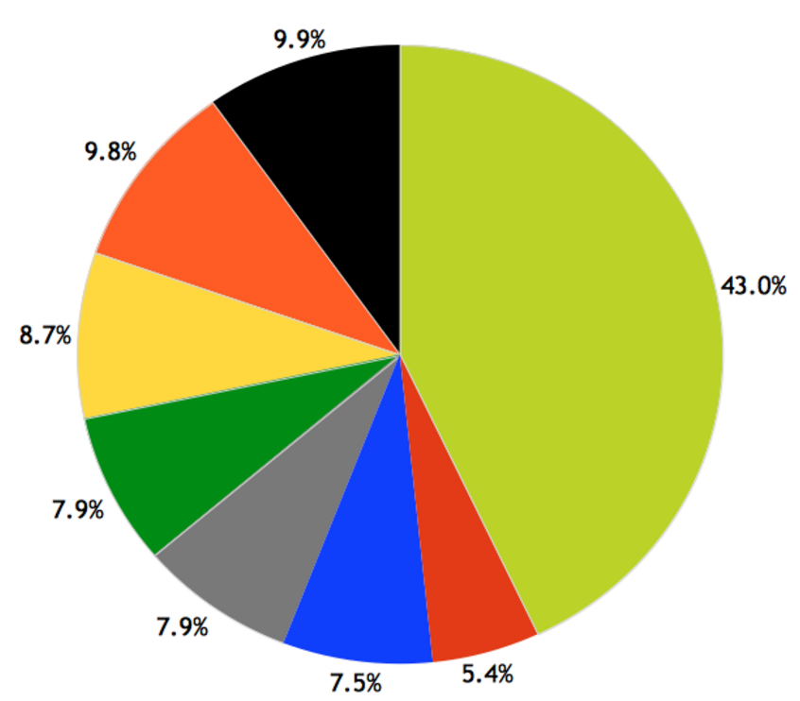
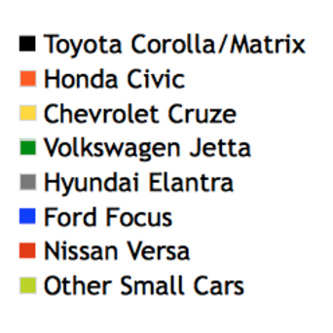

Analytics for Exxon Decision Makers
Car Model – Gas Station Analytics
Having the ‘My Car’ Phone app feature implemented, we will be able to perform the different types of analytics to provide weekly or on-demand reports for Exxon.
Exxon will decide when they need these reports to be created. However, the sooner we implement this phone app feature, the more data we will collect and make them available for future analytics.
There are several types of reports can be imagined such as:
What is the car model/year/etc distribution for each Exxon gas station? How is this distribution changing over time?
Which car models are running on low fuel more than others?
What are the preferred payment options for every car model?
.....

