Slide 1

Ecological Factors Associated with Self-Reported Mental Health Status
Alyssa Berger Andrew Cistola

Slide 2
aims topic and approaches
The purpose of this study is to utilize machine learning and spatial statistics to identify significant associations between ecological variables and health outcomes available from public data sources.
This study seeks to identify local socioeconomic factors associated with a higher prevalence and health resources that are associated with a lower prevalence of poor self-reported mental health status.
Once identified, hierarchical linear models can be developed to display these relationships and artificial neural networks can be used to predict future outcomes.
By searching among large numbers of candidate predictors, informative relationships that may not be already considered in previous research can be used to develop targeted future population health management efforts.

Slide 3
Specific aims
Identify local socioeconomic factors associated with a higher prevalence of poor self-reported mental health status
Identify area health resources that are associated with a lower prevalence of poor self-reported mental health status

Slide 4
introduction background and motivation
Ecological factors are known predictors of many health outcomes (1–7).
Neighborhood level deprivation is a useful measure in assessing risk for negative health outcomes and creating targeted interventions within population health management (8–13).
However, there are many complex ecological factors that have not yet been thoroughly identified.
With the advent of ‘big data,’ there is increased availability of ecological data that can measure these effects as well as machine learning algorithms that can analyze large datasets.
Alongside geographic information systems that can model complex associations, new computational approaches have great potential to improve public health research and population health management efforts (14–17).
However spatial analysis used for non-infectious public health outcomes is limited (18) and the use of machine learning often provides little benefit over traditional approaches (19,20).
Machine learning needs methodological improvement (21–24) to better assist population health management efforts (25–27).
There is a for expanded scope in spatial analysis to better inform translational science in public health (28–30).

Slide 5
data source: CDC and RWJF PLACES 2020
US Census American Community Survey (ACS) five-year percent estimates by zip code are collected from the 2020 data release to represent socio-economic ecological predictors.
The Health Services Resource Administration (HRSA) Area Health Resource File (AHRF) 2020 data release is collected and five-year averages are calculated by county to represent infrastructural ecological predictors.
The CDC and RWJF PLACES 2020 data release (formerly 500 Cities project) provided zip code level prevalence estimates of many common diseases, health conditions, and preventive care services.
Zip codes were joined to county using crosswalk files from the Department of Housing and Urban development so that each zip code could be contained within a specific county based on where a majority of the population is located.
Together these datasets provide a comprehensive list of approximately 2500 possible candidate predictors at zip code and county levels for all 50 states and include individual demographics, housing types, economic status, education levels, employment types, health workforce availability, insurance markets, and inpatient facilities, and hospital quality metrics.
For each of the datasets, the 2020 release was created based on data collected during 2014-2019. This time period was selected due to its timing immediately after the most significant period of ACA implementation and preceding the SARS-Cov20 pandemic.
When compared to other time periods, this 5-year window represents a relatively stable healthcare environment that can be useful in determining the direction for future reforms.

Slide 6
data source: CDC and RWJF PLACES 2020
US Census American Community Survey (ACS) five-year percent estimates by zip code are collected from the 2020 data release to represent socio-economic ecological predictors.
The Health Services Resource Administration (HRSA) Area Health Resource File (AHRF) 2020 data release is collected and five-year averages are calculated by county to represent infrastructural ecological predictors.
The CDC and RWJF PLACES 2020 data release (formerly 500 Cities project) provided zip code level prevalence estimates of many common diseases, health conditions, and preventive care services.
Zip codes were joined to county using crosswalk files from the Department of Housing and Urban development so that each zip code could be contained within a specific county based on where a majority of the population is located.
Together these datasets provide a comprehensive list of approximately 2500 possible candidate predictors at zip code and county levels for all 50 states and include individual demographics, housing types, economic status, education levels, employment types, health workforce availability, insurance markets, and inpatient facilities, and hospital quality metrics.
For each of the datasets, the 2020 release was created based on data collected during 2014-2019. This time period was selected due to its timing immediately after the most significant period of ACA implementation and preceding the SARS-Cov20 pandemic.
When compared to other time periods, this 5-year window represents a relatively stable healthcare environment that can be useful in determining the direction for future reforms.

Slide 7
data management and analyses
1. Collect estimated zip code level self-reported poor mental health status as percent of population from the 2020 release of the CDC and RWJF PLACES dataset.
2. Collect approximately 400 zip code level socio-economic variables as percent estimates from the 2020 release of the US Census American Community Survey.
3. Connect outcomes with predictors, remove observations with missing values, impute missing data for predictor variables using median values, standard scale all variables.
4. Collect approximately 2000 county level health resource variables from the 2020 release of the HRSA Area Health resource File.
5. Utilize open-source machine learning algorithms to identify socioeconomic variables with both high variation and high importance. Conduct cross-validated prediction to identify the smallest number of variables that will achieve the best fitting model for zip codes.
6. Calculate spatially adjusted rates and use an artificial neural network with backwards elimination to predict zip codes in the top quartile. Compare the predictive capability of all predictors, a random set of predictors, other known predictors, and the variables obtained in step 4.
7. Test for OLS assumptions and use domain knowledge to develop an appropriate mixed effects regression model for the purpose of identifying parameter estimates for socioeconomic predictors.
8. Using local Empirical Bayes smoothing and LISA quadrants, identify ‘hot and cold spot’ regions and assign nominal labels to contained counties .Use algorithms capable of multi-nominal prediction to identify health resources associated with each category.
9. Using zip code predictors, conduct geographic weighted regression to identify regions where each predictor has significantly higher or lower coefficients. Assign nominal labels and use algorithms capable of multi-nominal prediction to identify health resources associated with each category.
10. Test for OLS assumptions and use domain knowledge to develop an appropriate mixed effects regression model. The purpose is to identify parameter estimates for each county predictor identified in step 8 and an interaction term for county and zip code predictors in step 9.

Slide 8
Results and interpretation
Table I. Final list of selected zip code and county predictors used in mixed-effects model using natural log of crude prevalence as outcome.
Feature | Layer | Description
D2_T1_17 | Zip Code | Average Household Size
D2_T1_46 | Zip Code | Population 25 Years And Over Bachelor's Degree Or Higher
D2_T2_39 | Zip Code | Civilian Employed Population Government Workers
D2_T2_90 | Zip Code | Percentage of Families with Income Below The Poverty Level
D2_T4_5 | Zip Code | Total Population Female
D3_1029 | County | Manufacturing-Dependent Designation

Slide 9
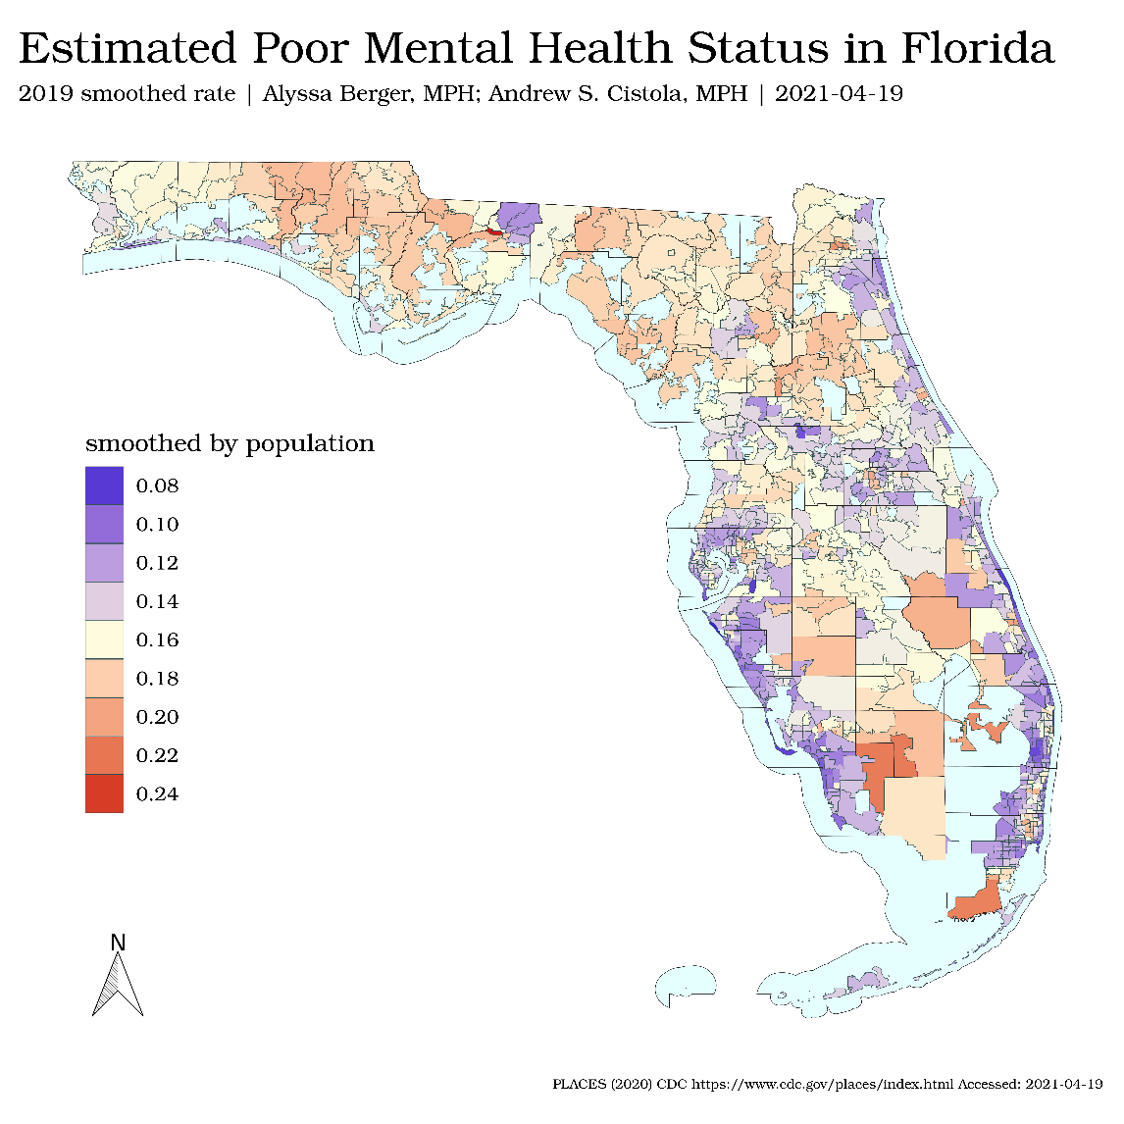
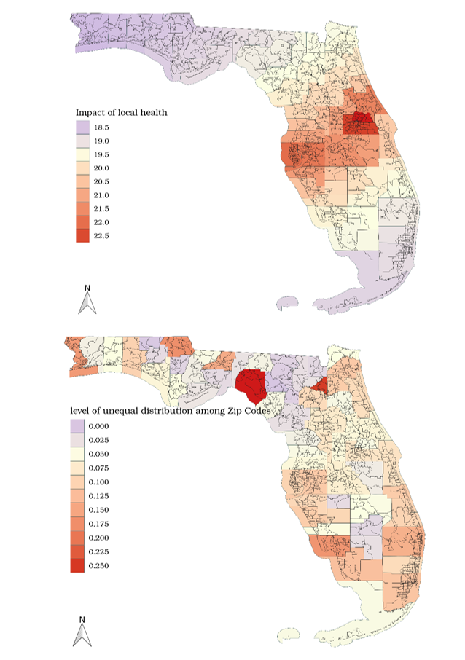
Results and interpretation
Figure 1 (left). Estimated zip code prevalence of self-reported poor mental health using local empirical bayes smoothing.
Figure 2 (right). Coefficient variation of aggregated local health status in a geographically weighted regression model Gini index measuring level of unequal distribution of higher rates among zip codes within counties.

Slide 10
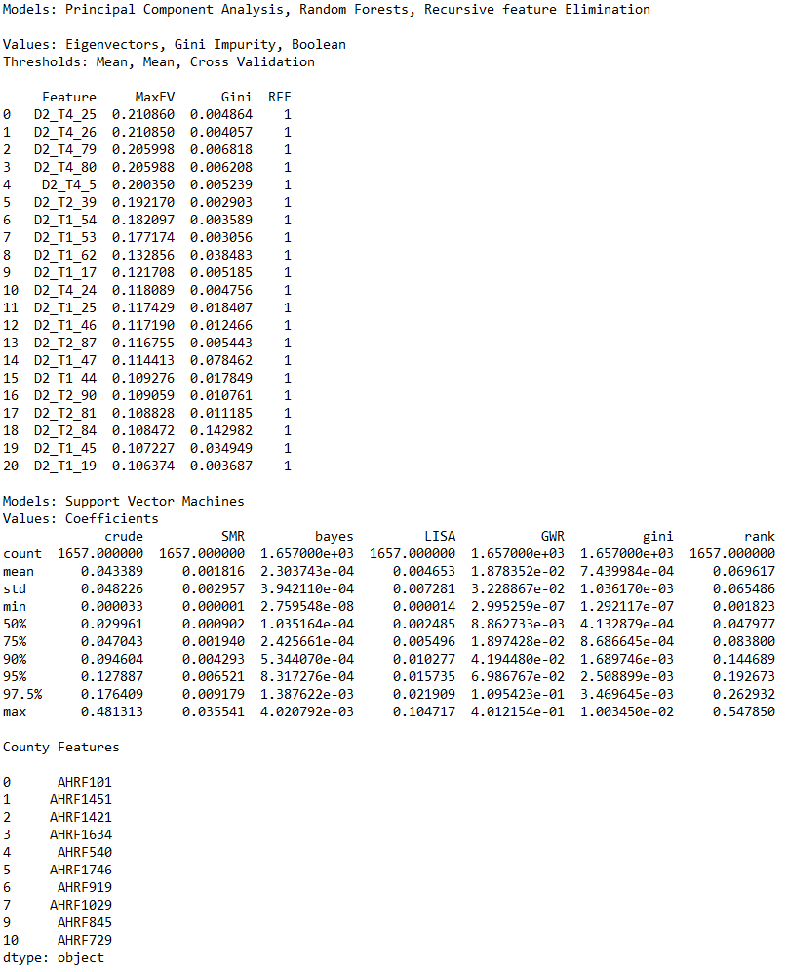
Results and interpretation Figure 3. Raw output from Python ‘scikit-learn’ library showing results from algorithms used in feature selection for zip codes (above) and counties (below). These features were selected for use in the ANN and HLM models.

Slide 11
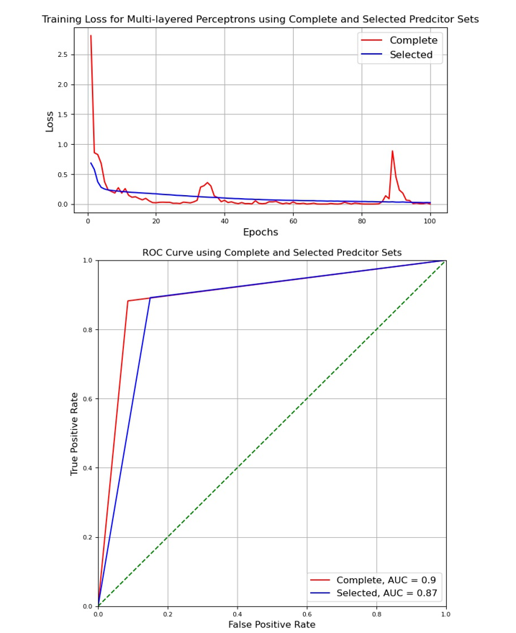
Results and interpretation
Figure 4. Training loss for each multi-layered perceptron used to compare complete and selected predictor sets (below) ROC with AUC tests comparing complete predictor set (N > 2000) and selected county/zip code predictors (N = 25).

Slide 12
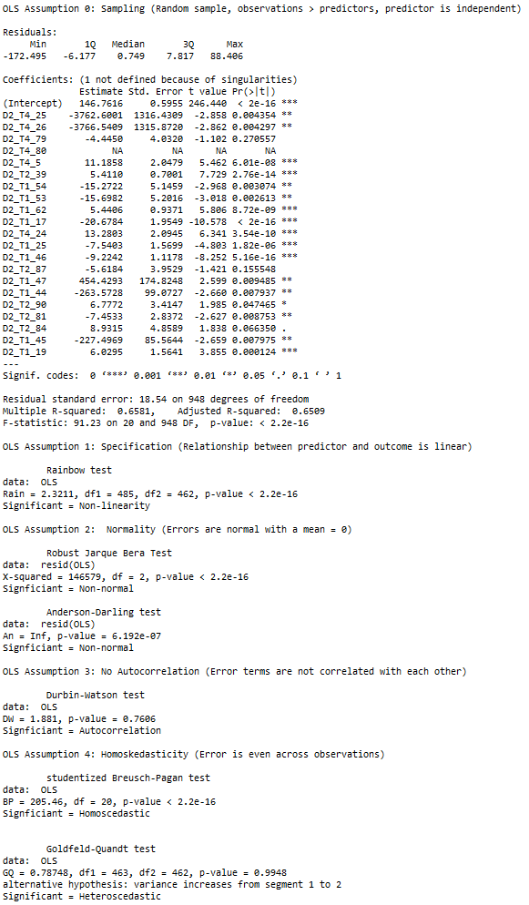
Results and interpretation
Figure 5. Raw model summary from R ‘stats’ library for initial OLS model using selected zip code predictors as well as test results checking OLS assumptions.

Slide 13
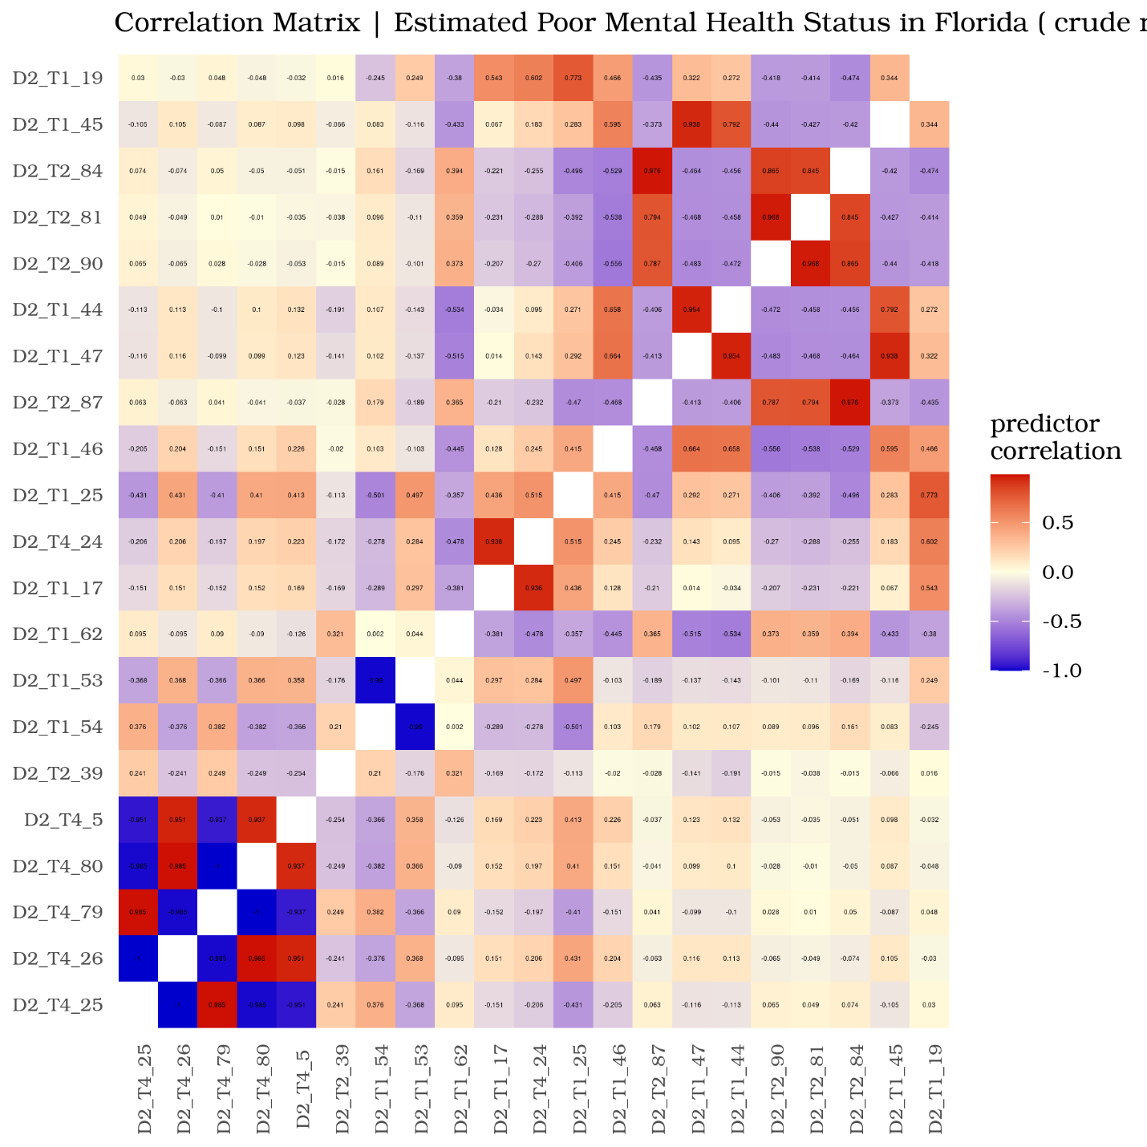
Results and Interpretation
Figure 6. Correlation matrix of zip code level predictors

Slide 14
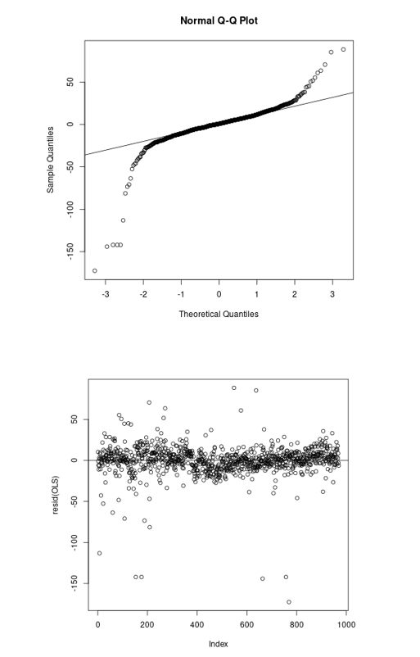
Results and interpretation
Figure 7. Q-Q (above) and residuals plot (above) from original OLS model.

Slide 15
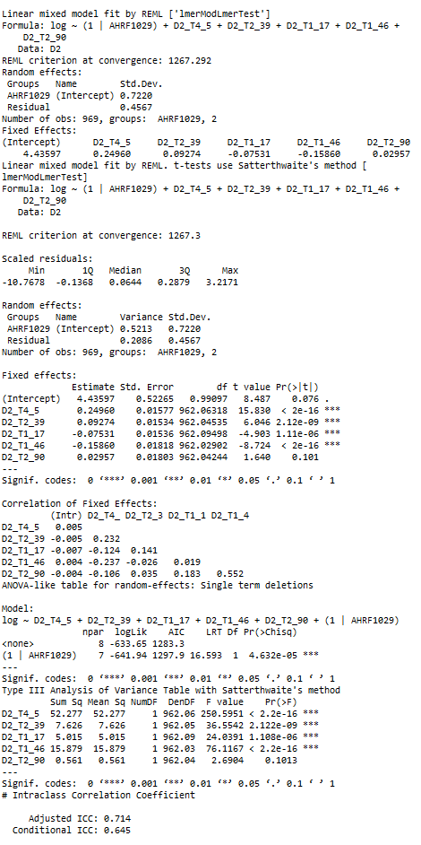
Results and interpretation
Figure 8. Raw model summary from R ‘lme4’ library for final mixed-effects model and intraclass correlation coefficient result.

Slide 16
advantages and limitations
Advantages:
Large, diverse sample size
Recent data from reliable source (CDC)
Enhanced generalizability
Hypothesis generating
Disadvantages:
Broad outcome measurement regarding mental health
Limited demographics

Slide 17
roles and responsibilities of each team member
Team members met weekly throughout the semester to discuss and coordinate all efforts of the project together
After all data management and analysis was agreed upon as a group, the team then split up responsibilities in coordinating and writing the presentation and project:
Alyssa managed the introduction, aims, and discussion section of the project
Andrew managed the design and analysis section of the project
Both Alyssa and Andrew approved the final version of the project together

Slide 18
references
1. Casper M, Kramer MR, Peacock JM, Vaughan AS. Population health, place, and space: spatial perspectives in chronic disease research and practice. Prev Chronic Dis. 2019 Sep 5;16:E123.
2. Bozigar M, Lawson AB, Pearce JL, King K, Svendsen ER. A Bayesian spatio-temporal analysis of neighborhood pediatric asthma emergency department visit disparities. Health Place. 2020 Nov;66:102426.
3. Cromer SJ, Lakhani CM, Wexler DJ, Burnett-Bowie S-AM, Udler M, Patel CJ. Geospatial Analysis of Individual and Community-Level Socioeconomic Factors Impacting SARS-CoV-2 Prevalence and Outcomes. medRxiv. 2020 Sep 30;
4. Richardson AS, Collins RL, Ghosh-Dastidar M, Ye F, Hunter GP, Baird MD, et al. Improvements in neighborhood socioeconomic conditions may improve resident diet. Am J Epidemiol. 2020 Oct 13;
5. Holder AL, Wallace DJ, Martin GS. Hotspotting sepsis: applying analytic tools from other disciplines to eliminate disparities. Ann Transl Med. 2016 Aug;4(15):295.
6. Beck AF, Anderson KL, Rich K, Taylor SC, Iyer SB, Kotagal UR, et al. Cooling the hot spots where child hospitalization rates are high: A neighborhood approach to population health. Health Aff (Millwood). 2019;38(9):1433–1441.
7. Eibich P, Krekel C, Demuth I, Wagner GG. Associations between Neighborhood Characteristics, Well-Being and Health Vary over the Life Course. Gerontology. 2016 Jan 29;62(3):362–370.
8. Miles JN, Weden MM, Lavery D, Escarce JJ, Cagney KA, Shih RA. Constructing a Time-Invariant Measure of the Socio-economic Status of U.S. Census Tracts. J Urban Health. 2016 Feb;93(1):213–232.
9. Diez Roux AV, Mair C. Neighborhoods and health. Ann N Y Acad Sci. 2010 Feb;1186:125–145.
10. Scaria E, Powell WR, Birstler J, Alagoz O, Shirley D, Kind AJH, et al. Neighborhood disadvantage and 30-day readmission risk following Clostridioides difficile infection hospitalization. BMC Infect Dis. 2020 Oct 16;20(1):762.
11. Kind AJH, Buckingham WR. Making Neighborhood-Disadvantage Metrics Accessible - The Neighborhood Atlas. N Engl J Med. 2018 Jun 28;378(26):2456–2458.
12. Messer LC, Laraia BA, Kaufman JS, Eyster J, Holzman C, Culhane J, et al. The development of a standardized neighborhood deprivation index. J Urban Health. 2006 Nov;83(6):1041–1062.
13. Walker AF, Hu H, Cuttriss N, Anez-Zabala C, Yabut K, Haller MJ, et al. The neighborhood deprivation index and provider geocoding identify critical catchment areas for diabetes outreach. J Clin Endocrinol Metab. 2020 Sep 1;105(9).
14. Krittanawong C, Virk HUH, Bangalore S, Wang Z, Johnson KW, Pinotti R, et al. Machine learning prediction in cardiovascular diseases: a meta-analysis. Sci Rep. 2020 Sep 29;10(1):16057.
15. Benedetto U, Dimagli A, Sinha S, Cocomello L, Gibbison B, Caputo M, et al. Machine learning improves mortality risk prediction after cardiac surgery: Systematic review and meta-analysis. J Thorac Cardiovasc Surg. 2020 Aug 10;
16. Hu L, Liu B, Ji J, Li Y. Tree-Based Machine Learning to Identify and Understand Major Determinants for Stroke at the Neighborhood Level. J Am Heart Assoc. 2020 Nov 3;e016745.
17. Ji J, Hu L, Liu B, Li Y. Identifying and assessing the impact of key neighborhood-level determinants on geographic variation in stroke: a machine learning and multilevel modeling approach. BMC Public Health. 2020 Nov 7;20(1):1666.
18. Forthman KL, Colaizzi JM, Yeh H-W, Kuplicki R, Paulus MP. Latent Variables Quantifying Neighborhood Characteristics and Their Associations with Poor Mental Health. Int J Environ Res Public Health. 2021 Jan 29;18(3).
19. Angier H, Jacobs EA, Huguet N, Likumahuwa-Ackman S, Robert S, DeVoe JE. Progress towards using community context with clinical data in primary care. Family Med Commun Hlth. 2019;7(1):e000028.
20. Christodoulou E, Ma J, Collins GS, Steyerberg EW, Verbakel JY, Van Calster B. A systematic review shows no performance benefit of machine learning over logistic regression for clinical prediction models. J Clin Epidemiol. 2019 Feb 11;110:12–22.
21. Walsh CG, Ribeiro JD, Franklin JC. Predicting risk of suicide attempts over time through machine learning. Clinical Psychological Science. 2017 May;5(3):457–469.
22. Wang W, Kiik M, Peek N, Curcin V, Marshall IJ, Rudd AG, et al. A systematic review of machine learning models for predicting outcomes of stroke with structured data. PLoS One. 2020 Jun 12;15(6):e0234722.
23. Wellner B, Grand J, Canzone E, Coarr M, Brady PW, Simmons J, et al. Predicting unplanned transfers to the intensive care unit: A machine learning approach leveraging diverse clinical elements. JMIR Med Inform. 2017 Nov 22;5(4):e45.
24. Miotto R, Li L, Kidd BA, Dudley JT. Deep Patient: An Unsupervised Representation to Predict the Future of Patients from the Electronic Health Records. Sci Rep. 2016 May 17;6:26094.
25. Bian J, Buchan I, Guo Y, Prosperi M. Statistical thinking, machine learning. J Clin Epidemiol. 2019 Aug 16;116:136–137.
26. Wang F. Why public health needs GIS: A methodological overview. Ann GIS. 2020;26(1):1–12.
27. Prosperi M, Min JS, Bian J, Modave F. Big data hurdles in precision medicine and precision public health. BMC Med Inform Decis Mak. 2018 Dec 29;18(1):139.
28. Weaver A, Lapidos A. Mental Health Interventions with Community Health Workers in the United States: A Systematic Review. J Health Care Poor Underserved. 2018;29(1):159–180.
29. Bidargaddi N, Schrader G, Klasnja P, Licinio J, Murphy S. Designing m-Health interventions for precision mental health support. Transl Psychiatry. 2020 Jul 7;10(1):222.
30. Campion J, Knapp M. The economic case for improved coverage of public mental health interventions. Lancet Psychiatry. 2018;5(2):103–105.

