Slide 1
Frequent Itemset Mining & Association Rules
Note to other teachers and users of these slides: We would be delighted if you found this our material useful in giving your own lectures. Feel free to use these slides verbatim, or to modify them to fit your own needs. If you make use of a significant portion of these slides in your own lecture, please include this message, or a link to our web site: http://www.mmds.org

Slide 2
Association Rule Discovery
Supermarket shelf management – Market-basket model:
Goal: Identify items that are bought together by sufficiently many customers
Approach: Process the sales data collected with barcode scanners to find dependencies among items
A classic rule:
If someone buys diaper and milk, then he/she is likely to buy beer
Don’t be surprised if you find six-packs next to diapers!

Slide 3
The Market-Basket Model
A large set of items
e.g., things sold in a supermarket
A large set of baskets
Each basket is a small subset of items
e.g., the things one customer buys on one day
Want to discover association rules
People who bought {x,y,z} tend to buy {v,w}
Amazon!
Input:
Output:
Rules Discovered:
{Milk} --> {Coke}
{Diaper, Milk} --> {Beer}

Slide 4
Applications – (1)
Items = products; Baskets = sets of products someone bought in one trip to the store
Real market baskets: Chain stores keep TBs of data about what customers buy together
Tells how typical customers navigate stores, lets them position tempting items
Suggests tie-in “tricks”, e.g., run sale on diapers and raise the price of beer
Need the rule to occur frequently, or no $$’s
Amazon’s people who bought X also bought Y

Slide 5
Applications – (2)
Baskets = sentences; Items = documents containing those sentences
Items that appear together too often could represent plagiarism
Notice items do not have to be “in” baskets
Baskets = patients; Items = drugs & side-effects
Has been used to detect combinations of drugs that result in particular side-effects
But requires extension: Absence of an item needs to be observed as well as presence

Slide 6
More generally
A general many-to-many mapping (association) between two kinds of things
But we ask about connections among “items”, not “baskets”
For example:
Finding communities in graphs (e.g., Twitter)

Slide 7
Outline
First: Define
Frequent itemsets
Association rules:
Confidence, Support, Interestingness
Then: Algorithms for finding frequent itemsets
Finding frequent pairs
A-Priori algorithm
SON Algorithm

Slide 8
Frequent Itemsets
Simplest question: Find sets of items that appear together “frequently” in baskets
Support for itemset I: Number of baskets containing all items in I
(Often expressed as a fraction of the total number of baskets)
Given a support threshold s, then sets of items that appear in at least s baskets are called frequent itemsets
Support of {Beer, Bread} = 2

Slide 9
Example: Frequent Itemsets
Items = {milk, coke, pepsi, beer, juice}
Support threshold = 3 baskets
B₁ = {m, c, b} B₂ = {m, p, j}
B₃ = {m, b} B₄ = {c, j}
B₅ = {m, p, b} B₆ = {m, c, b, j}
B₇ = {c, b, j} B₈ = {b, c}
Frequent itemsets: {m}, {c}, {b}, {j},
{m,b}
, {b,c}
, {c,j}.

Slide 10
Association Rules
Association Rules: If-then rules about the contents of baskets
{i₁, i₂,…,i_{k}} → j means: “if a basket contains all of i₁,…,i_{k} then it is likely to contain j”
In practice there are many rules, want to find significant/interesting ones!
Confidence of this association rule is the probability of j given I = {i₁,…,i_{k}}

Slide 11
Interesting Association Rules
Not all high-confidence rules are interesting
The rule X → milk may have high confidence for many itemsets X, because milk is just purchased very often (independent of X) and the confidence will be high
Interest of an association rule I → j: difference between its confidence and the fraction of baskets that contain j
Interesting rules are those with high positive or negative interest values (usually above 0.5)
Notes:
If confidence is high then interest cannot be negative

Slide 12
Example: Confidence and Interest
B₁ = {m, c, b} B₂ = {m, p, j}
B₃ = {m, b} B₄= {c, j}
B₅ = {m, p, b} B₆ = {m, c, b, j}
B₇ = {c, b, j} B₈ = {b, c}
Association rule: {m, b} →c
Confidence = 2/4 = 0.5
Interest = |0.5 – 5/8| = 1/8
Item c appears in 5/8 of the baskets
Rule is not very interesting!

Slide 13
Finding Association Rules
Problem: Find all association rules with support ≥s and confidence ≥c
Note: Support of an association rule is the support of the set of items on the left side
Hard part: Finding the frequent itemsets!
If {i₁, i₂,…, i_{k}} → j has high support and confidence, then both {i₁, i₂,…, i_{k}} and {i₁, i₂,…,i_{k}, j} will be “frequent”

Slide 14
Mining Association Rules
Step 1: Find all frequent itemsets I
(we will explain this next)
Step 2: Rule generation
For every subset A of I, generate a rule A → I \ A
Since I is frequent, A is also frequent
Variant 1: Single pass to compute the rule confidence
confidence(A,B→C,D) = support(A,B,C,D) / support(A,B)
Variant 2:
Observation: If A,B,C→D is below confidence, so is A,B→C,D
Can generate “bigger” rules from smaller ones!
Output the rules above the confidence threshold

Slide 15
Example
B₁ = {m, c, b} B₂ = {m, p, j}
B₃ = {m, c, b, n} B₄= {c, j}
B₅ = {m, p, b} B₆ = {m, c, b, j}
B₇ = {c, b, j} B₈ = {b, c}
Support threshold s = 3, confidence c = 0.75
1) Frequent itemsets:
{b,m} {b,c} {c,m} {c,j} {m,c,b}
2) Generate rules:
b→m: c=4/6 b→c: c=5/6 b,c→m: c=3/5
m→b: c=4/5 … b,m→c: c=3/4
b→c,m: c=3/6

Slide 16
Compacting the Output
To reduce the number of rules we can post-process them and only output:
Maximal frequent itemsets: No immediate superset is frequent
Gives more pruning
or
Closed itemsets: No immediate superset has the same count (> 0)
Stores not only frequent information, but exact counts

Slide 17
Example: Maximal/Closed
Frequent, but
superset BC
also frequent.
Support Maximal(s=3) Closed
A 4 No No
B 5 No Yes
C 3 No No
AB 4 Yes Yes
AC 2 No No
BC 3 Yes Yes
ABC 2 No Yes
Frequent, and
its only superset,
ABC, not freq.
Superset BC
has same count.
Its only super-
set, ABC, has
smaller count.

Slide 18
Finding Frequent Itemsets

Slide 19
Itemsets: Computation Model
Back to finding frequent itemsets
Typically, data is kept in flat files rather than in a database system:
Stored on disk
Stored basket-by-basket
Baskets are small but we have many baskets and many items
Expand baskets into pairs, triples, etc. as you read baskets
Use k nested loops to generate all sets of size k
Item
Item
Item
Item
Item
Item
Item
Item
Item
Item
Item
Item
Etc.
Items are positive integers, and boundaries between baskets are –1.
Note: We want to find frequent itemsets. To find them, we have to count them. To count them, we have to generate them.

Slide 20
Computation Model
The true cost of mining disk-resident data is usually the number of disk I/Os
In practice, association-rule algorithms read the data in passes – all baskets read in turn
We measure the cost by the number of passes an algorithm makes over the data

Slide 21
Main-Memory Bottleneck
For many frequent-itemset algorithms, main-memory is the critical resource
As we read baskets, we need to count something, e.g., occurrences of pairs of items
The number of different things we can count is limited by main memory
Swapping counts in/out is a disaster (why?)

Slide 22
Finding Frequent Pairs
The hardest problem often turns out to be finding the frequent pairs of items {i₁, i₂}
Why? Freq. pairs are common, freq. triples are rare
Why? Probability of being frequent drops exponentially with size; number of sets grows more slowly with size
Let’s first concentrate on pairs, then extend to larger sets
The approach:
We always need to generate all the itemsets
But we would only like to count (keep track) of those itemsets that in the end turn out to be frequent

Slide 23
Naïve Algorithm
Naïve approach to finding frequent pairs
Read file once, counting in main memory the occurrences of each pair:
From each basket of n items, generate its n(n-1)/2 pairs by two nested loops
Fails if (#items)² exceeds main memory
Remember: #items can be 100K (Wal-Mart) or 10B (Web pages)
Suppose 10⁵ items, counts are 4-byte integers
Number of pairs of items: 10⁵(10⁵-1)/2 = 5*10⁹
Therefore, 2*10¹⁰ (20 gigabytes) of memory needed

Slide 24
Counting Pairs in Memory
Two approaches:
Approach 1: Count all pairs using a matrix
Approach 2: Keep a table of triples [i, j, c] = “the count of the pair of items {i, j} is c.”
If integers and item ids are 4 bytes, we need approximately 12 bytes for pairs with count > 0
Plus some additional overhead for the hashtable
Note:
Approach 1 only requires 4 bytes per pair
Approach 2 uses 12 bytes per pair (but only for pairs with count > 0)

Slide 25
Comparing the 2 Approaches
4 bytes per pair
12 per
occurring pair
Triangular Matrix
Triples

Slide 26
Comparing the two approaches
Approach 1: Triangular Matrix
n = total number items
Count pair of items {i, j} only if i<j
Keep pair counts in lexicographic order:
{1,2}, {1,3},…, {1,n}, {2,3}, {2,4},…,{2,n}, {3,4},…
Pair {i, j} is at position (i –1)(n– i/2) + j –1
Total number of pairs n(n –1)/2; total bytes= 2n²
Triangular Matrix requires 4 bytes per pair
Approach 2 uses 12 bytes per occurring pair (but only for pairs with count > 0)
Beats Approach 1 if less than 1/3 of possible pairs actually occur

Slide 27
Comparing the two approaches
Approach 1: Triangular Matrix
n = total number items
Count pair of items {i, j} only if i<j
Keep pair counts in lexicographic order:
{1,2}, {1,3},…, {1,n}, {2,3}, {2,4},…,{2,n}, {3,4},…
Pair {i, j} is at position (i –1)(n– i/2) + j –1
Total number of pairs n(n –1)/2; total bytes= 2n²
Triangular Matrix requires 4 bytes per pair
Approach 2 uses 12 bytes per pair (but only for pairs with count > 0)
Beats Approach 1 if less than 1/3 of possible pairs actually occur
Problem is if we have too many items so the pairs do not fit into memory.
Can we do better?

Slide 28
A-Priori Algorithm

Slide 29
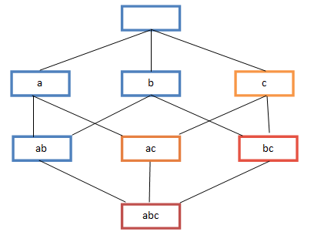
A-Priori Algorithm – (1)
A two-pass approach called A-Priori limits the need for main memory
Key idea: monotonicity
If a set of items I appears at least s times, so does every subset J of I
Contrapositive for pairs: If item i does not appear in s baskets, then no pair including i can appear in s baskets
So, how does A-Priori find freq. pairs?

Slide 30
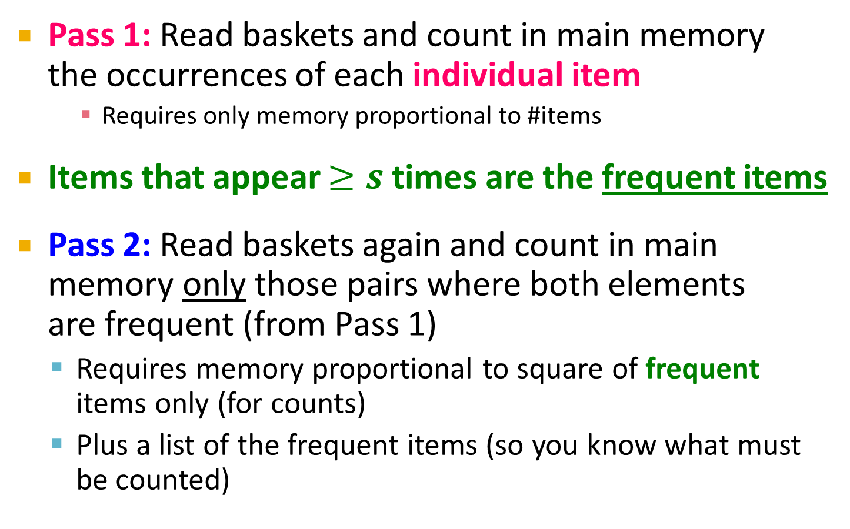
A-Priori Algorithm – (2)
Pass 1: Read baskets and count in main memory the occurrences of each individual item
Requires only memory proportional to #items
Items that appear $≥s$ times are the frequent items
Pass 2: Read baskets again and count in main memory only those pairs where both elements are frequent (from Pass 1)
Requires memory proportional to square of frequent items only (for counts)
Plus a list of the frequent items (so you know what must be counted)

Slide 31
Main-Memory: Picture of A-Priori
Item counts
Frequent items
Counts of pairs of frequent items (candidate pairs)
Main memory
Pass 1
Pass 2

Slide 32
Detail for A-Priori
You can use the triangular matrix method with n = number of frequent items
May save space compared with storing triples
Trick: re-number frequent items 1,2,… and keep a table relating new numbers to original item numbers
Item counts
Frequent items
Old item #s
Counts of pairs of frequent items
Counts of pairs of frequent items
Main memory
Pass 1
Pass 2

Slide 33
Frequent Triples, Etc.
For each k, we construct two sets of k-tuples (sets of size k):
C_{k} = candidate k-tuples = those that might be frequent sets (support > s) based on information from the pass for k–1
L_{k} = the set of truly frequent k-tuples
Count
the items
All pairs
of items
from L₁
Count
the pairs
All
items
To be
explained
Filter
Construct
Filter
Construct
C₁
L₁
C₂
L₂
C₃

Slide 34
Example
** Note here we generate new candidates by generating C_{k} from L_{k-1} and L₁. But that one can be more careful with candidate generation. For example, in C₃ we know {b,m,j} cannot be frequent since {m,j} is not frequent
Hypothetical steps of the A-Priori algorithm
C₁ = { {b} {c} {j} {m} {n} {p} }
Count the support of itemsets in C₁
Prune non-frequent: L₁ = { b, c, j, m }
Generate C₂ = { {b,c} {b,j} {b,m} {c,j} {c,m} {j,m} }
Count the support of itemsets in C₂
Prune non-frequent: L₂ = { {b,m} {b,c} {c,m} {c,j} }
Generate C₃ = { {b,c,m} {b,c,j} {b,m,j} {c,m,j} }
Count the support of itemsets in C₃
Prune non-frequent: L₃ = { {b,c,m} }
**

Slide 35
A-Priori for All Frequent Itemsets
One pass for each k (itemset size)
Needs room in main memory to count each candidate k–tuple
For typical market-basket data and reasonable support (e.g., 1%), k = 2 requires the most memory
Many possible extensions:
Association rules with intervals:
For example: Men over 65 have 2 cars
Association rules when items are in a taxonomy
Bread, Butter → FruitJam
BakedGoods, MilkProduct → PreservedGoods
Lower the support s as itemset gets bigger

Slide 36
Frequent Itemsets in < 2 Passes

Slide 37
Frequent Itemsets in < 2 Passes
A-Priori take k passes to find frequent itemsets of size k
Can we use fewer passes?
Use 2 or fewer passes for all sizes, but may miss some frequent itemsets
Random sampling
SON (Savasere, Omiecinski, and Navathe)
Toivonen (see textbook)

Slide 38
Random Sampling (1)
Take a random sample of the market baskets
Run a-priori or one of its improvements in main memory
So we don’t pay for disk I/O each time we increase the size of itemsets
Reduce support threshold proportionally to match the sample size
Copy of
sample
baskets
Main memory
Space
for
counts

Slide 39
Random Sampling (2)
Optionally, verify that the candidate pairs are truly frequent in the entire data set by a second pass (avoid false positives)
But you don’t catch sets frequent in the whole but not in the sample
Smaller threshold, e.g., s/125, helps catch more truly frequent itemsets
But requires more space

Slide 40
SON Algorithm – (1)
Repeatedly read small subsets of the baskets into main memory and run an in-memory algorithm to find all frequent itemsets
Note: we are not sampling, but processing the entire file in memory-sized chunks
An itemset becomes a candidate if it is found to be frequent in any one or more subsets of the baskets.

Slide 41
SON Algorithm – (2)
On a second pass, count all the candidate itemsets and determine which are frequent in the entire set
Key “monotonicity” idea: an itemset cannot be frequent in the entire set of baskets unless it is frequent in at least one subset.

