Slide 1
Infusion Seminar SharePoint & Office 365 Workflow

Slide 2
Andrew Connell
SharePoint Server, MVP
Developer, Speaker, Author & Trainer
Contributor/author to numerous articles & books
Hands-on Instructor for Critical Path Training
Authored numerous courses in Pluralsight catalog
www.andrewconnell.com
@andrewconnell

Slide 3
Infusion Agenda
Day 1: 10am – 5pm
Introduction to SharePoint 2013 Workflow:
Developing Workflows with with Visual Studio
Working with Tasks & Outcomes
Workflow Types
Workflow Services CSOM
Day 2: 10am – 5pm
Custom Forms
Custom Activities & Actions
Working with Anon Web Services
Working with with SharePoint REST API from Workflows
Working with Secured Web Services

Slide 4
01 – Introduction to SharePoint 2013 Workflow

Slide 5
History of Workflow in SharePoint
SharePoint 2003
No workflow “in the box”
Relied on 3rd party solutions
Very expensive & integration was bolt-on
SharePoint 2007
Released same time as Workflow Foundation in .NET Framework 3.0
Hosted Workflow Foundation runtime
All WF dependent services implemented by SharePoint
SharePoint 2010
Same core architecture as SharePoint 2007
Updated to .NET Framework 3.5 Service Pack 1
Added support for modeling & importing workflows using Visio 2010

Slide 6
Challenges with Workflow Pre-SharePoint 2013
Visual Studio developed workflows are programmatic
Limited to farm (fully trusted) solution deployment
Thus, only viable in on-premises deployments, not hosted like Office 365
Developers required intimate knowledge of the workflow APIs
Custom form development & deployment was very hard
Lots of “magic” and hidden code required in many scenarios
Association forms
Creating history & task lists
Not transparent
Hard to near-impossible to see…
What workflows were deployed and/or running
History of previously run workflows
Scalability of workflow directly tied to SharePoint

Slide 7
New Workflow Architecture in SharePoint 2013
SharePoint 2010 Workflow model included for backwards compatibility
Same .NET 3.5 SP1 Workflow Foundation runtime hosting by SharePoint
Addition of a new product: Workflow Manager 1.0
Acts as the host for the workflow runtime
Decouples workflow as a service from SharePoint
Requires SharePoint Server 2013 for User Profile Application
SharePoint Foundation 2013 uses embedded WF host like SharePoint 2010 used

Slide 8
Workflow Manager – How it Works
Workflow Manager exists external to SharePoint
Similar to SharePoint, stand up a workflow farm
Loose connection between SharePoint & Workflow Manager farms
Workflows are “outsourced” from SharePoint to Workflow Manager
Workflow Manager handles all workflow execution
Workflow Manager communicates with SharePoint 2013 via REST
All calls authenticated using OAuth, specifically via S2S high-trust
SharePoint communicates with Workflow Manager via REST

Slide 9
Workflow Platform Improvements
Workflow Manager hosts the .NET Framework 4.5 Workflow Foundation version
Added support for making REST / OData based Web Service calls
Added support for complex hierarchical data via DynamicValue
Ideal for REST services returning data as JSON
Workflow Manager: much more transparent
Own set of API’s for interrogation & interacting with the Workflow Manager farm

Slide 10
Workflow Glossary of Terms
Workflow Definition
Workflow Association / Subscription
Workflow Instance
Workflow Episode
Supporting Artifacts
Workflow Task List
Workflow History List

Slide 11
Introducing Workflow Manager 1.0
New product built in conjunction with workflow & Azure teams
Flexible deployment models:
Locally for on-premises SharePoint 2013 Deployments
In the cloud for hosted (Office 365) SharePoint 2013 Deployments
Works the same way in any deployment
Similar to SharePoint, involves creating a Workflow Manager farm
SharePoint 2013 & Workflow Manager 1.0 then associated with each other

Slide 12
Architecture & Scaling
Major Components
Workflow Front End
Service Bus
Workflow Back End
Scalable
Workflow Manager farms can exist on the same or different servers as SharePoint
Farm consists of one or three servers
All communication with Workflow Manager is over HTTP[S]
Can live behind network load balancer

Slide 13
Installing Workflow Manager 1.0
Acquire Workflow Manager 1.0
Web Platform Installer
http://aconn.me/11WgoCa
Web Platform Installer Command Line (ideal of offline installs)
http://aconn.me/ZWCd64
Install Workflow Manager 1.0 Client on SharePoint 2013 Servers
Proxy used by SharePoint to communicate with the Workflow Manager REST APIs
Workflow Manager Tools 1.0 for VS 2012
Adds tools to Visual Studio for development & debugging of workflows

Slide 14
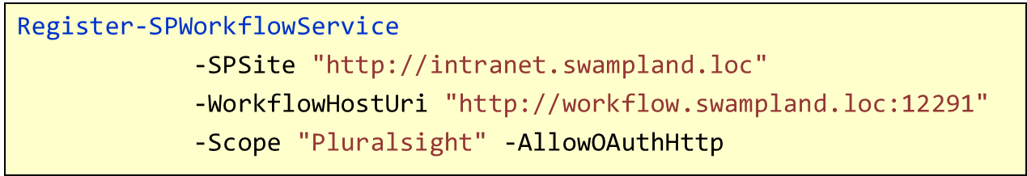
Configuring Workflow Manager 1.0
Create the Service Bus & Workflow Manager Farm
Run the Workflow Manager Configuration Wizard
Creates the databases & provisions the Service Bus & Workflow Manager Farm
Also generates PowerShell script to provision via PowerShell
Associate SharePoint 2013 & Workflow Manager 1.0 Farms
Only need to run association one time per farm
Target SharePoint site is just endpoint for Workflow Manager to call

Slide 15
New Model Based on Publications & Subscriptions
Publication & subscription service (aka PubSub)
Message senders do not talk to receivers
Subscribers only receive messages they are interested In
Associations are now subscriptions
Workflow Manager Backend is a subscriber
Service Bus makes workflow more resilient

Slide 16
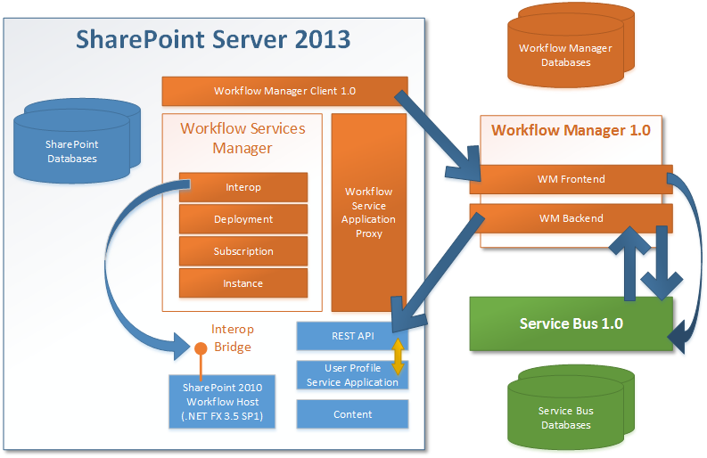
SharePoint & Workflow Architecture

Slide 17
Understanding how Workflows are Processed

Slide 18
02 – Developing Workflows with Visual Studio

Slide 19
Introduction to SharePoint 2013 Visual Studio Workflow Development
Primary audience: Developers
Full access to Workflow Foundation in .NET Framework 4.5
Flexible deployment options
Better ALM story than SharePoint Designer can offer
Create and utilize custom workflow activities
Use in Visual Studio or SharePoint Designer authored workflows
Create customized workflow forms
Association Forms
Initiation Forms
Many SharePoint activities changed to make REST

Slide 20
How is Visual Studio Different from SharePoint Designer 2013?
Workflow Templates vs. One-Off Workflows
SharePoint Designer: mostly one-off & not easily portable
Visual Studio: reusable definitions & fully portable
Deployment Options
SharePoint Designer 2013
Live SharePoint site
Sandboxed solution
Visual Studio
Fully-trusted farm solution
Sandboxed solution
SharePoint Apps

Slide 21
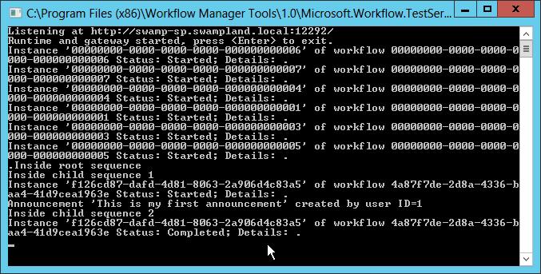
What’s New & Improved in Visual Studio?
All Visual Studio authored workflows are 100% declarative
Support for calling Web Services
Request or post data to web service (anon / authenticated)
Processing of complex JSON responses
Rich Debugging
Set breakpoints on activities
New service monitor for on-premises workflow development

Slide 22
New Project Item Templates
Workflow
Workflow Custom Activity
Workflow Association Form
Workflow Initiation Form

Slide 23
Workflow Activities in Visual Studio
SharePoint 2013 Specific Activities
List Activities
Task Activities
User Activities
Utility Activities
Base Workflow Foundation 4.5 & Workflow Manager 1.0 Activities
Workflow Manager 1.0 Microsoft.Activities
Workflow Foundation 4.5 System.Activities
SharePoint Server 2013 Microsoft.SharePoint.WorkflowServices.Activities

Slide 24
SharePoint 2013: List Activities
Check In Item
Check Out Item
Copy Item
Create List Item
Delete List Item
LookupSPList
LookupSPListItem
LookupSPListItemId
UndoCheckOutItem
UpdateListItem
WaitForFieldChange
WaitForItemEvent

Slide 25
SharePoint 2013: Task, User & Utility Activities
Task:
SingleTask
CompositeTask
User Activities
LookupSPGroup
LookupSPGroupMembers
LookupSPPrincipal
LookupSPPrincipalId
LookupSpUser
Utility:
AppOnlySequence
DelayUntil
Email
LookupSPChoiceFieldIndex
TranslateDocument
WaitForCustomEvent
WriteToHistory

Slide 26
Workflow Foundation 4.5 Activities
WriteLine
Assign
Core Control
If
ForEach
While
Pick
Parallel
Control Flow
Sequence
Flowchart
StateMachine

Slide 27
Workflow Manager 1.0 Activities
Core Activities
SetUserStatus
GetConfigurationValue
Web Service Activities
HttpSend
BuildDynamicValue
ContainsDynamicValueProperty
CopyDynamicValue
CountDynamicValueItems
CreateDynamicVlaue
GetDynamicValueProperties
GetODataProperties
GetDynamicValueProperty<T>
IsEmptyDynamicValue
ParseDynamicValue

Slide 28
Workflows & Web Services
Use to replace custom business logic
Request or post data to web service (anon / authenticated)
Processing of complex JSON responses
ACCEPT: application/json;odata=verbose
DynamicValue: New Object Type
Supports hierarchical structures
Ideal for JSON responses
Supports child objects
Extract to another dynamic value variable
Most SharePoint activities leverage this capability

Slide 29
Workflow Deployment Options
SharePoint Solution
Fully trusted farm solution
Sandboxed solution
Ideal for:
Deployment of custom activities
Deployment of workflows used throughout site collection
SharePoint App
Workflow available to just the app
Need to include:
Creation of workflow history list
Creation of workflow task list
Integrated Workflow App
Must manually add <IntegratedApp>true</IntegratedApp> to the WorkflorManifest.xml file in app package

Slide 30
Workflow Debugging Options
Various options & techniques
Two variables dictate options:
Workflow authoring tool: SharePoint Designer 2013 or Visual Studio
SharePoint deployment: on-premises or Office 365
 | SharePoint 2013 On-Premises | Office 365 / SharePoint Online
SharePoint Designer 2013 | Log to History List | Log to History List
Visual Studio | Log to History List Console debug message | Log to History List Breakpoints

Slide 31
Option 1: Workflow History List
All workflow associations ted to a history list
Enables workflow to write messages to the list
Useful for end user logging
Scenarios:
Good for user-friendly messages
Not good for true debugging
Available in all deployments
Available in all authoring tools

Slide 32
Option 2: Visual Studio Breakpoints
Familiar to developers – act just like code-based breakpoints
Visual Studio deploys the workflow + attaches the debugger
Execution pauses when breakpoint hit
Scenarios:
Troubleshooting execution issues
No setup (or tear-down) required
Available in all deployments
Available in Visual Studio authored workflows

Slide 33
Option 3: Debug WriteLine Messages
Similar to the console’s System.Diagnostics.Debug.WriteLine()
Messages appear in the debugger
Messages are not written in production
Introducing: WriteLine activity
Only visible via utility included in Workflow Manager developer tools
Scenarios:
Ideal for true debugging information
Available in Visual Studio authored workflows
Available in on-premises deployments only

Slide 34
03 - Working with Tasks & Outcomes

Slide 35
Task Content Type
Pre-SharePoint 2013
Workflows created using Task content type
ID: 0x108
SharePoint 2013
Name: Workflow Task (SharePoint 2013)
ID: 0x0108003365C4474CAE8C42BCE396314E88E51F
Adds two fields: outcome & workflow instance id

Slide 36
Task List
Pre SharePoint 2013
List Name: Tasks
List Template ID: 107
Included Content Types:
Task
Summary Task
Folder
SharePoint 2013
List Name: Workflow Tasks
Found in Feature HierarchyTasksList
List Template ID: 171
Included Content Types:
Tasks
Typically you add Workflow Task (SharePoint 2013)
Includes timeline view at top of the list
Add screenshot in slides

Slide 37
Types of Tasks
Single Task
SharePoint Designer 2013: Assign a Task
Visual Studio: Single Task
Multiple Tasks
SharePoint Designer 2013: Start a Task Process
Visual Studio: CompositeTask

Slide 38
Creating Custom Tasks
Pre-SharePoint 2013
Generally Created Task Content Type & Custom Form
OOTB SharePoint 2013
All OOTB tasks based on the content type Workflow Task (SharePoint 2013)
Custom Tasks in SharePoint 2013
Create Custom Content Type
Don’t Create Custom Form
In task Activities, Specify Your Content Type

Slide 39
How To: Create Custom Task
Create Custom Content Type that Inherits from Workflow Task (SharePoint 2013)
Add & Remove Desired Fields
Add Custom Content Type to the Workflow Task List
In Visual Studio, if Deploying Workflow with an Association, Associate the Content Type!

Slide 40
Task Outcomes
All Tasks Have Outcomes
OOTB, Task Forms Have Two Buttons
Save/Cancel – No Change to Workflow Completion screenshot
Approve/Reject – Outcome of the Task
Approve/Reject defined by a new column
Name: TaskOutcome
Type: OutcomeChoice

Slide 41
Custom Task Outcomes
Task outcome controlled by the site column TaskOutcome
Included within the Workflow Task (SharePoint 3013) Content Type
Create custom site column using the field type OutcomeChoice
Add your own choices
Create custom content type that inherits from Workflow Task (SharePoint 2013)
Remove the default outcome column from your content type

Slide 42
Custom Task Outcome Notes
SharePoint Designer 2013 authored workflows with custom tasks and outcomes
Remove the outcome column from the workflow task list columns
Visual Studio authored workflows with custom tasks and outcomes
Remove the content type binding from the default list

Slide 43
04 - Workflow Types

Slide 44
Sequential / Procedural Workflows
When working with a customer, this is always where they seem to start
Workflows have a prescribed linear path to follow
May / may not have loops & branches

Slide 45
Sequential Workflow Advantages & Disadvantages
Advantages
Simple to create
Easily modeled using Visio
Ideal for predetermined, ordered tasks that have a more systematic behavior
Disadvantages
Limited in how complex they can get
Not ideal for event driven, flexible or reactive processes

Slide 46
Flowchart Workflows
Flowchart
FlowDecision
FlowSwitch

Slide 47
Flowchart Workflow Advantages & Disadvantages
Advantages
Adds flexibility for modeling decision processes
Adds decision making modeling of a process without using loops of loops
Disadvantages
Not ideal for event driven, flexible or more reactive behaviors

Slide 48
State Machine Workflows
Different from other types
Define different states of the business process
Define how you transition FROM one state to another
Can define multiple transitions from a single state

Slide 49
Components of a State Machine Workflow
State Machine Activity
State Activity
Final State Activity
Transition

Slide 50
State, Final State & Transitions
State Activity
Entry Action
Exit Action
Final State Activity
Entry Action
Transition
Trigger
Condition
Action

Slide 51
State Machine Workflow Advantages & Disadvantages
Advantages
Very flexible and easy to add a new condition to transition from one state to another
Easily allows modeling real world business process
Ideal when there’s human interaction or when the process needs to be more reactive
Disadvantages
Can get complex quickly
When troubleshooting, can be tedious to step through as you have to open a lot of states & transitions to follow the process
Not ideal for ordered steps, decisions or systematic processes

Slide 52
05 - Workflow Services CSOM

Slide 53
Workflow Services CSOM / JSOM
Available in both CSOM & JSOM
Comprised of 5 Components / Services
Workflow Service Manager
Deployment Service
Subscription Service
Instance Service
Interop Service

Slide 54
Workflow Service Manager
Similar to the CSOM Client Context
Center of Gravity for all Workflow Related things in the CSOM
Dependency on the CSOM Client Context

Slide 55
Deployment Service
Used to Interact with Workflow Definitions
Can Validate and Create Workflow Definitions
Obtain Reference from Workflow Service Manager

Slide 56
Subscription Service
Used to Interact with Workflow Associations
Create Associations on Sites, Lists and Libraries
Obtain Reference from Workflow Service Manager

Slide 57
Instance Service
Used to Interact with Workflow Instances
Create new Instances from an Existing Association
Create new Instance for List Items or Sites
Communicate with Existing Instances
Cancel / Terminate
Publish Custom Events
Obtain Reference from Workflow Service Manager

Slide 58
Interop Service
Used to Interact with SharePoint 2010 Style Workflows in SharePoint 2013
Special Activity: InvokeSharePointWorkflow
Obtain Reference from Workflow Service Manager

