Slide 2
Building a Single Page App Using Angular and Typescript Using Office 365 APIs
689
Jeremy Thake
Microsoft
@jthake
Andrew Connell
MVP
@andrewconnell
Dan Wahlin
MVP, RD
@danwahlin

Slide 3

Agenda slide
Why & What – TypeScript
How - TypeScript
Office 365 Enterprise Services
TypeScript, Office 365 & Angular

Slide 4
Why & What - TypeScript

Slide 5
Why TypeScript?
Superset of JavaScript
Modular
Scalable Application Structure
Strong Typing
Tooling Support
EcmaScript 6 Standards

Slide 6
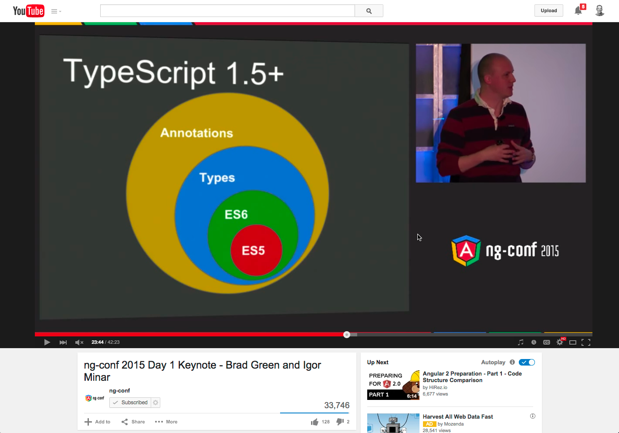
Why TypeScript with Angular?
https://youtu.be/QHulaj5ZxbI?t=20m53s

Slide 7
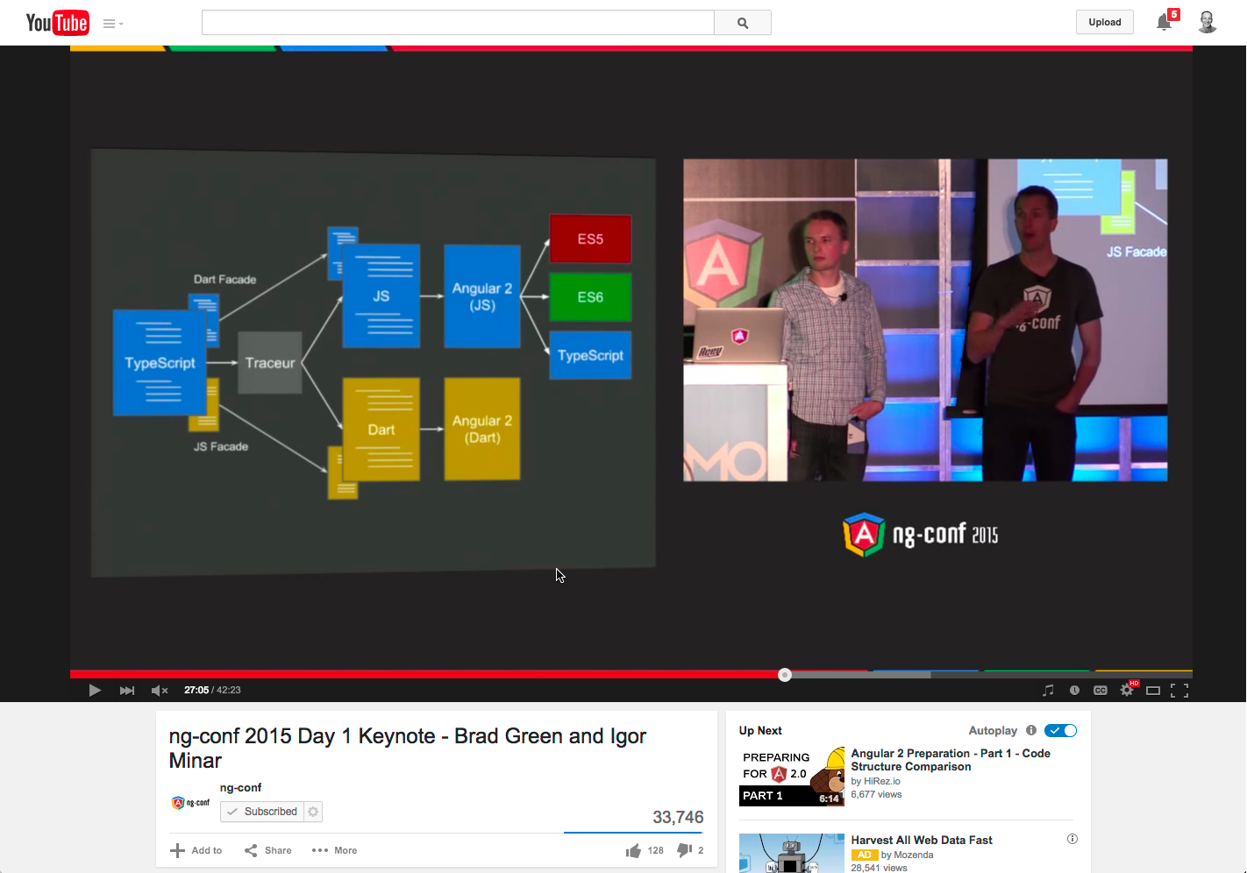
Why TypeScript with Angular?
https://youtu.be/QHulaj5ZxbI?t=27m5s

Slide 8
What is TypeScript?
Strongly Typed
Classes
Interfaces
Generics
Modules
Type Definitions
Compiles to JavaScript
EcmaScript 6 Features

Slide 9
TypeScript Playground

Slide 10
How TypeScript

Slide 11
Wide Editor Support
Out-of-the-Box Support
Visual Studio
WebStorm
Support via add-ins
Sublime Text
Brackets
Anything… leverage
Gulp or Grunt

Slide 12
TypeScript & Editor Support

Slide 13
Office 365 Enterprise Services

Slide 14
Office 365 as a Enterprise Service
Fastest growing Microsoft product
Contains collaborative data in SharePoint
Contains Exchange data (contacts, calendar & email)
Files (via OneDrive)
All data accessible via REST APIs
More APIs coming!

Slide 15
Custom App Challenges in O365
Cloud App Model vs. SharePoint Hosted
OAuth access tokens must be protected
Requires server-side intermediary
Client-side apps using OAuth tokens require proxy to talk to SharePoint / O365 APIs

Slide 16
Secure Client-Side Apps with ADAL JS
Azure AD now supports the OAuth implicit flow
Enables 100% client-side authentication
Apps must explicitly opt-in to this flow option
ADAL JS
Comprised in two components:
adal.js – core… not designed for direct use
adal.angular.js – Angular service

Slide 17
Office 365 & ADAL in Angular with TypeScript

Slide 18
Call to Action
Hands-on Lab
https://github.com/OfficeDev/TrainingContent/tree/master/O3657
See module O3657-2
Get the sample
http://aconn.me/typescript-o365-enterprise-angular

Slide 19
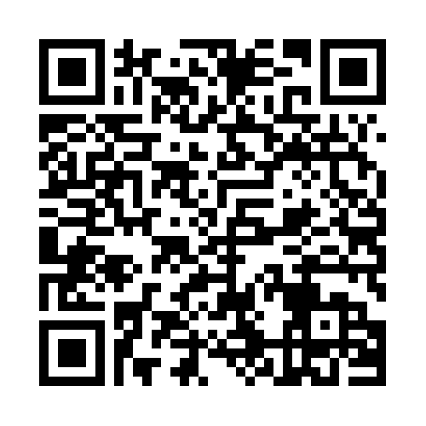
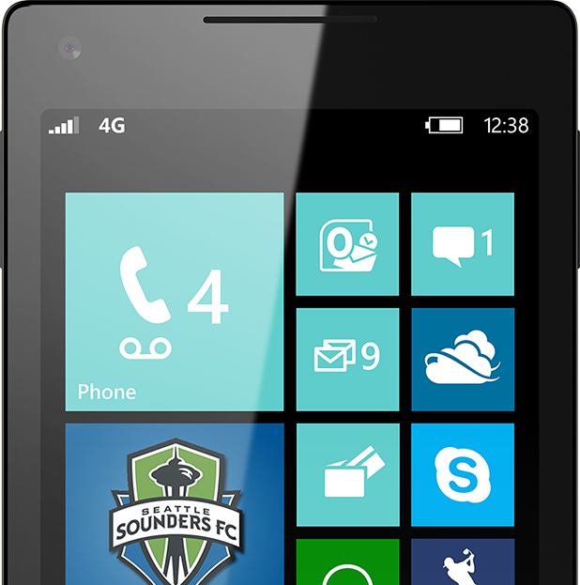

Please Complete An Evaluation Form Your input is important!
Required Slide
*delete this box when your slide is finalized
or
SAMPLE

Slide 20
Evaluate this session
Required Slide
*delete this box when your slide is finalized
Speakers: This slide will be updated during the scrub process with a unique QR code. Attendees scan the QR code to access the eval for your session.
SAMPLE
Notes:
Speakers: Please note this slide will be updated with your session’s QR code during the scrub process which is outlined on side 3. Attendees can scan the QR code for access to your session’s eval.

