Slide 1
Moving from SharePoint Fully Trusted Code Solutions to SharePoint Add-ins
github.com / andrewconnell / pres-sp-ftcapps-addins

Slide 2



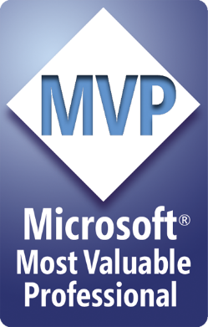


Andrew Connell
www.AndrewConnell.com
me@AndrewConnell.com
@andrewconnell
Full stack web developer & instructor
Co-host, Microsoft Cloud Show – www.MicrosoftCloudShow.com
Hands-On SharePoint Training Critical Path Training - www.CriticalPathTraining.com
On-Demand SharePoint Training Pluralsight – www.Pluralsight.com

Slide 3
Topics
Where are we?
Putting things in perspective – my take on SharePoint development
Hot-Button topics
Resources

Slide 4
Credits…
Ignite BRK4125
Transforming your SharePoint Full Trust Code to Add-in Model
https://channel9.msdn.com/Events/Ignite/2015/BRK4125
Bob German
Chris O’Brien
Erwin van Hunen
Frank Marasco
Vesa Juvonen

Slide 5
Where are we?

Slide 6
What is a SharePoint Add-in?
Solving some of the issues with SharePoint Add-Ins:
Tight coupling (“pure” SP Add-Ins need to be installed to a SharePoint site for app authentication)
Global rollout of an app is problematic (tenant-scoped installs appropriate sometimes, but not always..)
User experience (accessed from Site Contents page of a SharePoint site – user MUST access from SharePoint)
Little support for native device apps
Development complexity (related to app model, authentication, SharePoint APIs etc.)

Slide 7
What is a SharePoint Add-in?
SharePoint add-ins are:
Truly standalone
Globally accessible within Office 365
Integrated with Office 365 authentication (SSO with Azure AD)
Simpler to build (especially for using Office 365 services in your apps – sending mail, calendaring, storing files etc.)
Open (develop with .NET, JavaScript, iOS, Android libraries – or use the REST API)

Slide 8
Putting Things in Perspective My Take on SharePoint Development
aconn.me / StateOfSpDev2015

Slide 9
Hot Button Full Trust => ?

Slide 10
Branding
Use themes rather than master pages
Master pages changes by Microsoft are provided to your sites automatically
Avoid feature framework element usage
Many feature framework elements will create dependency to xml files on the disk, which then cannot be removed easily (“Content Migration”)
Sandbox solutions will also impact future cost model of the Office365 sites

Slide 11
Theme vs. Master Page
Themes
Can be introduce to bring color, font and background image settings
Sites with themes will still use out of the box master pages, so any updates will be automatically impacted to sites
Future major version upgrades don’t cause additional costs
Custom Master Page
Can introduce any level of customizations
When new changes are introduced to the out of the box master, those should be copied to custom master pages as well
Additional maintenance burden
Future major version upgrades can cause additional requirements to re-create the end user experience

Slide 12
Branding Resources
PnP: Branding and site provisioning solutions for SharePoint 2013 and SharePoint Online
http://aconn.me/1U2ksih
PnP: Use CSS to brand pages
http://aconn.me/1Ef6J0C
PnP: Use remote publishing to brand SharePoint pages
http://aconn.me/1LvCDZ2

Slide 13
Remote Provisioning
SharePoint Add-ins
SharePoint Hosted
Provider Hosted
Console Applications
PowerShell Scripts
Scheduled Jobs (timer jobs / Azure Web Jobs)

Slide 14
PnP Provisioning Engine
An engine that you can use anywhere
OOTB support XML
We went for recognization and reuse: it’s alike CAML and much can be simply copied from your feature.xml or onet.xml
Don’t like XML? The engine can be relatively simply extended to support other formats too

Slide 15
PnP’s Provisioning Template Schema
<?xml version="1.0"?> <pnp:ProvisioningTemplate>
<pnp:Security></pnp:Security> <pnp:SiteFields></pnp:SiteFields>
<pnp:Lists></pnp:Lists>
<pnp:TermGroups></pnp:TermGroups>
<pnp:Files></pnp:Files>
<pnp:Pages></pnp:Pages>
<pnp:ComposedLook />
</pnp:ProvisioningTemplate>

Slide 16
Provisioning Resources
PnP: SharePoint Add-in Recipe - Site Provisioning
http://aconn.me/1EdYPEp

Slide 17
Sandboxed Solutions

Slide 18
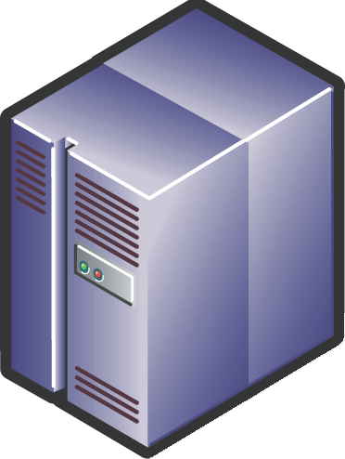
What are Sandboxed Solutions?
Site Collection Solutions Gallery
User Code Service
Declarative Items:
Web Templates
Lists and Libraries
Site Columns and Content Types
File deployment
Custom Actions
Client Code
Host Services (SPUCHostService.exe)
Worker Service
(SPUCWorkerProcess.exe)
Untrusted Code
Subset Object Model
Proxy Process (SUCWorkerProcessProxy.exe)
Full Object Model

Slide 19
Sandboxed Solutions
The Good
Customize SharePoint without a farm solution:
Declarative Features (lists, libraries, files, client side code)
User Code (web parts, InfoPath forms, event receivers, workflow actions)
Multi-tenant friendly
The Bad and the Ugly
Limited server side API
Provisioned content is brittle
Versioning is a black art
No central way to manage, update
Scalability Problem

Slide 20
App Script Parts vs. Client Web Parts
Client Web Part / App Part
Loads content within iFrame
Not responsive or flexible
App Script Part
Loads content witin DIV
PnP App Script: http://aconn.me/1EdZi9G

Slide 21
App Parts vs. App Script Parts
 | App Parts | App Script Parts
Provisioning across many sites
Direct access to page (e.g. Connected Web Parts, branding changes)
Access to SP Content (Host Web)
End-user additions / modifications
Protection from Untrusted Code
Storefront Distribution
Centralized Distribution
Requires App Model Setup | Yes | Optional

Slide 22
Resources
OfficeDev – Patters & Practices PnP
http://dev.office.com/patterns-and-practices
Transforming Your SharePoint Full Trust Code to the SharePoint App Model
https://channel9.msdn.com/Events/TechEd/Europe/2014/DEV-B308

Slide 23
Thanks! Questions?
github.com / andrewconnell / pres-sp-ftcapps-addins

