Slide 1
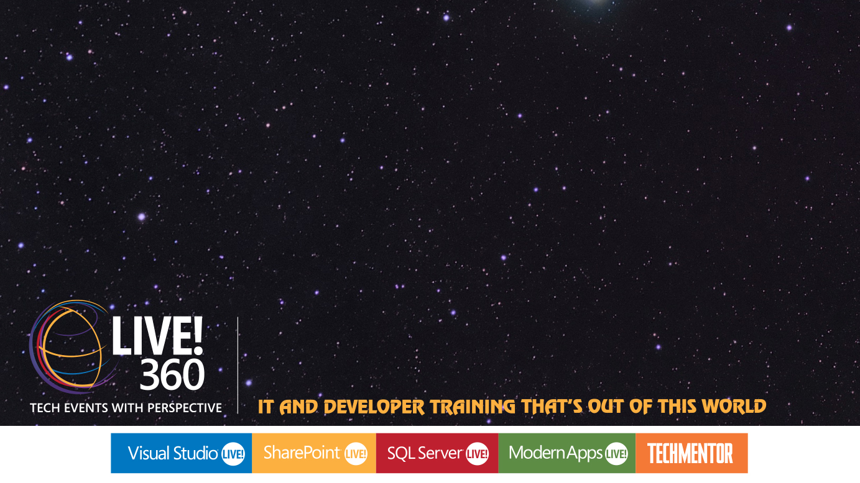
BreezeJS Makes Client-Side SharePoint 2013 REST Development a… BREEZE!
Andrew Connell
SharePoint Server MVP
Level: Intermediate

Slide 2






Andrew Connell
www.AndrewConnell.com
me@AndrewConnell.com
@andrewconnell
Independent Consultant, Developer, Speaker, Instructor
Hands-On SharePoint Training Critical Path Training - www.CriticalPathTraining.com
On-Demand SharePoint Training Pluralsight – www.Pluralsight.com

Slide 3
Primarily Demo Session
Get all the demos & follow along
Everything available in this GitHub Repo
https://github.com / andrewconnell / pres-sp15rest-breeze

Slide 4

Podcast: Microsoft Cloud Show
Focus on Microsoft’s cloud offerings & competitive landscape
Microsoft Azure
Office 365 & SharePoint
Amazon Web Services
Google Cloud
www.MicrosoftCloudShow.com | @mscloudshow
Search for “Microsoft Cloud Show” in iTunes, in the Windows Marketplaces or Stitcher

Slide 5


Questions? Want to Learn More?
www.CriticalPathTraining.com
Hands-On & Virtual Training
www.Pluralsight.com
On-Demand Training
SharePoint Courses for Everyone
SharePoint 2007, 2010 & 2013
Developers, Administrators & End Users
Get Training How You Like it
Hands-On (classroom with hands-on labs)
Online (live webcast with take-away labs)
Private Classes Available for Large Groups
SharePoint Courses for Everyone
SharePoint 2007, 2010 & 2013
Developers, Administrators & End Users
Individual, Small Business & Enterprise Plans
Monthly or Annual Subscriptions
Watch Online & Offline
Subscribers Have Access to Entire Catalog

