Slide 1
An introduction to Bayesian statistics for palaeoclimatologists
Andrew C Parnell, Niamh Cahill, Michael Salter-Townshend

Slide 2
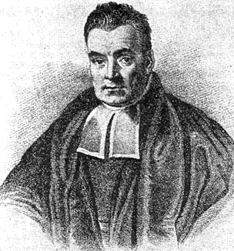
Who was Bayes?
An essay towards solving a problem on the doctrine of chances (1763)
$$P(A|B)=\frac{P(B|A)P(A)}{P(B)}$$

Slide 3
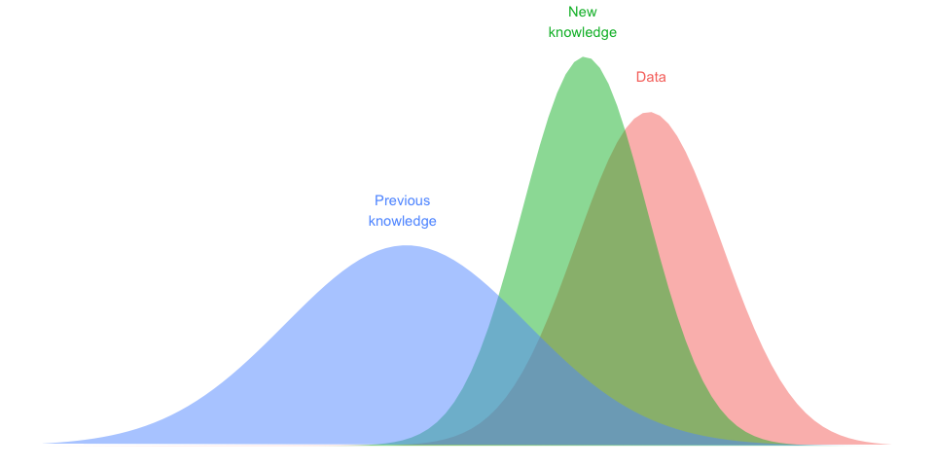
What is Bayes?

Slide 4
How does it work?
Divide up your world into things you know (data) and things you don’t know (parameters)
Create a generative model that says what the data would look like if you knew what the parameters were
Calculate the posterior probability distribution to obtain our new knowledge using Bayes’ theorem (and a helpful R package or Bayesian statistician)

Slide 5
How does this work for palaeoclimate reconstruction?
We know the ancient proxies and the modern proxy/climate relationship. These are our data. The ancient climate are our unknown parameters
We can build a generative model for how ancient pollen might form from ancient climate
We turn the Bayesian handle to produce a posterior probability distribution of ancient climate given ancient pollen

Slide 6
Why is this better?
Because you get a probability distribution for your unknowns given what you know
Because you can incorporate external information that you know about your system
Because it avoids terrible $p$-values
A p-value, or statistical significance, does not measure the size of an effect or the importance of a result - American Statistical Association 2017

Slide 7
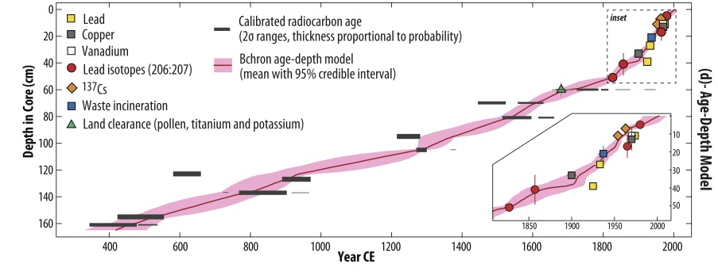
Ex 1: Kemp et al. 2013 QSR

Slide 8
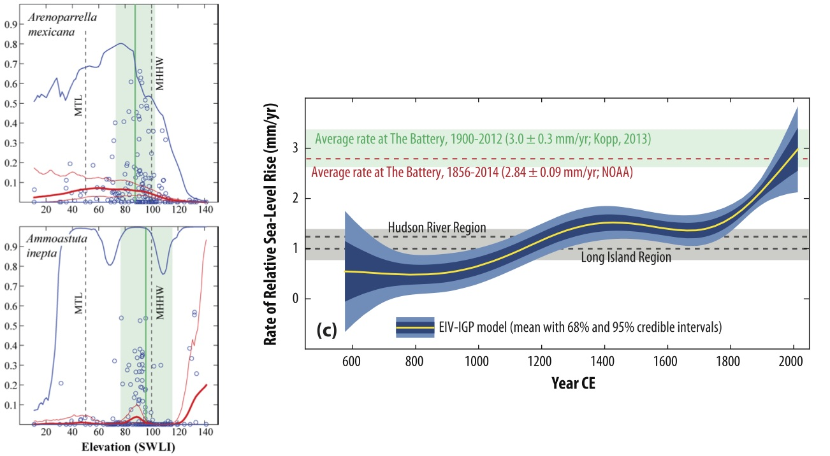
Ex 2: Cahill et al. 2016 COTP

Slide 9
A note on computation
Most methods to compute the posterior distribution (the new knowledge) work via trial and error on the unknown parameters
This means that rather than a single best value you get a spreadsheet of values that match the data
## c(t_1) c(t_2) c(t_3) ## 1 0.599 -1.629 0.293 ## 2 -0.828 -1.699 -1.065 ## 3 1.704 1.599 1.532 ## 4 -0.326 -1.038 -0.404 ## 5 -0.941 0.468 -0.064

Slide 10
The rest of this session
Nils Weitzel, Combining a proxy synthesis and climate simulations for spatial reconstructions of European climate using Bayesian filtering
Lauren Gregoire, Searching for the deglaciation: sampling spatio-temporal climate uncertainty for simulating ice sheet evolution
Lambert Caron, Quantifying the Information Content of Relative Sea-level and Geodetic Data for Constraint on North American GIA Models
Erica Ashe, Estimating global sea level over the late Holocene using a spatio-temporal empirical Bayesian hierarchical framework
Marco Antonio Aquino Lopez, Bayesian improvements to 210Pb dating

