Slide 1
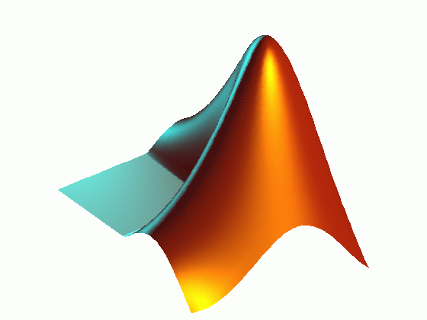
Introduction to Matlab
Eugene Kashdan, PhD
eugene.kashdan@ucd.ie

Slide 2
Matlab stands for Matrix Laboratory.
Matlab had many functions and toolboxes to help in various applications
It allows you to solve many technical computing problems, in a fraction of the time it would take to write a program in a scalar non-interactive language such as C.
Matlab is very efficient and natural choice for medical image analysis and statistical data processing.

Slide 3
The Matlab System
Matlab system consists of these main parts:
Desktop Tools and Development Environment
Includes the Matlab desktop and Command Window, an editor and debugger, a code analyzer, browsers for viewing help, the workspace, files, and other tools
Mathematical Function Library
vast collection of computational algorithms ranging from elementary functions, like sine, cosine, and complex arithmetic, to more sophisticated grouped in the toolboxes, like Image Processing Toolbox, Statistics Toolbox and many others.

Slide 4
The Language
The Matlab language is a high-level matrix/array language with control flow statements, functions, data structures, input/output, and object-oriented programming features.
Graphics
Matlab has extensive facilities for displaying vectors and matrices as graphs, as well as editing and printing these graphs. It also includes functions that allow you to customize the appearance of graphics as well as build complete graphical user interfaces on your Matlab applications.
Import
Matlab can read and process data from multiple formats, e.g., MS Excel, SQL, text and all types of digital images, including DICOM.
Sequence data (fasta, embl, genbank, etc.)
Microarray (Affymetrix, GenePix, GEO, etc.)
BLAST Reports, Mass Spec, Phylogenetic Trees, etc.

Slide 5
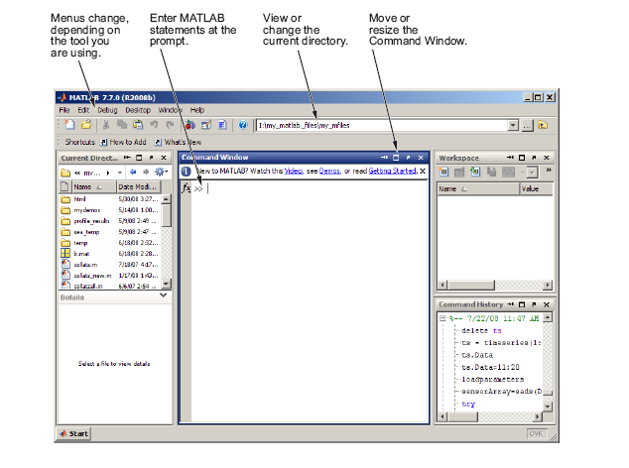
Main Matlab Window

Slide 6
Working with Matrices and Arrays
Since Matlab makes extensive use of matrices, the best way for you to get started with Matlab is to learn how to handle matrices.
Separate the elements of a row with blanks or commas.
Use a semicolon ; to indicate the end of each row.
Surround the entire list of elements with square brackets, [ ].
A = [16 3 2 13; 5 10 11 8; 9 6 7 12; 4 15 14 1]

Slide 7
Matlab displays the matrix you just entered:
A =
16 3 2 13
5 10 11 8
9 6 7 12
4 15 14 1
Once you have entered the matrix, it is automatically remembered in the Matlab workspace. You can simply refer to it as A.
Keep in mind, variable names are case-sensitive

Slide 8
When you do not specify an output variable, Matlab uses the variable ans, short for answer, to store the results of a calculation.
Subscripts
The element in row i and column j of A
is given by A(i,j).
So to compute the sum of the elements in the fourth
column of A, we have:
A(1,4) + A(2,4) + A(3,4) + A(4,4)
Which produces:
ans = 34

Slide 9
The Colon Operator
For example: 1:10
is a row vector containing the integers from 1 to 10:
1 2 3 4 5 6 7 8 9 10
To obtain non-unit spacing, specify an increment. For example: 100:-7:50 will give you
100 93 86 79 72 65 58 51
Subscript expressions involving colons refer to portions of a matrix. For example: A(1:k,j)
refers to the first k elements of the jth column of A.

Slide 10
Numbers
Matlab uses conventional decimal notation, with an optional decimal point and leading plus or minus sign, for numbers. Scientific notation uses the letter e to specify the power. Examples of legal numbers are:
3 -99 0.0001
9.6397238 1.60210e-20 6.02252e23

Slide 11
The Load Function
The load function reads binary files containing matrices generated by earlier Matlab sessions, or reads text files containing numeric data.
M-Files
You can create your own programs using M-files, which are plain text files containing Matlab code. Use the Matlab Editor or another text editor to create a file containing the same statements you would type at the Matlab command line. Save the file under a name that ends in .m

Slide 12
Arrays
Arithmetic operations on arrays are done element by element. This means that addition and subtraction are the same for arrays and matrices, but that multiplicative operations are different. Matlab uses a dot, or decimal point, as part of the notation for multiplicative array operations.
Example: A.*A
the result is an array containing the squares of the integers
ans =
256 9 4 169
25 100 121 64
81 36 49 144
16 225 196 1

Slide 13
Multivariate Data
Matlab uses column-oriented analysis for multivariate statistical data. Each column in a data set represents a variable and each row an observation. The (i,j)th element is the ith observation of the jth variable.
As an example, consider a data set with three variables:
• Heart rate • Weight • Hours exercise per week
For five observations, the resulting array might look like
D = [ 72 134 3.2
81 201 3.5
69 156 7.1
82 148 2.4
75 170 1.2 ]

Slide 14
Now you can apply Matlab analysis functions to this data set. For example, to obtain the mean and standard deviation of each column, use
mu = mean(D), sigma = std(D)
mu = 75.8 161.8 3.48
sigma = 5.6303 25.499 2.2107
Entering Long Statements
If a statement does not fit on one line, use an ellipsis (three periods), ... , followed by Return or Enter to indicate that the statement continues on the next line. For example,
s = 1 -1/2 + 1/3 -1/4 + 1/5 - 1/6 + 1/7 ...
- 1/8 + 1/9 - 1/10 + 1/11 - 1/12;

Slide 15
Graphics
Matlab provides a variety of techniques to display data graphically.
Interactive tools enable you to manipulate graphs to achieve results that reveal the most information about your data.
You can also edit and print graphs for presentations, or export graphs to standard graphics formats for presentation in Web browsers or other media.

Slide 16
Basic Plotting Functions
The plot function has different forms, depending on the input arguments.
If y is a vector, plot(y) produces a piecewise graph of the elements of (y) versus the index of the elements of (y).
If you specify two vectors as arguments, plot(x,y) produces a graph of y versus x.
x = 0:pi/100:2*pi;
y = sin(x);
You can also label the axes and add a title, using the ‘xlabel’, ‘ylabel’, and ‘title’ functions.
xlabel('x = 0:2\pi')
ylabel('Sine of x')
title('Plot of the Sine Function','FontSize',12)

Slide 17
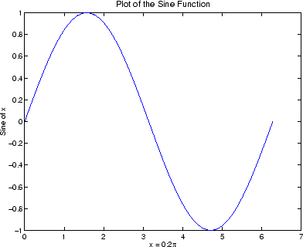

Slide 18
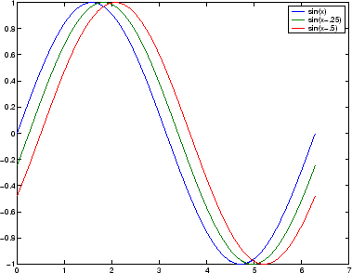
Plotting Multiple Data Sets in One Graph
Multiple x-y pair arguments create multiple graphs with a single call to plot.
For example: x = 0:pi/100:2*pi;
y = sin(x);
y2 = sin(x-.25);
y3 = sin(x-.5);
plot(x,y,x,y2,x,y3)

Slide 19
Specifying Line Styles and Colors
It is possible to specify color, line styles, and markers (such as plus signs or circles) when you plot your data using the plot command:
plot(x,y,'color_style_marker')
For example: plot(x,y,'r:+')
plots a red-dotted line and places plus sign markers at each data point.
Adding Plots to an Existing Graph
When you type: hold on
Matlab adds the new data to the current graph, rescaling the axes if necessary.

Slide 20
Figure Windows
Graphing functions automatically open a new figure window if there are no figure windows already on the screen.
To make a figure window the current figure, type figure(n)
where n is the number in the figure title bar. The results of subsequent graphics commands are displayed in this window.

Slide 21
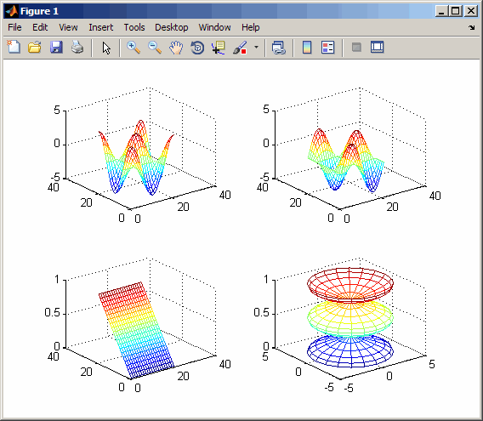
Displaying Multiple Plots in One Figure
subplot(m,n,p)
This splits the figure window into an m-by-n matrix of small subplots and selects the pth subplot for the current plot.
Example:
t = 0:pi/10:2*pi;
[X,Y,Z] = cylinder(4*cos(t));
subplot(2,2,1); mesh(X)
subplot(2,2,2); mesh(Y)
subplot(2,2,3); mesh(Z)
subplot(2,2,4); mesh(X,Y,Z)

Slide 22
Controlling the Axes
Setting Axis Limits & Grids
The axis command lets you to specify your own limits: axis([xmin xmax ymin ymax])
You can use the axis command to make the axes visible or invisible: axis on / axis off
The grid command toggles grid lines on and off: grid on / grid off

Slide 23
Programming in Matlab
Conditional Control
- if, else, elseif
- switch, case
Loop Control
- for, while, continue, break
Error Control
- try, catch
Program Termination
- return

Slide 24
Multidimensional Arrays
One way of creating a multidimensional array is by calling zeros, ones, rand, or randn with more than two arguments.
For example: R = randn(3,4,5);
creates a 3-by-4-by-5 array with a total of 3*4*5 = 60 normally distributed random elements.

Slide 25
Scripts and Functions
There are two kinds of M-files:
- Scripts, which do not accept input arguments or return output arguments. They operate on data in the workspace. Any variables that they create remain in the workspace, to be used in subsequent computations
- Functions, which can accept input arguments and return output arguments. Internal variables are local to the function.

Slide 26
Global Variables
If you want more than one function to share a single copy of a variable, simply declare the variable as global in all the functions. The global declaration must occur before the variable is actually used in a function.
Example: function h = falling(t)
global GRAVITY
h = 1/2*GRAVITY*t.^2;

Slide 27
Medical imaging
In medical imaging, information is transferred to the observer in two steps:
1. Data acquisition and image formation in the imaging system
2. Processing and display of image data
Visual performance in medical imaging can be divided into three categories:
1. Detection of an abnormality (presence)
2. Recognition of an abnormality (shape and size)
3. Identification (relation to likely disease) of the abnormality

Slide 28
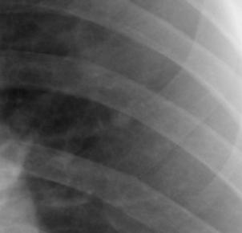
Medical Image Perception
Changes in Image display can lead to errors in interpretation. In this example the “subtle” abnormality (lung cancer) can be missed in the left image due to poor display….

Slide 29
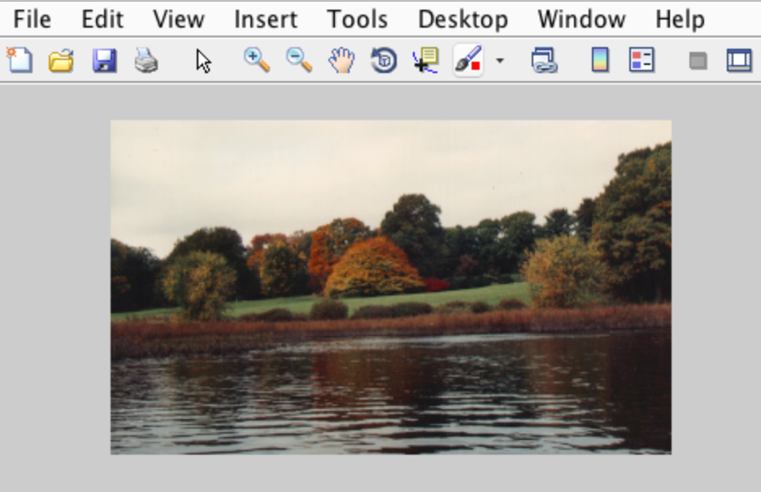
Image processing
Loading an image:
a = imread(‘autumn.tif’);
imshow(a);
Image (=matrix) size:
size(a)
206 345 3
206
R G B
345

Slide 30
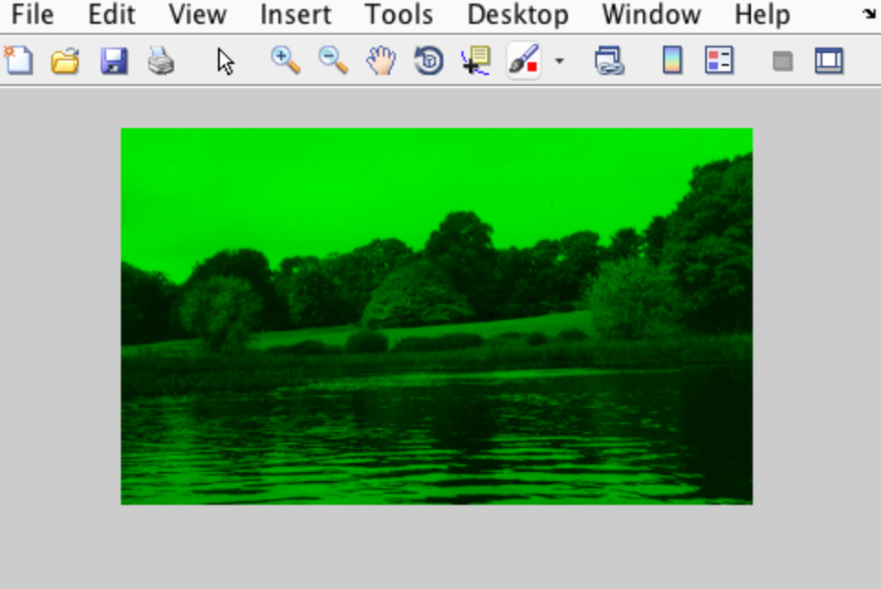
Color separation
Show GREEN plane:
a(:,:,[1 3]) = 0;
imshow(a);

Slide 31
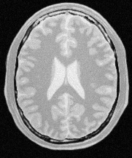
Operations on images
3x3 neighborhood
Origin (Ox,Oy)
Pixel Value
Pixel Region
Spacing (Sy)
Spacing (Sx)
Images are treated as matrices and can be quantified ,added, multiplied and subtracted.

Slide 32
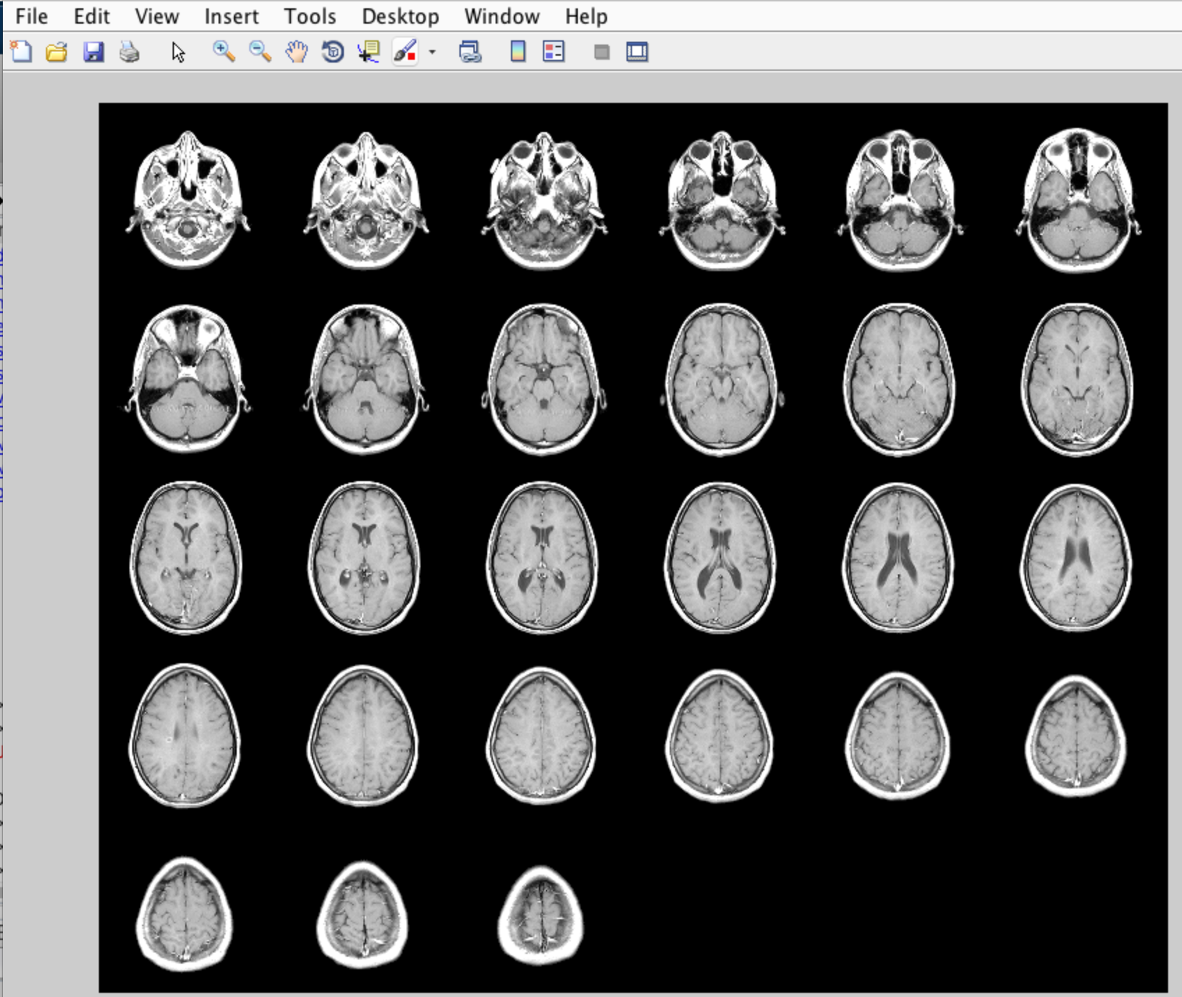
Combination of images
>> load mri
>> montage(D,map)

Slide 33
Noise reduction and filtering
Example:
Median filter J = medfilt2(I) | Removes the outliers without reducing the sharpness of the image.
Wiener filter J = wiener2(I,noise_type) | Removes additive noise and deblurring.
Anisotropic filter J=anisodiff2D(I,…) | Preserves the edges of the object, reduces the high frequency noise.
Mean filter mf = ones(3,3)/9; J=filter2(mf,I) | Removes grain noise from an image.
The original MRI brain image.
Image after applying Wiener filter.

Slide 34
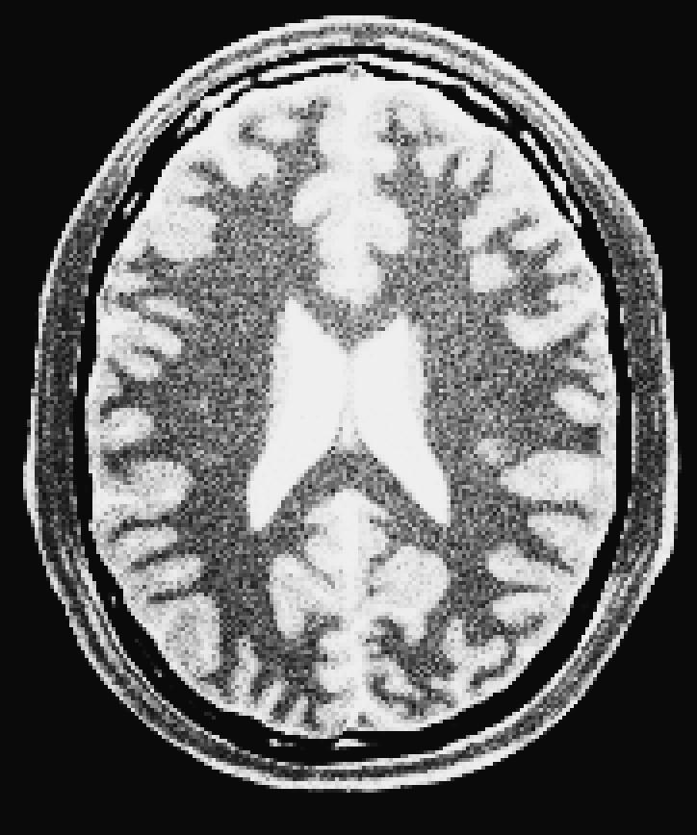
Contrast enhancement
imadjust increases the contrast of the image by mapping the values of the input intensity image to new values, 1% of the data is saturated at low and high intensities of the input data.
histeq performs histogram equalization. It enhances the contrast of images by transforming the values in an intensity image so that the histogram of the output image approximately matches a uniform distribution.
adapthisteq performs contrast-limited adaptive histogram equalization. it operates on small data regions (tiles) rather than the entire image. Each tile's contrast is enhanced so that the histogram of each output region approximately matches the uniform distribution.

Slide 35
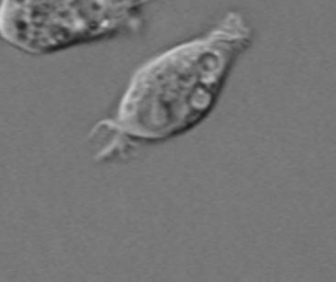


Detecting a Cell Using Image Segmentation
Step 1: Read Image
>>I = imread('cell.tif') % read prostate cancer cell image
>>figure, imshow(I), title('original image');
Step 2: Detect Entire Cell
>>[~, threshold] = edge(I, 'sobel');
>>fudgeFactor = .5;
>>BWs = edge(I,'sobel', threshold * fudgeFactor);
>>figure, imshow(BWs), title('binary gradient mask');
Step 3: Dilate the Image
>>se90 = strel('line', 3, 90);
>>se0 = strel('line', 3, 0);
>>BWsdil = imdilate(BWs, [se90 se0]);
>>figure, imshow(BWsdil), title('dilated gradient mask');

Slide 36



Detecting a Cell Using Image Segmentation
Step 4: Fill Interior Gaps
>>BWdfill = imfill(BWsdil, 'holes');
>>figure, imshow(Bwdfill), title('binary image with filled holes');
Step 5: Remove Connected Objects on Border
>>BWnobord = imclearborder(BWdfill, 4);
>>figure, imshow(BWnobord), title('cleared border image');
Step 6: Smoothen the Object
>>seD = strel('diamond',1);
>>BWfinal = imerode(BWnobord,seD);
>>BWfinal = imerode(BWfinal,seD);
>>figure, imshow(BWfinal), title('segmented image');

Slide 37
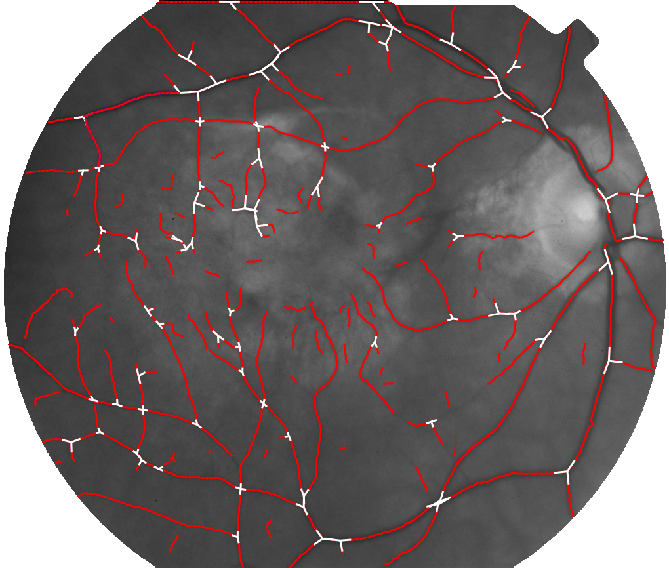
High level image understanding
Landmarks
(bifurcation/crossover)
Traces
(vessel centerlines)

Slide 38
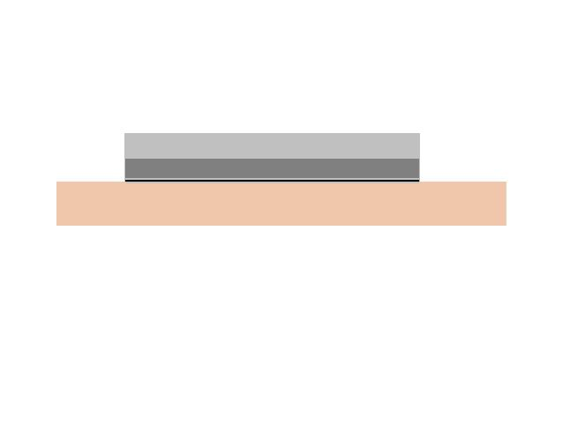
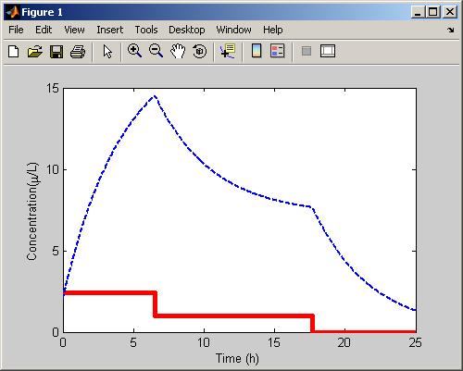
Systems Biology - Pharmacokinetics
Nicotine patch is applied to the skin for 16 hours
Overlapping zero-order input rates
Drug concentration monitored for 24 hours
Single compartment model
Rapid decrease in concentration
when infusion rates drop
Patch
Skin
F_{fast} =
Total dose – Dose_{slow}
Time_{fast}
F_{slow} =
Dose_{slow}
Time_{slow}
Burst + controlled
infusion
No infusion
dC/dt = (F_{fast} + F_{slow} – Cl*C)/V
Controlled infusion

Slide 39
PK Example… continued
Total dose of 15,890 µg
Fast infusion runs for time Time_{fast}
Slow infusion runs for time Time_{slow}
Initial nicotine concentration = 2 µg/L
Initial Parameter Estimates
V = 140 L (0 – 500)
Cl = 78 L/h (0 – 190)
Dose_{slow} = 10,000 µg (500 – 15,000)
Time_{fast} = 6 h (0 – 8)
Time_{slow} = 17 h (0 - 30)
Experimental Data
Time | Concentration
0.1 | 25
0.15 | 35
0.25 | 42
0.5 | 48
0.75 | 46.5
0.8 | 47
1 | 46
1.25 | 44.5
1.5 | 45
2 | 42.1
3 | 63
4 | 70.15
5 | 72
6 | 65
8 | 55
12 | 39
24 | 14

Slide 40
Statistical data analysis
(Almost) Everything you’re used to doing with your favorite statistics software (SPSS, etc.) is possible to do under the Matlab’s rooftop*
* you’ll might have to work a bit harder to code the specific tests you’ve got ready in spss – you can always look for other people’s code in Mathworks website
Exploratory data analysis
Hypothesis testing

Slide 41
Random number generators
>>rand(n)
% n uniformly distributed numbers between [0,1]
% Multiply and shift to get any range you need
>>randn(n)
% Normally distributed random numbers
% mean = 0, STD = 1
Example: Mean = 0.6, Variance = 0.1:
>>n=10;
>>x = .6 + sqrt(0.1) * randn(n,1);

Slide 42
Histograms 1D
>>X = randn(1,1000);
>>[C, N] = hist(X, 50);
>>bar(N,C/sum(C))
% N = location of bins,
% C = counts in each location
>>[C, N] = hist(X, 10);
>>bar(N,C/sum(C))

Slide 43
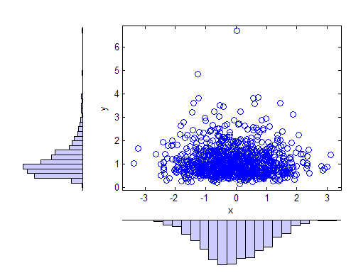
Histograms in 2D
>>x = randn(1000,1);
>>y = exp(.5*randn(1000,1));
>>scatterhist(x,y)
Allows viewing correlations in your data!

Slide 44
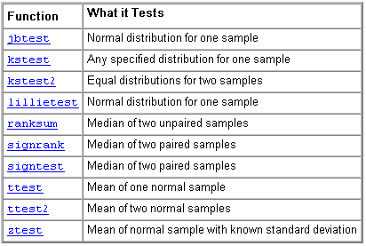
Statistics toolbox - Hypothesis Tests

Slide 45
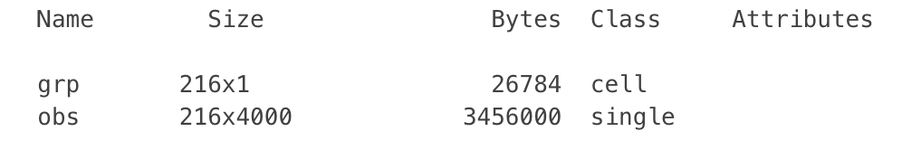
Test study: Ovarian Cancer
Loading the Data
Serum proteomic pattern diagnostics can be used to differentiate observations from patients with and without disease. Profile patterns are generated using surface-enhanced laser desorption and ionization (SELDI) protein mass spectrometry. These features are ion intensity levels at specific mass/charge values.
The data in this example is from the FDA-NCI Clinical Proteomics Program Databank. This example uses the high-resolution ovarian cancer data set that was generated using the WCX2 protein array. After some pre-processing steps, the data set has two variables obs and grp. The obs variable consists 216 observations with 5000 features. Each element in grp defines the group to which the corresponding row of obs belongs.
We use Quadratic Discriminant Analysis (QDA) as the classification algorithm
>>load ovariancancer;
>>whos

Slide 46
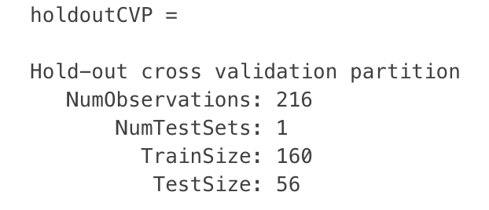
Dividing Data Into a Training Set and a Test Set
The performance on the training data is not a good estimate for a model's performance on an independent test set.
It will usually be over-optimistic. To predict the performance of a selected model, you need to assess its performance on another data set that was not used to build the model.
Here, we use cvpartition to divide data into a training set of size 160 and a test set of size of size 56. Both the training set and the test set have roughly the same group proportions as in grp.
We select features using the training data and judge the performance of the selected features on the test data. This is often called holdout validation.
>>holdoutCVP = cvpartition(grp,'holdout',56)
>>dataTrain = obs(holdoutCVP.training,:);
>>grpTrain = grp(holdoutCVP.training);

Slide 47
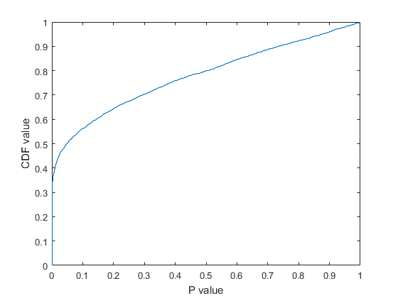
Selecting Features Using a Simple Filter Approach
Our goal is to reduce the dimension of the data by finding a small set of important features which can give good classification performance.
For example, we might apply the t-test on each feature and compare p-value (or the absolute values of t-statistics) for each feature as a measure of how effective it is at separating groups.
>>dataTrainG1 = dataTrain(grp2idx(grpTrain)==1,:);
>>dataTrainG2 = dataTrain(grp2idx(grpTrain)==2,:);
>>[h,p,ci,stat] = ttest2(dataTrainG1,dataTrainG2,'Vartype','unequal');
In order to get a general idea of how well- separated the two groups are by each feature, we plot the empirical cumulative distribution function (CDF) of the p-values:
>>ecdf(p);
>>xlabel('P value');
>>ylabel('CDF value')

Slide 48
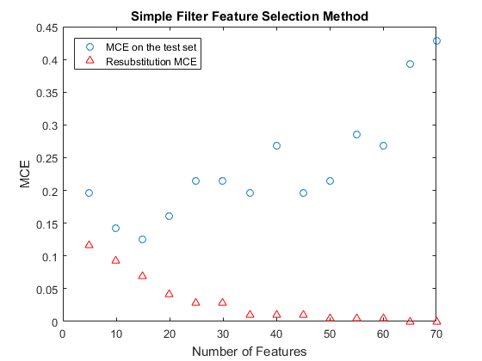
There are about 35% of features having p-values close to zero and over 50% of features having p-values smaller than 0.05, meaning there are more than 2500 features among the original 5000 features that have strong discrimination power.
One quick way to decide the number of needed features is to plot the MCE (misclassification error, i.e., the number of misclassified observations divided by the number of observations) on the test set as a function of the number of features.

Slide 49
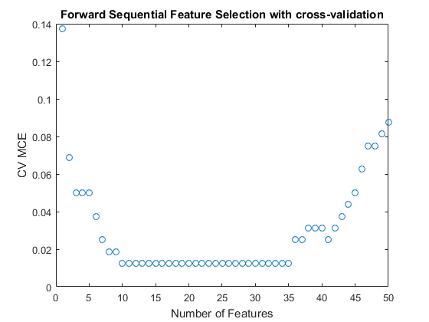
For instance, we draw the plot of the cross-validation MCE as a function of the number of features for up to 50 features.
>>[fsCVfor50,historyCV] = sequentialfs(classf,dataTrain(:,fs1),grpTrain,...
'cv',tenfoldCVP,'Nf',50);
>>plot(historyCV.Crit,'o');
>>xlabel('Number of Features');
>>ylabel('CV MCE');
>>title('Forward Sequential Feature Selection with cross-validation');

Slide 50
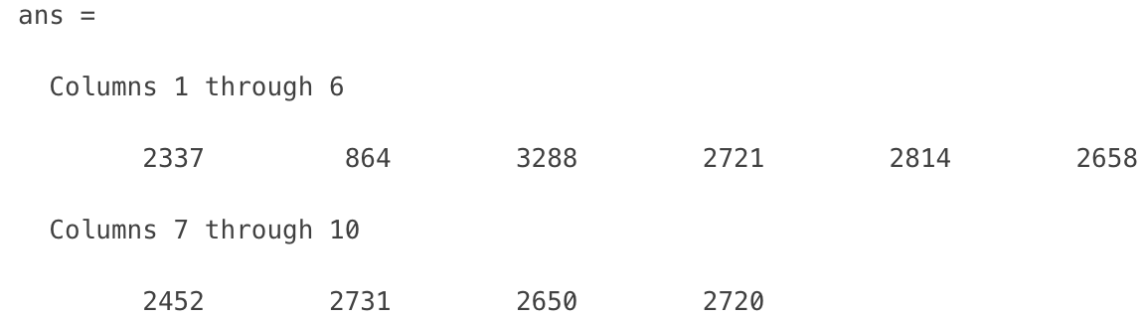
The cross-validation MCE reaches the minimum value when 10 features are used and this curve stays flat over the range from 10 features to 35 features. Also, the curve goes up when more than 35 features are used, which means overfitting occurs there.
It is usually preferable to have fewer features, so here we pick 10 features:
>>fsCVfor10 = fs1(historyCV.In(10,:))
To show these 10 features in the order in which they are selected in the sequential forward procedure, we find the row in which they first become true in the historyCV output:
>>[orderlist,ignore] = find( [historyCV.In(1,:); diff(historyCV.In(1:10,:) )]' );
To evaluate these 10 features, we compute their MCE for QDA on the test set. We get the smallest MCE value so far:
>>testMCECVfor10 = crossval(classf,obs(:,fsCVfor10),grp,'partition',...
holdoutCVP)/holdoutCVP.TestSize
testMCECVfor10 =
0.0357

Slide 51
Tomorrow
Dr Andrew Parnell will talk about:
Basics of experimental design;
Very basic intro to models for classification and regression in cancer studies: linear and logistic regression, basic machine learning tools;
Measuring model performance via specificity, sensitivity, area under the curve, and cross validation;
- How to run all the above in R.

