Slide 1
COP 3502 Computer Science I
Order Analysis
Kurt Kullu
Slides mostly adapted from slides by Dr. Andrew Steinberg

Slide 2
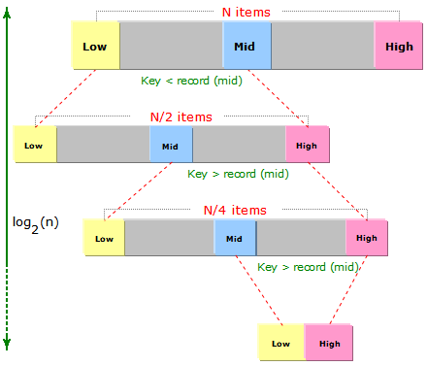
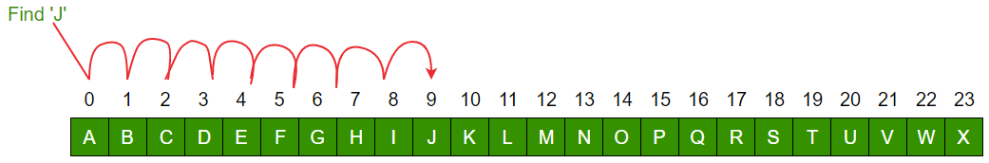
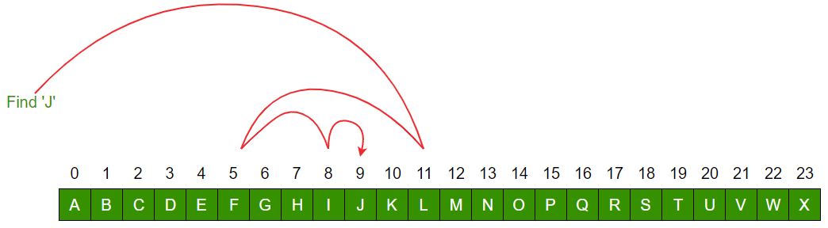
Reminding Our Discussions From Week 1
Linear Search
Binary Search
Linear time or O(n)
Logarithmic time or O(log n)
These were two alternative search algorithms and codes we’ve discussed the first week

Slide 3
Comparing Growth of Two Functions
Let’s plot these two functions, n and log n
How did we conclude that linear search had O(n) running time?
Figured out that we aren’t interested in many details (processor speed, programming language, etc.) that affect the actual running time in seconds for one run
We focused on counting basic operations and how they change with input size
Even for a specific input size, we can have best or worst-case scenarios, or any scenario in between
We said that best-case is generally not interesting
We will not look at all this in a bit more detail

Slide 4
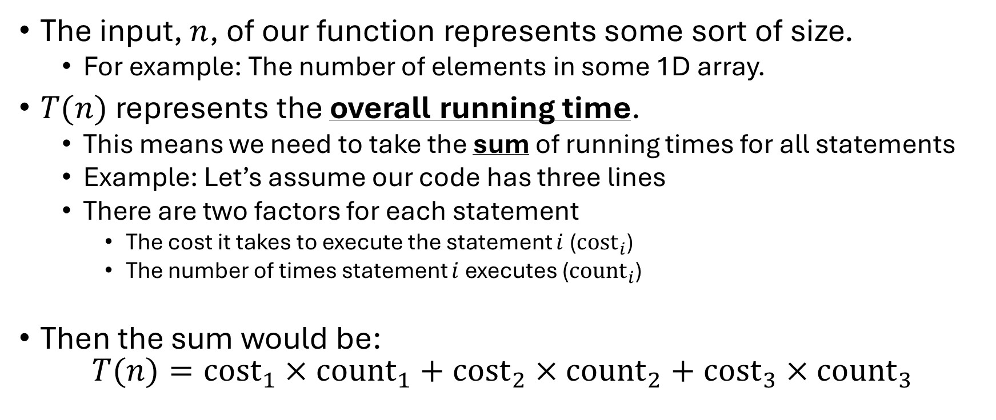
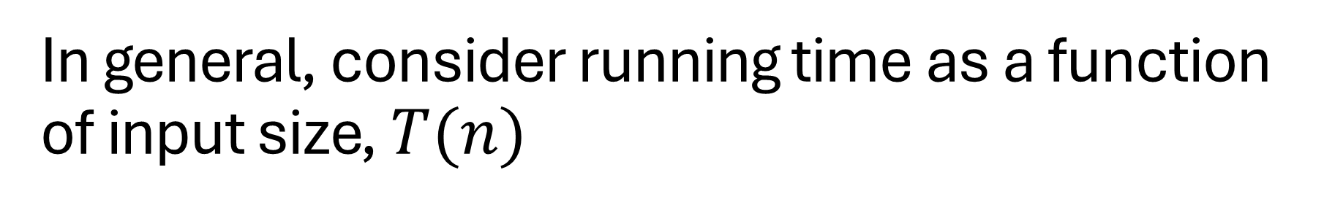
In general, consider running time as a function of input size, $T(n)$
The input, $n$, of our function represents some sort of size.
For example: The number of elements in some 1D array.
$T(n)$ represents the overall running time.
This means we need to take the sum of running times for all statements
Example: Let’s assume our code has three lines
There are two factors for each statement
The cost it takes to execute the statement $i$ (${\text{cost}}_{i}$)
The number of times statement $i$ executes (${\text{count}}_{i}$)
Then the sum would be: $T(n)={\text{cost}}_{1}×{\text{count}}_{1}+{\text{cost}}_{2}×{\text{count}}_{2}+{\text{cost}}_{3}×{\text{count}}_{3}$

Slide 5
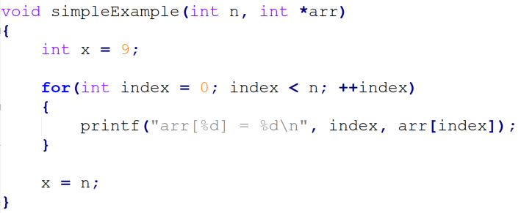
T(n) Example
Here we have a simple user defined function with two parameters. The 1st parameter represents an integer which is the size of the array, and the 2nd parameter is the address of the first index of the array.

Slide 6

T(n) Example
Here we have a simple user defined function with two parameters. The 1st parameter represents an integer which is the size of the array, and the 2nd parameter is the address of the first index of the array.
$${\text{count}}_{1}=1$$
The first statement is a simple variable declaration and assignment statement. The statement will only execute once!

Slide 7

T(n) Example
Here we have a simple user defined function with two parameters. The 1st parameter represents an integer which is the size of the array, and the 2nd parameter is the address of the first index of the array.
$${\text{count}}_{1}=1$$
$${\text{count}}_{2}=n+1$$
The next statement is a for loop header. The header contains 3 components that we should know from our intro to c course!
We need to determine how many times that line would execute. The header tells us that the variable index will start at 0 and increment by 1 until index is no longer smaller than n itself. We need a way in terms of n to express the number of times the statement will execute. The condition will be n times, but the condition will be false one time. Hence, the number of times can be expressed as n + 1

Slide 8

T(n) Example
Here we have a simple user defined function with two parameters. The 1st parameter represents an integer which is the size of the array, and the 2nd parameter is the address of the first index of the array.
$${\text{count}}_{1}=1$$
$${\text{count}}_{2}=n+1$$
$${\text{count}}_{3}=n$$
Now we need to determine the statements inside the for-loop body. Using our logic, we already know that they are going to execute when the condition is true. In this case n times! That means the number of times the printf statement will execute is n times.

Slide 9

T(n) Example
Here we have a simple user defined function with two parameters. The 1st parameter represents an integer which is the size of the array, and the 2nd parameter is the address of the first index of the array.
$${\text{count}}_{1}=1$$
$${\text{count}}_{2}=n+1$$
$${\text{count}}_{3}=n$$
$${\text{count}}_{4}=1$$
The final statement is only an assignment statement which is going to execute once.

Slide 10


T(n) Example
Here we have a simple user defined function with two parameters. The 1st parameter represents an integer which is the size of the array, and the 2nd parameter is the address of the first index of the array.
$${\text{count}}_{1}=1$$
$$statement_{2}=n+1$$
Now that we have observe each statement. We can properly express the overall running time T(n) of the simpleExample user defined function.
$$statement_{3}=n$$
$${\text{count}}_{4}=1$$
The final statement is only an assignment statement which is going to execute once.

Slide 11
T(n) Example
Here we have a simple user defined function with two parameters. The 1st parameter represents an integer which is the size of the array, and the 2nd parameter is the address of the first index of the array.
$${\text{count}}_{1}=1$$
$$statement_{2}=n+1$$
We just have to take the summation of all the statements!
$$statement_{3}=n$$
$${\text{count}}_{4}=1$$
The final statement is only an assignment statement which is going to execute once.

Slide 12

T(n) Example
Here we have a simple user defined function with two parameters. The 1st parameter represents an integer which is the size of the array, and the 2nd parameter is the address of the first index of the array.
$${\text{count}}_{1}=1$$
$${\text{count}}_{2}=n+1$$
$${\text{count}}_{3}=n$$
$${\text{count}}_{4}=1$$
The overall running time is $$T\left(n\right)={\text{cost}}_{1}∗1+{\text{cost}}_{2}∗\left(n+1\right)+{\text{cost}}_{3}∗n+{\text{cost}}_{4}∗1$$
The final statement is only an assignment statement which is going to execute once.

Slide 13
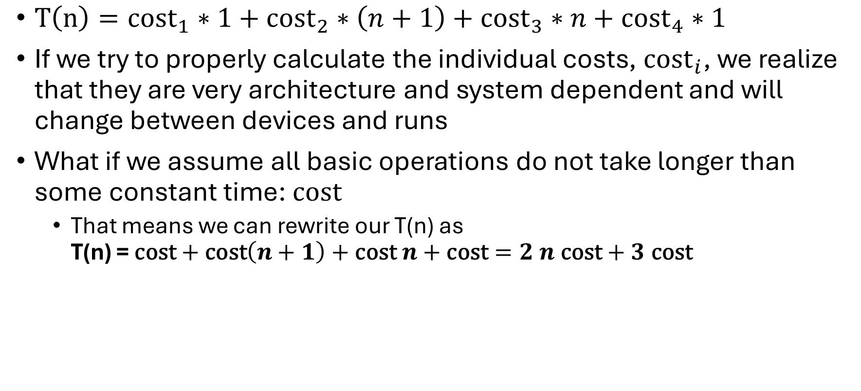
Statement Costs and our Assumption
$T\left(n\right)={\text{cost}}_{1}∗1+{\text{cost}}_{2}∗\left(n+1\right)+{\text{cost}}_{3}∗n+{\text{cost}}_{4}∗1$
If we try to properly calculate the individual costs, ${\text{cost}}_{i}$, we realize that they are very architecture and system dependent and will change between devices and runs
What if we assume all basic operations do not take longer than some constant time: $\text{cost}$
That means we can rewrite our T(n) as T(n) = $\text{cost}+\text{cost}\left(n+1\right)+\text{cost} n+\text{cost}=2 n \text{cost}+3 \text{cost}$

Slide 14
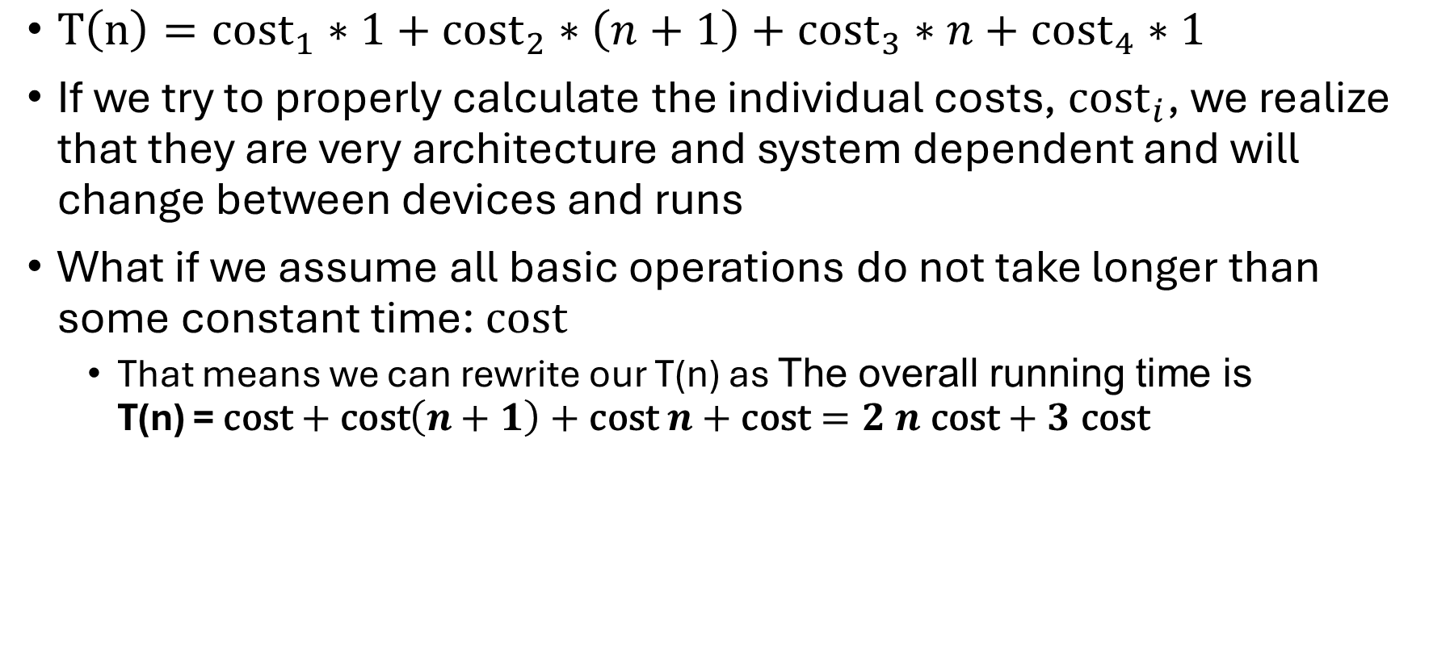
Statement Costs and our Assumption
$T\left(n\right)={\text{cost}}_{1}∗1+{\text{cost}}_{2}∗\left(n+1\right)+{\text{cost}}_{3}∗n+{\text{cost}}_{4}∗1$
If we try to properly calculate the individual costs, ${\text{cost}}_{i}$, we realize that they are very architecture and system dependent and will change between devices and runs
What if we assume all basic operations do not take longer than some constant time: $\text{cost}$
That means we can rewrite our T(n) as The overall running time is T(n) = $\text{cost}+\text{cost}\left(n+1\right)+\text{cost} n+\text{cost}=2 n \text{cost}+3 \text{cost}$
In this course (and in general when speaking about algorithms), we assume that the cost is the same for all statements, which means we can disregard the individual statement costs and just focus on the number of times the statements execute.

Slide 15
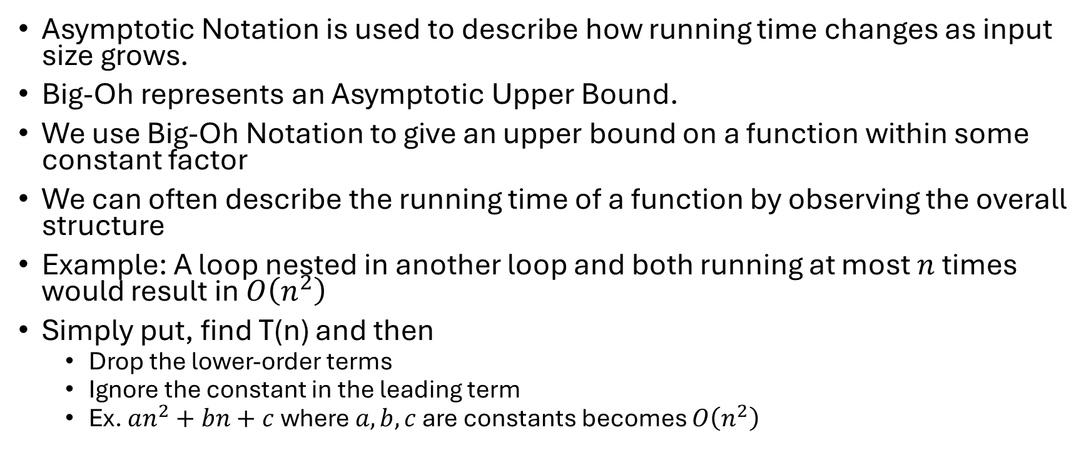
Big-Oh Notation
Asymptotic Notation is used to describe how running time changes as input size grows.
Big-Oh represents an Asymptotic Upper Bound.
We use Big-Oh Notation to give an upper bound on a function within some constant factor
We can often describe the running time of a function by observing the overall structure
Example: A loop nested in another loop and both running at most $n$ times would result in $O\left(n^{2}\right)$
Simply put, find T(n) and then
Drop the lower-order terms
Ignore the constant in the leading term
Ex. $an^{2}+bn+c$ where $a,b,c$ are constants becomes $O\left(n^{2}\right)$

Slide 16
Informal Definition of Big-Oh
In the CS1 course we will only explore the informal definition of big-Oh.
We have already described in the previous slide what big-Oh means.
The next part is how to determine a running time in big-Oh notation.
All you have to do is find the leading factor (highest growth rate) and drop the constant.
Your future CS2 course will explore the formal definition of big-Oh.

Slide 17
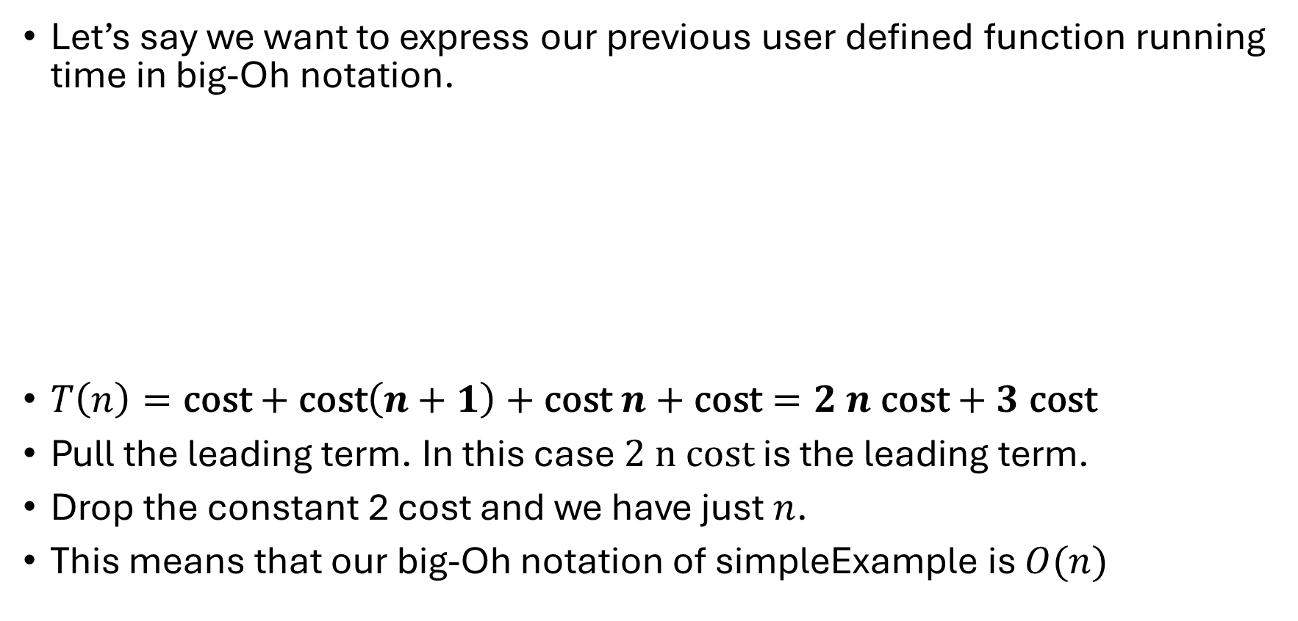
Previous Example
Let’s say we want to express our previous user defined function running time in big-Oh notation.
$T\left(n\right)=\text{cost}+\text{cost}\left(n+1\right)+\text{cost} n+\text{cost}=2 n \text{cost}+3 \text{cost}$
Pull the leading term. In this case $2 n cost$ is the leading term.
Drop the constant 2 cost and we have just $n$.
This means that our big-Oh notation of simpleExample is $O(n)$

Slide 18
Loops and Running Times
A lot of code we are going to see in this course and beyond will have more than just one for loop.
You should remember we have certain types of loops from your C language course!
for loops
Counter-based loops. I.e., we count how many times we want to execute a group of statements. They involve an increment statement (usually by 1).
while loops
Also used to repeatedly execute a group of statements. Generally, a bit more challenging than for loops since they don’t always increment or decrement by 1. Usually need more thinking to evaluate.
do-while loops
Same as while loop but guaranteed 1 iteration.

Slide 19
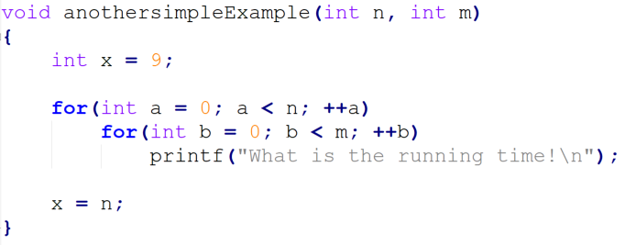

Running Time with Multiple Variables
The previous example only showed one variable to observe.
It is possible that there are multiple variables that will determine an overall running time if repetition rely on different variables.
Example
anotherSimpleExample running time in big-Oh would be
$$O\left(mn\right)$$

Slide 20
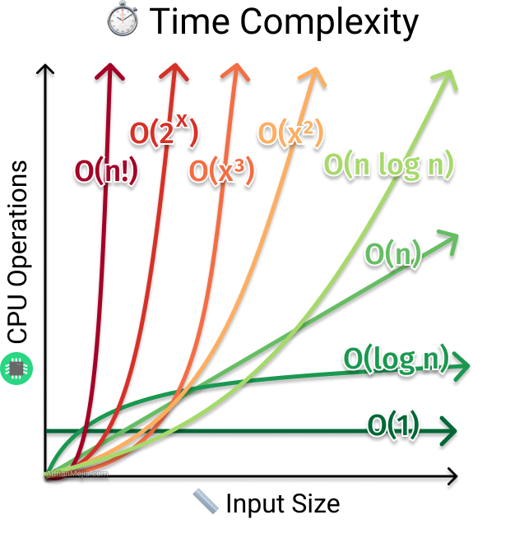

Common Orders You will see in CS1
Replace x’s with n’s in the figure below
Better
Constant Time $O\left(1\right)$
Logarithmic Time $O\left(\log{n}\right)$
Linear Time $O\left(n\right)$
Linearithmic Time $O\left(n\log{n}\right)$
Polynomial Time $O\left(n^{k}\right)$
Exponential Time $O\left(2^{n}\right)$
Factorial time $O\left(n!\right)$
Worse

Slide 21
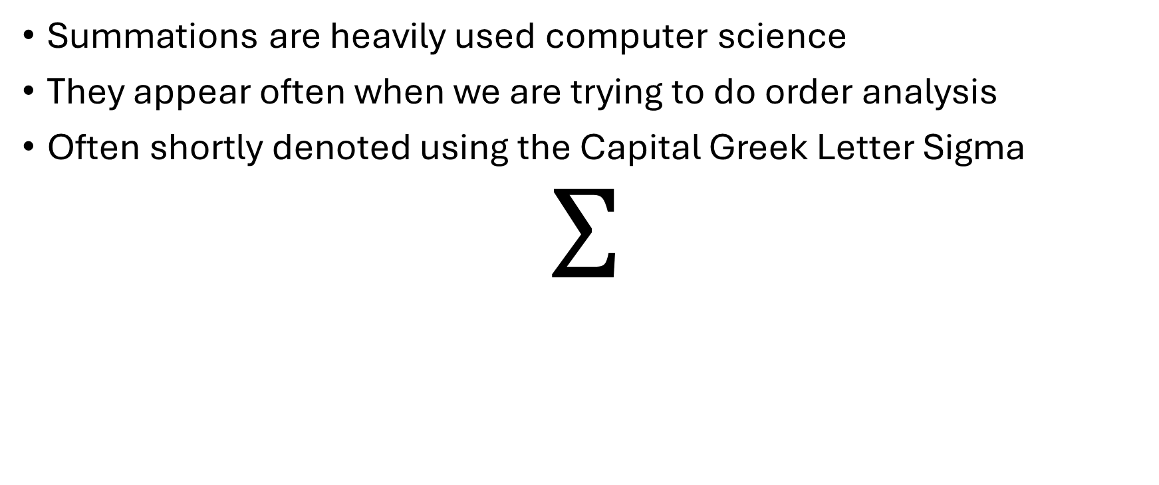
Summation
Summations are heavily used computer science
They appear often when we are trying to do order analysis
Often shortly denoted using the Capital Greek Letter Sigma
$$Σ$$

Slide 22
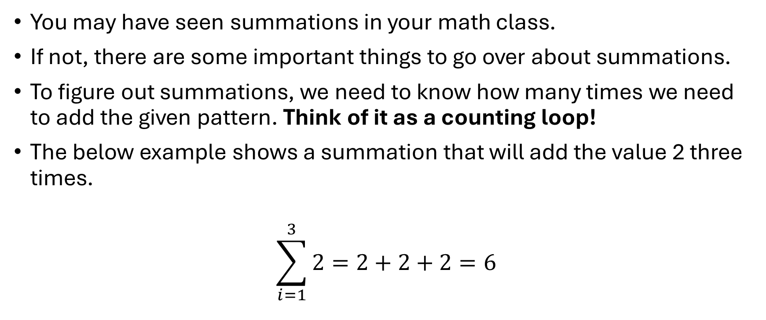
Understanding Summations
You may have seen summations in your math class.
If not, there are some important things to go over about summations.
To figure out summations, we need to know how many times we need to add the given pattern. Think of it as a counting loop!
The below example shows a summation that will add the value 2 three times.
$$\sum_{i=1}^{3}{2}=2+2+2=6$$
Last Iteration
Here, we are taking the summation of the value 2. We start at iteration 1 and increment i by 1 while performing the sum. The last iteration will be when i is 3.
First Iteration

Slide 23
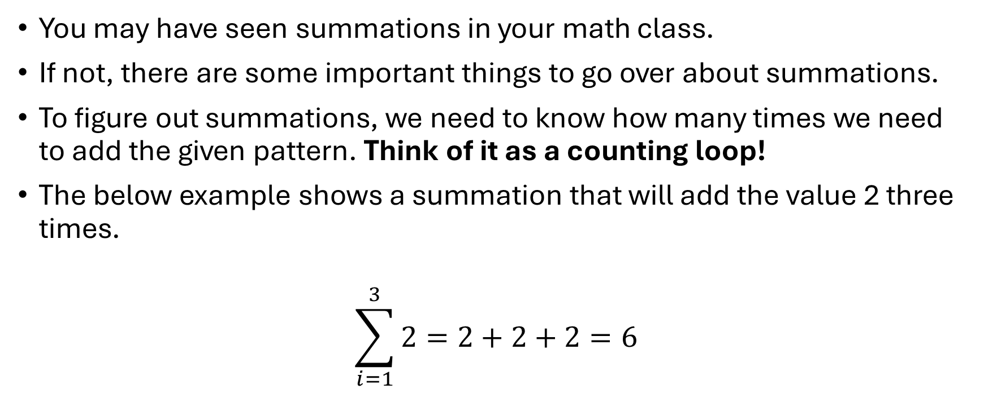
Understanding Summations
You may have seen summations in your math class.
If not, there are some important things to go over about summations.
To figure out summations, we need to know how many times we need to add the given pattern. Think of it as a counting loop!
The below example shows a summation that will add the value 2 three times.
$$\sum_{i=1}^{3}{2}=2+2+2=6$$
Last Iteration
Here, we are taking the summation of the value 2. We start at iteration 1 and increment i by 1 while performing the sum. The last iteration will be when i is 3.
First Iteration

Slide 24
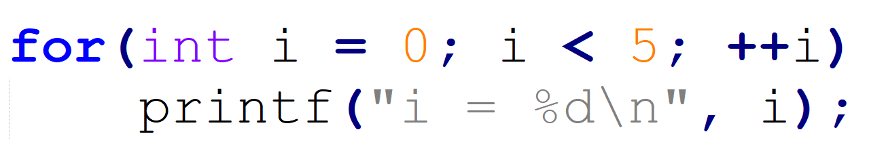
Loops and Summations
In our previous function running time example, we were able to derive how many times a statement would execute in some loop.
However, when we face more complex cases, it will help us a lot if we understand how counting statements in loops can be written mathematically. And that will involve a SUMMATION!!!
Let’s understand how a summation can express the count with a very simple example.

Slide 25
Loops and Summations
Using our super duper knowledge from our C Language course, here are some observations.
The starting iteration starts at the value 0
The condition is true as long as i is less than 5.
The variable i increments by 1 for each iteration.
The first question is how many iterations are going to occur for the body loop to execute?

Slide 26
Loops and Summations
Using our super duper knowledge from our C Language course, here are some observations.
The starting iteration starts at the value 0
The condition is true as long as i is less than 5.
The variable i increments by 1 for each iteration.
That is right! Only 5 iterations will occur inside the body of the for loop.

Slide 27
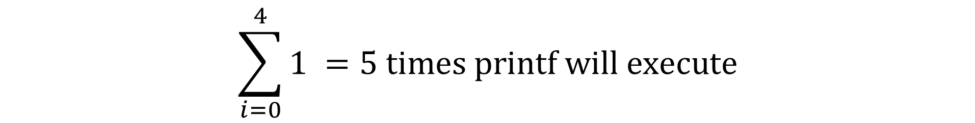
Loops and Summations
Using our super duper knowledge from our C Language course, here are some observations.
The starting iteration starts at the value 0
The condition is true as long as i is less than 5.
The variable i increments by 1 for each iteration.
Remember! We are assuming here that the print statements are executed in constant time O(1).
Final iteration that will be true for condition
$$\sum_{i=0}^{4}{1} =5 times printf will execute$$
Start iteration

Slide 28

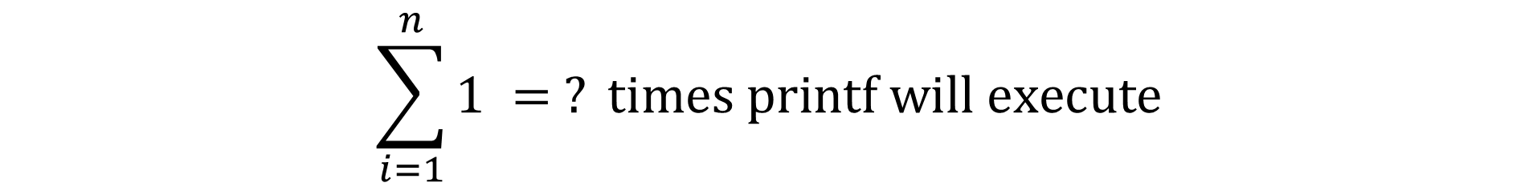
Loops and Summations Another Example
Using our super duper knowledge from our C Language course, here are some observations.
The starting iteration starts at the value 1
The condition is true as long as i is less or equal than n.
The variable i increments by 1 for each iteration.
Final iteration that will be true for condition
$$\sum_{i=1}^{n}{1} = ? times printf will execute$$
Start iteration

Slide 29
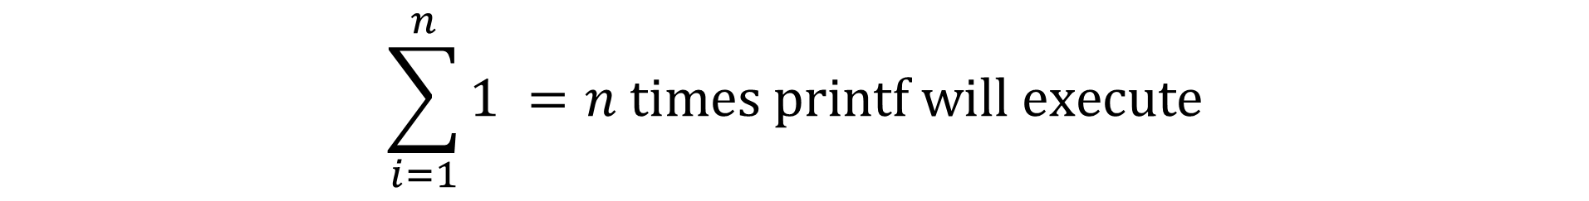
Loops and Summations Another Example
Using our super duper knowledge from our C Language course, here are some observations.
The starting iteration starts at the value 1
The condition is true as long as i is less or equal than n.
The variable i increments by 1 for each iteration.
Final iteration that will be true for condition
$$\sum_{i=1}^{n}{1} =n times printf will execute$$
Start iteration

Slide 30
Not All Summations are Simple
The previous example only showed 2 simple summations.
Plus we only looked at for loops. What about while loops?
We are going to be exploring more rigorous summations that may need further manipulation to simplify in allowing us to determine the appropriate run time in big-Oh.
We generally want to convert our summation into some expression where the informal definition of big-Oh can be applied. This is known as closed form.
Next, we look at some common summations and their closed forms.

Slide 31

Closed Form Summations
Basic Summation (assume c and m to be constants)
$\sum_{k=m}^{n}{c}=$

Slide 32

Closed Form Summations
Basic Summation
$\sum_{k=m}^{n}{c}=c+c+…+c=\left(n−m+1\right)c=O(n)$
Arithmetic Series
$\sum_{k=1}^{n}{k=}$

Slide 33
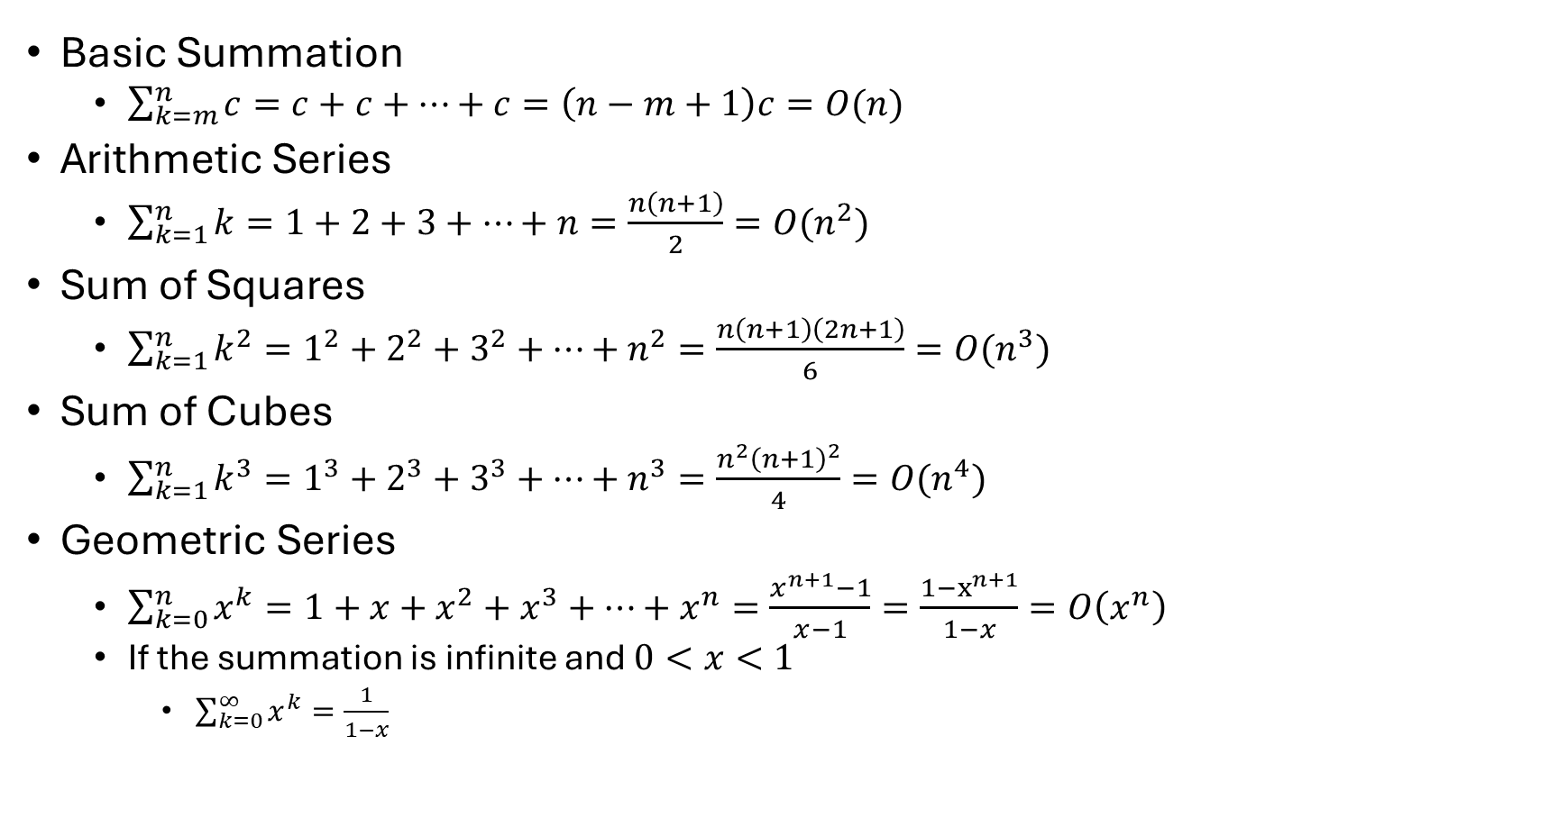
Closed Form Summations
Basic Summation
$\sum_{k=m}^{n}{c}=c+c+…+c=\left(n−m+1\right)c=O(n)$
Arithmetic Series
$\sum_{k=1}^{n}{k=1+2+3+…+n=\frac{n\left(n+1\right)}{2}=O(n^{2})}$
Sum of Squares
$\sum_{k=1}^{n}{k^{2}=1^{2}+2^{2}+3^{2}+…+n^{2}=\frac{n\left(n+1\right)\left(2n+1\right)}{6}=O(n^{3})}$
Sum of Cubes
$\sum_{k=1}^{n}{k^{3}=1^{3}+2^{3}+3^{3}+…+n^{3}=\frac{n^{2}{\left(n+1\right)}^{2}}{4}=O(n^{4})}$
Geometric Series
$\sum_{k=0}^{n}{x^{k}=1+x+x^{2}+x^{3}+…+x^{n}=\frac{x^{n+1}−1}{x−1}=\frac{1−x^{n+1}}{1−x}}=O\left(x^{n}\right)$
If the summation is infinite and $0<x<1$
$\sum_{k=0}^{∞}{x^{k}}=\frac{1}{1−x}$

Slide 34
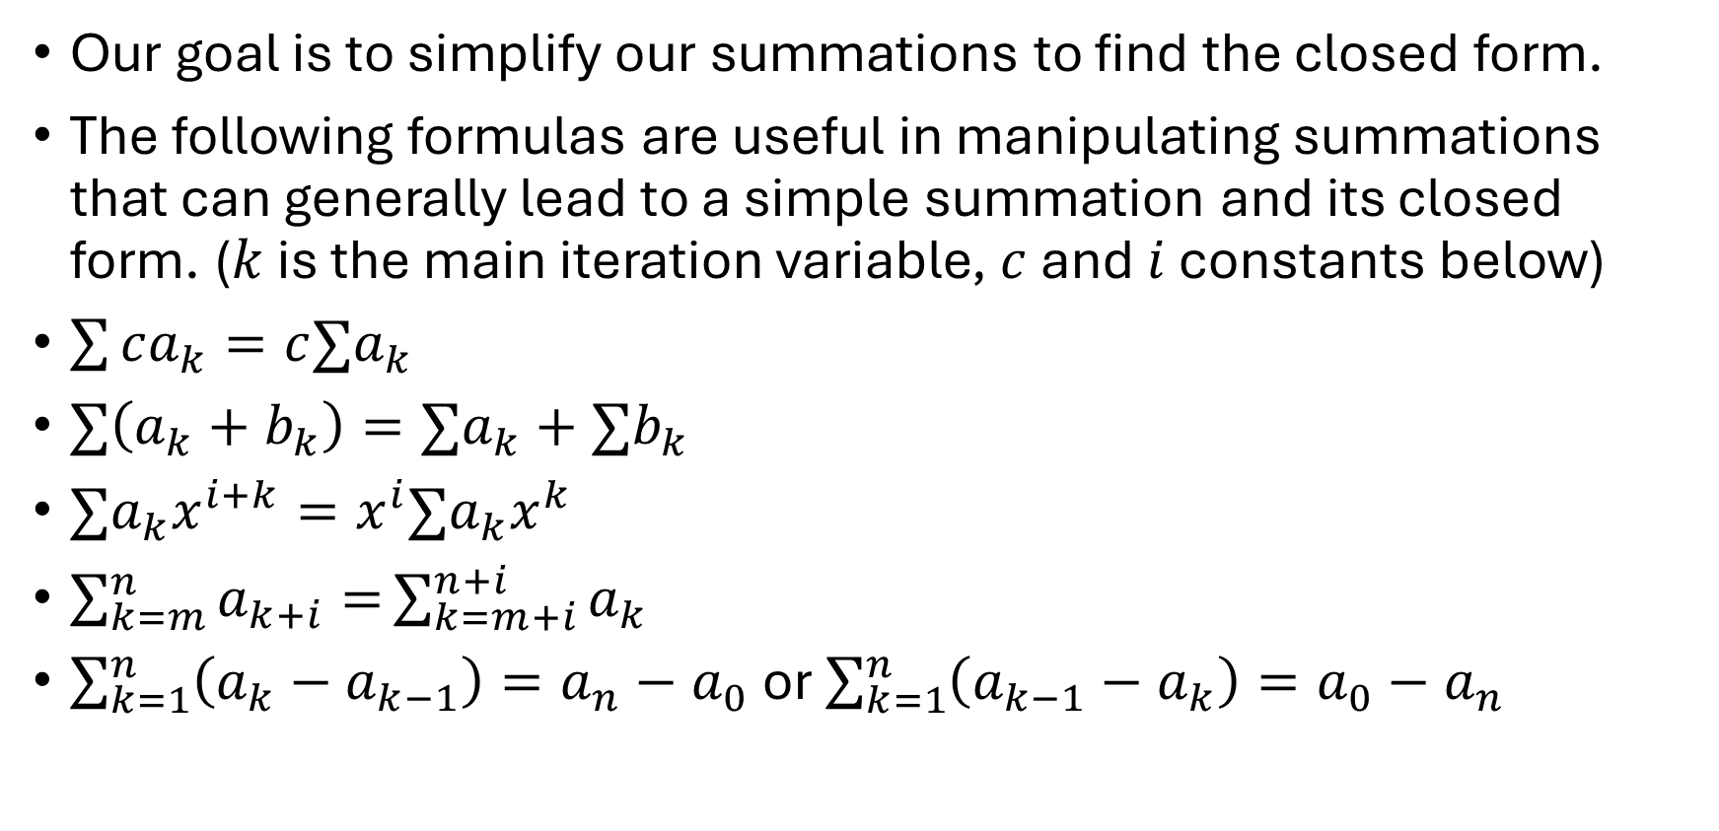
Useful Summations Manipulations
Our goal is to simplify our summations to find the closed form.
The following formulas are useful in manipulating summations that can generally lead to a simple summation and its closed form. ($k$ is the main iteration variable, $c$ and $i$ constants below)
$\sum{ca_{k}}=c∑a_{k}$
$∑\left(a_{k}+b_{k}\right)=∑a_{k}+∑b_{k}$
$∑a_{k}x^{i+k}=x^{i}∑a_{k}x^{k}$
$\sum_{k=m}^{n}{a_{k+i}=}\sum_{k=m+i}^{n+i}{a_{k}}$
$\sum_{k=1}^{n}{\left(a_{k}−a_{k−1}\right)=a_{n}−a_{0}}$ or $\sum_{k=1}^{n}{\left(a_{k−1}−a_{k}\right)=a_{0}−a_{n}}$

Slide 35

Properties of Logs
$\log_{b}{a}=c↔b^{c}=a$
$\log_{b}{a^{n}}=n\log_{b}{a}$
$\log_{a}{a^{c}}=c$
$\log_{c}{ab}=\log_{c}{a}+\log_{c}{b}$
$\log_{c}{\frac{a}{b}}=\log_{c}{a}−\log_{c}{b}$
$a^{\log_{c}{b}}=b^{\log_{c}{a}}$
Change of Base
$\log_{b}{n}=\frac{\log_{c}{n}}{\log_{c}{b}}$

Slide 36
Best-Case, Worst-Case, Average-Case Runtimes
Best-Case
Ask what conditions allow the function/algorithm to terminate in the best possible time.
Example: for searching, this happens when the searched element is found in the first index.
Worst-Case
The absolute worst possible scenario for a function to go through in solving a problem.
This (gives an upper bound and) is useful and common for theoretical computer scientist to study.
Average-Case
This is useful and common to observe from a practical perspective.
This is when input is randomly drawn from a given distribution.

