Slide 1


File I/O

Slide 2
Review from your Intro to C course
Adapted from slides by Dr. Steinberg

Slide 3
Files
In C we can access files (such as text files)
This access allows for reading and writing.
Reading – Input
Writing – Output
There is a special kind of variable in C that allows us access for text files.
File Pointers!

Slide 4


Slide 5

Type of Access we give to File Pointers
There are two basic types of access we will learn today
r for Reading – this allows the program to collect input from a text file. Think of it like scanf for collecting input from the keyboard
w for Writing – this allows the program to write output to a text file. Think of it like printf for displaying output to the monitor

Slide 6
Other Type of File I/O Access
There are other modes for FILE I/O Access besides r and w mode.
a – append mode
Adds content to the next available space in the File
r+ – both reading and writing
Acts as both r and w mode. Assumes that File exists in memory
If file does not exist then it doesn’t work
w+ – both reading and writing
Acts as both r and w mode. Doesn’t assume that File exist in memory
If it does exist already, content will be deleted by setting the length to zero bytes
If it doesn’t exist, it will create the File
a+ – both reading and writing
If file doesn’t exist, it will create it
When reading, pointer starts at the beginning of the file content
Writing to file will only be appended

Slide 7

Syntax for allowing proper access to Files

Slide 8
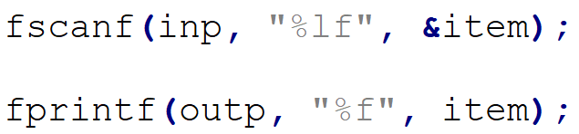
Syntax for reading and writing to File
Reading file
Writing file

Slide 9
Syntax for reading and writing to File
Does this almost look like a typical printf and scanf statement we have seen throughout the semester?
Reading file
Writing file

Slide 10
Syntax for reading and writing to File
Let’s take a closer look…
Reading file
Writing file

Slide 11
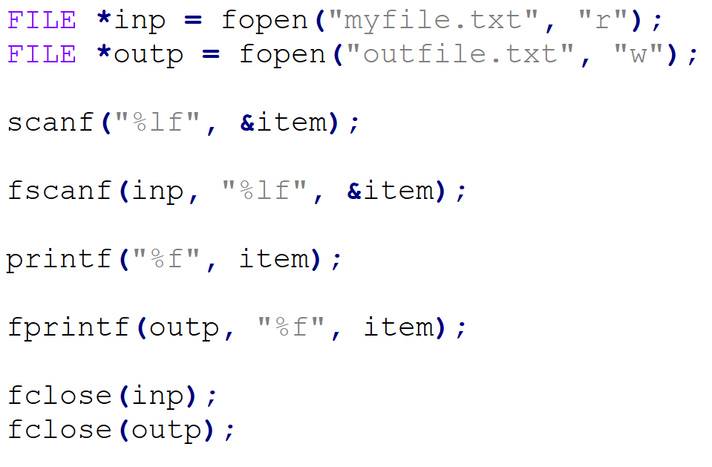
printf, scanf, fprintf, and fscanf

Slide 12
printf, scanf, fprintf, and fscanf
Notice the placeholder and variable address.
Notice the placeholder and variable.

Slide 13
printf, scanf, fprintf, and fscanf
Notice the placeholder and variable address.
The only addition is the FILE POINTER!!
Notice the placeholder and variable.

Slide 14
printf, scanf, fprintf, and fscanf
Notice the placeholder and variable address.
This is a very very small difference!!!
The only addition is the FILE POINTER!!
Notice the placeholder and variable.

Slide 15
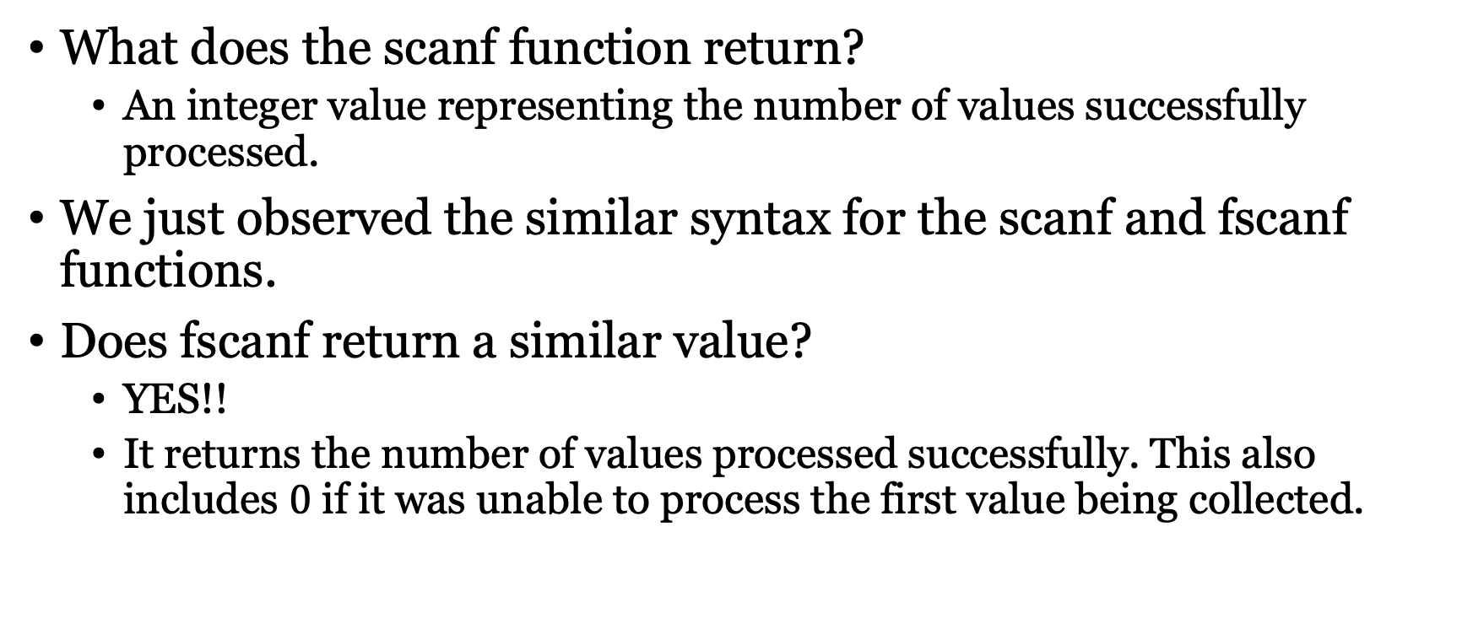
The fscanf Function
What does the scanf function return?
An integer value representing the number of values successfully processed.
We just observed the similar syntax for the scanf and fscanf functions.
Does fscanf return a similar value?
YES!!
It returns the number of values processed successfully. This also includes $0$ if it was unable to process the first value being collected.

Slide 16
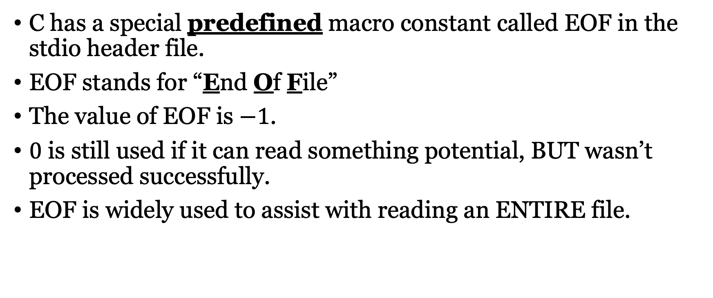
EOF Macro Constant
C has a special predefined macro constant called EOF in the stdio header file.
EOF stands for “End Of File”
The value of EOF is $−1$.
$0$ is still used if it can read something potential, BUT wasn’t processed successfully.
EOF is widely used to assist with reading an ENTIRE file.

Slide 17
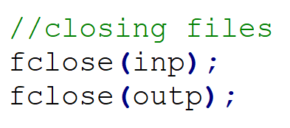
One Last Important Item with File Access
After you done accessing the file for reading or writing you must CLOSE the file.
If you forget to close the file, the program will still run BUT leaves files open with access.
It’s a common mistake beginners make. Remember after opening to close the files.

