Slide 1
Ensemble Models

Slide 2
classwise.org/student/quiz/cba24c75-0686-435b-993c-ff6782542b56

Slide 3
Project 2

Slide 4
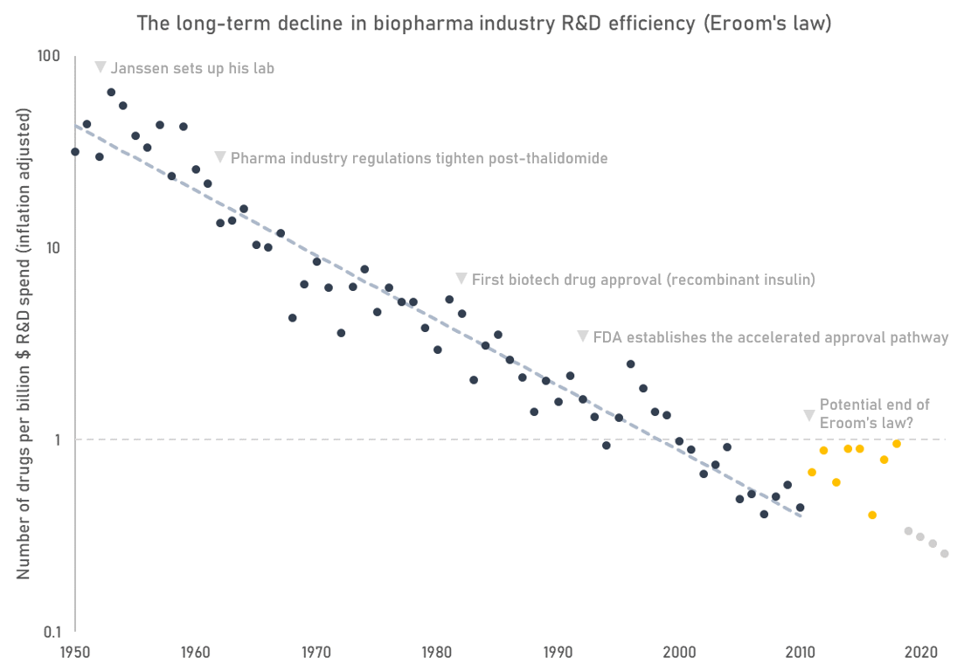
Challenges in Pharma R&D

Slide 5

Clinical Trial Outcome Prediction

Slide 6


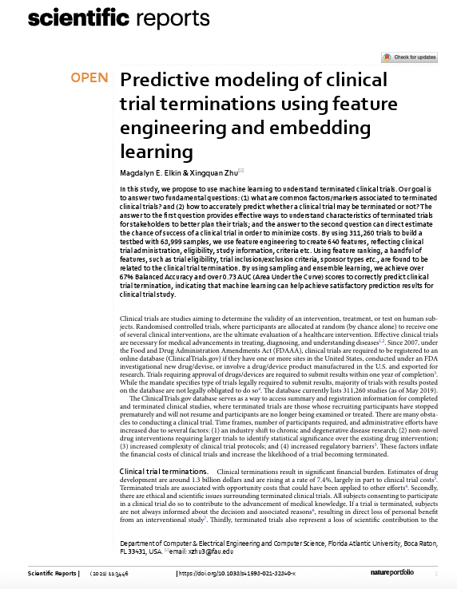
Clinical Trial Outcome Prediction

Slide 7
Project Scope
Objective: develop a model to predict probability of success of a trial
Data options:
ClinicalTrials.gov API
Download the entire dataset and manage yourself (notebook provided)
Labeling:
Use an existing labeled set of trials
Label a set yourself
Model: any algorithm

Slide 8
Deliverables
Presentation: Data used, labeling approach, data pipeline, features, models, eval approach, performance
Writeup (2-4 pages): your approach to the problem, how you applied what we learned in class
Code repo

Slide 9
Teams
Team | Student 1 | Student 2 | Student 3 | Student 4
1 | Bhargava, Yash | Goel, Mrinal | Mirji, Diya
2 | De Oliveira Neves, Jonas | Kallichanda, Sharmil Nanjappa | Tanzillo, Dominic
3 | Aher, Jaideep | Jin, Andrew | Zhao, Hanfu
4 | Degbotse, Tiffany | Mahale, Arnav | Ross, Danny
5 | Gill, Roshan | Oh, Alex | Zhou, Keming
6 | Gross, Lindsay | Jog, Atharva Ashish | Packer, Sam
7 | Guo, Yifei | Mendi, Shreya | Saju, Mike | Sreekanth, Omkar

Slide 10
Decision Trees for Classification

Slide 11
Decision Trees
Horns?
Ask a series of questions to narrow in on the label
No
Yes
# Legs?
Moose
 | Horns | Color | # Legs | Label
Animal 1 | No | Brown | 4 | Dog
Animal 2 | No | Green | 4 | Lizard
Animal 3 | No | Black | 2 | Bird
Animal 4 | Yes | Brown | 4 | Moose
2
4
Bird
Color?
Green
Brown
Lizard
Dog

Slide 12
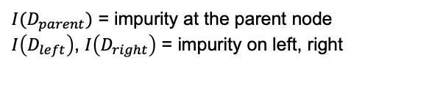

How to choose the splits
Our goal is to build the most efficient tree – the one that successfully splits the data using the minimum number of splits
We define an objective function to optimize via the decision tree
Our objective function is to maximize the Information Gain (IG) at each split in the tree:
$$IG=Decrease in impurity= I\left(D_{parent}\right)−\left(\frac{N_{left}}{N_{parent}}I\left(D_{left}\right)+\frac{N_{right}}{N_{parent}}I\left(D_{right}\right)\right)$$
${I(D}_{parent})$ = impurity at the parent node
$I\left(D_{left}\right)$, $I\left(D_{right}\right)$ = impurity on left, right
$N_{left},N_{right}$ = # examples on left, right
$N_{parent}$ = # examples at parent node

Slide 13
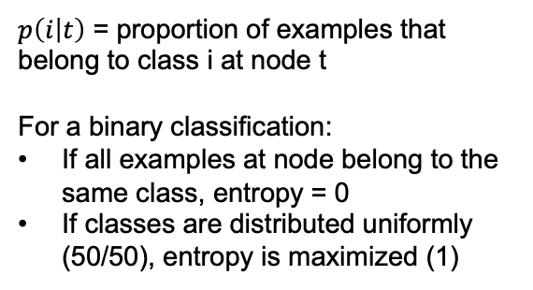
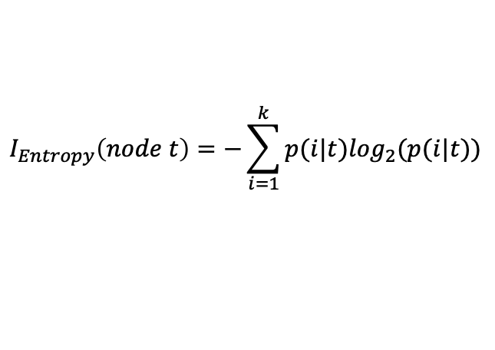
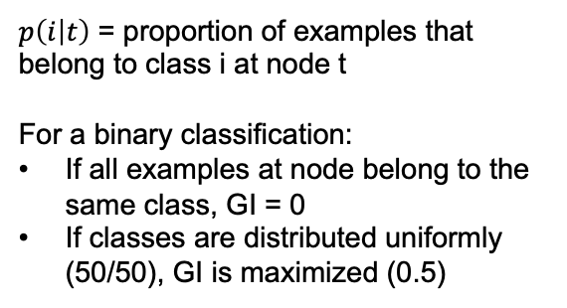
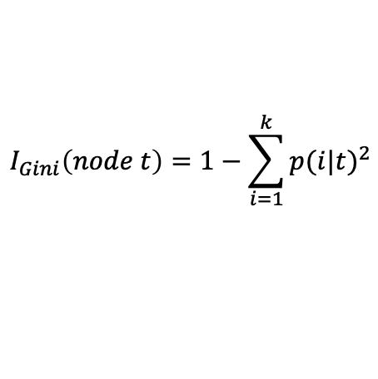
Measures of impurity
Entropy
Gini Impurity
$$I_{Entropy}\left(node t\right)=−\sum_{i=1}^{k}{p(i|t)\log_{2}(p(i|t)})$$
$$I_{Gini}\left(node t\right)=1−\sum_{i=1}^{k}{{p(i|t)}^{2}}$$
$p\left(i | t\right)$ = proportion of examples that belong to class i at node t
For a binary classification:
If all examples at node belong to the same class, entropy = 0
If classes are distributed uniformly (50/50), entropy is maximized (1)
$p\left(i | t\right)$ = proportion of examples that belong to class i at node t
For a binary classification:
If all examples at node belong to the same class, GI = 0
If classes are distributed uniformly (50/50), GI is maximized (0.5)

Slide 14
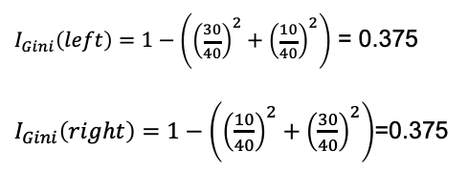


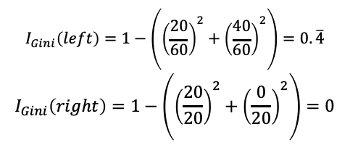


Calculating IG using Gini
Split A:
Split B:
Two possible splitting scenarios:
(40,40)
(40,40)
(30,10)
(10,30)
(20,40)
(20,0)
$$I_{Gini}\left(parent\right)=1−\left({0.5}^{2}+{0.5}^{2}\right)=0.5$$
$$I_{Gini}\left(parent\right)=1−\left({0.5}^{2}+{0.5}^{2}\right)=0.5$$
$$I_{Gini}\left(left\right)=1−\left({\left(\frac{20}{60}\right)}^{2}+{\left(\frac{40}{60}\right)}^{2}\right)=0.\overline{4}$$
$$I_{Gini}\left(right\right)=1−\left({\left(\frac{20}{20}\right)}^{2}+{\left(\frac{0}{20}\right)}^{2}\right)=0$$
$I_{Gini}\left(left\right)=1−\left({\left(\frac{30}{40}\right)}^{2}+{\left(\frac{10}{40}\right)}^{2}\right)$ = 0.375
$I_{Gini}\left(right\right)=1−\left({\left(\frac{10}{40}\right)}^{2}+{\left(\frac{30}{40}\right)}^{2}\right)$=0.375
$$IG=0.5−(\frac{40}{80}∗0.375+\frac{40}{80}∗0.375)=0.125$$
$$IG=0.5−(\frac{60}{80}∗0.\overline{4}+\frac{20}{80}∗0)=0.\overline{16}$$

Slide 15
Getting predictions from the tree
We continue splitting the tree either until we cannot split any further, or we decide to stop
The bottom nodes are called “leaves” of the tree
If a leaf has >1 examples at it, we take the majority class and label all examples at the leaf with that class prediction
(A,B)
(4,4)
Leaf 1
(3,1)
(1,3)
Leaf 2
Prediction: ”Class A”
Prediction: ”Class B”

Slide 16
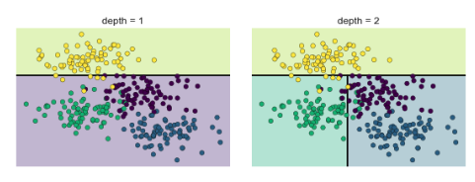
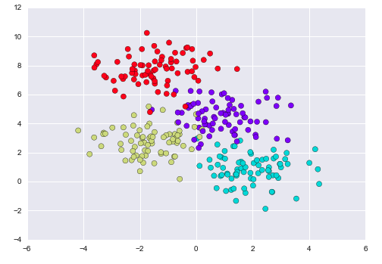
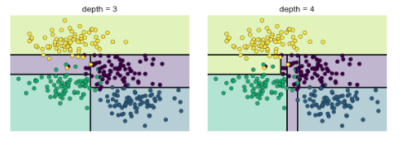
Tree depth
Depth of our tree (max # of splits of a branch) is a hyperparameter
Very shallow trees will underfit the data
Deep trees will overfit the data (every example ends up as own leaf)

Slide 17
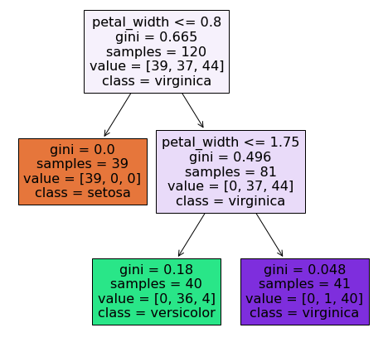
Visualizing a decision tree
We can use Scikit Learn’s plot_tree() function to visualize the tree model
This shows us the splits, the impurity values, contents of each branch, and the prediction at each node/leaf

Slide 18
Regression trees
We can also use decision tress for regression
Rather than impurity to measure split quality we use MSE of children
Rather than taking the majority vote of samples in a leaf, we calculate the mean target value of the samples
Node
Leaf 1
Leaf 2
4 samples
Target values: [5,9,6,8]
Prediction for leaf: (5+9+6+8)/4 = 7
3 samples
Target values: [4,2,3]
Prediction for leaf: (4+2+3)/3 = 3

Slide 19
Benefits & challenges of trees
Benefits
Challenges
Highly interpretable
Train quickly
Handle non-linear relationships well
Do not require scaling or one-hot encoding variables
Highly sensitive to hyperparameters (tree depth)
Very prone to overfitting

Slide 20
Decision tree Demo

Slide 21
Ensembling

Slide 22

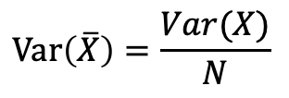
Ensembling
Goal of ensembling is to combine multiple models together into a meta-model that has better generalization performance than each individual model alone
Averaging multiple models makes the aggregate model less likely to overfit and better at generalizing to new data
Bias is same -> bias of average predictions is same as bias of the predictions
Variance is lower -> if model outputs are independent (or close), the variance of the average prediction is lower than the variance of the individual model predictions by a factor N (# of models in ensemble)
$$Var\left(\overline{X}\right)=\frac{Var(X)}{N}$$
$$X=outputs from independent models$$
$$N=\# of models sampled$$

Slide 23
Ensembling
Goal of ensembling is to combine multiple models together into a meta-model that has better generalization performance than each individual model alone
Full dataset or slices of data
Same algorithm or different
Majority vote, simple average, weighted average etc.
D₁
Model 1
Data
D₂
Model 2
Aggregation function
Predictions
…
…
D_{N}
Model 3

Slide 24



Slide 25

$1M Netflix Prize
Goal: to decrease RMSE of predicted movie ratings by >10% to under 0.8572
The only 2 teams which achieved the goal both were mergers of teams that used ensemble models
Winning model consisted of 107 models ensembled together
https://netflixtechblog.com/netflix-recommendations-beyond-the-5-stars-part-1-55838468f429
”We evaluated some of the new methods offline but the additional accuracy gains that we measured did not seem to justify the engineering effort needed to bring them into a production environment.”

Slide 26
Challenges of ensemble models
Time and compute resources to train
Computational cost of running multiple models
Decrease in interpretability

Slide 27
Random Forest

Slide 28
Bootstrap aggregating (bagging)
In bagging, we use “bootstrapped” samples from the training dataset to train each model
Bootstrapping = sampling with replacement
We select the size of each bagging subset (usually as a % of total training)
Therefore, there are some duplicates and some points left out entirely
Because each model is trained on a different set of data, their output predictions can be considered close to independent
Thus, when we use the average of their predictions we reduce the variance

Slide 29

From tree to random forest
Decision trees tend to overfit
We can grow several trees and take the majority vote
We use bagging to ensure each tree is trained on a different subset
To predict on new data, we take the majority vote / simple average
Tree 1
Data
D₁
Average
Tree 2
D₂

Slide 30
RF hyperparameters
Random Forests require tuning of several hyperparameters:
Number of trees in the forest (default = 100)
Sampling strategy for bagging
Bagging sample size as % of total rows in training set
Max % of features represented in each bagging sample
Depth of trees
Max depth (max_depth)
Minimum samples per leaf (min_samples_leaf)

Slide 31
Feature selection using RF
 | Filter Methods | Wrapper Methods | Embedded Methods
Methods | Univariate methods Information gain Correlation matrix | Forward selection Backward elimination Recursive feature elimination | Regularization methods (LASSO) Random Forest feature importance
Characteristics | Rely on characteristics of the data – do not use a model Computationally inexpensive Use before modeling as screen to remove irrelevant features | Train model on subsets of features Computationally very expensive Often unfeasible for real-world modeling | Can be run while training a model Extracts features which contribute most to training of model

Slide 32
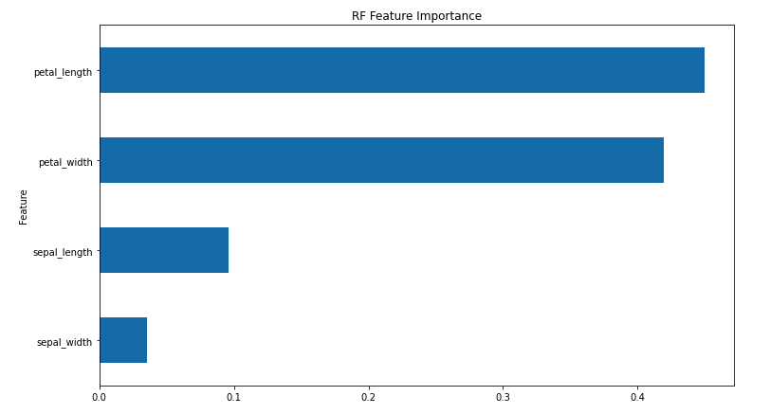
Feature Importance
We can calculate the relative importance of each feature using the random forest’s model.feature_importances_ attribute
“Feature importance” is calculated by looking at how much the nodes that use each feature reduce gini impurity on average (across each tree and then all trees in the forest), weighted by number of samples at node

Slide 33
Random Forest Demo

Slide 34
Boosting

Slide 35
What is boosting?
A form of ensemble modeling using multiple weak learners
Unlike random forests, in boosting the weak learners are related – for each successive model built, the model focuses on compensating for the mistakes of the previous models
Therefore, each successive model learns from the mistakes of the previous
The final model combines all previous weak learner models

Slide 36
Decision Stumps
x₂
Single-node decision trees
Attempt to separate data based on values of a single feature
Moderately accurate at classifying the data
x₁
X₁=0.6

Slide 37
Decision Stumps
x₂
Let’s define a different decision stump to try to correctly classify the points that we previously got incorrect
X₂=0.6
x₁

Slide 38
Decision Stumps
x₂
Close, but not quite
Let’s try one more to correctly classify the points we got wrong last time
x₁
X₁=0.9

Slide 39

Decision Stumps
x₂
None of the individual decision stumps was able to correctly predict all points
But look what happens when we combine them together
x₁

Slide 40
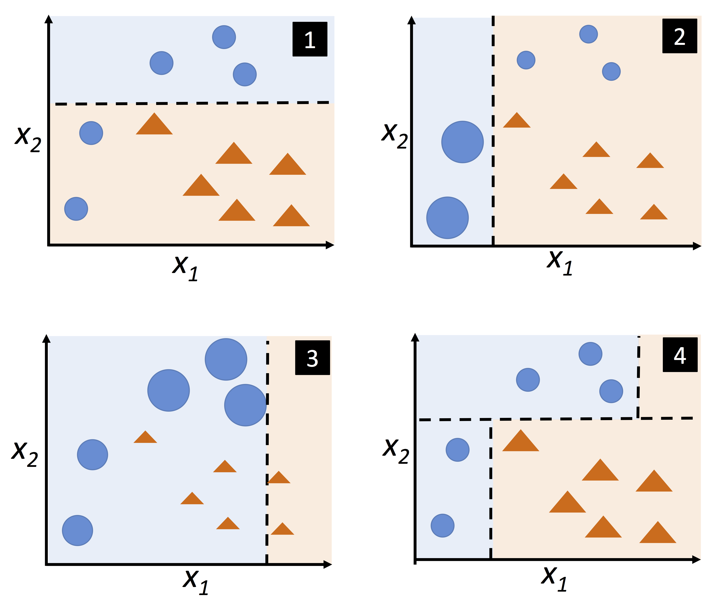
AdaBoost
We start by fitting a decision stump model on all training points
In round 2, we assign higher weight to the points misclassified in round 1 and lower weight to the points classified correctly
For round 3, we increase the weights of points misclassified in round 2, and decrease the weights of points correctly classified
We combine all 3 weak learners into an ensemble model by a weighted majority vote, weighted by classification performance
Source: Raschka, Sebastian. “Python Machine Learning”

Slide 41
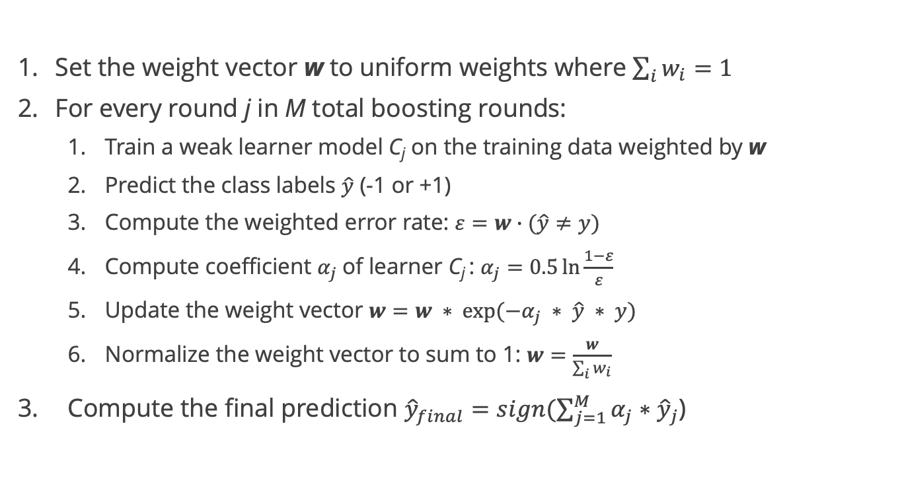
AdaBoost algorithm
Set the weight vector w to uniform weights where $\sum_{i}{w_{i}}=1$
For every round j in M total boosting rounds:
Train a weak learner model C_{j} on the training data weighted by w
Predict the class labels $\hat{y}$ (-1 or +1)
Compute the weighted error rate: $ε=w∙(\hat{y}≠y)$
Compute coefficient $α_{j}$of learner C_{j} : $α_{j}=0.5\ln{\frac{1−ε}{ε}}$
Update the weight vector $w=w ∗ exp⁡(−α_{j} ∗ \hat{y} ∗ y)$
Normalize the weight vector to sum to 1: $w=\frac{w}{\sum_{i}{w_{i}}}$
Compute the final prediction ${\hat{y}}_{final}=sign(\sum_{j=1}^{M}{α_{j}}∗$ ${\hat{y}}_{j}$)

Slide 42
AdaBoost in Scikit Learn
The default AdaBoost model uses a decision stump classifier
We can choose to use a different classifier if we wish
Our main hyperparameter is the number of weak learners (n_estimators)

Slide 43
Gradient Boosting

Slide 44
Thought exercise
We are given (x₁,y₁), (x₂,y₂)… (x_{n},y_{n}) and we want to fit a model F(x) to minimize the squared loss (SSE)
We create a model F(x) but it has some error
We find F(x₁) = 2.5 but y₁ = 2.6, and F(x₂) = 0.7 but y₂ = 0.8
How can we improve this model?
Rules:
You cannot change the model F(x)
But you can add more models

Slide 45
Thought exercise
Suppose we create an additional model G(x)
But rather than training G(x) to estimate y, we train it to estimate the errors (residuals) of model F(x)
G(x₁) = y₁ - F(x₁)
G(x₂) = y₂ - F(x₂)
…
G(x_{n}) = y_{n} - F(x_{n})
So we train G(x) on the data (x₁, y₁-F(x₁)), (x₂, y₂-F(x₂)) … (x_{n}, y_{n}-F(x_{n}))
The role of model G(x) is to compensate for the shortcomings of F(x)
If our combined model is still not good, we can add another H(x)

Slide 46


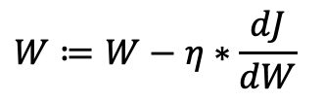
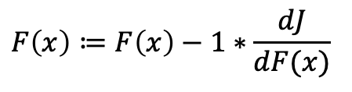
Thought exercise
Our new model is now F(x) + G(x)
If our combined model is still not satisfactory, we can add another H(x)
H(x) will attempt to model the residuals of F(x) + G(x) --> y - (F(x) + G(x) )
This is actually very similar to gradient descent:
$$F\left(x\right)≔F\left(x\right)+G\left(x\right)$$
$$F\left(x\right)≔F\left(x\right)+(y−F\left(x\right))$$
$$F\left(x\right)≔F\left(x\right)−1∗\frac{dJ}{dF(x)}$$
$$W≔W−η∗\frac{dJ}{dW}$$

Slide 47
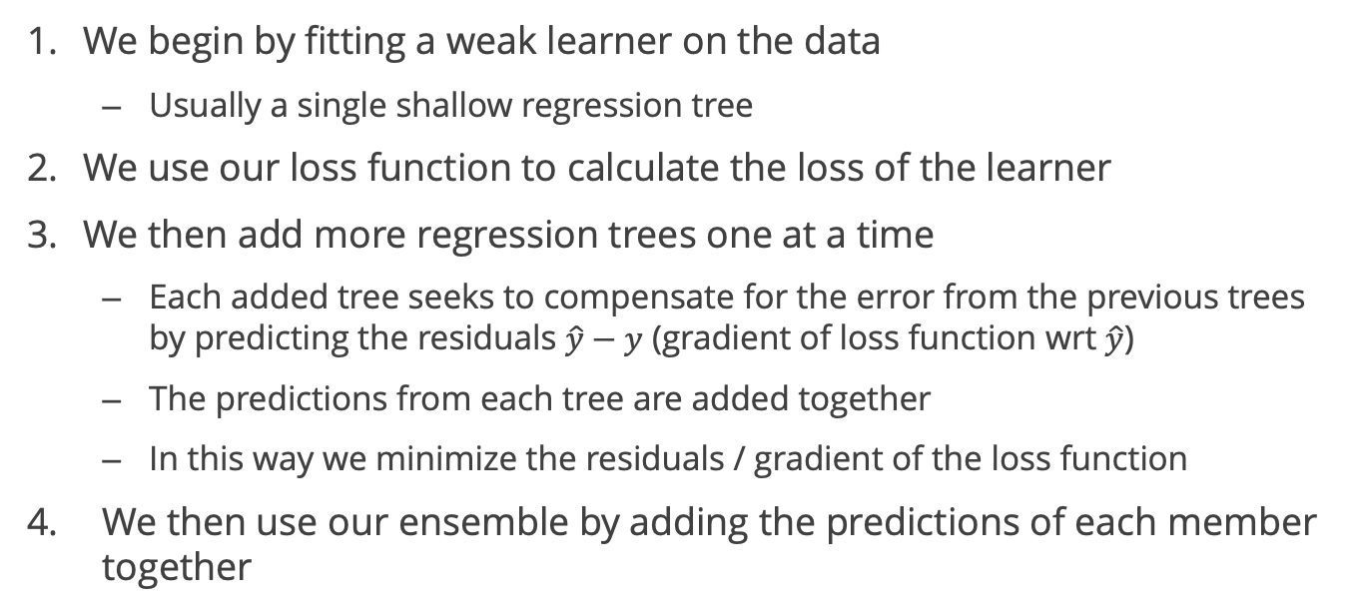
Gradient Boosting
We begin by fitting a weak learner on the data
Usually a single shallow regression tree
We use our loss function to calculate the loss of the learner
We then add more regression trees one at a time
Each added tree seeks to compensate for the error from the previous trees by predicting the residuals $\hat{y}−y$ (gradient of loss function wrt $\hat{y}$)
The predictions from each tree are added together
In this way we minimize the residuals / gradient of the loss function
We then use our ensemble by adding the predictions of each member together

Slide 48
Gradient boosting
Gradient boosting also works for classification by modeling the probabilities of each class and adding models to compensate for errors
Gradient boosting can quickly overfit
Methods to reduce overfitting:
Constrain the depth of each tree in the ensemble
Multiply the predictions of subsequent trees by a “learning rate” to reduce the influence of each tree and allow for more trees to be added
Use subsampling from rows and columns for each tree rather than the entire dataset (“stochastic gradient boosting”)

Slide 49
Boosting Demo

Slide 50
Boosting vs. Bagging
 | Bagging | Boosting
Sampling method for each weak learner | Random subset with replacement | Uses full training dataset
Relationship between weak learners | Close to independent | Models learn from mistakes of previous
Ensembling method | Simple average | Weighted average or additive combination
Training efficiency | High (easy to parallelize) | Low (trained in series)
Performance | Usually good | Sometimes better
Likelihood to overfit | Low | Higher

Slide 51
Ensembles – Conclusion
Ensembled models can be very powerful, and are commonly used in the real world as well as in ML competitions
Bagging and boosting are two of the most common ensembling techniques
However, ensembling increases the computational complexity relative to individual models
We must decide if the increased computational costs are worth the improvement in performance

