Slide 1


Demonstration:
WSO2 Platform Integration
Amal Gunatilake

Slide 2
Agenda
Demo scenario
Message mediation (routing)
Message transformation
Protocol transformation
Condition evaluation
WSO2 connector store
Error handling (Interface switching)
Debugging
Auditing & Monitoring
Analytics
API security (API Manager)
APIM with IS as Key Manager SSO
Q&A

Slide 3
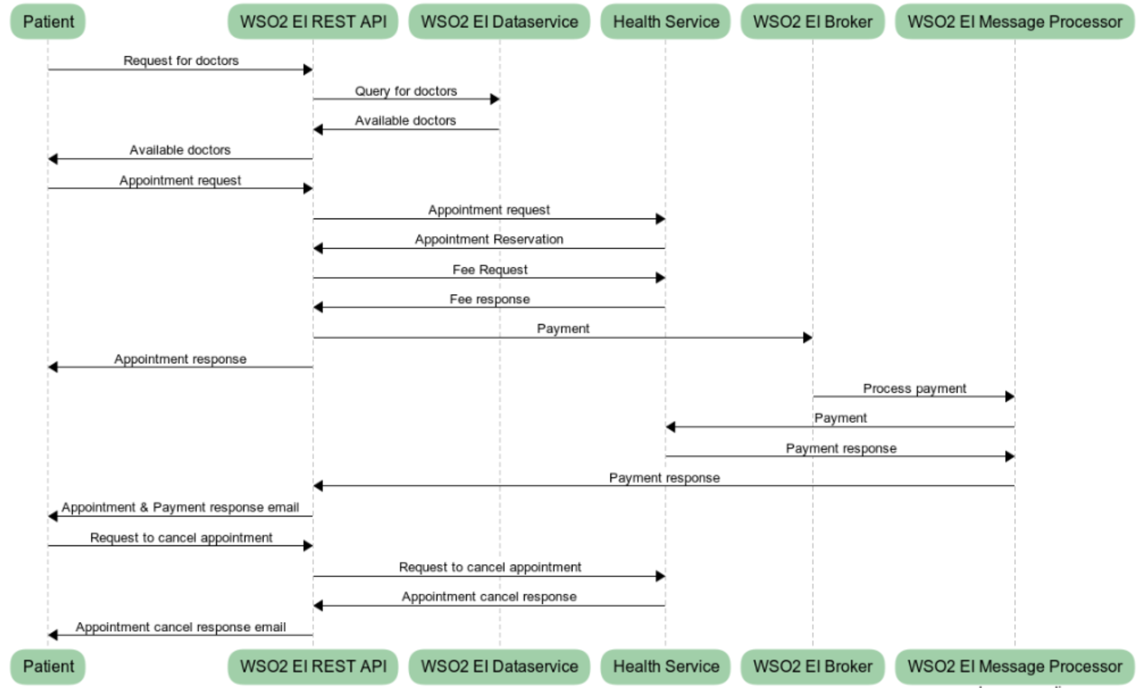
Demo Scenario

Slide 4
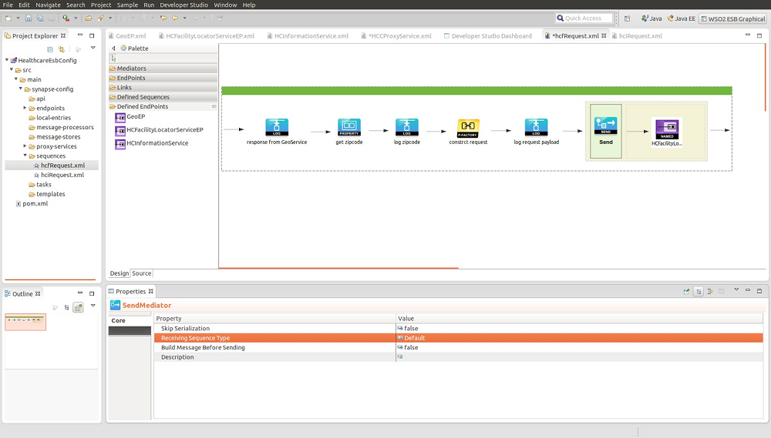
WSO2 Developer Studio
https://wso2.com/products/developer-studio/

Slide 5
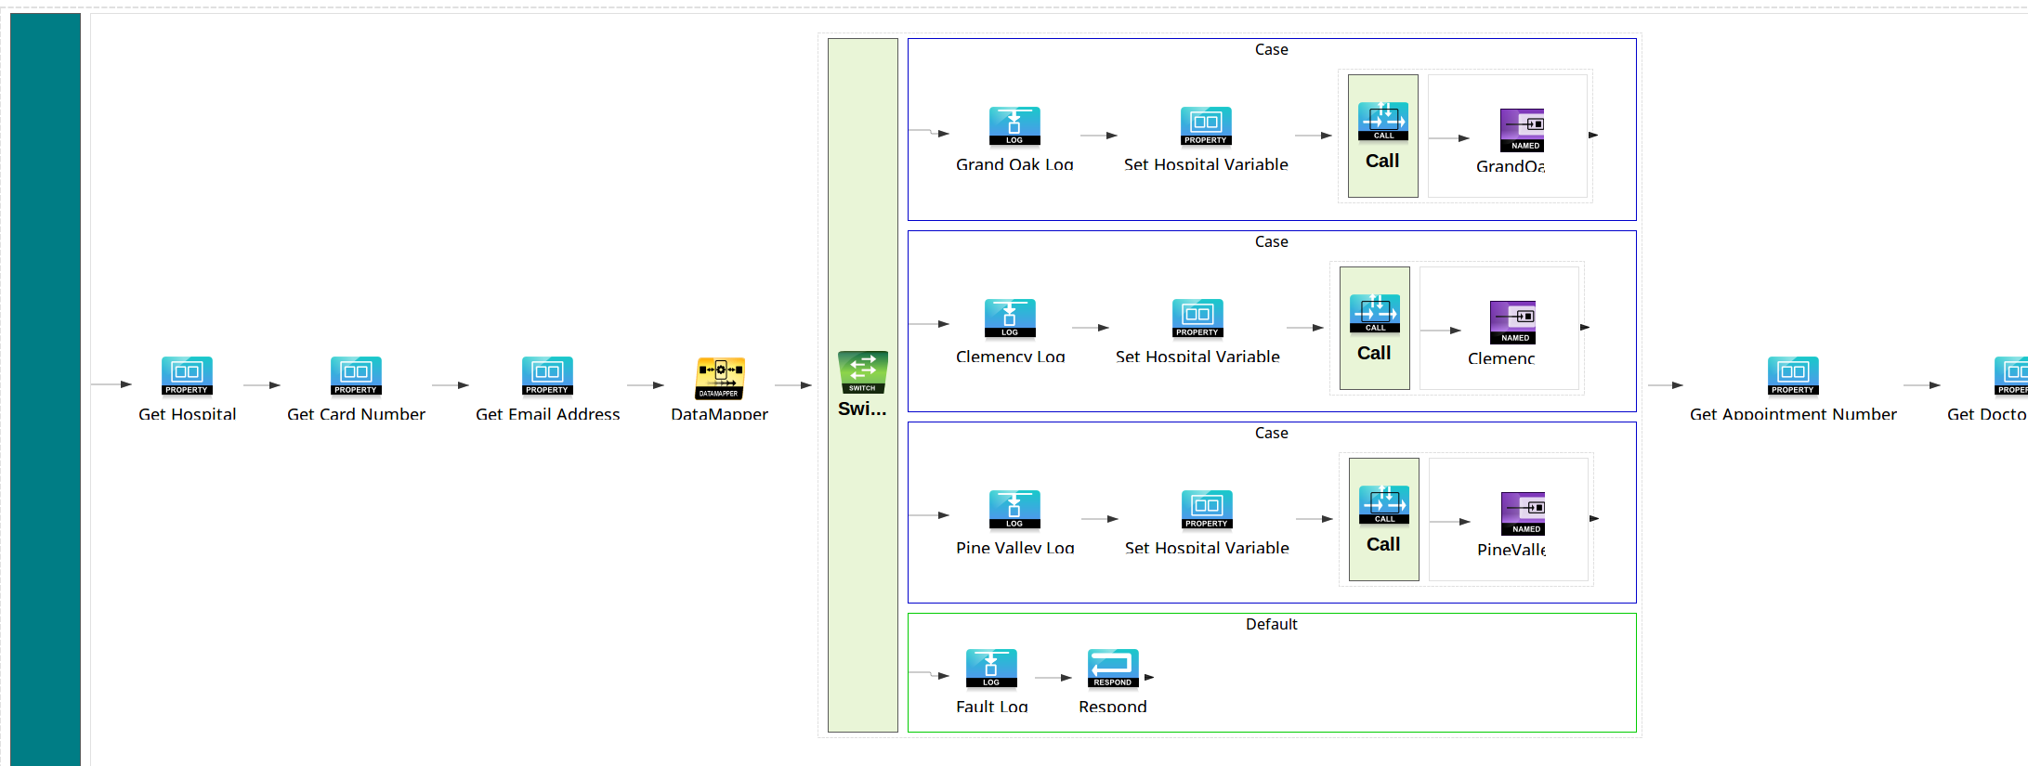
Message mediation
https://docs.wso2.com/display/EI611/Mediators

Slide 6
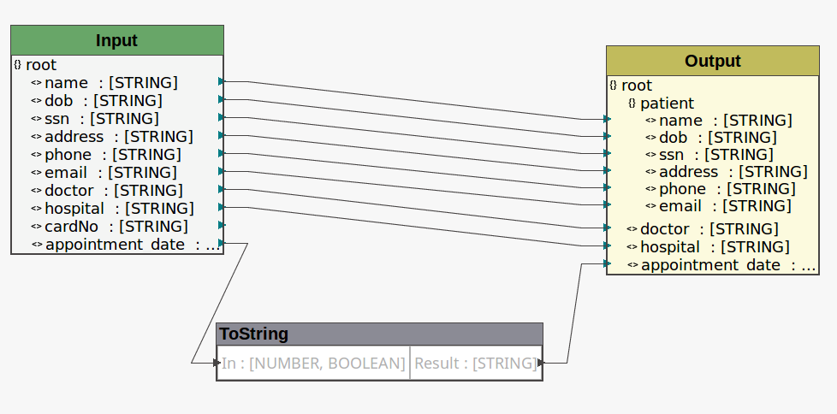
Message transformation
Datamapper
Payload Factory
XSLT
Smooks Mediator
https://docs.wso2.com/display/ei611/Data+Mapper+Mediator

Slide 7
Protocol transformation
REST
SOAP
VFS
FTP, etc.
https://docs.wso2.com/display/EI611/Using+REST+with+a+Proxy+Service#UsingRESTwithaProxyService-RESTClientandSOAPService

Slide 8
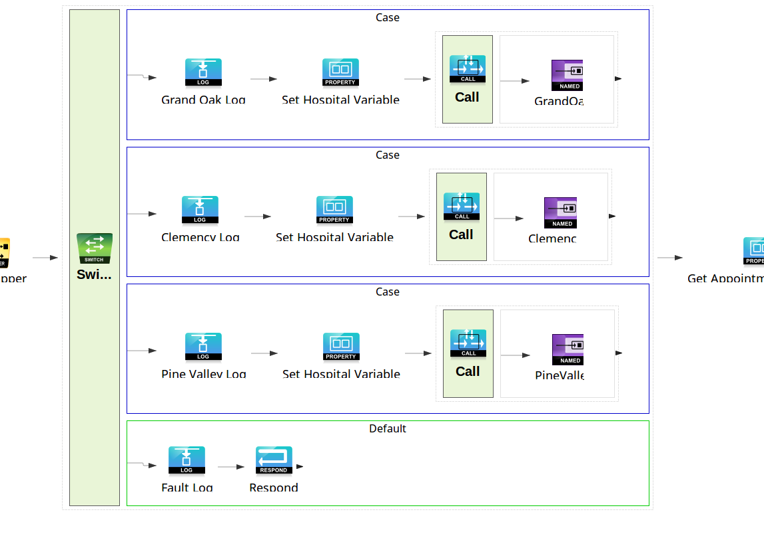
Condition Evaluation

Slide 9
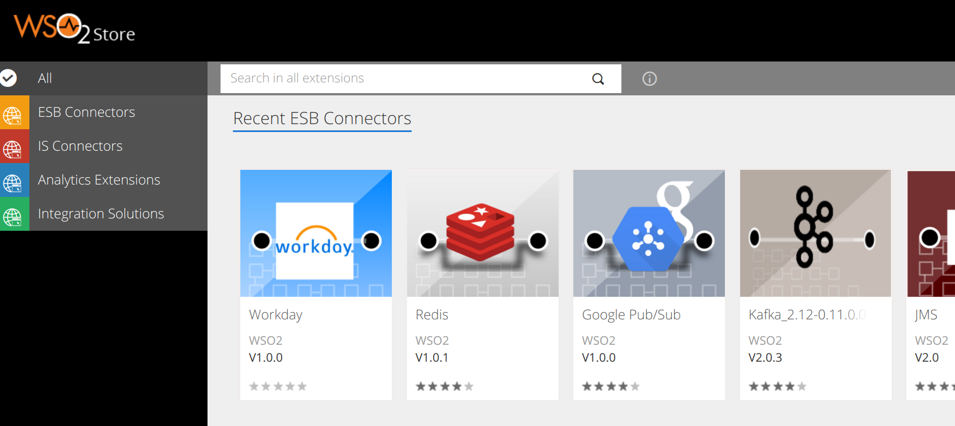
WSO2 Connector Store
https://store.wso2.com
Demo: Gmail

Slide 10
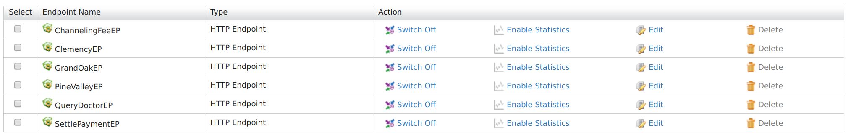
Error handling - Interface switching
Guaranteed message delivery with WSO2 ESB message store and message forwarding processor
Endpoint Switching

Slide 11
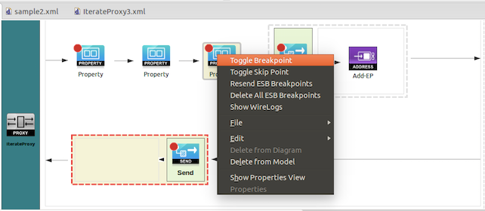
Debugging
https://docs.wso2.com/display/EI600/Debugging+Mediation

Slide 12
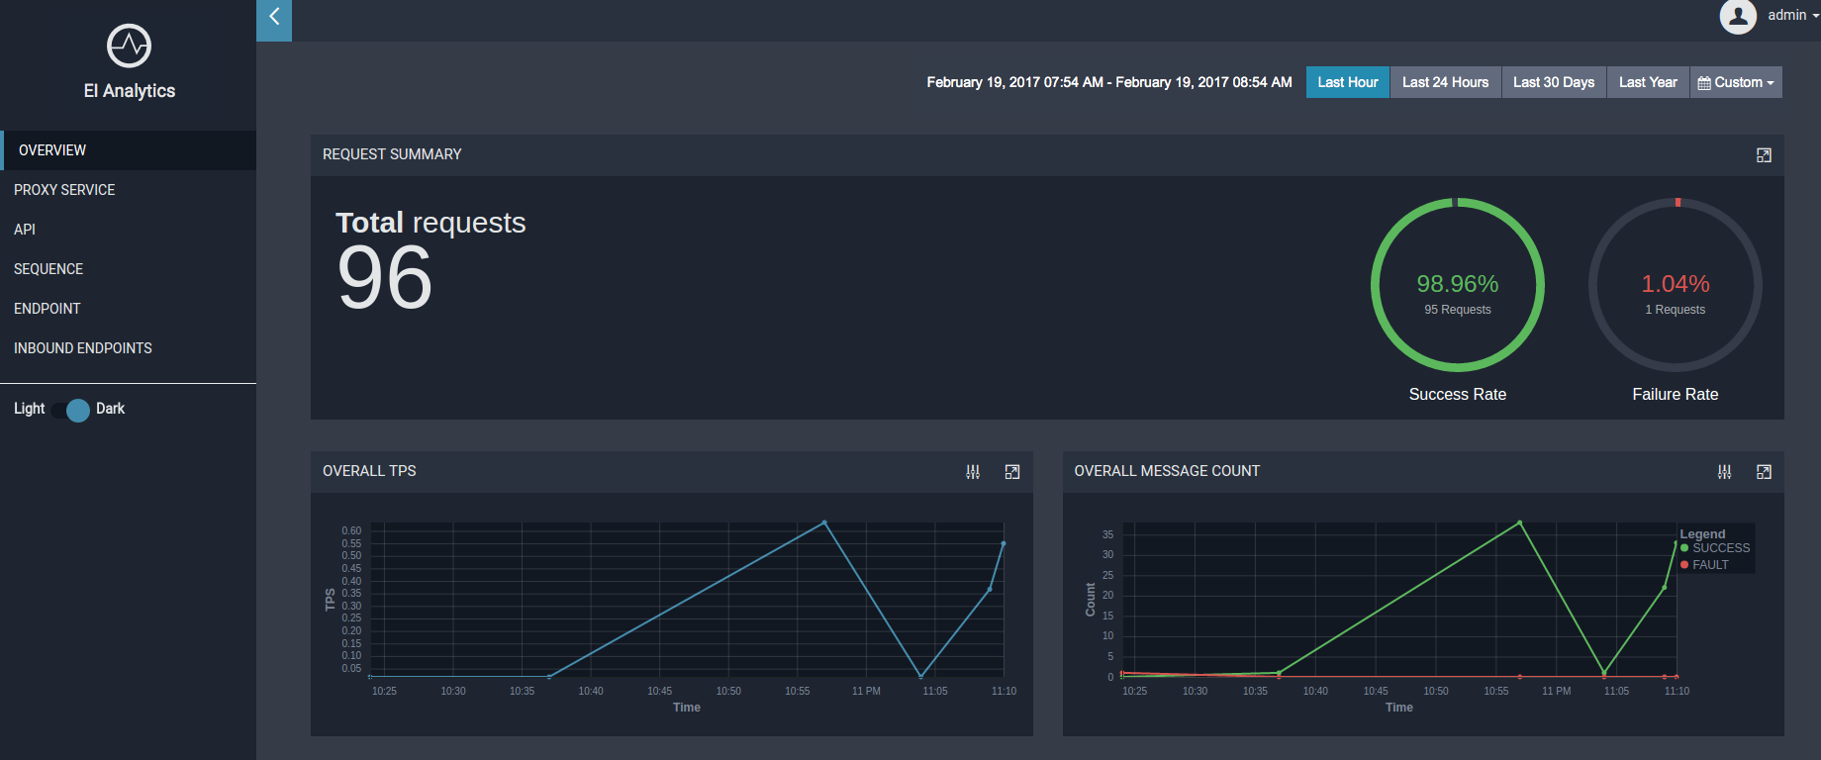
Auditing & Monitoring (Analytics)

Slide 13
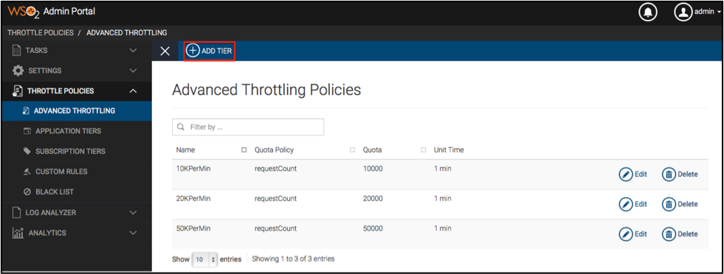
API Security
WSO2 API Manager 2.1.0

Slide 14
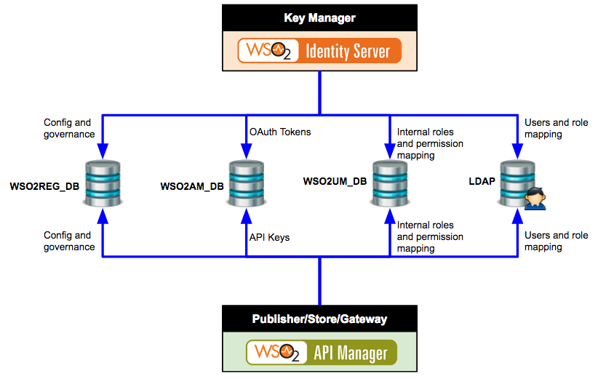
APIM with IS as Key Manager SSO

