Slide 1
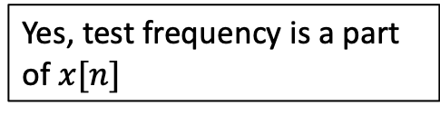
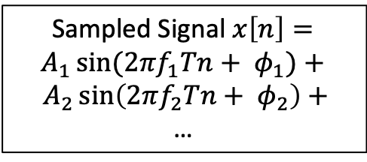
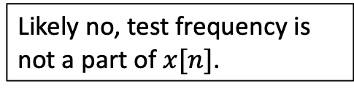
Inner Product of
Two Signals
Non-Zero
Yes, test frequency is a part of $x[n]$
Sampled Frequency to Test
Sampled Signal $x\left[n\right]=A_{1}\sin{(2πf_{1}Tn+ φ_{1})}+ A_{2}\sin\left(2πf_{2}Tn+ φ_{2}\right)+$
…
Zero
Likely no, test frequency is not a part of $x[n]$.

Slide 2
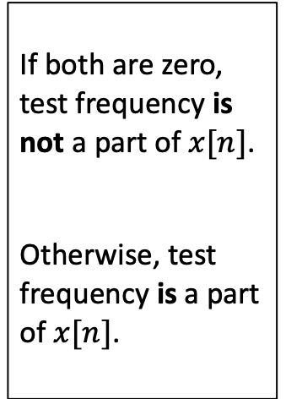
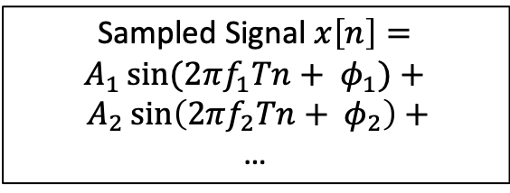
Inner Product of
Two Signals
Non-Zero
Sampled Cosine Frequency to Test
If both are zero, test frequency is not a part of $x[n]$.
Otherwise, test frequency is a part of $x[n]$.
Zero
Sampled Signal $x\left[n\right]=A_{1}\sin{(2πf_{1}Tn+ φ_{1})}+ A_{2}\sin\left(2πf_{2}Tn+ φ_{2}\right)+$
…
Inner Product of
Two Signals
Non-Zero
Sampled Sine Frequency to Test
Zero

Slide 3
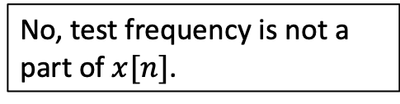
Inner Product of
Two Signals
Non-Zero
Sampled Complex Exponential to Test
Yes, test frequency is a part of $x[n]$
Sampled Signal $x\left[n\right]=A_{1}\sin{(2πf_{1}Tn+ φ_{1})}+ A_{2}\sin\left(2πf_{2}Tn+ φ_{2}\right)+$
…
Zero
No, test frequency is not a part of $x[n]$.

