Slide 1
To Rerack the Spectrum Library, Three programs will be run.
SpecReRack1
Moves 50 ul to Storage plate
ABGene0781_384Storage
Spec Aliquot
    Dispenses 10 ul from storage plate to three screening plates
ABGene1055_384
Dispenses 3 ul into Plate with 72 ul of DMSO for diluted plate
SpecRerack 70 ul
Moves the remaining Chemical Library to Storage plate.

Slide 2
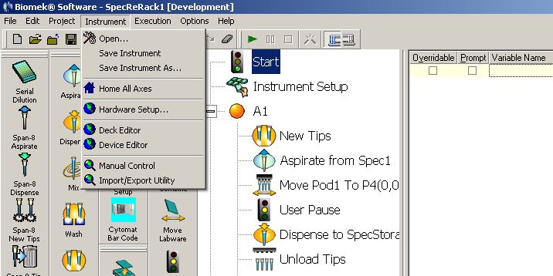
Turn On instrument and hotel.
Check Deck of instrument and remove all tip boxes and plates ect.
Open Biomek Software
Be sure gripper UP
Home all axes.

Slide 3
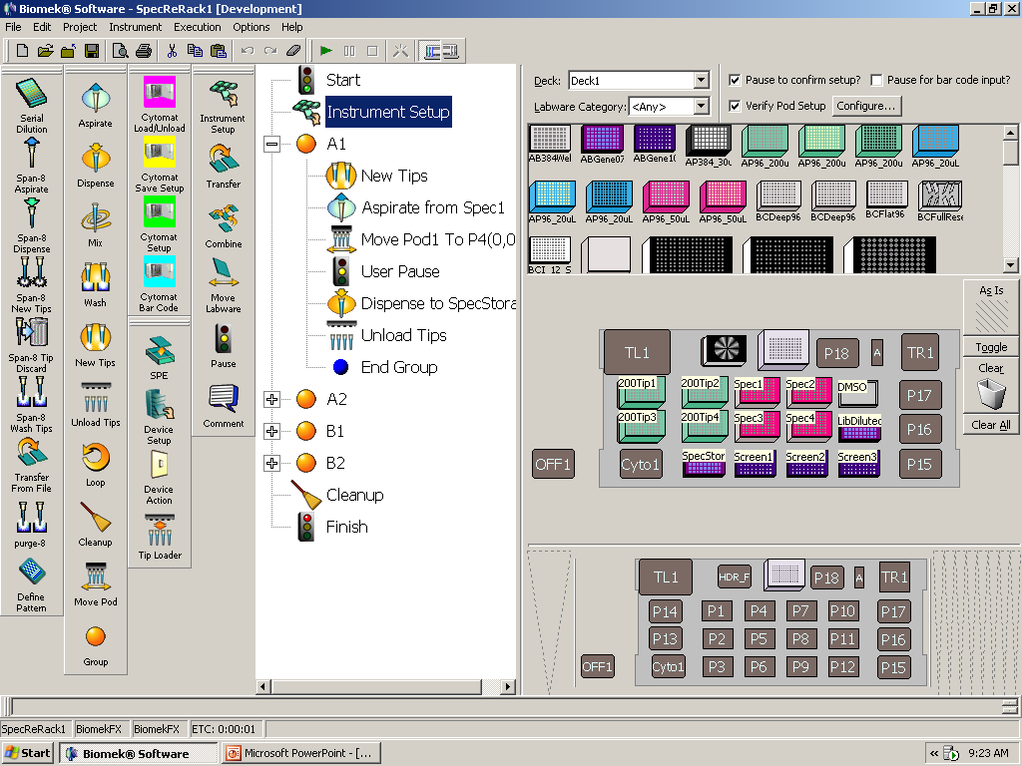
Thaw libraries (about 1 hour)
Centrifuge briefly.
Open SpecReRack1
Set up Deck (red arrow)
Hit start (Blue Arrow)

Slide 4
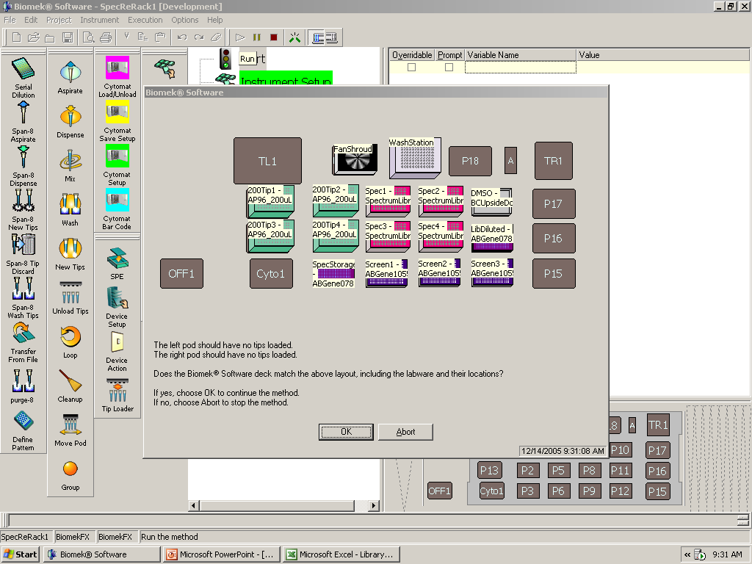
Check deck again
All errors in deck set up will crash the robot. So check Again!
Run program

Slide 5
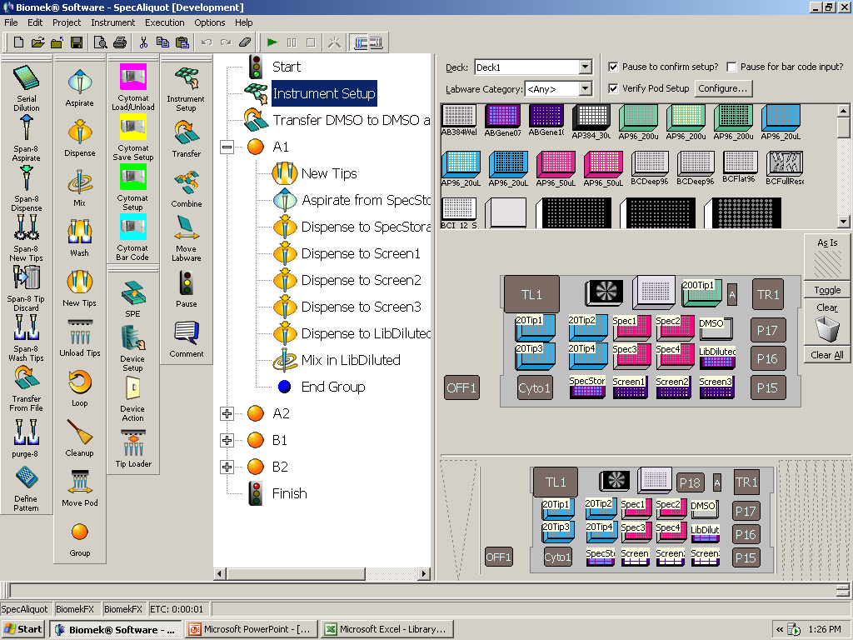
Close program
Remove used tips
Spin Storage plate to remove bubbles
Open Spec Aliquot
Set up deck

Slide 6
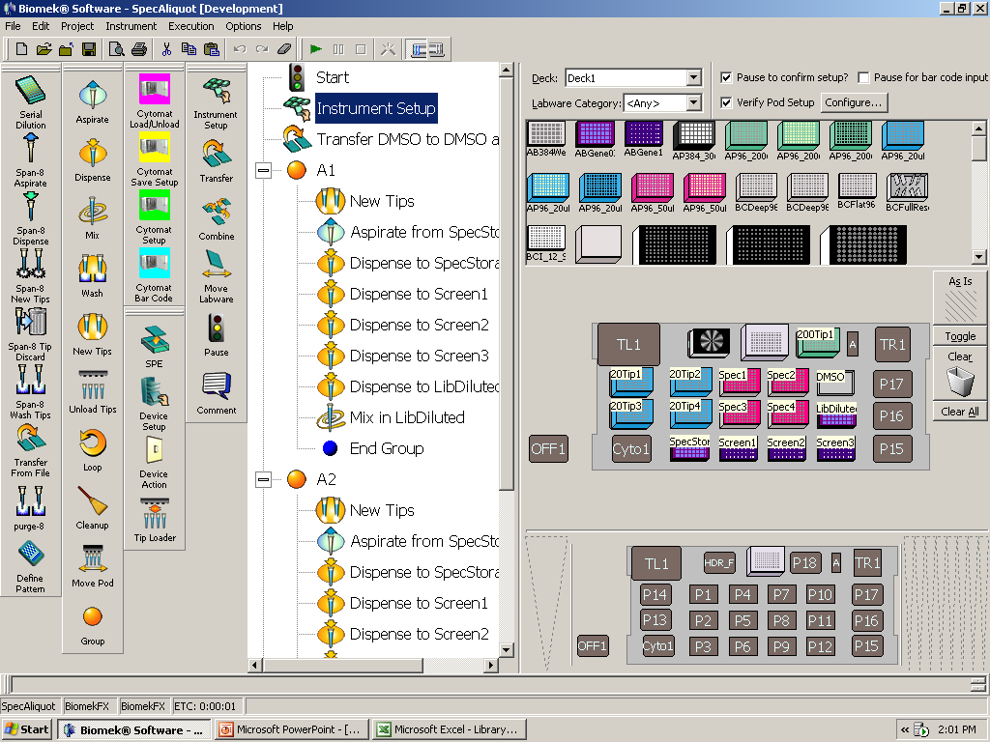
Run Spec Aliquots program
Check deck again when prompted

Slide 7
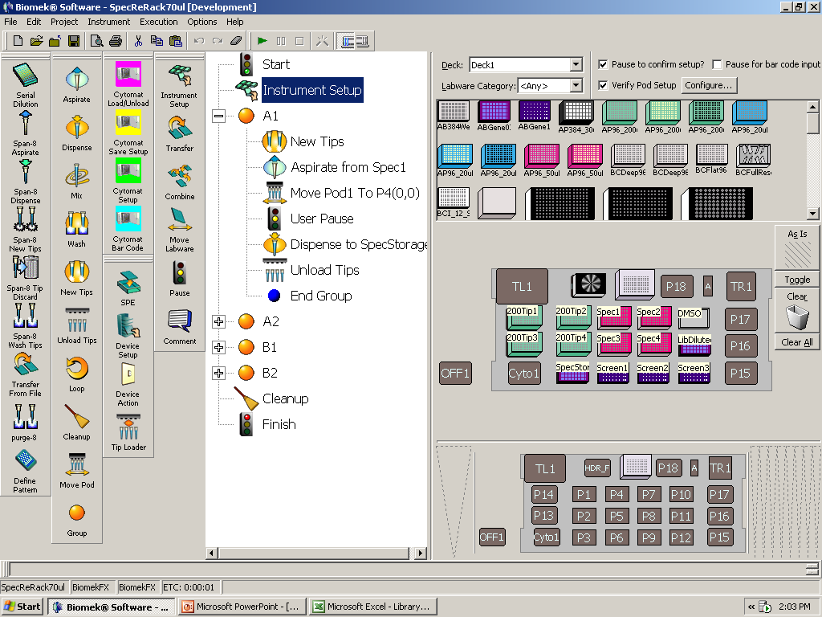
Run SpecRerack 70 ul
Quick spin for all plates to put all chemicals at bottom of well.

