Slide 1


SMBHD
Mission Command: Real-Time Hero Deployment in Salesforce
Technical Architecture and Implementation Demo
Andrew Hood
January 20th, 2026

Slide 2


Justice Alliance Needs
An increase in global threats necessitates rapid superhero response
Current process: standard SF record page
User pain points: too slow for real-time crisis management
Stakeholder needs: a new, visual, “Mission Command” interface
  Custom console that should live on a mission record page
  Must allow mission leaders to visualize available roster of heroes
  Must allow leaders to quickly deploy heroes to current mission
  UI must update immediately
  “Feel native”

Slide 3
Functional Requirements
Display hero roster using visual cards (not a standard data table)
Display each hero card in a responsive grid
Allow filtering by power type
Injured superheroes should be excluded from roster
Visual status should indicate availability
  If available: show green icon
  If on mission: show red icon
Deploy heroes with a single click
Enforce maximum of 3 heroes per mission
UI should be immediately responsive – no page refresh*

Slide 4
Technical Requirements
Should feel like part of the “Native” Lightning Experience
Apex Trigger on Mission Assignment object
Scalable code
  Apex logic is bulkified
  Design patterns
  Apex design pattern best practices (e.g. TriggerHandler)
  Test-Driven Development
UI should be immediately responsive – no page refresh*
Parse error messages to make them user-friendly
Must work in the UI and via the API

Slide 5
Clarifying Questions
Do missions have a specific start and end date (or dateTime)? e.g. Should missions be able to be scheduled?
What should happen to mission assignment records when their respective mission is marked as complete? Should we distinguish between mission assignments that are scheduled vs complete for reporting purposes?
Can a hero be assigned to multiple missions simultaneously (assuming no time conflicts), or is it strictly one "active" mission at a time?
What determines when a hero transitions from "Injured" back to "Available"? Is this process a manual update, or can I implement a recovery date field?
What Salesforce license(s) does the Justice Alliance hold?

Slide 6
Answers and Assumptions
Do missions have a specific start and end date (or dateTime)? e.g. Should missions be able to be scheduled?
What should happen to mission assignment records when their respective mission is marked as complete? Should we distinguish between mission assignments that are scheduled vs complete for reporting purposes?
Can a hero be assigned to multiple missions simultaneously (assuming no time conflicts), or is it strictly one "active" mission at a time?
What determines when a hero transitions from "Injured" back to "Available"? Is this process a manual update, or can I implement a recovery date field?
What Salesforce license(s) does the Justice Alliance hold?
No – keep it simple.
Let records accumulate; possibly export to data warehouse for completed missions in a future enhancement via Apex batch job
Strictly one active mission at a time
This process is a manual update.
Best licenses available.
Notes:
This helped to directly shape the schema and validation logic

Slide 7
Architectural Design Considerations
Declarative-first implementation solutions I considered:
Matching Rules and Duplicate Rules for duplicate prevention
Roll-up Summary & Validation Rule for team capacity (max 3 heroes)
Record-triggered flow for status updates
Master-Detail relationship for the junction object
However, after reviewing these options, I realized some Salesforce limitations that necessitate an Apex-heavy approach.

Slide 8
Limitation #1 – Matching Rules
Plan: Create a Matching Rule on Mission_Assignment__c matching on both Superhero__c and Mission__c
Problem: Salesforce limits Custom Object Matching Rules to one lookup field
Result: Cannot deploy Matching Rule or dependent Duplicate Rule
Fix: Move uniqueness validation to Apex: before insert

Slide 9
Limitation #2 – Roll-Up Summary Timing
Plan: Create Hero_Count__c field on Mission Assignment object and enforce logic using a Validation Rule
Problem: Order of Execution problem:
  Before triggers run
  Validation rules run (reading stale count of heroes!)
  Record saves
  After triggers run
  Roll-Up recalculates (too late!!)
Result: Failure scenario
  Mission has 3 heroes
  Validation Rule reads 3 (passes)
  Allows 4th hero to be added
  Roll-Up summary updates to 4 after database commit
Fix: Aggregate SOQL query in before insert trigger for real-time count

Slide 10
Limitation #3 – Why Not Flow?
Plan: After Apex creates Mission Assignment, an after-save Flow could update hero status to “On Mission”
Problem: Flow runs in a separate execution context
  When Apex returns values to LWC, Flow may not have committed
  UI might show stale information until manual refresh
Result: Conflicts with the requirement that UI must update instantly
Fix: Handle this in Apex to ensure the same execution context runtime, we can control when this data is manipulated

Slide 11
Limitation #4 – Master-Detail Row Locking
Plan: Use Master-Detail relationships for the junction object
Problem: M-D relationships lock the parent record during child DML
  Two users deploy to same mission simultaneously
  UNABLE_TO_LOCK_ROW errors
  Do not want to implement manual locking and unlocking of records
Result: UI failures during peak crisis response, the worst possible time
Fix: Use lookup relationships: no implicit parent locking

Slide 12
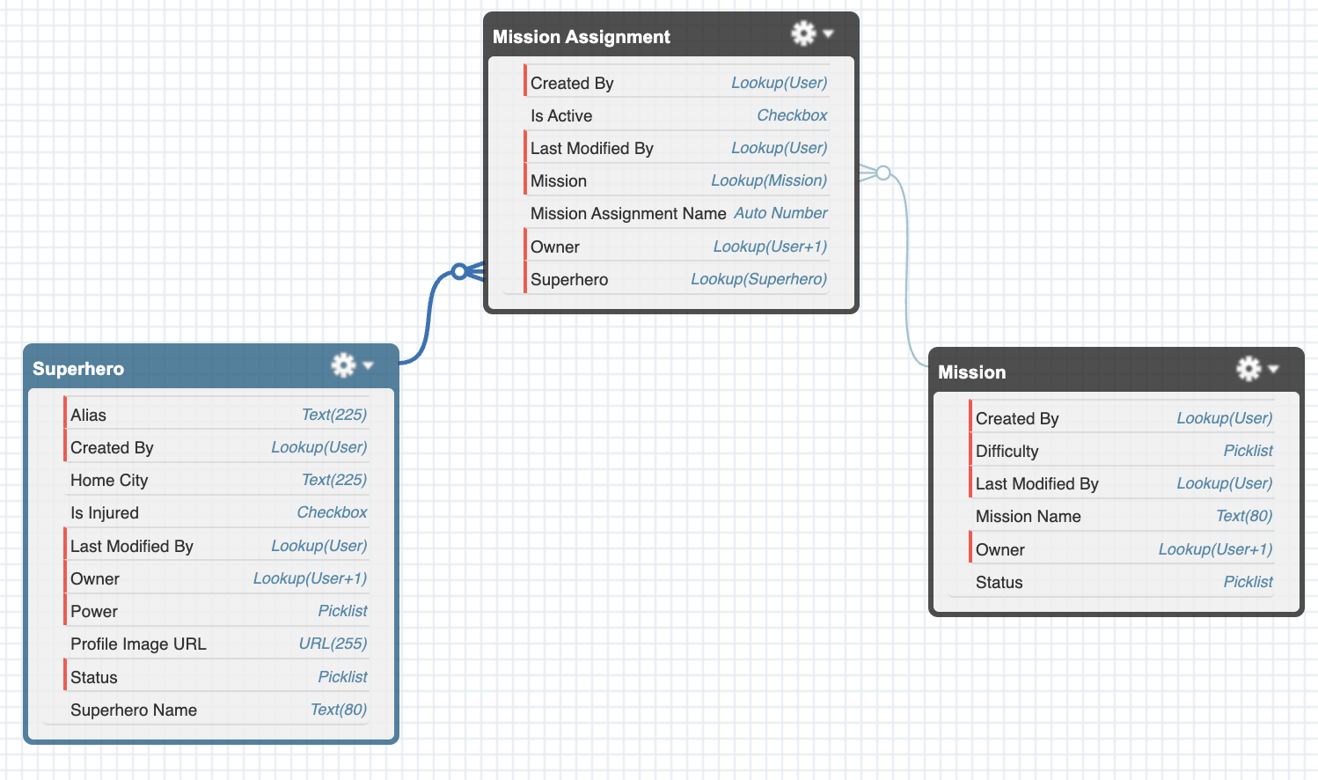
Schema Design
Lookups > Master-Detail for the junction object
  No row locking
  Keep historical records
  Independent sharing
  Flexibility in reparenting
  Tradeoffs:
    Must handle cascade delete
    Manual sharing
Notes:
This helped to directly shape the schema and validation logic

Slide 13
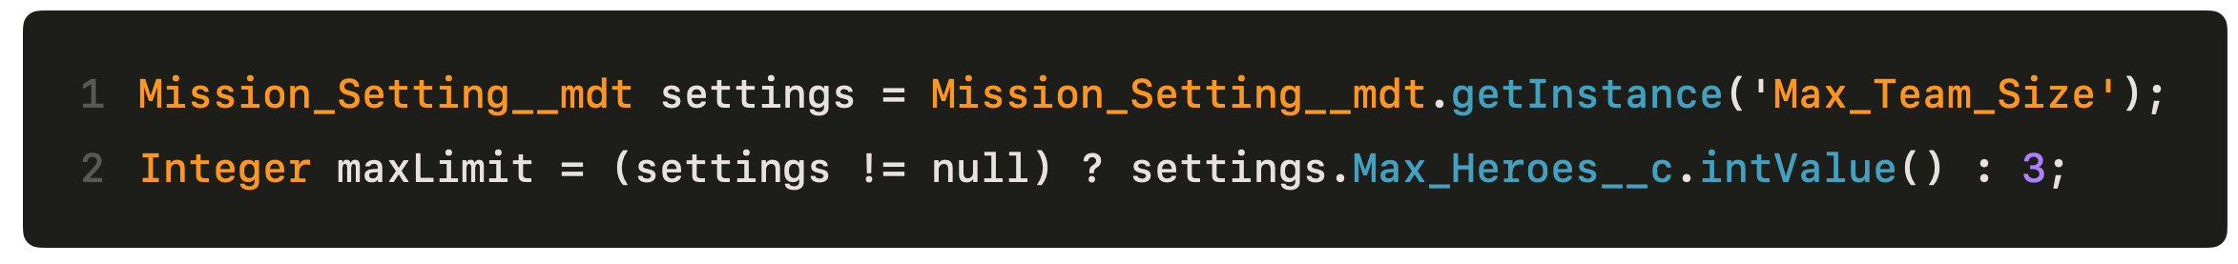
Custom Metadata
Hard-coding the maximum hero team size to 3 requires deployment to change
Easy win - use custom metadata type and custom field to set the team size
Admins can now adjust the maximum team size without deployment

Slide 14
Lightning Web Component Design
missionCommand
Parent-Child Architecture:
  Parent: missionCommand
  Child: heroCard
Data flow
  Parent owns state, passes to child via @api decorator
  @wire service allows for real-time data binding to:
    missionId
    powerFilter
  refreshApex after hero deploy/recall
Event flow
  Children dispatch events
  parent handles actions
Power Filter
Deployed: 2/3
heroCard
Name
Image
Status
….
heroCard
Name
Image
Status
….
…
Deploy
Recall
…
Lightning Web Component Wireframe
Notes:
This helped to directly shape the schema and validation logic

Slide 15
Apex Architecture
Mission Assignment Trigger
(router only, no logic)
before insert → Handler
after insert → Handler
after delete → Handler
delegates to
Mission Assignment Handler
(Trigger Handler)
+ handeBeforeInsert(List)
+ handleAfterInsert(List)
+ handleAfterDelete(List)
Separation of Concerns:
  Trigger – routes context to trigger handler; contains no logic
  Handler – extracts data, orchestrates flow
  Service Layer – Contains all business rules
  Controller – serves the LWC
  Wrapper – inner class in controller helps serve data to LWC in consistent format
Mission Assignment Service
(Service Layer)
+ validateAssignments(List)
+updateHeroStatuses(Set, String)
calls
calls
Mission Command Controller (LWC Apex Controller)
+ getMissionDetails(Id)
+ getPowerOptions()
+ getHeroesForMission(Id, String)
+ deployHeroToMission(Id, Id)
+ recallHeroFromMission(Id, Id)
(inner) HeroWrapper
Notes:
This helped to directly shape the schema and validation logic

Slide 16
Logic Deep Dive
The following sequence diagrams display:
Hero deploy flow
Hero recall flow
Deploy blocked flow

Slide 17
Live Demo
Demo of current functionality, including MVP of hero deployment and instant UI reaction. All business requirements have been implemented, as well as two big quality-of-life enhancements: hero recall and variable team size, adjustable by an administrator.

Slide 18
Proposed Future Enhancements
Jests for the LWC
Mission Completion Flow
  Implement Record-Triggered Flow
    When a mission status changes from “In-Progress” to “Complete”
    Automatically switch all heroes assigned to that mission back to “Available” status
    Not used in real-time UI, so background process is acceptable
Injured Hero Recovery Date Flow
  Implement Schedule-Triggered Flow
    Runs daily and processes all heroes whose recovery date has passed
    Automatically switch all heroes from “Injured” to “Available” status
    Unchecks the “Is_Injured__c” flag
    Sets the “Recovery_Date__c” field to NULL

Slide 19
Key Takeaways
Clarifying questions helped to keep the implementation simple
Identified platform limitations that ruled out most declarative tools
Chose Lookup over Master-Detail for concurrency safety
Implemented TriggerHandler design pattern instead of simple Trigger for maximum flexibility and ease of future development
Developed bulkified Apex with Handler/Service/Wrapper patterns
Delivered beyond requirements with Recall functionality (serving dual purpose) and variable team sizing with custom metadata
Comprehensive Apex test coverage (93%), ready to deploy

Slide 20


Thank You
    Questions?
    Code is available here: https://github.com/andrewdhood/SMBHD/tree/main/src
    Andrew Hood
    281-733-5217
    andrewdavidhood@gmail.com
    https://www.linkedin.com/in/adhood/

