Slide 1
Automating Almost All Application Security Things with CI/CD
Even Honeypots!
Mick Douglas and Andy Douglas
Link to slides+resources at end!

Slide 2

Continuous
Integration
Continuous Delivery
or Deployment
Development
Notes:
Andy
Most software organizations are following processes that include continuous integration and some form of continuous delivery or continuous deployment. CI/CD automation offers amazing opportunities to bolster the security of your applications as they make their way from developer laptop to Production.

Slide 3

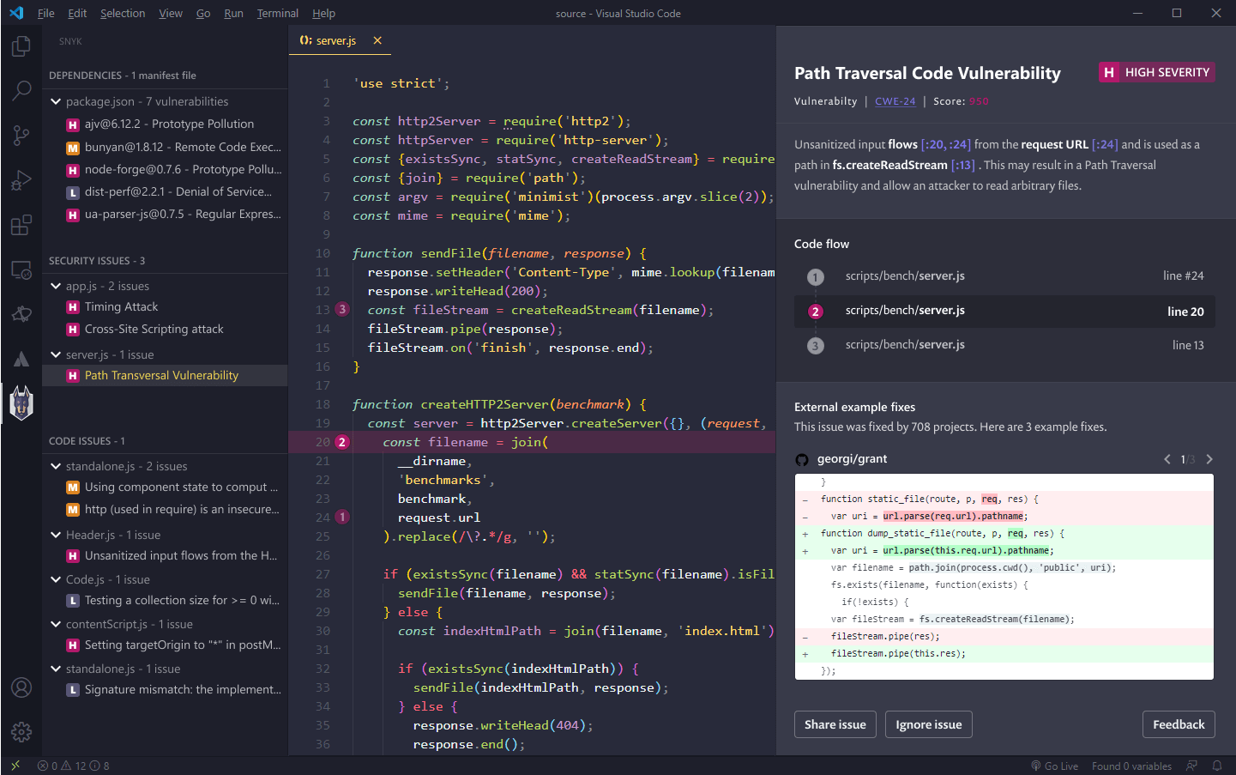
Continuous
Integration
Continuous Delivery
or Deployment
Development
Notes:
Andy
With static application security testing or SAST, you can shift all the way left to discover vulnerabilities as you write code inside your IDE. Our focus in this session is DAST and Active Defense, so we won’t spend a lot of time on looking at SAST.

Slide 4

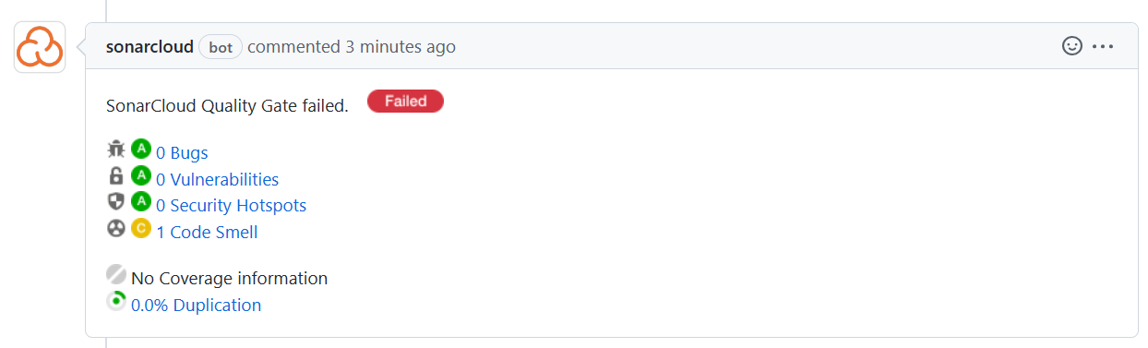
Continuous
Integration
Continuous Delivery
or Deployment
Development
Notes:
Andy
…except to say that SAST tools can also be incorporated into your CI pipelines to detect vulnerabilities before they get merged into your “main” branch, prior to deployment in any environment.

Slide 5

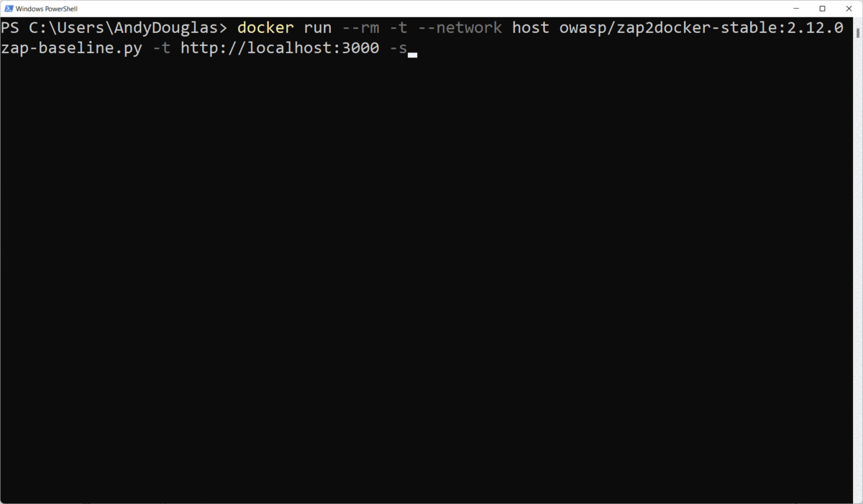
Continuous
Integration
Continuous Delivery
or Deployment
Development
Notes:
Andy
In your deployment pipelines, similar to executing smoke tests against a running application, Dynamic Application Security Testing or DAST, can quickly scan your application as it makes its way through your environments to further protect your organization.

Slide 6
Continuous
Integration
Continuous Delivery
or Deployment
Development
Active Defense
Notes:
Mick
2022 IBM report - Average time to detect data breach is 287 days
https://www.ibm.com/reports/data-breach

Slide 7
Automate Application Security with CI/CD
Notes:
Mick
Application security is transitioning away from scans and other hardening activities done late in the software development lifecycle to “shifting left” by way of automation that executes well before software makes its way into Production. This talk covers how to embrace this transition of “shifting left” and focuses on technologies you can quickly and cheaply incorporate into your existing pipelines to greatly improve your security posture while minimizing disruption to the software development lifecycle or burdening software developers on your team.

Slide 8
Part 1: Dynamic Scans for prevention
Notes:
Andy
These slides are divided into 2 sections: part 1 focuses on preventing security vulnerabilities from making it to Production via dynamic scans integrated into your deployment pipelines and…

Slide 9
Part 2: Active Defense for detection
Notes:
Mick
… part 2 focuses on Active Defense techniques you can incorporate into your pipelines. We’ll explain what Active Defense is, and how you can and should incorporate honeypots and other Active Defense tools and techniques into your software pipelines.

Slide 10
Goal: Actionable Security Improvement
Notes:
Andy
The tools and techniques we’ll show you in this session are easy for a non-expert to implement and nearly free to deploy save for a little of your time. Our hope is that this content is relevant and highly actionable for you; we hope that this content and the accompanying labs will inspire you to take action to improve the security posture of your organizations.

Slide 11
Hi, my name is Andy Douglas
Long-time CodeMash attendee, first-time speaking
Full Stack Software Dev/Engineer > Architect > Engineering Manager
Security…meh
Notes:
Andy
I’m passionate about delivering high-quality software that delights users, without jumping through lots of hoops like security scans. In Part 1 of this talk I’ll be introducing some concepts and demonstrating a free/open-source tool that you can easily incorporate into your existing pipelines to automate security scans so you can focus on building great software with more piece of mind on the security front. I’m excited to be co-presenting with my brother Mick!

Slide 12
Hi, my name is Mick Douglas
First time CodeMash attendee
Passionate about security
Infosec Innovations, SANS Principle Instructor, IANS Research Faculty
Notes:
Mick
Gaaah security smash

Slide 13

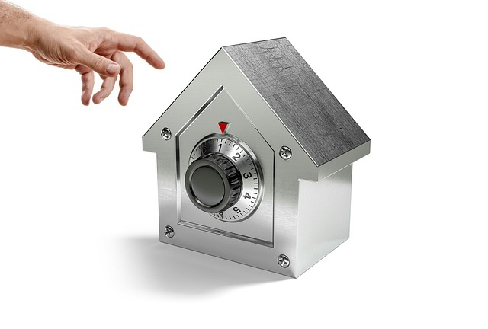
Part 1: Dynamic Scans for prevention
Notes:
Andy
Spider image from: https://pixabay.com/photos/spider-arachnid-spider-web-cobweb-281142/
Safe image from: https://pixabay.com/photos/fraud-crime-hand-security-safety-3229757/

Slide 14
SAST - quick word
Notes:
Andy
A quick word about SAST

Slide 15
Recommendation:
Integrate SAST w/ IDE + CI
Popular Tools: Snyk, Checkmarx, SonarQube/SonarCloud
Notes:
Andy
DO integrate SAST into your CI pipelines if you have the budget, and ideally into your IDE
Popular SAST tools include: Snyk, Checkmarx, SonarQube/SonarCloud
OWASP has some great advice regarding how to select a SAST tool - link at end

Slide 16
Dynamic Application Security Testing (DAST)
Notes:
Andy
Let’s talk about DAST. As compared with static analysis, dynamic analysis is done after software has been deployed and is running in some environment. DAST scanners have no insight into your application source code, but seek to expose security vulnerabilities in your running software. Traditionally, DAST tools have been used manually by security experts / penetration testers to probe for vulnerabilities while an application is running. Waiting for people to manually scan your application means that you’re not able to shift left with this technique as you otherwise could. Instead, we highly recommend incorporating DAST into your software pipelines to improve your security posture.

Slide 17

Merge into main
CI build runs
(hopefully with SAST)
CD build runs
to deploy to env X
Smoke tests
and DAST
Notes:
Andy
A pipeline which incorporates DAST might look like this

Slide 18
4 Labs
Notes:
Andy
For this session, we’ve prepared 4 labs for you. These labs are mutually exclusive; do them in any order you’d like.

Slide 19
DAST Lab
Notes:
Andy
In the DAST lab, you’ll have the opportunity to learn about a leading DAST tool and how to incorporate it into your deployment pipelines.

Slide 20
DAST Lab: deploy vulnerable web app
Notes:
Andy
as our attack target

Slide 21
DAST Lab: Automate a leading DAST tool
Notes:
Andy

Slide 22
DAST Lab: Learn how to include DAST in your pipelines
Notes:
Andy

Slide 23
DAST Strengths
Notes:
Andy
Accuracy - false positives are unlikely compared with SAST tools
Expense - less expensive than SAST tools

Slide 24
DAST Weaknesses
Notes:
Andy
Long scan times make inclusion with pipelines challenging. According to State of DevOps DORA report, “elite” performers are able to support “Lead Time for Changes” of less than 60 minutes, with the ideal deployment cycle time being less. There are ways to implement efficiency here though - via smaller microservices exposing fewer endpoints, micro front-ends where UI is sliced into different applications, and thoughtfully separating quick pipeline scans from slower/more thorough scheduled scans.

Slide 25
Recommendation:
DAST: CD and/or scheduled
Popular Tools: ZAP, StackHawk, Burp Suite, Astra Pentest, etc.
Notes:
Andy
Popular tools include: ZAP (free), StackHawk (built on ZAP - between $0 and $49 per month), Burp Suite ($8k-$35k per year), Astra Pentest ($1k and $10k per year plus), etc.
OWASP DAST tool list: https://owasp.org/www-community/Vulnerability_Scanning_Tools
DAST tool reviews: https://www.getastra.com/blog/security-audit/top-dast-tools/

Slide 26




Part 2: Active Defense for detection
Notes:
Mick
Skeleton Bomber Image: https://pixabay.com/photos/wall-breaker-clash-of-clans-online-4488105/
Hourglass image: https://pixabay.com/photos/hourglass-time-hours-clock-620397/
Honeypot image: https://pixabay.com/photos/honey-table-pot-white-wood-2588187/
Labyrinth image: https://pixabay.com/illustrations/labyrinth-puzzle-maze-target-away-2037286/

Slide 27
Part 2: Active Defense for detection FTW!!
Notes:
Mick
Skeleton Bomber Image: https://pixabay.com/photos/wall-breaker-clash-of-clans-online-4488105/
Hourglass image: https://pixabay.com/photos/hourglass-time-hours-clock-620397/
Honeypot image: https://pixabay.com/photos/honey-table-pot-white-wood-2588187/
Labyrinth image: https://pixabay.com/illustrations/labyrinth-puzzle-maze-target-away-2037286/

Slide 28
WAF
Notes:
Mick

Slide 29
Traditional Defense == Passive
Notes:
Mick

Slide 30
Traditional Defense == KNOWN
Notes:
Mick

Slide 31
Active Defense == Passive & Active
Notes:
Mick

Slide 32
Shift focus/effort to higher reward
Notes:
Mick

Slide 33
Attackers have predictable paths
Notes:
Mick

Slide 34
Active Defence at each phase
Notes:
Andy?

Slide 35
Recon: Ports
Notes:
Mick

Slide 36
Honey Port
Notes:
Mick

Slide 37
DEMO: Honey Port
Notes:
Mick

Slide 38
Privilege Escalation: session tokens
Notes:
Mick

Slide 39
Honey Tokens
Notes:
Mick

Slide 40
Demo: Honey Tokens
Notes:
Mick

Slide 41
Strategy: Defense Options
Notes:
Mick

Slide 42
Watch and learn?

Slide 43
Random error response?
Notes:
Mick

Slide 44
Firewall
Notes:
Mick

Slide 45
QoS
Notes:
MIck

Slide 46
Demo response options
Notes:
Mick

Slide 47
Security != Hard/Expensive
Notes:
Mick

Slide 48
Security as Functional Requirement
Notes:
Andy
We encourage engineers and devops practitioners to treat security as a functional requirement! Consider building your pipelines with SAST, DAST, and Active Defense in mind.

Slide 49
Security + CI/CD is good
Notes:
Andy
We recommend incorporating SAST, SCA, DAST, Active Defense. The free DAST and AD tools we demoed can easily be incorporated into your existing pipelines to bolster your organization’s security posture.

Slide 50
LAB IT UP!!
Notes:
Mick
We’ve curated, tuned, and automated, pre-existing development and security techniques to provide coordinated, layered, and measurable improvements to the defensive posture of software stacks at key choke points throughout the SDLC
We challenge you to join us in a more resilient future.

