Slide 1
Introduction to Data Structures
CSE 205 : Data Structures Lecture 1

Slide 2

15
CHAPTER
THE JAVA COLLECTIONS FRAMEWORK
Slides by Donald W. Smith
TechNeTrain.com

Slide 3

Chapter Goals
To learn how to use the collection classes supplied in the Java library
To use iterators to traverse collections
To choose appropriate collections for solving programming problems
To study applications of stacks and queues

Slide 4
Contents
An Overview of the Java Collections Framework
Linked Lists
Stacks, Queues
Tree data structure and binary tree (separate notes)
Heap and heap sort (separate notes)
In this chapter, you will learn about the Java collection framework, a hierarchy of interface types and classes for collecting objects

Slide 5
15.1 Java Collections Framework
When you need to organize multiple objects in your program, you can place them into a collection
The ArrayList class that was introduced in Chapter 6 is one of many collection classes that the standard Java library supplies
Each interface type is implemented by one or more classes
A collection groups together elements and allows them to be accessed and retrieved later

Slide 6
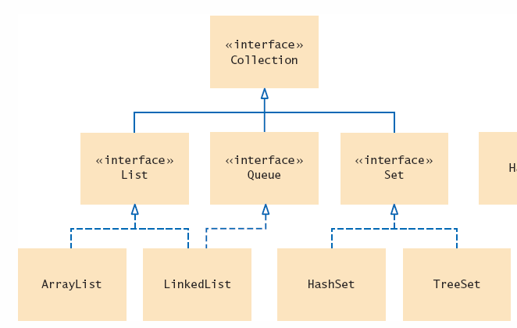
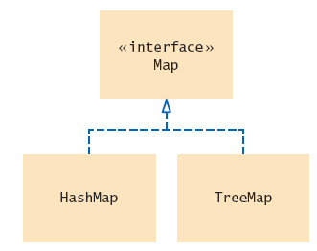
Collections Framework Diagram
Each collection class implements an interface from a hierarchy
  Each class is designed for a
  specific type of storage

Slide 7
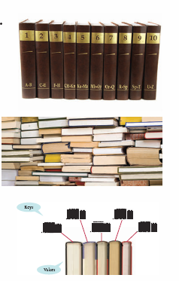
Summary: Collections
A collection groups together elements and allows them to be retrieved later
  A list is a collection that remembers the order of its elements
  A set is an unordered collection of unique elements
  A map keeps associations between key
  and value objects

Slide 8

Summary: Stacks and Queues
A stack is a collection of elements with “last-in, first-out” retrieval.
A queue is a collection of elements with “first-in, first-out” retrieval.
When removing an element from a priority queue, the element with the most urgent priority is retrieved.

Slide 9

Lists and Sets
Ordered Lists
  ArrayList
    Stores a list of items in a dynamically sized array
  LinkedList
    Allows speedy insertion and removal of items from the list
A list is a collection that maintains the order of its elements.

Slide 10

Stacks and Queues
Another way of gaining efficiency in a collection is to reduce the number of operations available
Two examples are:
  Stack
    Remembers the order of its elements, but it does not allow you to insert elements in every position
    You can only add and remove elements at the top
  Queue
    Add items to one end (the tail)
    Remove them from the other end (the head)
    Example: A line of people waiting for a bank teller

Slide 11
15.5 Stacks and Queues
Queues and Stacks are specialized lists
  Only allow adding and removing from the ends
 | Insert At | Remove At | Operation
Stack | Start(top) | Start(top) | List in, first out (LIFO)
Queue | End (tail) | Start (head) | First in, first out (FIFO)

Slide 12
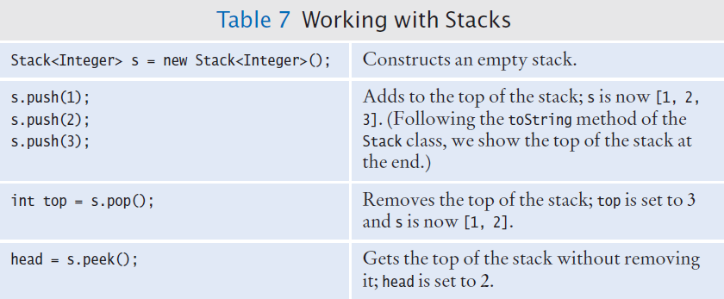
Working with Stacks

Slide 13
Stack Example
The Java library provides a Stack class that implements the abstract stack type’s push and pop operations.
  The Stack is not technically part of the Collections framework, but uses generic type parameters
Stack<String> s = new Stack<String>();
s.push("A");
s.push("B");
s.push("C");
// The following loop prints C, B, and A
while (s.size() > 0)
{
System.out.println(s.pop());
}
The stack class provides a size method

Slide 14
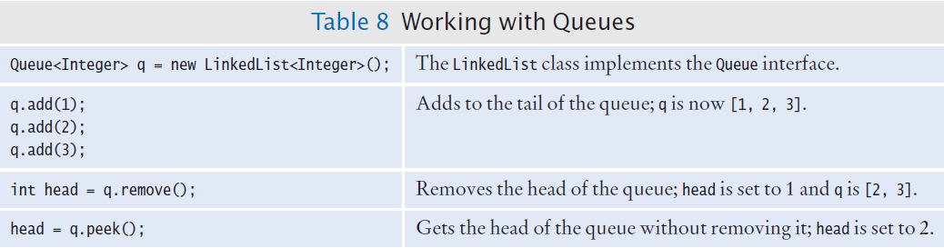
Queues and Priority Queues

Slide 15

15.6 Stack and Queue Applications
Balancing Parenthesis
  Section 2.5, showed how to balance parenthesis by adding 1 for each left ( and subtracting for each right )
  A stack can be used to keep track of ‘depth’:
    When you see an opening parenthesis, push it on the stack.
    When you see a closing parenthesis, pop the stack.
    If the opening and closing parentheses don’t match
      The parentheses are unbalanced. Exit.
      If at the end the stack is empty
      The parentheses are balanced.
    Else
      The parentheses are not balanced.

Slide 16
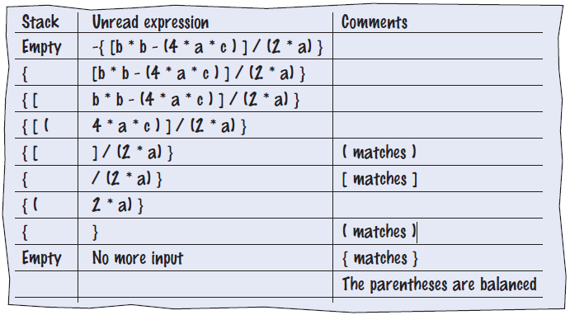
Using a Stack (Example)
Here is a walkthrough of the sample expression
  We will use the mathematical version (three types of parenthesis)

Slide 17
Palindrome Checker using Stack and Queue
In-class dicussion

