Slide 1

15
CHAPTER
THE JAVA COLLECTIONS FRAMEWORK
Copyright © 2013 by John Wiley & Sons. All rights reserved.
Slides by Donald W. Smith
TechNeTrain.com

Slide 2
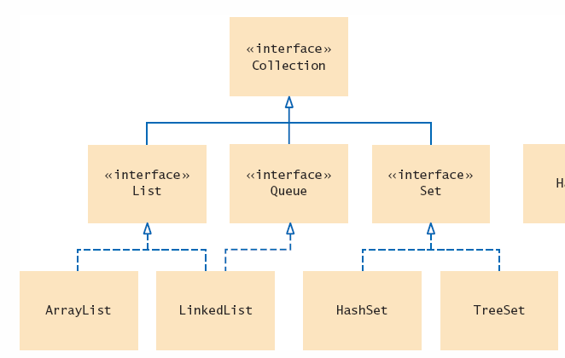
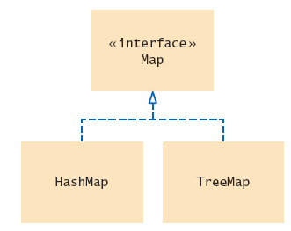
Collections Framework Diagram
Each collection class implements an interface from a hierarchy
  Each class is designed for a
  specific type of storage
Copyright © 2013 by John Wiley & Sons. All rights reserved.
Page <number>

Slide 3
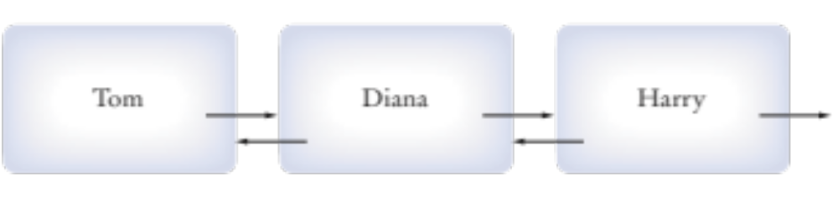
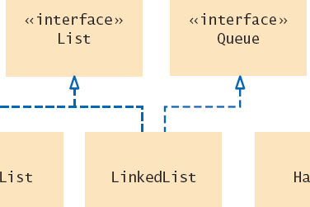
15.2 Linked Lists
Linked lists use references to maintain an ordered lists of ‘nodes’
  The ‘head’ of the list references the first node
  Each node has a value and a reference to the next node
  They can be used to implement
    A List Interface
    A Queue Interface
Copyright © 2013 by John Wiley & Sons. All rights reserved.
Page <number>

Slide 4
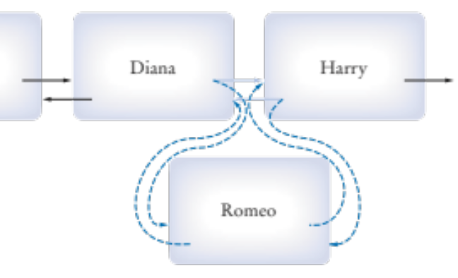
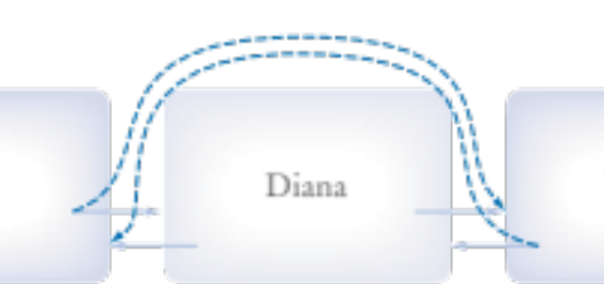
Linked Lists Operations
Efficient Operations
  Insertion of a node
    Find the elements it goes between
    Remap the references
  Removal of a node
    Find the element to remove
    Remap neighbor’s references
  Visiting all elements in order
Inefficient Operations
  Random access
Each instance variable is declared just like other variables we have used.
Copyright © 2013 by John Wiley & Sons. All rights reserved.
Page <number>

Slide 5
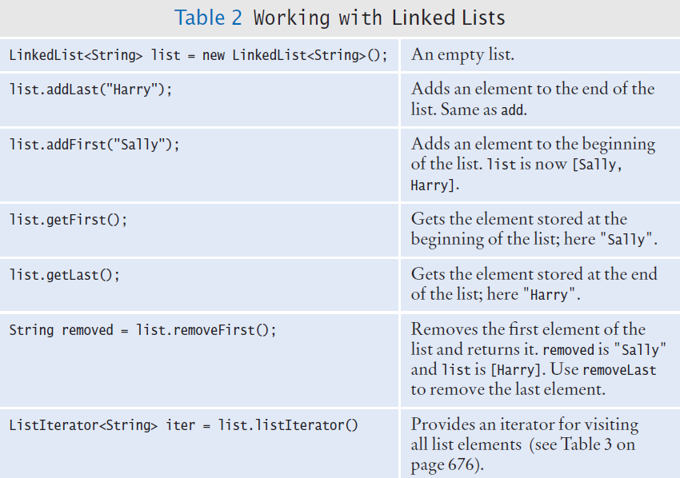
LinkedList: Important Methods
Copyright © 2013 by John Wiley & Sons. All rights reserved.
Page <number>

Slide 6
Generic Linked Lists
The Collection Framework uses Generics
  Each list is declared with a type field in < > angle brackets
LinkedList<String> employeeNames = . . .;
LinkedList<String>
LinkedList<Employee>
Copyright © 2013 by John Wiley & Sons. All rights reserved.
Page <number>

Slide 7
List Iterators
When traversing a LinkedList, use a ListIterator
  Keeps track of where you are in the list.
Use an iterator to:
  Access elements inside a linked list
  Visit other than the first and the last nodes
LinkedList<String> employeeNames = . . .;
ListIterator<String> iter = employeeNames.listIterator()
Copyright © 2013 by John Wiley & Sons. All rights reserved.
Page <number>

Slide 8



Using Iterators
Think of an iterator as pointing between two elements
ListIterator<String> iter = myList.listIterator()
iterator.next();
Note that the generic type for the listIterator must match the generic type of the LinkedList
iterator.add(“J”);
Copyright © 2013 by John Wiley & Sons. All rights reserved.
Page <number>

Slide 9
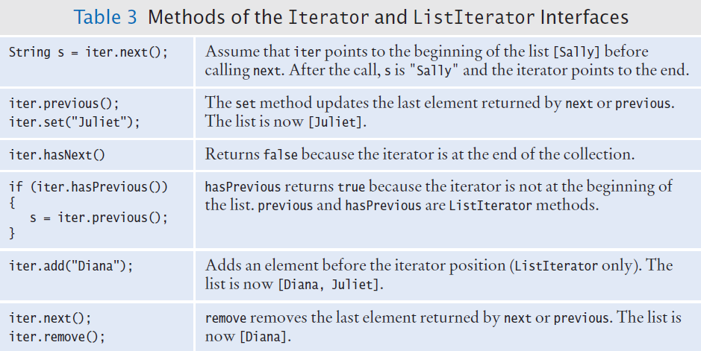
Iterator and ListIterator Methods
Iterators allow you to move through a list easily
  Similar to an index variable for an array
Copyright © 2013 by John Wiley & Sons. All rights reserved.
Page <number>

Slide 10
Iterators and Loops
Iterators are often used in while and “for-each” loops
  hasNext returns true if there is a next element
  next returns a reference to the value of the next element
  Where is the iterator in the “for-next” loop?
    It is used ‘behind the scenes’
while (iterator.hasNext())
{
String name = iterator.next();
// Do something with name
}
for (String name : employeeNames)
{
// Do something with name
}
Copyright © 2013 by John Wiley & Sons. All rights reserved.
Page <number>

Slide 11
Adding and Removing with Iterators
Adding
  A new node is added AFTER the Iterator
  The Iterator is moved past the new node
Removing
  Removes the object that was returned with the last call to next or previous
  It can be called only once after next or previous
  You cannot call it immediately after a call to add.
iterator.add("Juliet");
while (iterator.hasNext())
{
String name = iterator.next();
if (condition is true for name)
{
iterator.remove();
}
}
If you call the remove
method improperly, it throws an IllegalStateException.
Copyright © 2013 by John Wiley & Sons. All rights reserved.
Page <number>

Slide 12
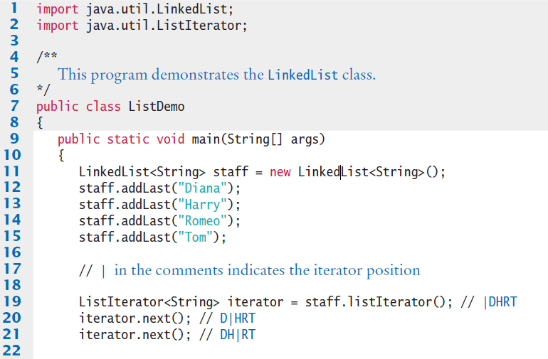
ListDemo.java (1)
Illustrates adding, removing and printing a list
Copyright © 2013 by John Wiley & Sons. All rights reserved.
Page <number>

Slide 13
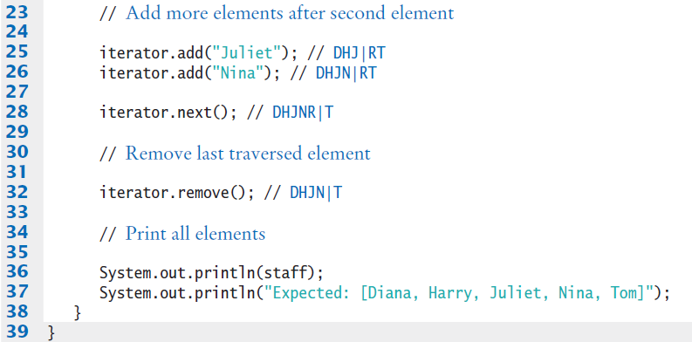

ListDemo.java (2)
Copyright © 2013 by John Wiley & Sons. All rights reserved.
Page <number>

Slide 14
Using LinkedList
[1] Suppose the list lst contains elements "A", "B", "C", and "D". Draw the contents of the list and the iterator
position for the following operations:
ListIterator<String> iter = letters.iterator();
iter.next();
iter.next();
iter.remove();
iter.next();
iter.add("E");
iter.next();
iter.add("F");
Copyright © 2013 by John Wiley & Sons. All rights reserved.
Page <number>

Slide 15
Using LinkedList
[2] Write a loop that removes all strings with length less than four from a linked list
of strings called words.
[3] Write a loop that prints every second element of a linked list of strings called
words.
Copyright © 2013 by John Wiley & Sons. All rights reserved.
Page <number>

