Slide 1


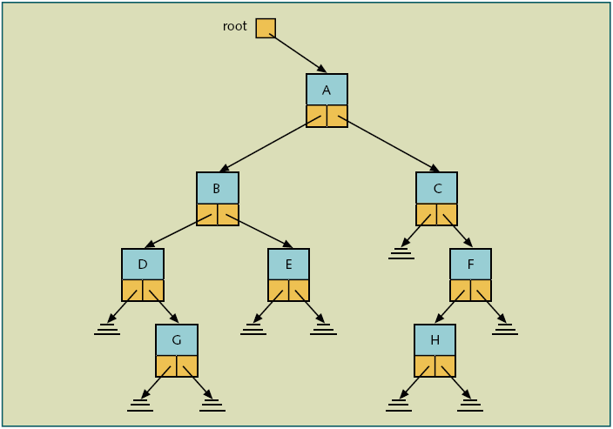

Tree data structures
Data can be stored in a tree format, such as binary trees.
A node for binary trees can be defined as follows:
class Node
{
Object data;
Node rightNode;
Node leftNode;
}
Here the letters A, B, C, D, E, F, G, and H are stored in a binary tree data structure.

Slide 2
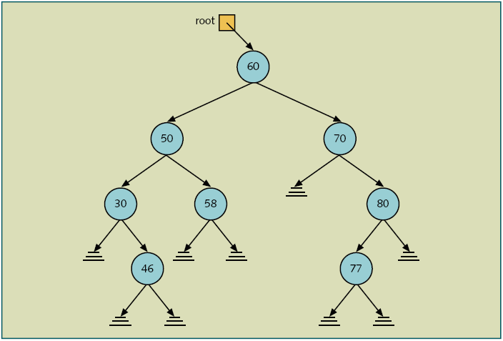
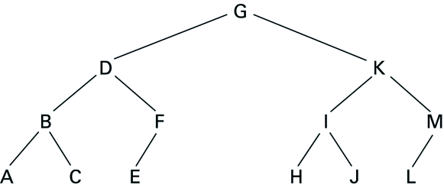
Binary Search Trees:
The binary search property is that any element in the right sub tree is larger than the value of the node,
and any element in the left sub tree is smaller than (or equals to ) the value of the node.
Thus those elements need to be compared such as numbers or strings.
Searching operation can be more efficient in a tree data structure than a linear list.

Slide 3
Constructing a Binary Search Tree
Let’s try to create a binary search tree that results when the following values are added, in order, to a new tree
24 61 28 17 72 4 23 49 24 80 10 36 16
Demo: https://www.cs.usfca.edu/~galles/visualization/BST.html

Slide 4
Tree Traversals
How can we process or go through all nodes in a tree?
We will look at three types of traversals, pre-order traversals, in-order traversals, and post-order traversals.
Pre-order Traversal:
The root is processed previous to its two sub-trees.
For a non-empty tree:
Step1: Process the root.
Step2: Process the nodes in the left sub-tree with a recursive call.
Step3: Process the nodes in the right sub-tree with a recursive call.
//The following preorderPrint method prints the data from each node
//at or below this node of the binary tree.
//Assume that this method is defined in the Node class in the previous page.
public void preorderPrint()
{
System.out.print(data + “ “);
if (leftNode != null)
leftNode.preorderPrint();
if (rightNode != null)
rightNode.preorderPrint();
}
Here the output will be “G D B A C F E K I H J M L “

Slide 5
In-order Traversal:
The root is processed in between the processing of its two sub-trees.
For a non-empty tree:
Step1: Process the nodes in the left sub-tree with a recursive call.
Step2: Process the root.
Step3: Process the nodes in the right sub-tree with a recursive call.
//The following inorderPrint method prints the data from each node
//using in-order.
//Assume that this method is defined in the Node class in the previous page.
public void inorderPrint()
{
if (leftNode != null)
leftNode.inorderPrint();
System.out.print(data + “ “);
if (rightNode != null)
rightNode.inorderPrint();
}
Here the output will be “A B C D E F G H I J K L M “

Slide 6
Post-order Traversal:
The root is processed after processing its two sub-trees.
For a non-empty tree:
Step1: Process the nodes in the left sub-tree with a recursive call.
Step2: Process the nodes in the right sub-tree with a recursive call.
Step3: Process the root.
//The following postorderPrint method prints the data from each node
//using post-order.
//Assume that this method is defined in the Node class in the previous page.
public void postorderPrint()
{
if (leftNode != null)
leftNode.postorderPrint();
if (rightNode != null)
rightNode.postorderPrint();
System.out.print(data + “ “);
}
Here the output will be “A C B E F D H J I L M K G “

Slide 7
Lecture Review Quiz part I
(In-class)

Slide 8
Design and Implementation of Binary Tree

Slide 9
Design
Requirement 1: Need a Node that has data, pointer to the left child and a pointer to the right child
private class Node
{
Object data;
Node left;
Node right;
public Node(Object o)
{
data = o;
left=null;
right = null;
}
}

Slide 10
Design – Initializing the Tree
private Node root;
private int size; //number of nodes inside the tree
/** Create a default binary tree */
public BinaryTree()
{
root = null;
size = 0;
}

Slide 11
Design - Inserting a Node
/** Insert data o into the binary tree, return true if the data is inserted successfully */
public boolean insert(Object o)
{
if (root == null)
root = new Node(o); // Create a new tree with new node as the root
else
{
// Locate the parent node
Node parent = null;
Node current = root;
while (current != null)
{
if (((Comparable)o).compareTo(current.data) < 0)
{
parent = current;
current = current.left;
}
else if (((Comparable)o).compareTo(current.data) > 0) {
parent = current;
current = current.right;
}
else
return false; // Duplicate node not inserted
}
// Create the new node and attach it to the parent node
if (((Comparable)o).compareTo(parent.data) < 0)
parent.left = new Node(o);
else
parent.right = new Node(o);
}
size++;
return true; // the new node inserted successfully
}

Slide 12
Design – Traversing the Tree
/** Inorder traversal */
public void inorder()
{
inorder(root);
}
/** Inorder traversal from a subtree */
private void inorder(Node root)
{
if (root == null)
return;
inorder(root.left);
System.out.print(root.data + "\t");
inorder(root.right);
}

Slide 13
Lecture Review Quiz part II (Take home)

