Slide 1
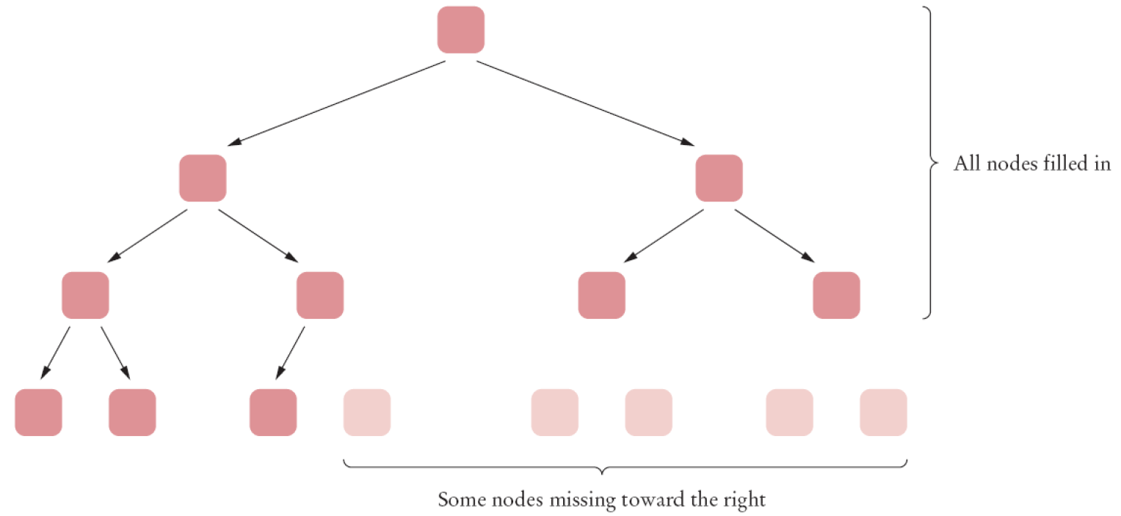
Heaps
A heap or min-heap (max-heap) is a binary tree with two special properties:
1. A heap is almost complete: all nodes are filled in, except the last level may have some nodes
missing toward the right.
2. The tree fulfills the heap property: all nodes store values that are at most as small (large)
as the values stored in their descendants.
It is easy to see that the heap property ensures that the smallest element is stored in the root.
Example of an almost complete tree:

Slide 2
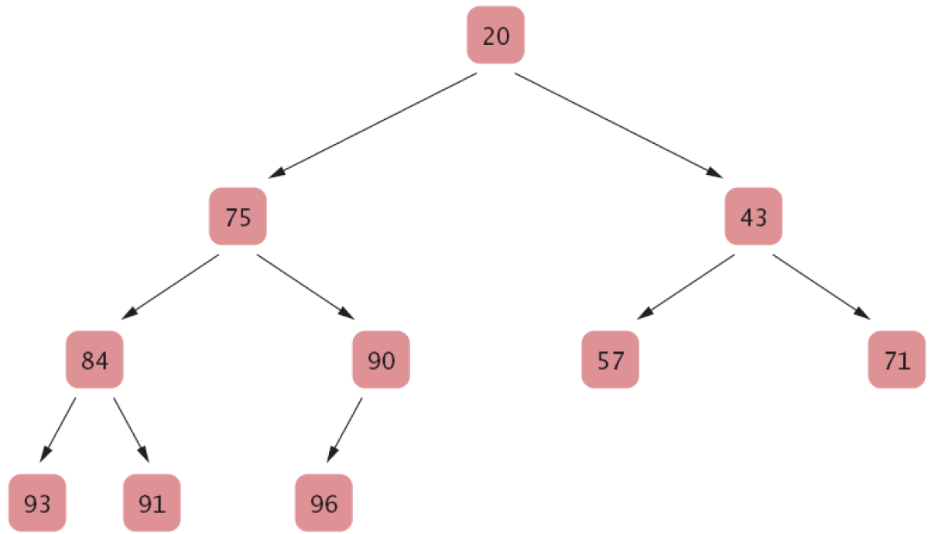
An example of a heap
A heap content can be physically stored in an array (or arrayList) because of the first property:
0 1 2 3 4 5 6 7 8 9
20 | 75 | 43 | 84 | 90 | 57 | 71 | 93 | 91 | 96

Slide 3

0 1 2 3 4 5 6 7 8 9
20 | 75 | 43 | 84 | 90 | 57 | 71 | 93 | 91 | 96
For an element at the index i of the array,
The index of its left child is: 2*i + 1
The index of its right child is: 2*i + 2
The index of its parent is: the integer part of (i-1)/2
Using these formula, we can find the children or the parent of a node in the array.
i=0
For example,
for the node at the index = 3,
the left child is 2*3+1=7
the right child is 2*3+2=8
the parent is: (3-1)/2 = 1
i=1
i=2
i=4
i=3
i=5
i=6
i=7
i=8
i=9

Slide 4
A priority queue collects elements, each of which has a priority.
Elements are retrieved according to their priority. New items can be inserted in any order,
but the item with the highest priority is removed first.
example: A collection of work requests, some of which many be more urgent than others.
A heap can be used to represent a priority queue because of its 2nd property.
The element at the root position has the smallest value, so it can be viewed as having the highest priority.
It is easy to find the element with the highest priority in a heap.
We will be looking at three operations:
-Inserting a new element into a heap
-Extracting (Deleting) the root of a heap
-Sort an array using a heap (Heap Sort)

Slide 5
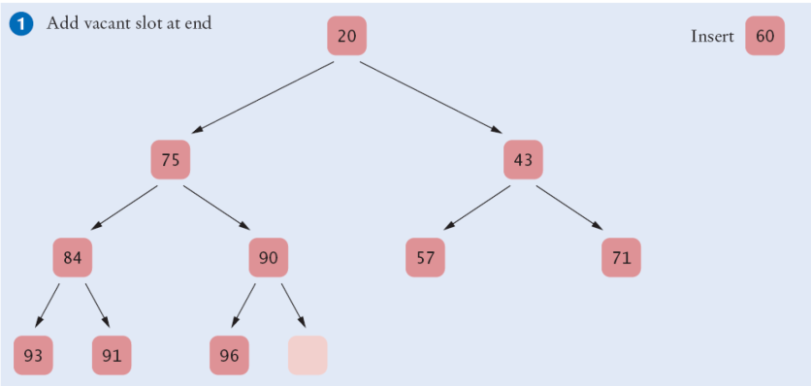
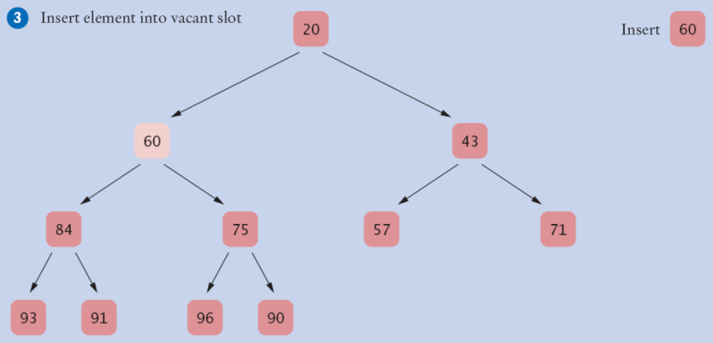
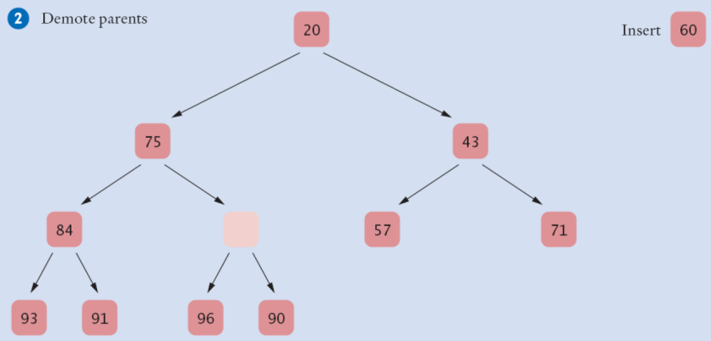
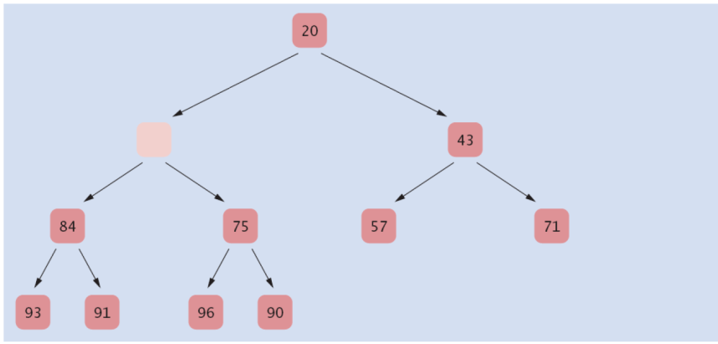
1. Inserting an element into a heap
Example: Inserting a new element with 60.

Slide 6
Insertion steps:
Step1: Insert a new element as the last element in the heap (array).
(This makes the 1st property of the heap hold.)
Step2: Repeat the following until we are done or reach the top of the heap (no parent)
Compare the added element to its parent.
If the parent is larger than the new element,
then swap them
Else
DONE!
(This makes the 2nd property of the heap hold.)
Efficiency of Insertion:
-Step1 takes a constant time: O(1)
-In each comparison and swapping in the step 2 using an array or an arraylist takes a constant time.
Step 2 can be repeated at most the height of the heap.
If we have n elements in a heap, the height of the heap is O( log n) -- same idea as binary search
This total running time of Insertion is:
O(1) + O(1) * O(log n) = O( log n). It is O(log n).

Slide 7
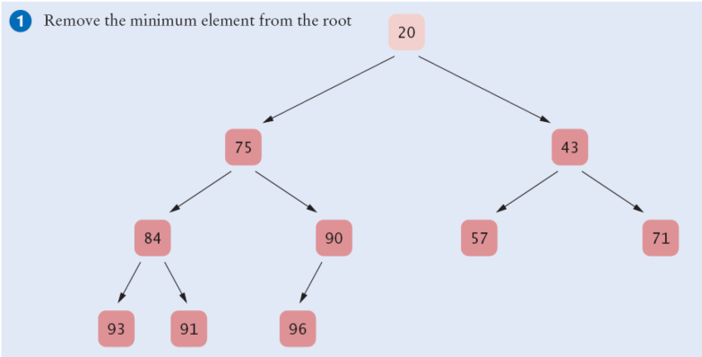
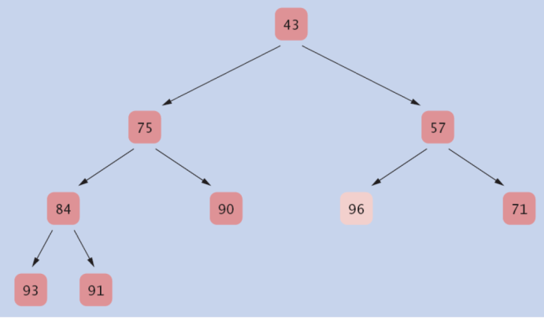
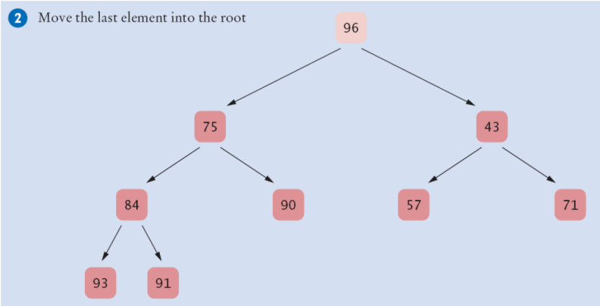
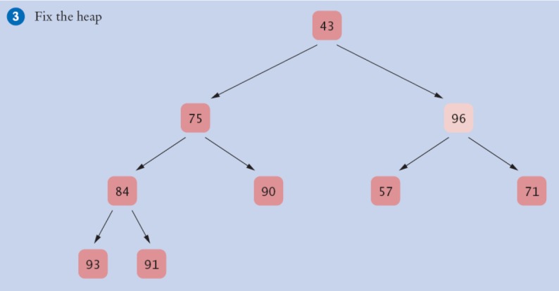
2. Extracting the root node from a heap

Slide 8
Extraction (Removing) steps:
Step1: Extract the root element.
Step2: Remove the last element in the heap (array) and set it as the root.
(This makes the 1st property of the heap hold.)
Step3: Repeat the following until we are done or reach the bottom of the heap (no child)
Compare the new root element to its children.
If at least one of the children is smaller than the new root,
then swap it with the smaller value child element,
Else
DONE!
(This makes the 2nd property of the heap hold.)
Efficiency of Extraction of the root:
-Step1 and Step2 take a constant time: O(1)
-In each comparison and swapping in the step 3 using an array or an arraylist takes a constant time.
Step 3 can be repeated at most the height of the heap.
If we have n elements in a heap, the height of the heap is O( log n) -- same idea as binary search
This total running time of Deletion of the root is:
O(1) + O(1) * O(log n) = O( log n). It is O(log n).

