Slide 1
Introduction to Multithreading
CSE 205 - Spring 2014

Slide 2
Some Definitions
Multitasking
Multithreading
Multithreading vs. Multitasking
Counter Example
Moving Ball Example

Slide 3

Multi-Threading
Java supports the creation of programs with concurrent flows of control.
Threads -- independent flows of control. (They are light weight processes.)
We first look at two Timer classes to have concurrent flows. There are two Timer classes. One is in java.util package and
another in javax.swing package. They have a different set of methods, thus slightly different functionality.
Multiple threads on multiple CPUs
Multiple threads sharing a single CPU

Slide 4
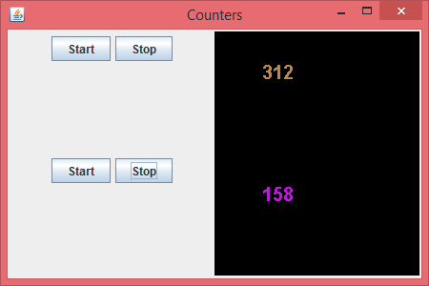
Counter Example
Two counters scheduled as threads using java swing Timer : See the program posted with week 14 lectures

