Slide 1
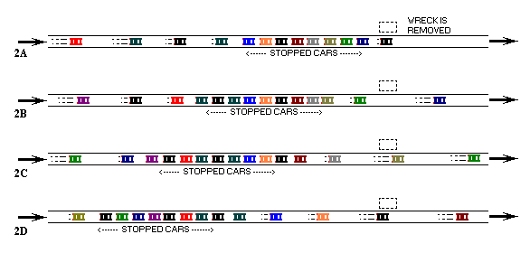
Traffic Jam Simulation
By: Andrew Durkiewicz
Credit: http://trafficwaves.org/

Slide 2
Human Element
2008 study from the New Journal of Physics
Demonstrated that ghost traffic-jams may be a direct result of inconsistencies with human reaction time and breaking efficiency.
The Mathematical Society of Traffic Flow", Yuki Sugiyama et al.,
New Journal of Physics, 2008
Credit: https://www.youtube.com/watch?v=7wm-pZp_mi0

Slide 3
How Do These Events Occur?
High vehicle densities reduce available reaction times for all vehicles on the road.
When a vehicle breaks hard at an unexpected moment during high densities, trailing cars are forced to adjust.
As vehicles adjust, the effect spreads and forms a velocity ‘jam.’
This event can last for hours and has wavelike properties.

Slide 4



Method and Approach
Euler's method applied to projected velocities
Using the car flowing model to project velocities in time:
Reaction Time
Breaking Coefficient
Euler’s Method
x_{n}
x_{n-1}
Thus,

Slide 5
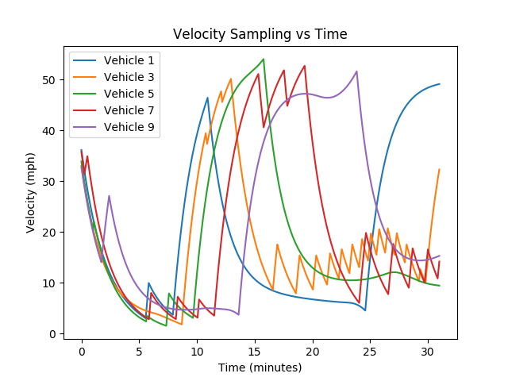
Stop and Go
Graph on left shows the relationship between when a car enters a jam, and when it leaves.
Note how it takes only ten minutes for the vehicles to enter the jam. It takes over 15 minutes for the vehicles to get back up to speed, only to enter another jam. This is “stop and go” traffic.

Slide 6

Density vs Time

Slide 7
Physical Representation

Slide 8

Traffic-Jam Acts Like A Wave

Slide 9
Conclusions
Using Euler’s method, I was able to simulate conditions which favored the development of a vehicle jam on a looped course.
In the process I increased the number of vehicles as well as the loop radius.
The density wave properties were more prominent when the radius was increased.

