Slide 1


Can I Patent this?
US Patent and Trademark OFFIce
Classifier Patentability score
CS 670 – NJIT Summer 2023
Andrew Dziedzic

Slide 2

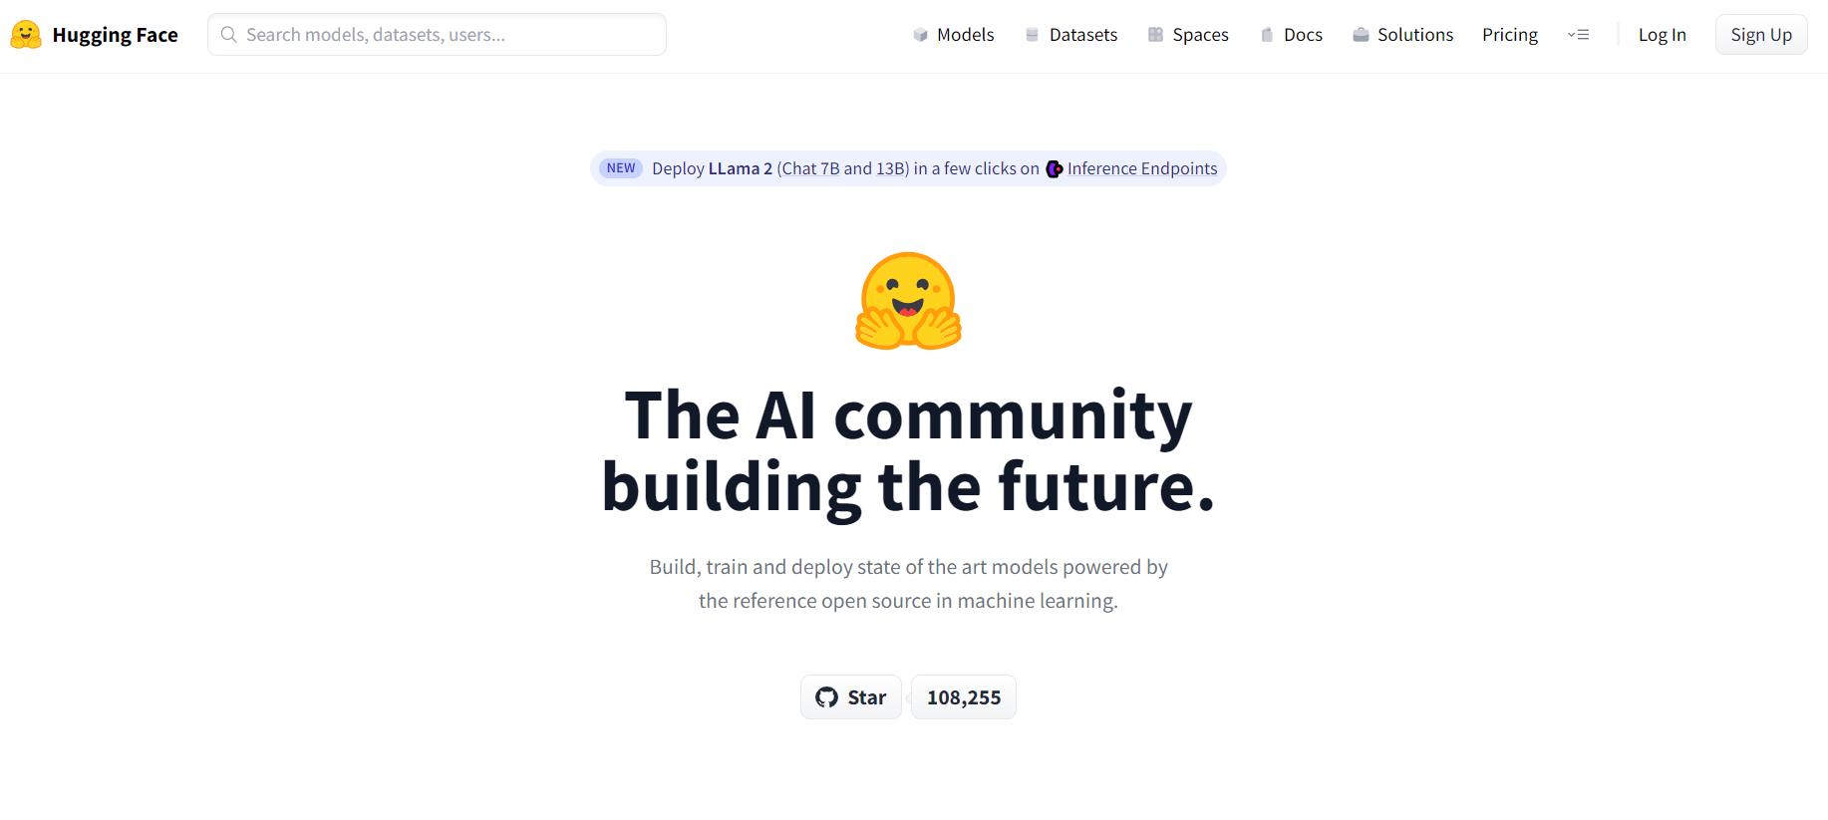
Harvard USPTO Patent Dataset
To develop the required classifier using the Harvard USPTO Patent Dataset (HUPD), I will use Hugging Face's Datasets and Transformers libraries. The classifier will be trained on a small subset of the dataset corresponding to all patent applications submitted in January 2016, with a focus on the abstract and claims. Below is the full code, including comments, that loads the dataset, preprocesses the data, trains the classifier, and performs predictions:
https://huggingface.co/datasets/HUPD/hupd/blob/main/hupd_metadata_2022-02-22.feather

Slide 3
Import Libraries
import os
from pprint import pprint
from datasets import load_dataset
from transformers import AutoTokenizer
from torch.utils.data import DataLoader
import torch
from sklearn.svm import SVC
from sklearn.metrics import accuracy_score

Slide 4
Cache Directories for Hugging Face
# Set the cache directories for Hugging Face
HG_DIR = '/nlp/scr/msuzgun/cache_extra/huggingface'
os.environ['TRANSFORMERS_CACHE'] = f'{HG_DIR}/transformers'
os.environ['HF_HOME'] = HG_DIR

Slide 5
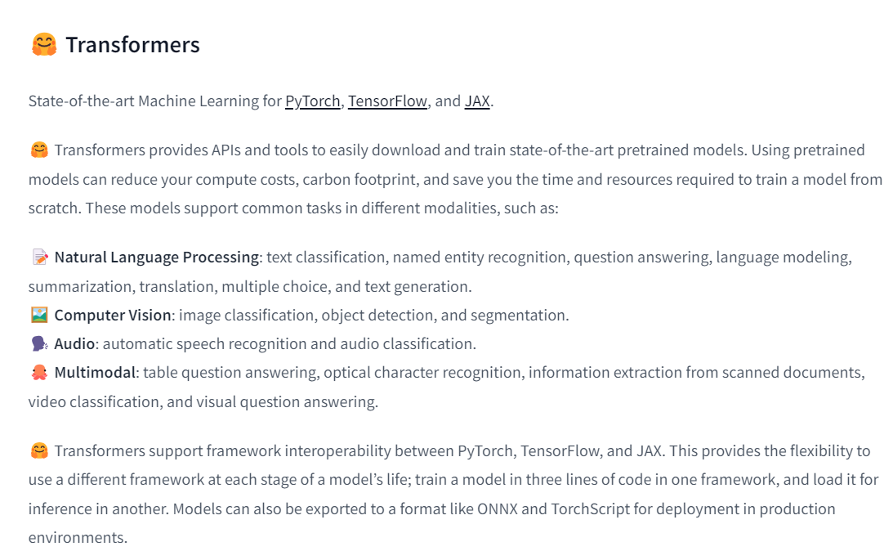
Hugging Face Transformers
# Information on Hugging Face Transformers:
https://huggingface.co/docs/transformers/index

Slide 6
Load Dataset for Jan 2016
# Load the HUPD dataset for January 2016 patent applications
dataset_dict = load_dataset('HUPD/hupd',
name='sample',
data_files="https://huggingface.co/datasets/HUPD/hupd/blob/main/hupd_metadata_2022-02-22.feather",
cache_dir='/u/scr/nlp/data/HUPD',
icpr_label=None,
train_filing_start_date='2016-01-01',
train_filing_end_date='2016-01-31',
)

Slide 7
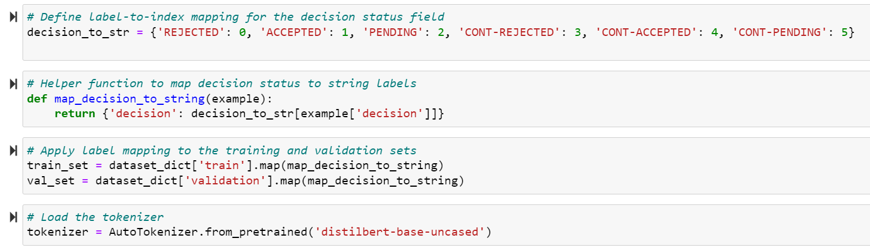
Decision Status Field

Slide 8
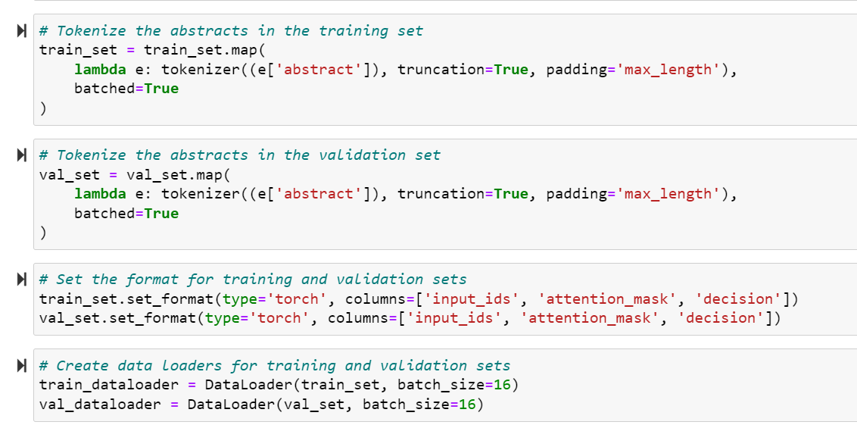
Tokenize Abstracts

Slide 9
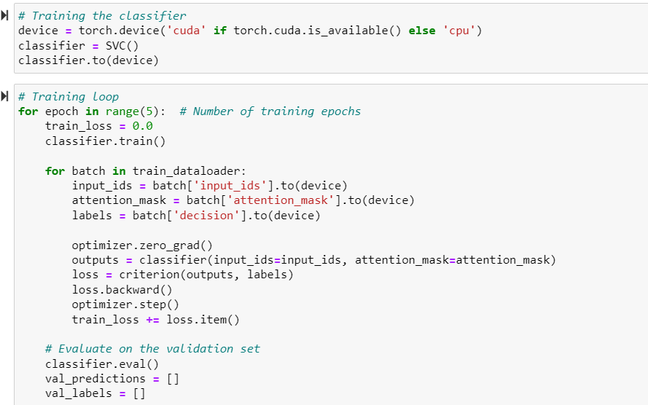
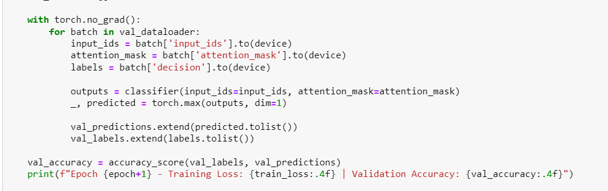
Training Classifier

Slide 10
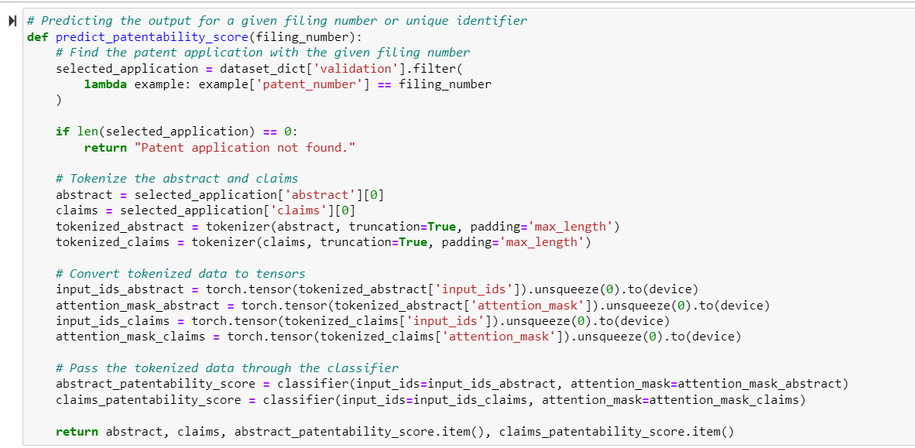
Prediction Patentability Score

Slide 11
Explanation of Classifier
# Step1 : Loading and Preprocessing:
# - The code loads the HUPD dataset for January 2016 patent applications using the `load_dataset` function from the `datasets` library.
# - The dataset is filtered based on the specified filing date range, and label-to-index mapping is defined for the decision status field.
# - The tokenizer (`AutoTokenizer`) is initialized to tokenize the abstracts of the patent applications.
# Step 2: Tokenization and Data Preparation:
# - The abstracts in the training and validation sets are tokenized using the tokenizer and preprocessed with truncation and padding.
# - The datasets are set in the torch format with the required columns: `input_ids`, `attention_mask`, and `decision`.
# - Data loaders (`DataLoader`) are created for the training and validation sets, enabling batch processing during training.
# - The function returns the abstract, claims, and the patentability scores.
# Step 3: Classifier Training:
# - The classifier, an SVM model (`SVC`), is initialized.
# - The training loop runs for a specified number of epochs.
# - For each epoch, the classifier is trained using batches of input data.
# - The optimizer and criterion (not shown in the code) can be defined according to the specific requirements.
# - After each epoch, the classifier is evaluated on the validation set to calculate the validation accuracy.
# Step 4: Predicting Patentability Score:
# - The `predict_patentability_score` function takes a filing number as input.
# - The function retrieves the corresponding patent application from the validation set.
# - The abstract and claims are tokenized and converted to tensors.
# - The tokenized data is passed through the trained classifier to obtain the predicted patentability scores for the abstract and claims.
# - The function returns the abstract, claims, and the patentability scores.

