Slide 1
AES Encryption
Group C
Andrew Chang
Adam DeVictoria
Rachel Martinez
Nicholas Williams

Slide 2
Goals
Implement AES 128, 192, and 256 encryption in C
Measure execution time for repeated encryptions and calculate average time per encryption
Compare the difference between encryption times based on block sizes
Compare the difference between encryption times based on clock speed
Evaluate performance of AES software implementation
Notes:
The goal of this project is to implement AES encryption and measure its performance. We verify correctness using known plaintext and ciphertext values, then run the encryption repeatedly to measure total execution time and compute the average time per encryption.

Slide 3
What is AES?
Advanced Encryption Standard
AES encrypts data into 16-byte blocks using a key and a series of rounds that transform the data
This encryption makes the original data unreadable without the correct key
Common uses include wireless networking, disk encryption, web security, etc.
Notes:
AES, or Advanced Encryption Standard, is a symmetric encryption algorithm that processes data in blocks of 128 bits, which is 16 bytes. It uses a secret key to perform multiple rounds of mathematical transformations on the data. In each round, the algorithm substitutes bytes using an S-box, shifts rows of data, mixes columns using finite field arithmetic, and adds a round key derived from the original key. These repeated transformations scramble the data so that it becomes secure and cannot be easily reversed without the correct key.

Slide 4
Benchmarking
Benchmarking is the process of measuring system performance by running a task repeatedly and recording execution time.
In this project:
AES encryption is executed many times
Total runtime is measured
Average time per encryption is calculated.
Notes:
Benchmarking helps us understand how fast an algorithm runs. Instead of timing a single encryption, we run the encryption many times, such as one million times, and measure the total runtime. Then we divide the total time by the number of encryptions to find the average time per encryption.

Slide 5
System Setup
Programming Language: C
AES library implementation
Standard test vectors for verification
Repeated encryption loop for benchmarking
Notes:
The system uses a C implementation of AES. We use predefined test vectors to verify that the encryption produces the correct output. A loop is used to repeat the encryption many times to measure performance.

Slide 6
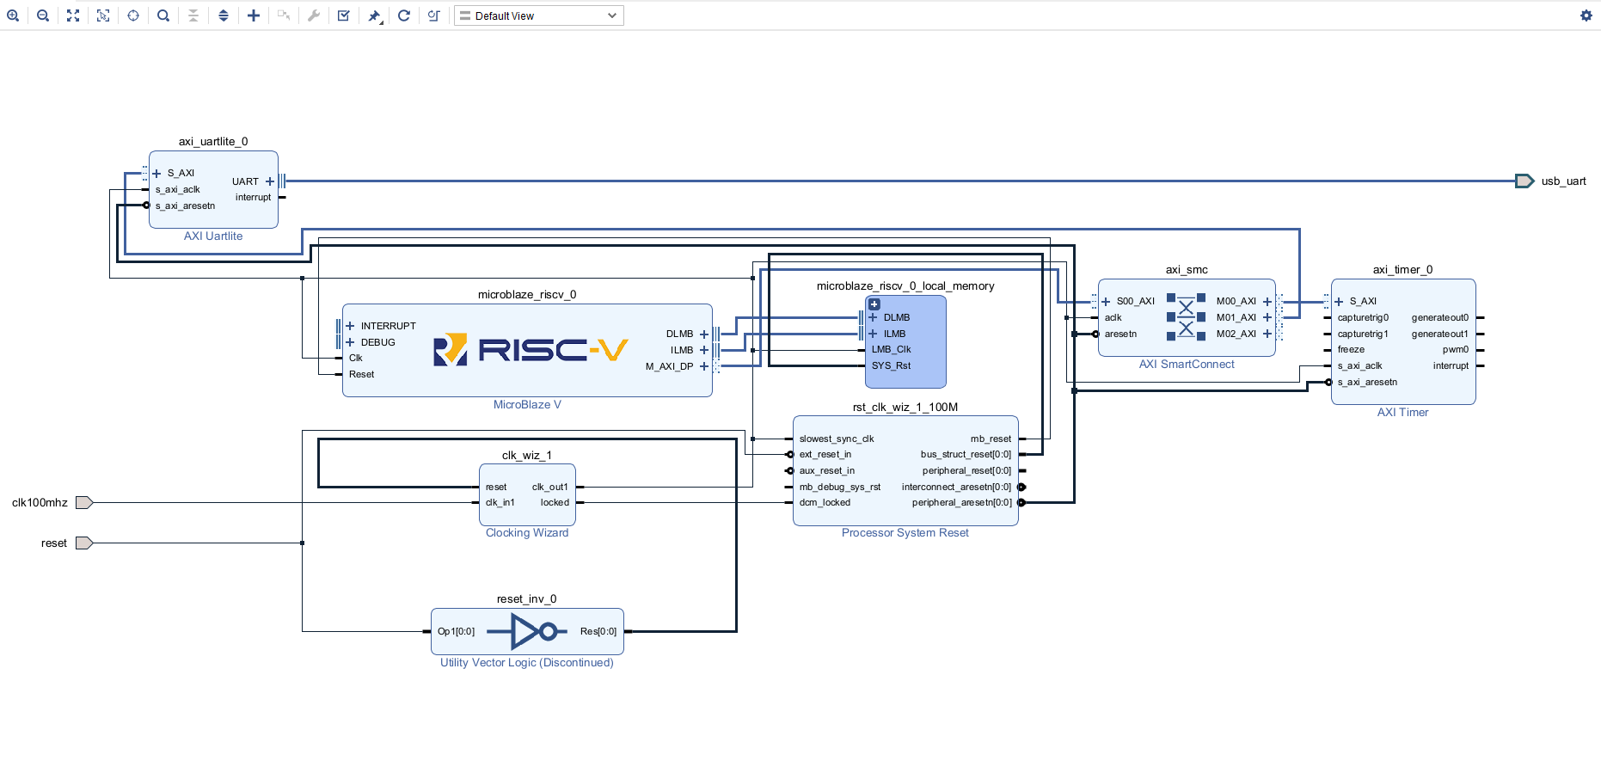
Microblaze V Block Diagram (Done in Vivado)

Slide 7
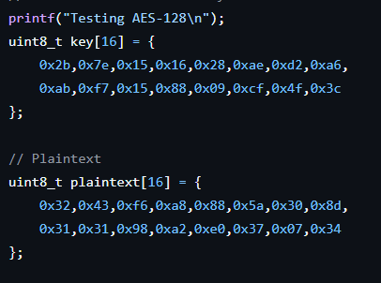
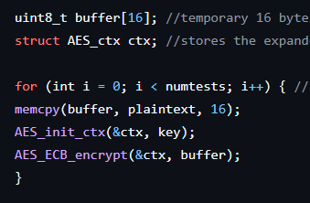
Implementation
Define encryption key and plaintext
Initialize AES context
Encrypt data block using ECB mode
Repeat encryption multiple times
Compare result with expected ciphertext
Notes:
The program starts by defining the key and plaintext values. It initializes the AES encryption context, then encrypts the data block using ECB mode. This process is repeated many times to measure performance, and the final result is compared with the expected ciphertext to confirm correctness.

Slide 8
Program Flow
Load key and plaintext
Initialize AES encryption context
Encrypt 16-byte data block
Repeat encryption 1 million times
Measure total execution time
Compute average time per encryption
Input
Key + Plaintext
Process
AES Encryption
Output
Ciphertext + Timing Results
Notes:
This slide shows how the program runs. The encryption process is repeated many times to generate measurable runtime data. The total execution time is recorded, and then the average time per encryption is calculated.

Slide 9
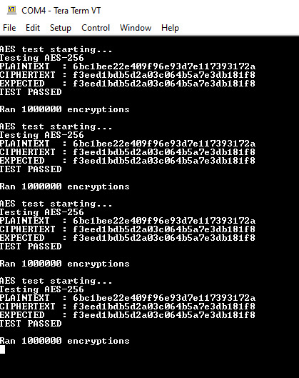
Output
Plaintext = original unscrambled text
Expected = hard-coded expected output
Ciphertext = output after many rounds of encryptions
We did 1 million encryptions each for 128, 192, and 256-bit AES using the same plaintext and measured execution time

Slide 10
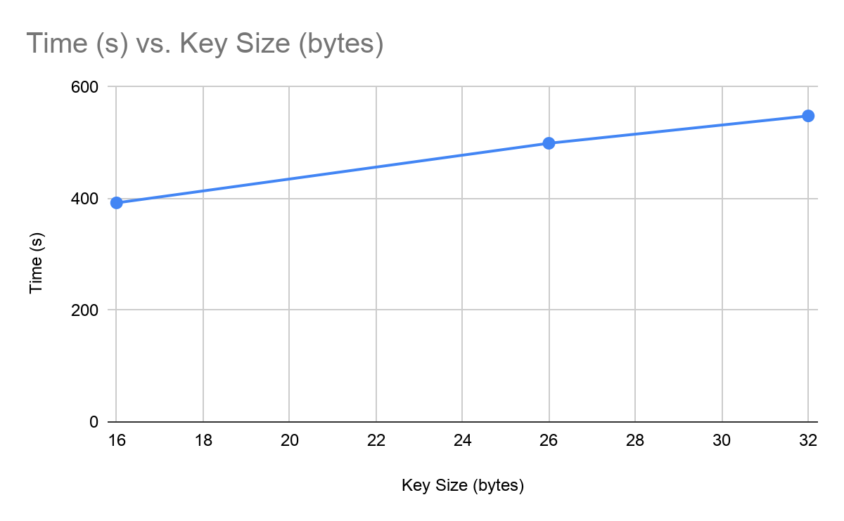
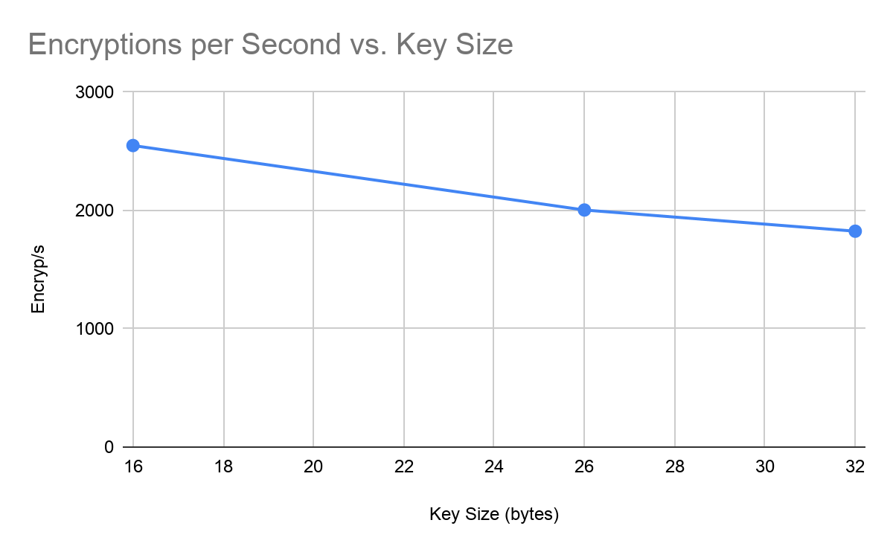
Results
4 trials of each type of encryption
AES-128:
392.375 seconds to encrypt
2,548.4 encryp/s or 39.8 KB/s
AES-196
499.125 seconds to encrypt
2,003.6 encryp/s or 31.3 KB/s
AES-256
548.1325 seconds to encrypt
1,824.5 encryp/s or 28.5 KB/s

Slide 11
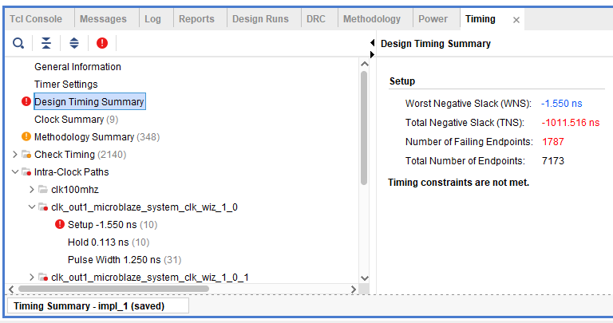
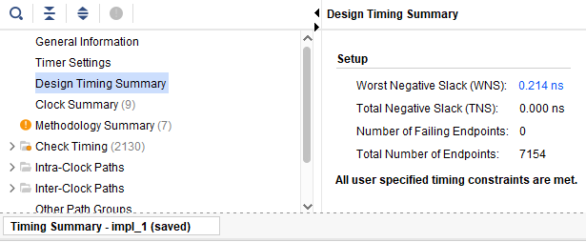
Alternate Clock Speed
Base clock speed for Nexys A7-100T is 100 MHz but in Vivado’s clocking wizard, the speed can be changed
We tried to go up to 200 MHz but the implementation timing kept failing
145 MHz was the highest clock speed that succeeded
50 MHz was the lowest clock speed that we tested
200 MHz
145 MHz

Slide 12
Comparing Clock Speeds (1 million encryptions)
Time to encrypt
Clock Speed | AES-128 | AES-192 | AES-256
50 MHz | 13:04.46 (784.46s) | 16:37.92 (997.92s) | 18:16.42 (1,096.42s)
100 MHz | 6:32.375 (392.375s) | 8:19.125 (499.125s) | 9:08.133 (548.133s)
145 MHz | 4:30.32 (270.32s) | 5:44.06 (344.06s) | 6:18.05 (378.05s)
Encryptions/second
Clock Speed | AES-128 | AES-192 | AES-256
50 MHz | 1,274.5 encryp/s | 1,002.1 encryp/s | 912.2 encryp/s
100 MHz | 2,548.6 encryp/s | 2,003.5 encryp/s | 1,824.4 encryp/s
145 MHz | 3,699.31 encryp/s | 2,906.5 encryp/s | 2,645.1 encryp/s

Slide 13
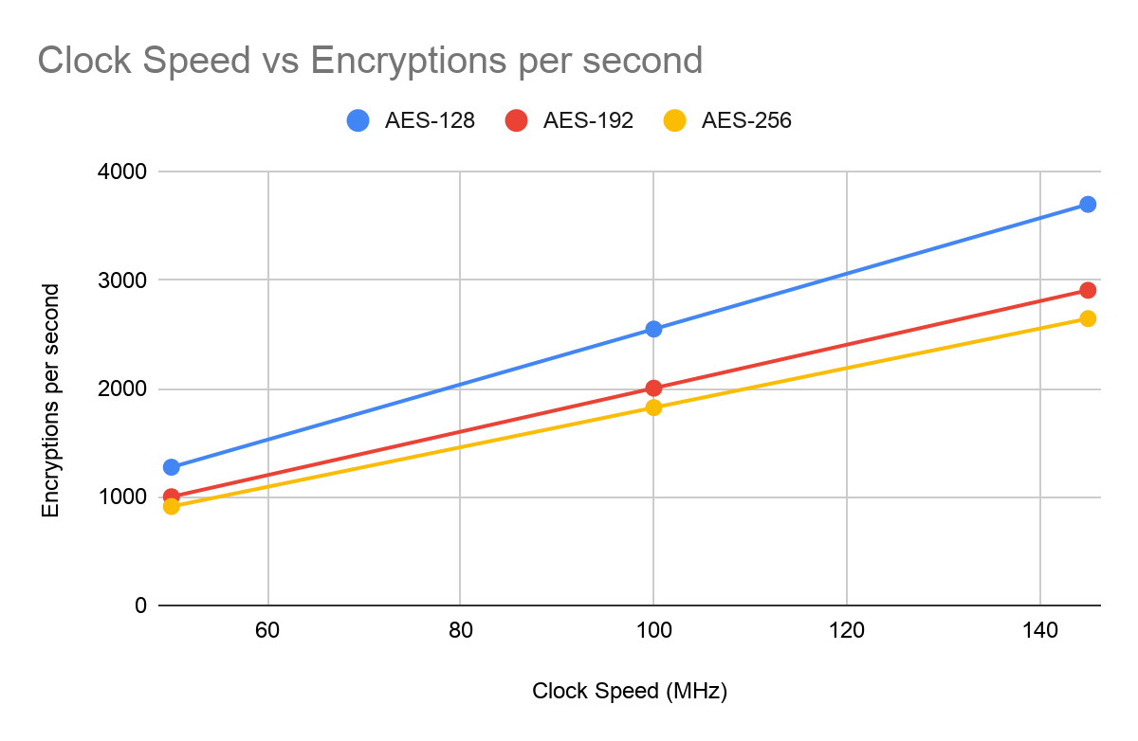

Slide 14
Extra Tests (Personal computers, AES-256 10,000,000 encryptions)
AMD Ryzen 5 2600 @ 3.4 GHz (32.3 seconds) AMD Radeon RX 580 16 GB RAM
Apple M1 @ 3.2 GHz (21.4 seconds) Apple M1 integrated GPU 8 GB RAM
Intel i7-11800H @ 2.30GHz (21.2 seconds) Intel UHD Graphics 32 GB RAM
AMD Ryzen 9 7940 @ 4.00GHz (20.54 seconds) Radeon 780M 16 GB RAM

Slide 15
Observations
We were unable to isolate singular variables such as amount of RAM, cache, and any hardware AES capability, however:
Clock speed makes a big difference (100MHz on FPGA vs. 2-4GHz on PCs)
Our own computers ran the AES encryptions much faster than our FPGA boards
About 2.1 seconds for 1 million AES-256 encryptions vs. 548 seconds for FPGA software-only
Upscaling FPGA’s clock speed from 100 MHz to 3.0 GHz, we would expect 54,732 encryptions/s but our computers did more than 476,000 encryptions/s
Many CPUs have special hardware dedicated to AES (AES-NI in Intel & AMD CPUs, ARM cryptography extensions, etc. that are much faster than software AES
Running AES in parallel (such as with GPU acceleration) means multiple blocks of AES can be encrypted at the same time, vs. sequential software AES 1 at a time

Slide 16
Conclusion
AES encryption was successfully implemented using C software
Encryption correctness was verified using known test vectors
Performance was measured using repeated encryptions and average time per encryption
Results showed:
Increased key sizes lead to slower encryption time
Increased clock speeds lead to faster encryption time

