Slide 1
The Impact of Federal Upper Limit Provisions on Prescription Drug Accessibility for Medicaid Beneficiaries
Andrew ElHabr
April 27, 2018

Slide 2
Overview
Background
Research Question
Model
Analysis
Findings
Conclusions

Slide 3
Background
Medicaid provides health coverage to millions of Americans, including eligible low-income adults, children, pregnant women, elderly adults and people with disabilities.¹
In April 2016, the method for how Medicaid agencies reimburse pharmacies for prescription drugs fundamentally changed, in what is known as the Federal Upper Limit (FUL) provisions.
Part of the changes brought by Affordable Care Act (2010)
Project analysis covers post-Medicaid expansion era (2014-2017)
1 “Medicaid.” Medicaid.gov, U.S. Government, www.medicaid.gov/medicaid/index.html.

Slide 4
Research Question
How has the FUL provisions impacted prescription drug accessibility for Medicaid beneficiaries?
Importance: Americans spend more out-of-pocket for prescriptions and experience more financial barriers than people from Australia, Canada, Germany, the Netherlands, New Zealand, and the U.K.²
Idea: Use the number of drug prescriptions filled as a proxy for drug accessibility to determine if the FUL provisions has worsened the U.S.’s drug affordability and accessibility problem.
2 Morgan, S., and J. Kennedy. “Prescription Drug Accessibility and Affordability in the United States and Abroad.” Issue Brief (Commonwealth Fund), June 2010, pp. 1–12.

Slide 5
Model Specification
Panel data analysis
i → states in the U.S. (N = 50)
t → years (T = 4)
Cannot use Difference-in-Difference analysis since there is no control group (FUL provisions applied to all 50 states).
Focus is on significance of 2017 time dummy variable – FE method seems most appropriate.
Dependent Variables (y_{it})
Log of the number of prescriptions of drug k filled that are paid for by state Medicaid agencies: k = Amoxicillin, Fluoxetine, Lamotrigine, Carvedilol, Morphine Sulfate
Independent Variables (x_{it})
Log of per capita personal income
% of population enrolled in Medicaid
% of population enrolled in Medicare
% of population uninsured
% of adult population that smokes
% of adult population that is obese

Slide 6
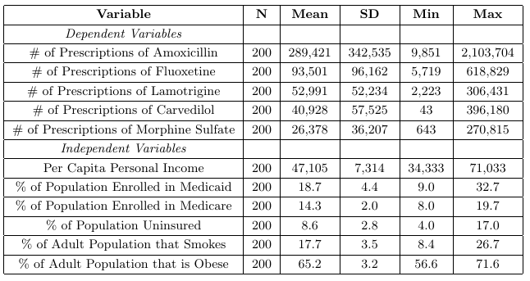
Summary Statistics

Slide 7
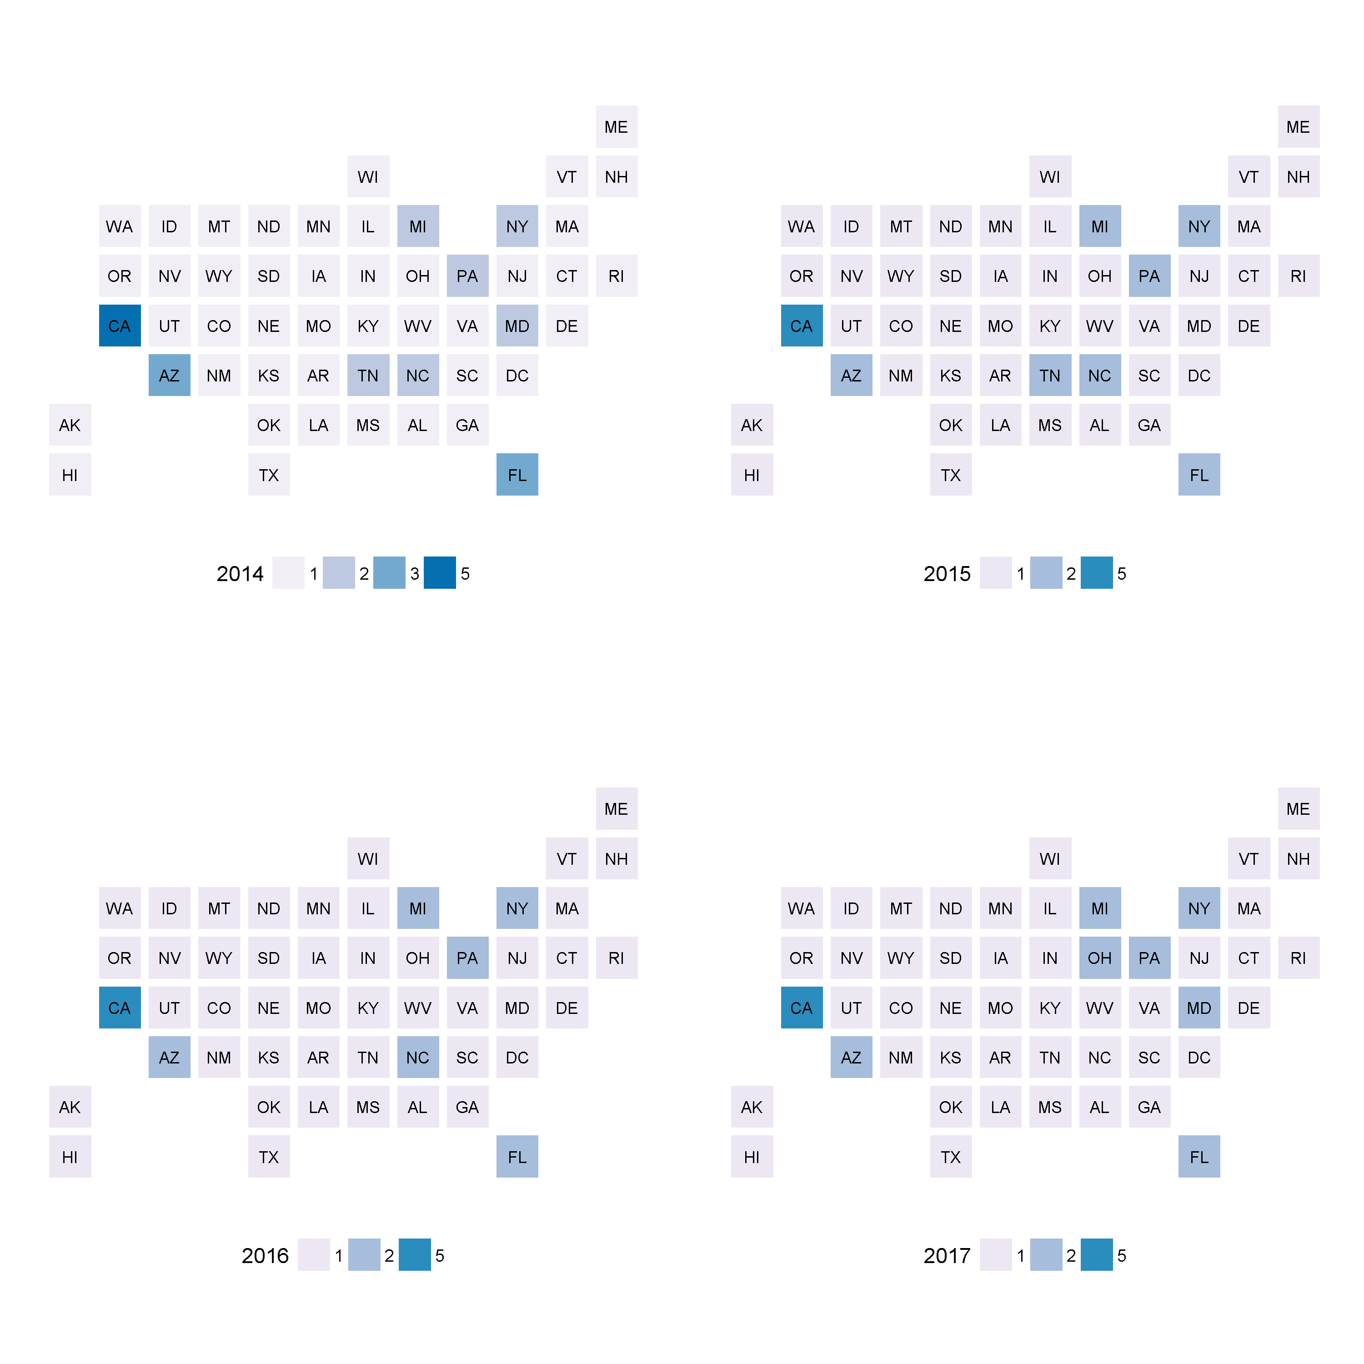
Example of Drug Utilization Progression: Density of Prescriptions of Morphine Sulfate by State from 2014-2017
Noticeable decrease over time
Noticeable increase over time

Slide 8
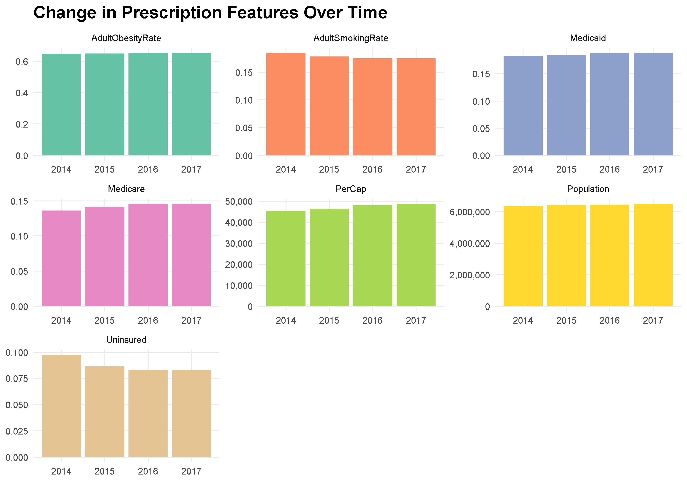
Variation of Independent Variables over Time
The lack of variation in the dependent variables indicates that we might have inefficient estimates when using fixed effects estimation. This is why it important to perform pooled OLS estimation as well.

Slide 9

Analysis Progression
Start with linear trend model to determine the existence/ significance of a general trend in number of prescriptions filled.
Perform pooled OLS with time dummies and obtain robust standard errors as a base case for determining the significance of FUL provisions via the estimate of δ₃.

Slide 10

Analysis Progression (cont.)
Perform fixed effects estimation with time dummies (within and FD estimation) for determining the significance of FUL provisions via the estimate of δ₃.
Perform GMM estimation on dynamic model to determine if number of prescriptions filled follows a yearly trend or if 2017 behavior indicates a significant deviation from the norm.

Slide 11
Findings
For various types of estimation methods (including random effects), the percentage of people on Medicaid has the most statistically significant effect on the number of prescriptions filled for each drug that is covered by Medicaid (positive relationship, as expected).
All methods seem to indicate that there is a significant drop-off in the number of prescriptions filled for each drug after the FUL provisions in 2016, especially for Morphine Sulfate and Fluoxetine.

Slide 12
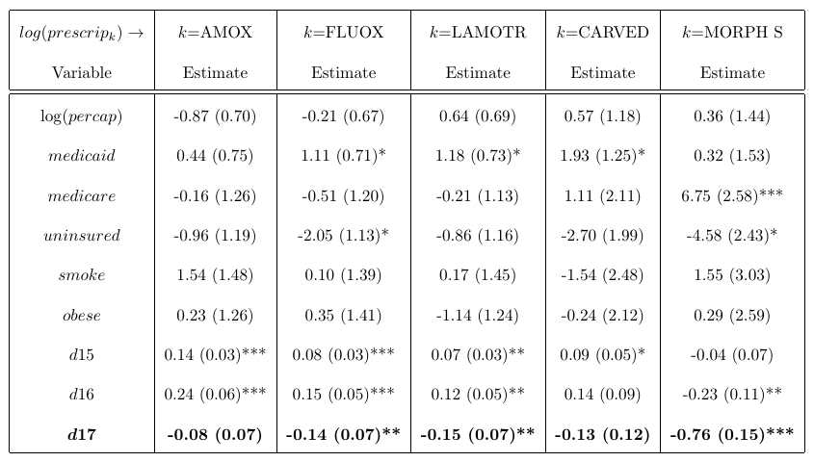
A summary of coefficient estimates and significance for the FD estimated model. (*** - significant at 1% level, ** - significant at 5% level, * - significant at 15% level)

Slide 13
Conclusions
Need data from 2018 and need to investigate more drugs before any strong conclusions can be made about the effect of the 2016 FUL provisions → there still could be a variety of reasons for these findings.
But current analysis indicates that the FUL provisions have had a negative impact on prescription drug accessibility, which was suspected.
Implications: U.S. government needs to reconsider the provisions that were made to the FUL if they care about prescription drug accessibility.

