Slide 1


Intro to RxJS
By: Andrew Evans

Slide 2
Agenda
What is RxJS?
How does RxJS work?
Subscriptions and Memory Leaks
Advanced Example
Closing Remarks

Slide 3
RxJS History
Reactive Extensions = concept started by Erik Meijer and others
Implementation of the Observer Pattern
Taken shape for many different languages to include .NET and Java
RxJS = implementation of Reactive Extensions in JavaScript
Project was originally started by Matthew Podwysocki and others as independent open source project
Project expanded by Ben Lesh (version 5 and beyond) and improved to what we have today
RxJS implements both the Observer Pattern and Iterator Pattern.
RxJS uses functional programming for managing sequences (streams).

Slide 4
Imperative vs Declarative
Imperative refers to code that you write to behave a specific way
you manually write the sequence yourself
Think promises
Declarative refers to declared statements or functions to perform actions
define event stream flow
Rely on observables and operators to do the work for you.

Slide 5
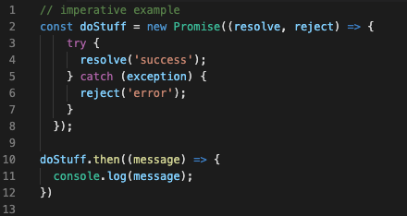
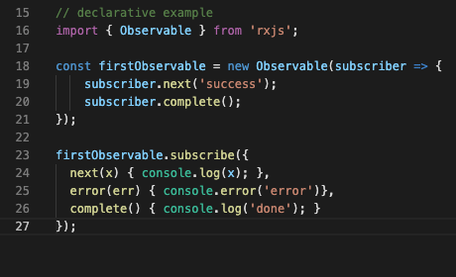
Promise vs Observable

Slide 6
How does RxJS work?
Observable = defined stream of events
Subscription = represents the execution of a flow (turning it “on” to run)
Operators = “pure” functions that can invoke flows with subscriptions
Subject = a formal event emitter, can be used for multicasting
Schedulers = handle concurrency and other things (advanced)

Slide 7
How does RxJS work? (continued)
Typical first introduction to RxJS is with Observables
Observables implement an Observer
next = emits events in stream
error = returns error to stream
complete = frees resources of stream

Slide 8
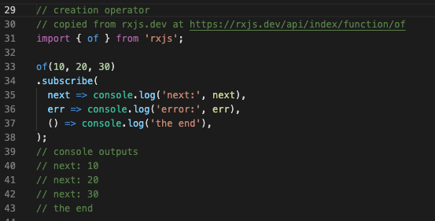
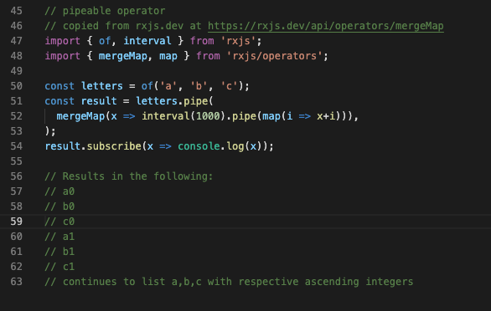
RxJS Operators
Instead of manually defining an observer for each task, you can rely on operators
creation operators = generate observables
pipeable operators = return observables from observables using the syntax “.pipe”

Slide 9
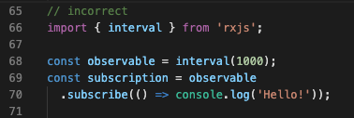
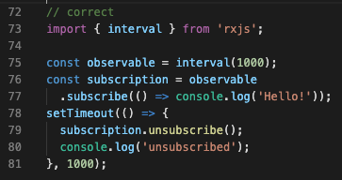
Handling Subscriptions and Memory Leaks
If you miss a subscription = memory leak
slow down your application
Make sure to handle subscriptions with:
“.unsubscribe”
built in framework mechanism like Angular’s Async Pipe
Check out my DEV.TO post on correctly handling subscriptions
https://dev.to/rxjs/common-approaches-to-handling-subscriptions-1nk7

Slide 10
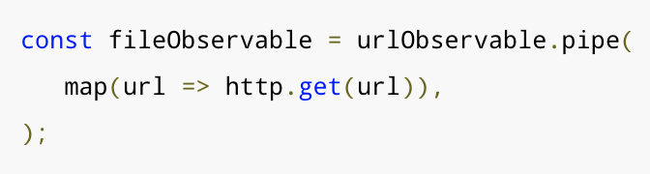
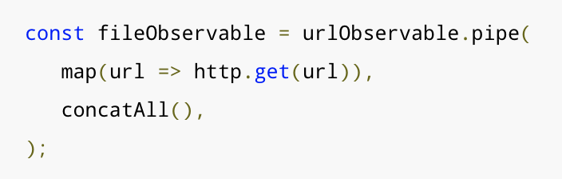
Higher Order Observables
What happens when you have an Observable of a group of Observables?
This is called a Higher Order Observable.
You can flatten the group of observables into one single observable with an operator like:
concatAll()
mergeAll()
switchAll()
exhaust()
For more information on this check out the RxJS Guide on Operators here https://rxjs.dev/guide/operators
http.get returns an Observable, but with map this could be many. concatAll() combines all of the resulting string values into one output

Slide 11
Advanced Example
“From Promises to Observables”
https://dev.to/rxjs/from-promises-to-observables-4bdk
Stackblitz
https://stackblitz.com/edit/learning-rxjs-with-angular

Slide 12
Further Learning
Functional Programming = Really Cool
Lots of things that you can do with RxJS that go far beyond this presentation
Recommend the RxJS Docs at https://rxjs.dev/
My post on “Getting Started with RxJS” here https://rhythmandbinary.com/2020/02/12/getting-started-with-rxjs
My GitHub project with some additional links here https://www.github.com/andrewevans0102/intro-to-rxjs-talk

Slide 13
Credits
RxJS image on first slide was copied from here https://rxjs.dev/
JS image on first slide was copied from here https://www.freecodecamp.org/news/learn-these-core-javascript-concepts-in-just-a-few-minutes-f7a16f42c1b0/

