Slide 1


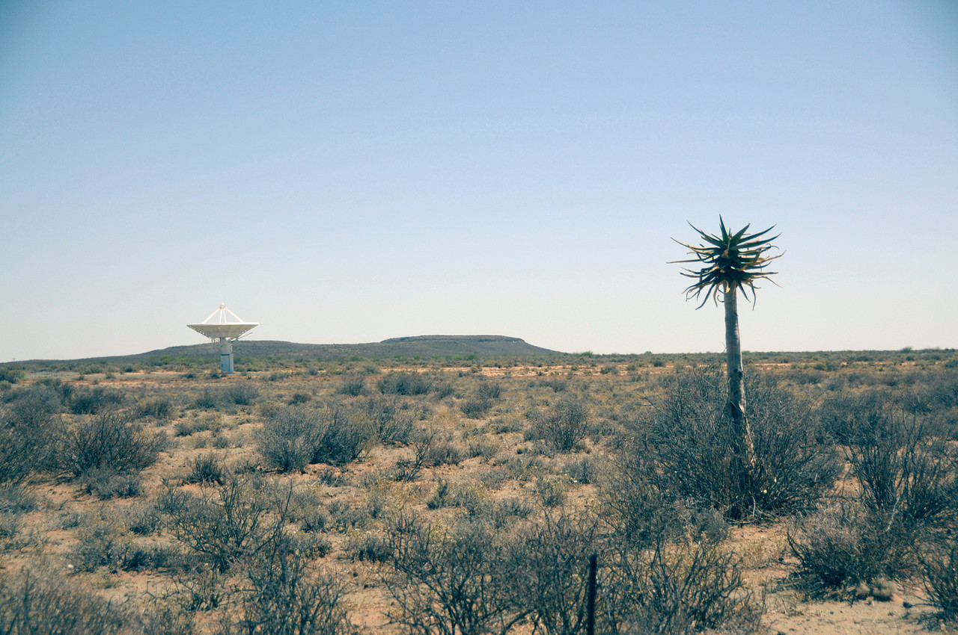

Leveraging Remote Sensing Observations for Regional Climate Change Research
Andrew F. Hart, Cameron E. Goodale, Chris A. Mattmann, Peter Lean, Jinwon Kim, Paul Zimdars, Duane E. Waliser, Daniel J. Crichton
Userlab 2, 04.12.2012. Daka Senegal

Slide 2
Rationale...
Increasing interest in historical remote sensing observations for local, near-term decision support
Multiple International efforts seeking to provide a better understanding of Earth’s climate through modeling
Emphasis on regional scale and decadal timeframes vs. global, long-term models

Slide 3
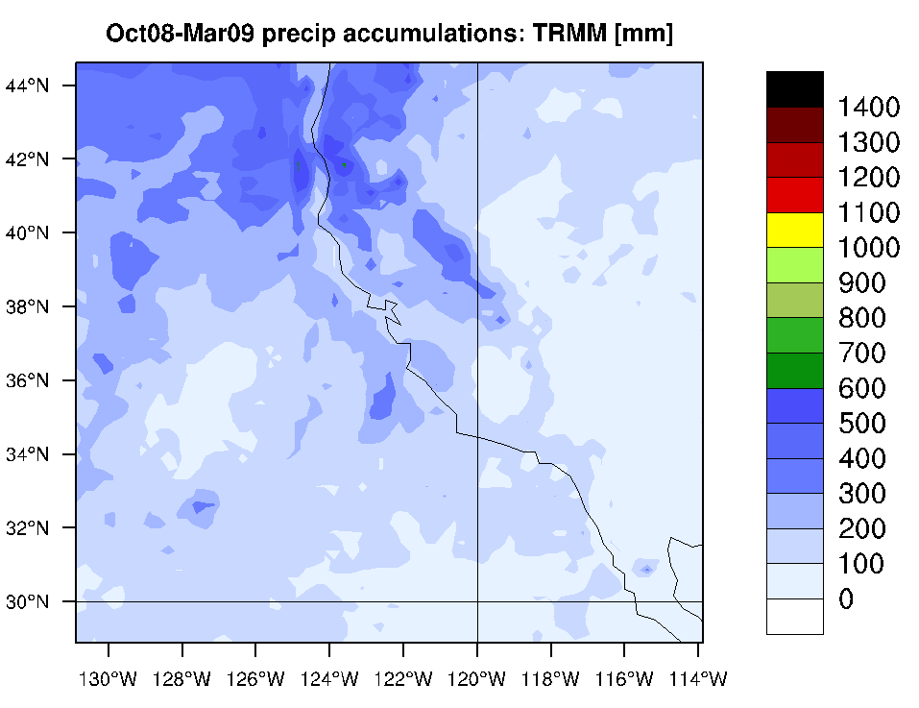
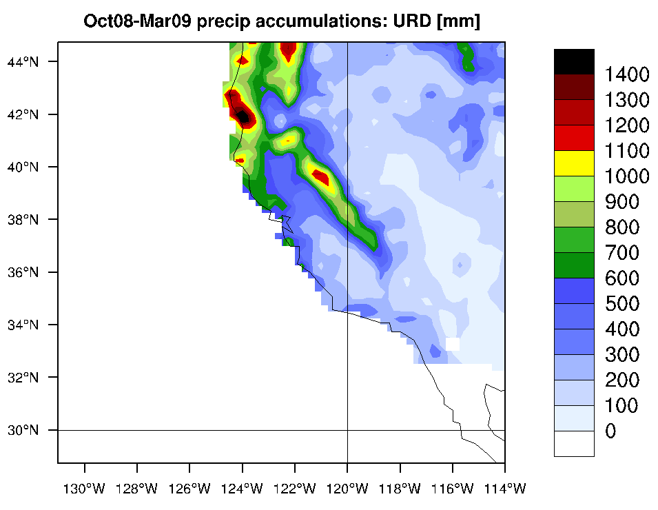
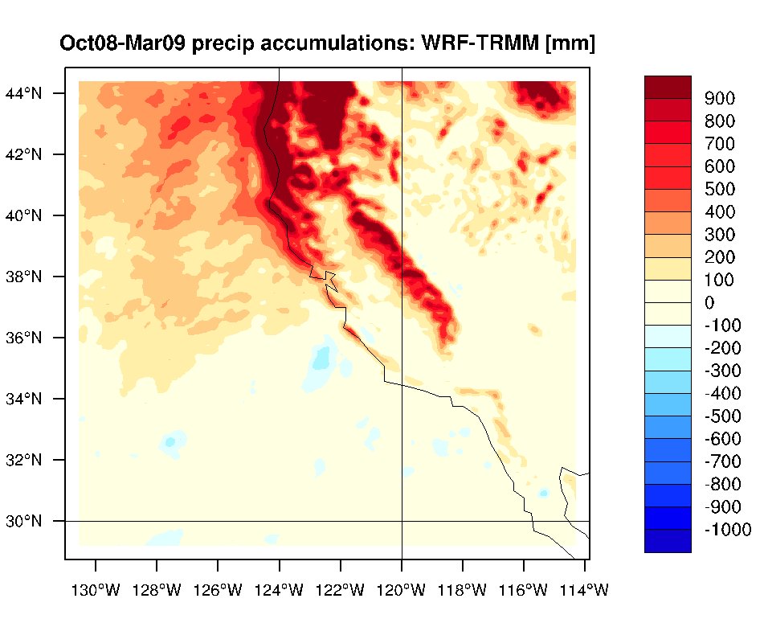
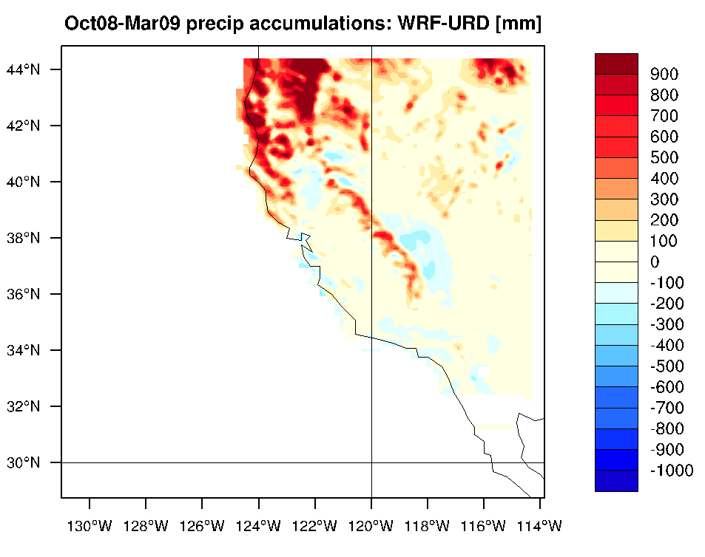
Opportunity...
TRMM observations
Remote sensing observations can provide a complimentary perspectective

Slide 4
Challenges...
Remote sensing data collected for various purposes by different instruments and teams
Remote sensing data stored in disconnected repositories and managed by different organizations
Remote sensing data stored in heterogeneous formats, not always optimized for research

Slide 5
Tools...
RCMES: Regional Climate Model Evaluation System
“Reduce the time and effort required to interact with remote sensing data products”
“Allow researchers to focus on their research, not data management.”

Slide 6
System Overview...
RCMED:
Scalable container for decades of observations from multiple sources, aligned to a common data model
Optimized for regional climate modeling query characteristics

Slide 7
System Overview...
RCMED:
What comes out?
Raw remote sensing observations (data points)
Uniform format

Slide 8
System Overview...
RCMET:
Client toolkit for interacting with RCMED
Browser-based interface for performing configurable processing tasks
Common algorithms for comparing models to observations
Data visualization tools

Slide 9
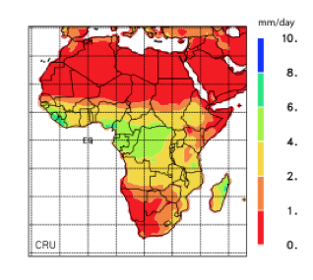
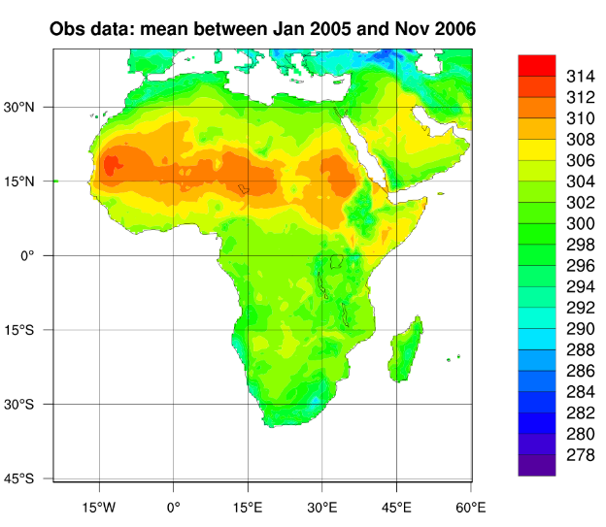
System Overview...
RCMET:
What comes out?
Visualizations of remote sensing observations

Slide 10
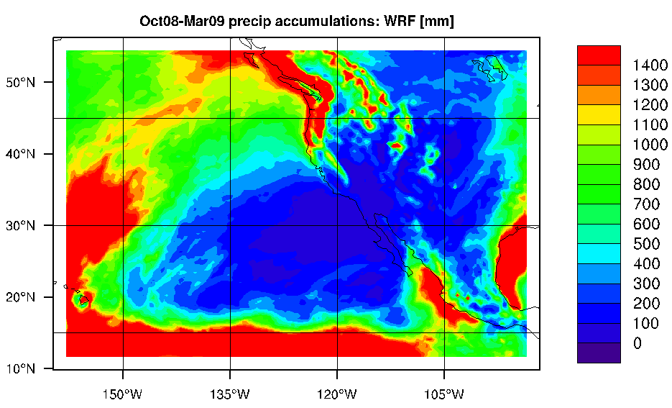
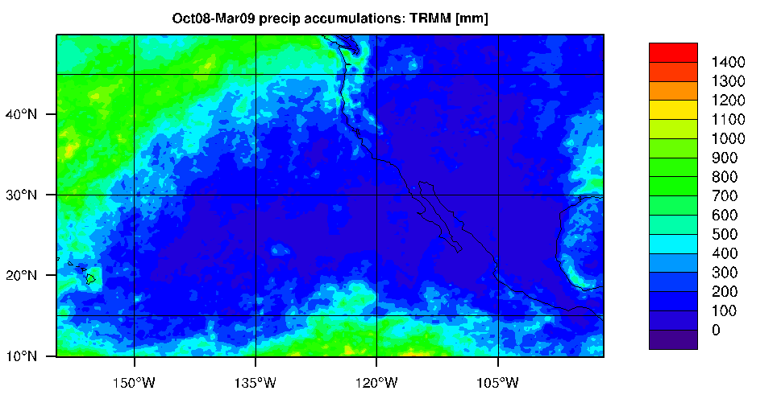
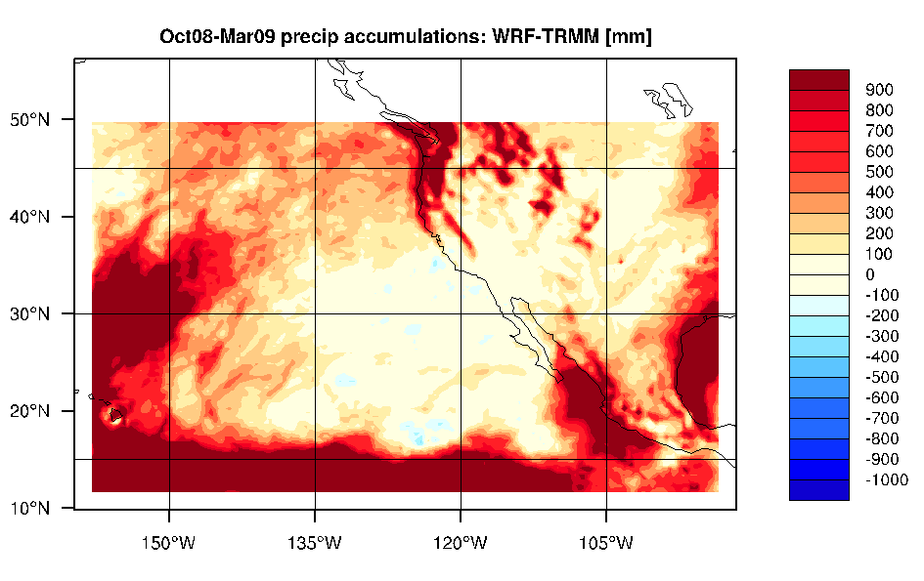
Use Cases...
Bias Calculation

Slide 11
Applications...
RCMES is a research effort that is still in its early stages
Much of the RCMES software is just becoming publicly available
Designed to support a wide variety of research

Slide 12
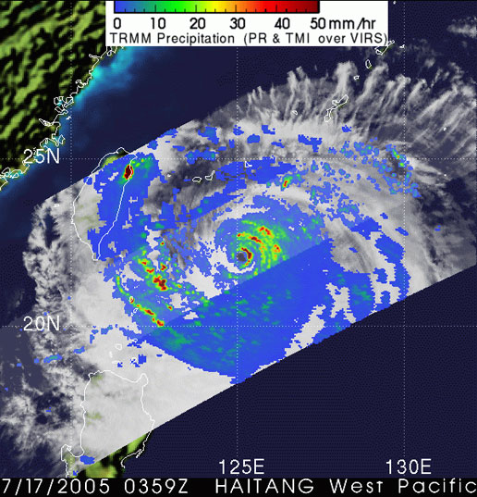

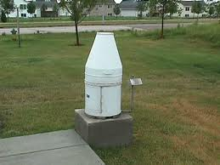
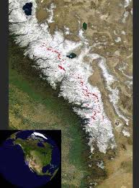
Datasets that have been included so far:
TRMM (satellite precipitation): [1998– 2010]‏
AIRS (satellite atmospheric surface + profile retrievals) [2002 – 2010]
ERA-Interim (reanalysis): [1989 – 2010]
NCEP Unified Rain gauge Database (gridded precipitation):
[1948 – 2010]
Snow Water Equivalent (Noah Molotch): [2000-2009]‏
T(2m), T(p), z(p)
T(2m), Td(2m), T(p), z(p)
Statistical Metrics included:
Bias, RMS error, Anomaly Correlation, Pattern Correlation

Slide 13
Applications...
How can we make this more relevant:
Identify parameters of research interest
Identify existing datasets that would be useful to include

Slide 14
More Information:
http://rcmes.jpl.nasa.gov
{ahart,cgoodale,crichton,mattmann}@jpl.nasa.gov

Slide 15
End.
Thank you very much for your attention!

