Slide 1

TEAM CODELETHES
Use Case 15 : Virtual Patient Recruitment`

Slide 2





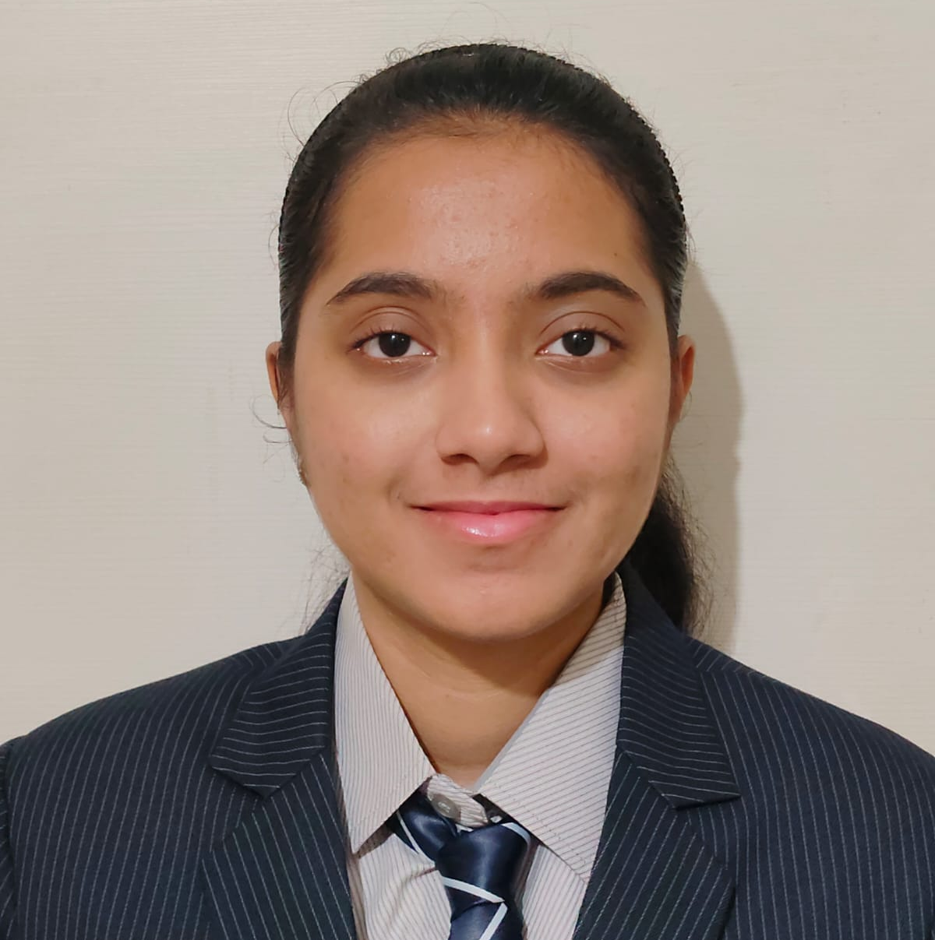

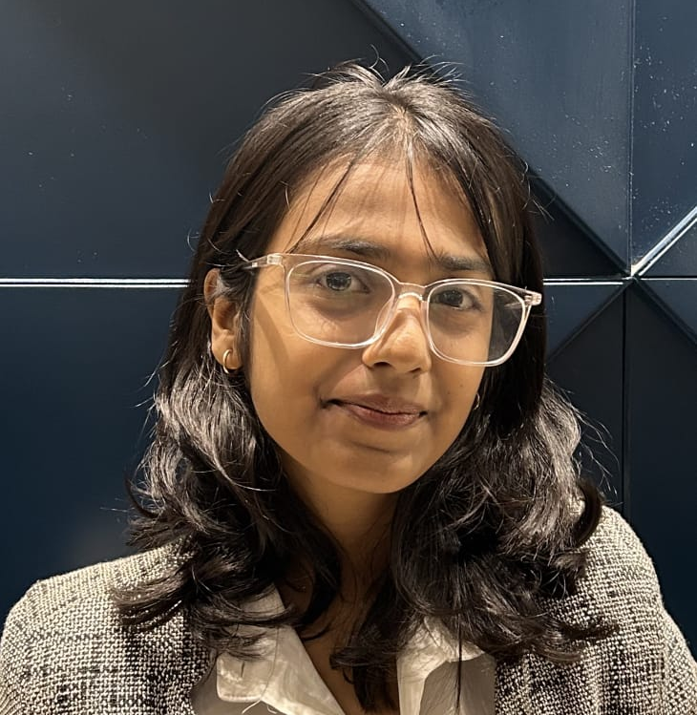

Meet The Team
Himanshi Chaudhari
Ayush Yede
Anshul Bhaisare
Yash Ghule
Mrunal Daddi
Narayani Gupta
Minal Gajbhiye
Indrayani Thakur

Slide 3

How are we testing the Drugs Nowadays?
Patient recruitment is done manually. Recruiters check a patient's medical history, disease stage, prior treatments and dozens of other data points.
However, this process takes a lot of time, can lead to high failure rates, and isn't easy to scale up for the thousands of patients required for major trials.
“ These challenges show why a faster, more automated solution is needed ”

Slide 4

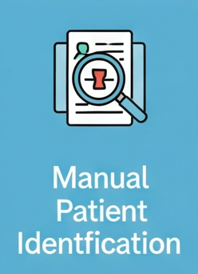



Traditional System

Slide 5

🩺 V-Recruit
A Virtual Recruitment System
To automate patient matching and predict eligibility using AI.
To enable remote screening and recruitment from any location.
To improve the patient experience with a simple and accessible process.
To reduce recruitment delays, costs, and manual effort.

Slide 6


Our approach to solution
Data Collection & Preprocessing
Model Training
Web Application
Chatbot
Eligibility & Notification
Gather patient data from medical experts, which was then cleaned and structured for high-quality model training.
Developed and validated multiple ML models to predict patient eligibility, selecting the most accurate algorithm for deployment.
Built a web app for hospitals (bulk uploads) and individual patients (eligibility self-check form).
Integrated an AI chatbot to provide 24/7 user support, answer queries, and guide patients through the process.
Intuitive and Interactive Interface between the user.

Slide 7

System Architecture
CHATBOT
Conversational
Assistance
BACKEND
FRONTEND
SMS to Users
Check Eligibility
Dashboard
MODEL
Fast2SMS
Upload CSV
Login
Pediatric
Infectious
Contact Us
Bulk Processing
Output
Recruit
Trial Section
Oncology
Hypertension
Admin email
Single Patient
Logs
Fill Form
Database
Email to Users

Slide 8





DataSet
Expert-Driven Foundation
Purpose-Built for Accuracy
Specialized Scope
Our project is built upon a unique dataset curated in direct collaboration with medical experts, including doctors and pharmacists.
The data contains key clinical testing parameters across four diverse and high-impact trial areas: Oncology, Hypertension, Infectious Disease, and Pediatrics.
This specialized dataset was designed specifically to train our AI model on the complex nuances of patient eligibility, ensuring our system's predictions are both highly accurate and relevant.
Oncology
Hypertension
Infectious Disease
Pediatrics

Slide 9



FrontEnd
React
React is a free JavaScript library created by Facebook for building user interfaces.
It allows developers to create large web applications that can change data, without reloading the page, by using reusable UI components.

Slide 10

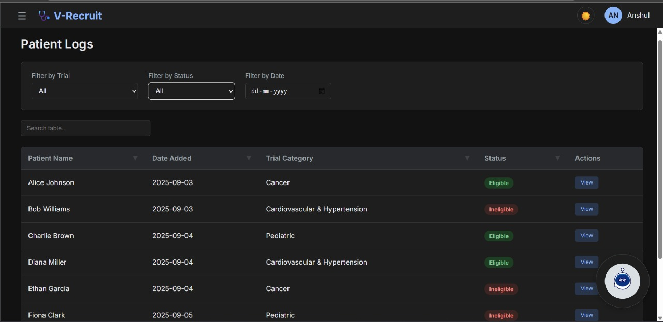
Frontend Design
Intuitive Trial Browsing
A seamless and responsive interface for patients and hospitals to search and filter trials.

Slide 11
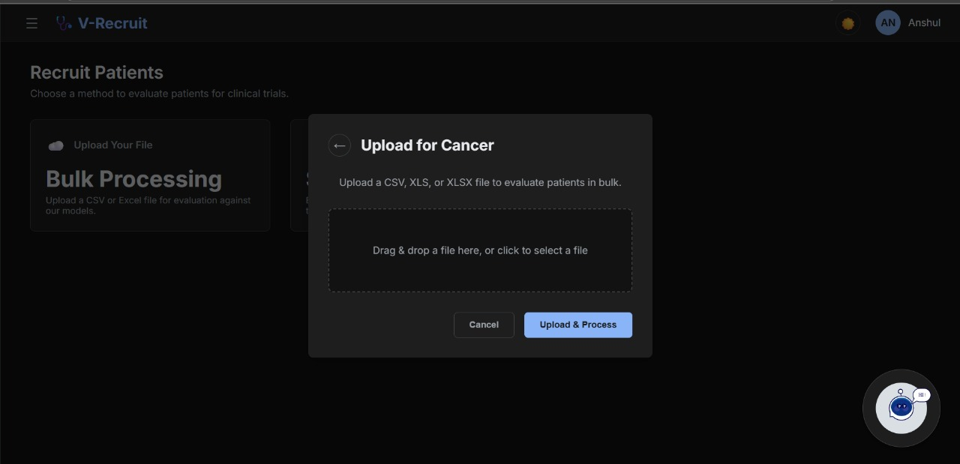
CSV Upload for Hospitals
Secure functionality for hospitals to upload patient databases (.csv files) for bulk screening.

Slide 12
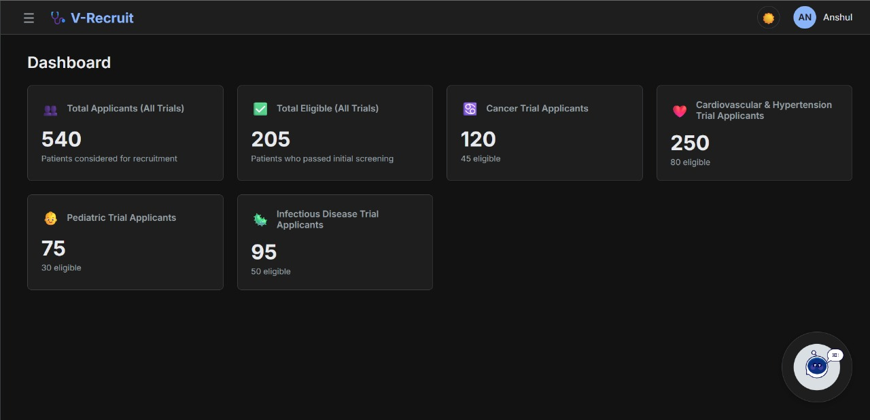
Instant Eligibility Feedback
Dynamic forms for patients to input their details and receive immediate eligibility results.

Slide 13

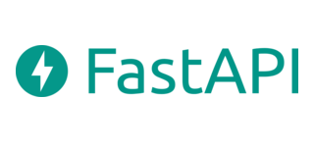



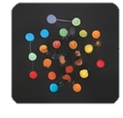





Backend Architecture
API Layer
Service Layer
Auth Service
Patient service
Predictions Service
Hashing
JWT
Notifications Service
ML/ AI Model
Sql Alchemy ORM
SMTP
Database Layer
Email
SMS (Fast2SMS)

Slide 14




AI Powered ”CareBot” Assistant
User Question
CareBot
Predefined Question
Complex Question
Gemini API
Instant Answer
LLM-Powered Answer

Slide 15

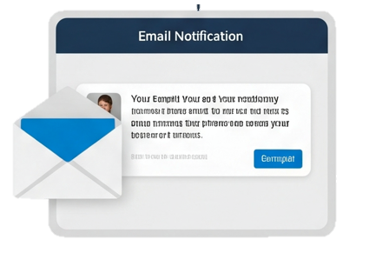
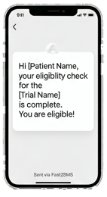

Automated Patient Notifcations
Accelerated Communication
Eliminates waiting and uncertainty by delivering automated, real-time eligibility notifications the instant a determination is made.
Hi Vikas, your eligibility check for Oncology is complete.
You are not eligible!
Compose
Guaranteed Outreach
Maximizes patient reach and ensures message delivery by leveraging both high-urgency SMS alerts (via Fast2SMS API) and formal, detailed email confirmations.

Slide 16


Integration with
Gemini LLM
We integrated the Gemini LLM via an API to power the advanced conversational abilities of our 'CareBot' assistant. When a user asks a complex question not covered by our predefined answers, the chatbot seamlessly queries Gemini to provide a dynamic and context-aware response.

Slide 17
FUTURE
AI-Powered Retention & Risk Prediction
Advanced Analytics & Diversity Tracking
Full DCT Support
Real-Time EMR/EHR Integration
Predict dropout risk using patient data to improve retention and engagement.
Enable eConsent, telehealth visits, and remote monitoring with wearables for decentralized trials.
Provide real-time analytics to monitor recruitment diversity and optimize strategies.
Automate recruitment via secure, continuous EMR integration, removing manual uploads.

Slide 18

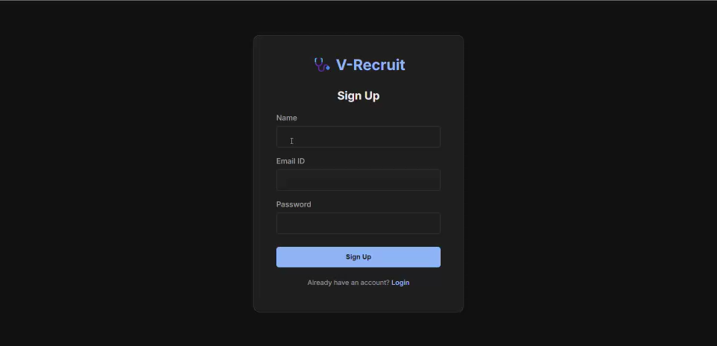
DEMO

Slide 19

THANK YOU

