Slide 1
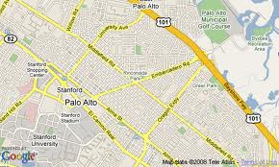
Fresh Food Finder Layout
Search … (User types input)
Apple
Banana
Carrot
.
.
.
User selects food button or types recognized food
Recipes

Slide 2
Fresh Food Finder Layout
Map provides position of vendors of that food in a one-mile radius
Selecting any one of the vendors produces a popup message with a list of directions to that vendor
Recipes
Selecting the “recipes” button produces a popup message with one recipe ( andpossibly a link to find more recipes)

