Slide 1




STA 4102 Project
Andrew Gomez

Slide 2

About me
Major: Computational & Applied Mathematics
Minor: Psychology
Junior
Data Analytics
NBA Sports Analytics
Hobbies: Pickleball, watching movies, being an avid Heat fan

Slide 3



QuestionS
Which stats in an NBA game/season have the largest influence on the players’ salaries?
Can we create a model that accurately predicts an NBA player’s salary for the following season based on the previous season’s stats?

Slide 4
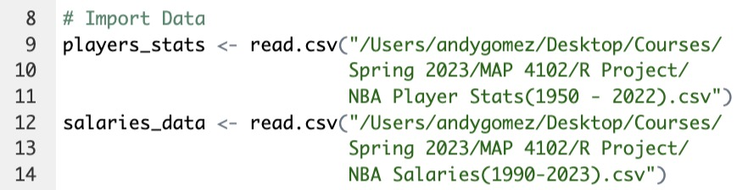
Data
NBA Players Stats (1950-2022)
NBA Salaries (1990-2023)
kaggle.com

Slide 5
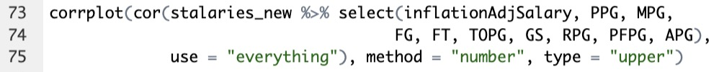
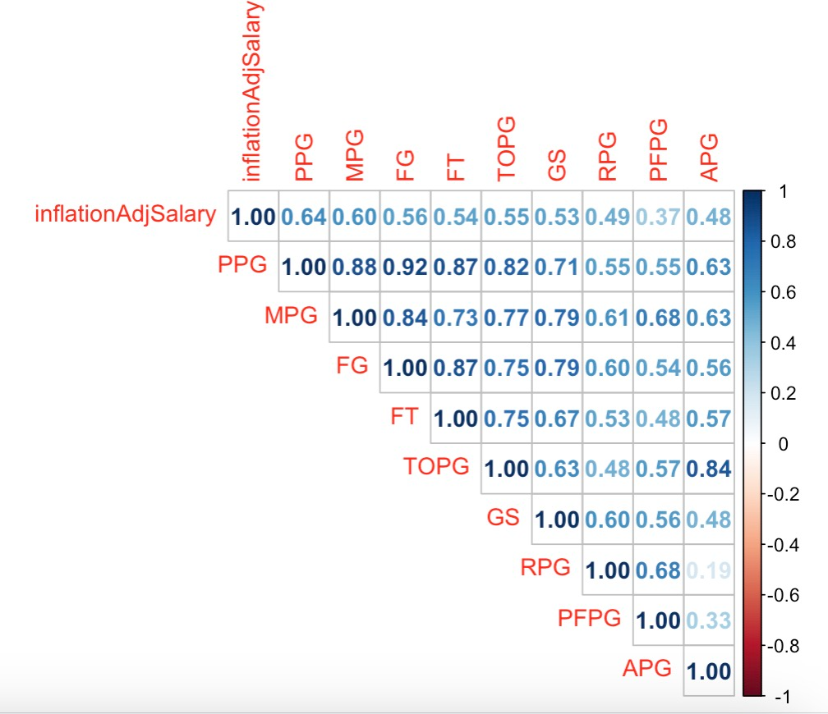
Variables
inflation_adj: Salary adjusted for inflation
PPG: points per game
MPG: minutes per game
FG: field goals scored
FT: free throws made
TOPG: turnovers per game
GS: games started
RPG: rebounds per game
PFPG: fouls per game
APG: assists per game

Slide 6
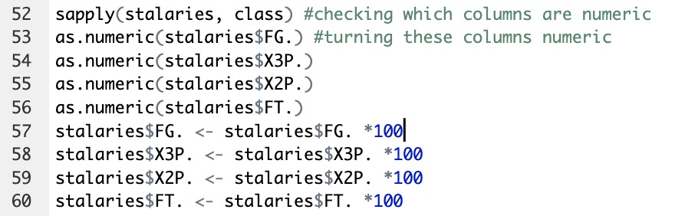
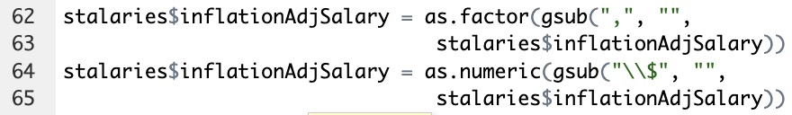

Data Cleaning/Wrangling
Just 2015-2016 season stats
Narrowed down from 45 columns to 10 as shown in previous slide
Merged players_stats and salaries_data to a new data frame called stalaries
Made percentage and dollar values numeric
Removed rows that included players that played under 20 games

Slide 7
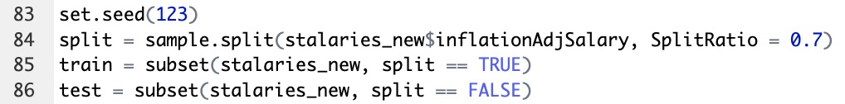
Data Cleaning/Wrangling cont.
Split into train set and test set

Slide 8

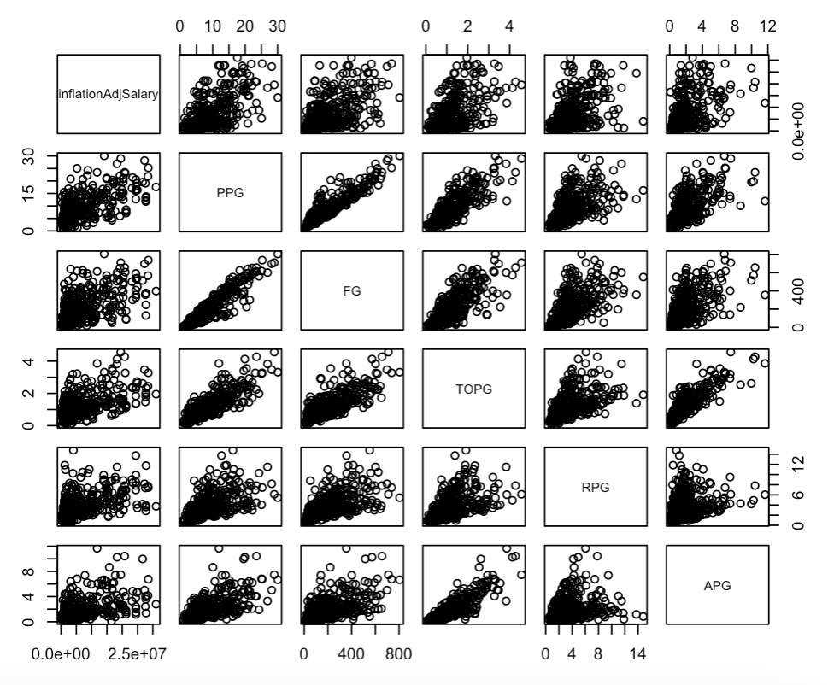
Exploratory Data Analysis
Generated scatterplots to visualize the correlation between our dependent variable and a few independent variables
Can conclude that PPG, FG, TOPG, RPG, and APG are the five factors that most heavily influence the salary of the player

Slide 9

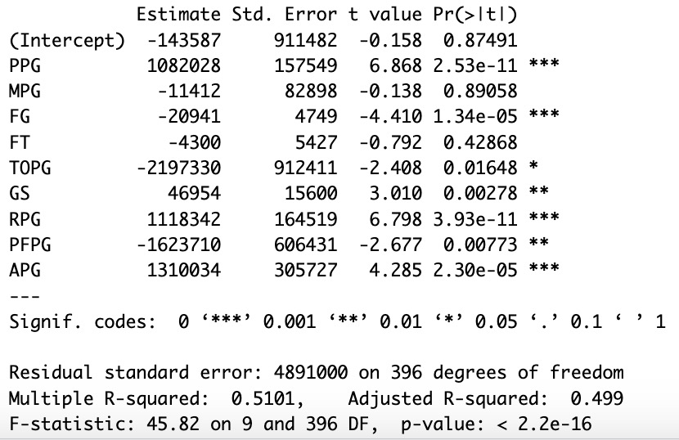
Exploratory Data Analysis
Ran multiple linear regression and compared p-values (able to rule out MPG and FT)
Adjusted R-squared = 0.499

Slide 10

Predictive Analysis
Made a model using the training set
Generated predictions using the test set
Did it again, with scaled data

Slide 11
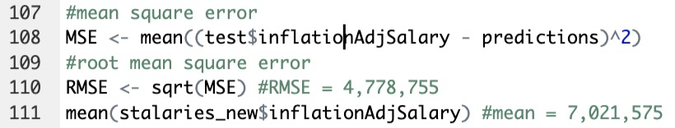
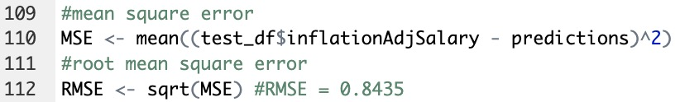
Model Evaluation
RMSE (unscaled) = $4,778,755
RMSE (scaled) = 0.8435

Slide 12


Statistical Analysis
Test for multicollinearity
Variance Inflation Factor > 5
So I decided to run a ridge regression to find the most optimal coefficients for my linear model that will result in the lowest RMSE.
Used the scaled data from earlier

Slide 13
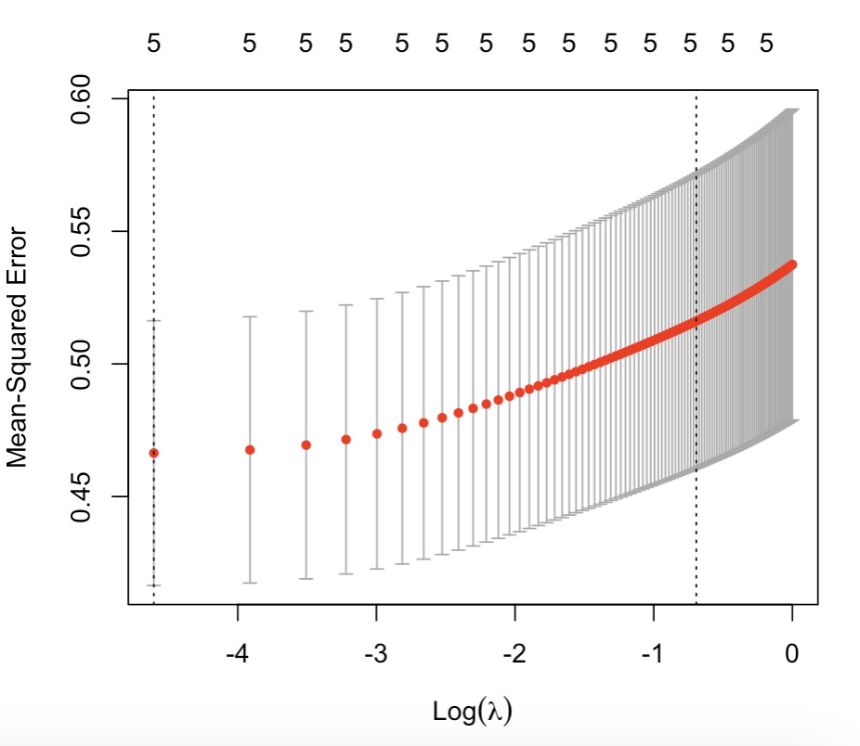
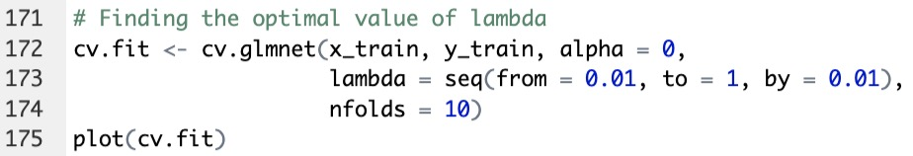
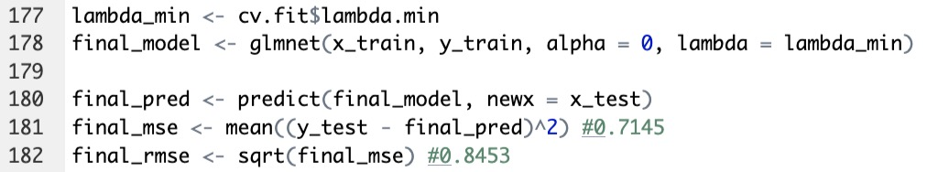
Ridge Regression
Had to find optimal lambda value
Performed k-fold cross validation
Once we get our optimal lambda, we can create a final model and predict using the test set.
MSE = 0.7145
RMSE = 0.8453
In summary, this told me how much shrinkage needed to go towards the coefficients to minimize mean square error.

Slide 14
Conclusion
We can conclude that the top five player stats that influence their salary are points per game, rebounds per game, assists per game, field goals made, and turnovers per game.
We can also conclude that although the Variance Inflation Factors were above 5 (indicating that multicollinearity existed), the RMSE was minimized when there were no changes to the coefficients of the regression model.
Therefore, although PPG, RPG, APG, FG, & TOPG were the most influential, the error was far too high to say we can accurately predict players’ salaries.

Slide 15
Possible Errors
Confounding variables
Contract length
Injuries
Team success
Off-court factors
Increasing popularity

