Slide 1
Choose And Perish
Andrew Gonzalez
andrew.gonzal@gmail.com
Available under the MIT License

Slide 2
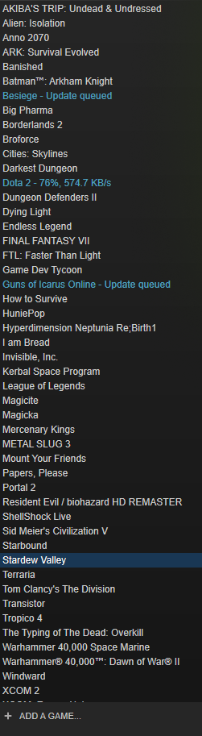
What and why? …and who?
An Android app that chooses a random steam game for you!
Paralysis of Choice
What’s the best option?!
Feeling indecisive? Can’t settle on one game with friends?
Let RNG be your guide!
Up to four players can be added to the selection
Decisions…

Slide 3
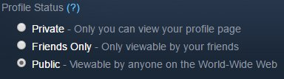

Before you venture out you’ll need:
A steam account
Set your steam account to public
Set your custom url
This can be found on the Edit Profile page for your profile

Slide 4
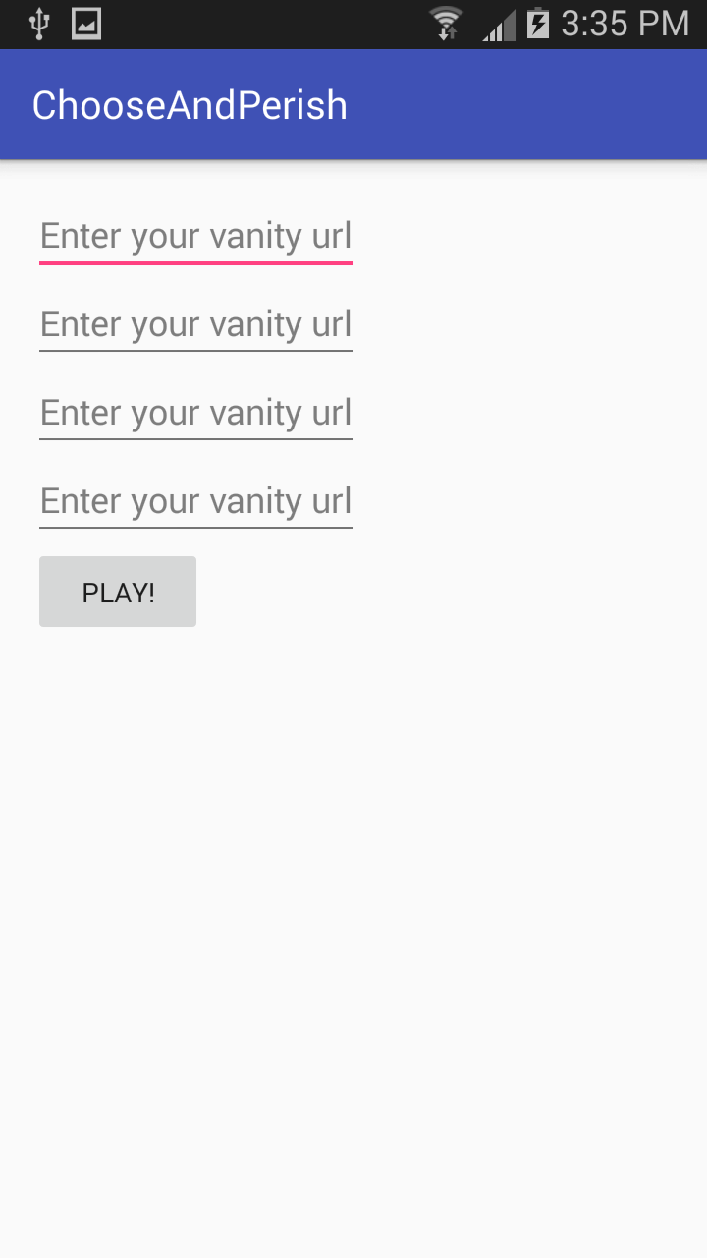
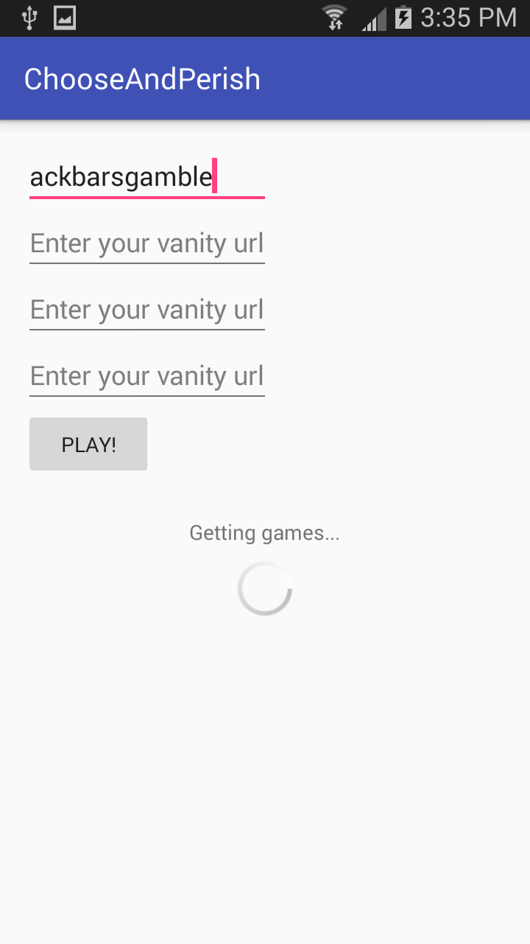
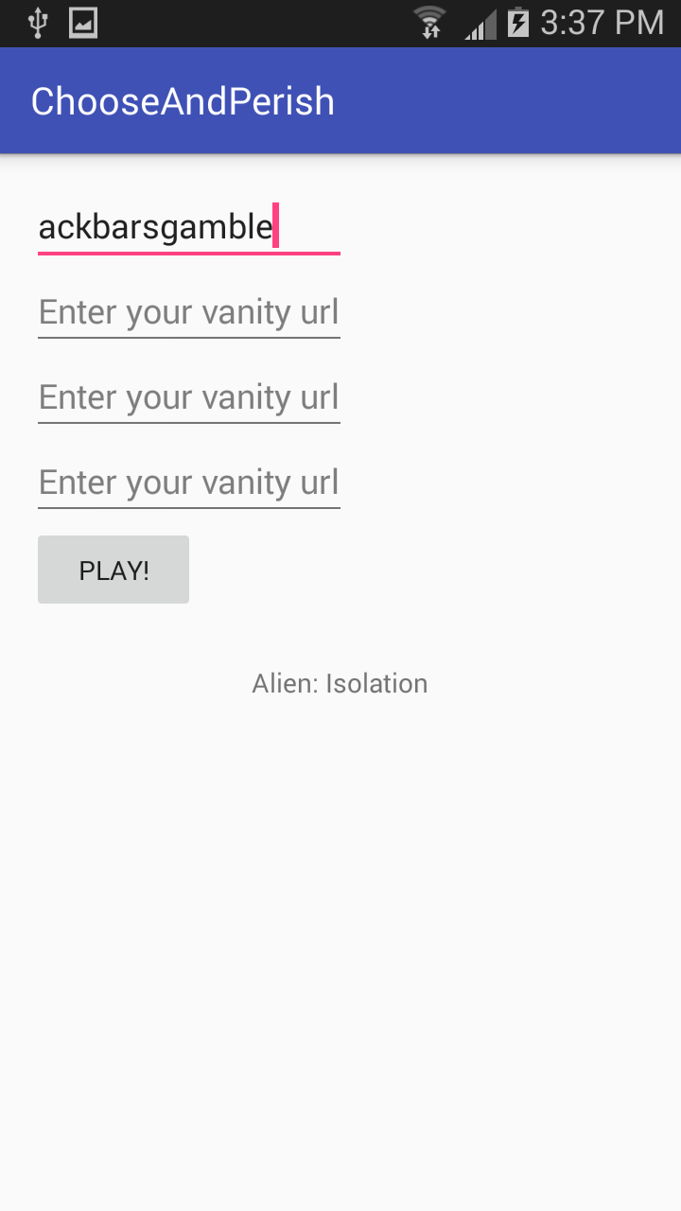
Let’s see it in action!

Slide 5
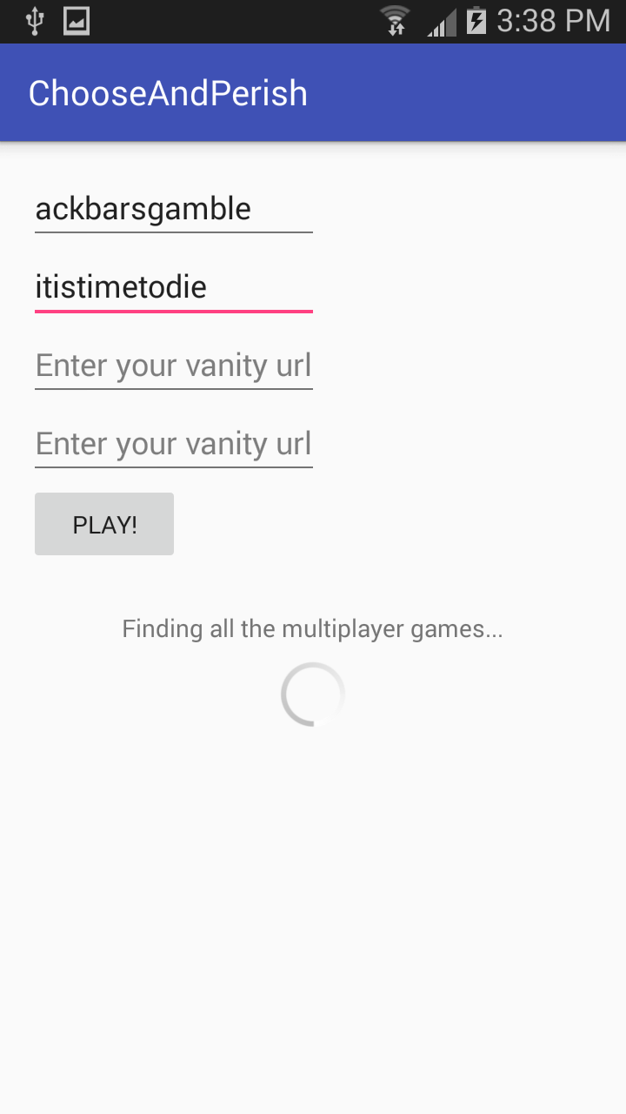

A multiplayer game we can all agree on
Enter your friends’ urls and game away!

Slide 6
Other options – a.k.a. my rivals!
At the most basic, a pencil and paper and several dice would work
Here are a couple things a bit more complicated than that:
http://whatshouldiplayonsteam.com/
http://www.thewheelhaus.com/

Slide 7
A mobile app… but why?
This would make more sense as a web app
Wanted the challenge of working with something new
New environment – I’ve never made a mobile app before
Mobile apps have their own set of challenges
Memory constraints, data usage, battery drain

Slide 8
What worked …and what didn’t
I REALLY wanted the multiplayer game selection for multiple urls
Random game for a single player is kind of boring
Learned the fundamentals of making an android app
Became more knowledgeable about git, and working with version control
Rotating the phone mid processing interrupts the requests to the steam api’s
Tried to save the state when the application process’ onStop() is triggered but haven’t quite figured it out
DON’T MAKE YOUR API KEY PUBLIC
git filter-branch –-tree-filter is your friend

Slide 9
For the future
Add a service to allow background processing
Use the cache to save on data usage
Cache players’ game lists for repeat requests
Publish on the Google Play store!

Slide 10
Project Info
Get the code at:
https://github.com/andrewgonzalez/ChooseAndPerish
Get me at:
andrew.gonzal@gmail.com

