Slide 1
Open Source Software for
Commercial Off-the-Shelf GPS Receivers
Andrew Greenberg
Portland State Aerospace Society
Takuji Ebinuma
Mitsubishi Electric Corporation, Kamakura Works

Slide 2
Overview
Introduction to Open Source
Motivations behind GPL-GPS
Choosing a Chipset and Receiver
Choosing a RTOS
GPL-GPS: Take OSGP, add eCos, stir well.
Status and Initial Results
Future work

Slide 3
Introduction to
Open Source and
Open Source GNSS Projects

Slide 4
Open Source Software
Not just software that comes with source code.
Two versions of open source:
  It’s yours, do whatever you want with it.
  (Berkeley License, or BSD)
  It’s yours, do whatever you want with it privately. But distributions of the software, and modified versions of the software, must also be open source.
  (Free Software Foundation’s General Public License, or GPL)

Slide 5
Why Open Source?
Allows authors to contribute their expertise, while giving them access to the sum of all other author’s expertise.
Creates dynamic, surprisingly full featured software because users:
  Want the ability to modify the software, and
  Deeply care about their expertise and the code they generate.
Extremely successful software development model
  Linux operating system
  Firefox web browser
  Eclipse software development tool

Slide 6
GPS: A different sort of constellation
Embedded Systems
Orbital Mechanics
DSP
GPS
Microwave RF
Relativity
Control theory

Slide 7
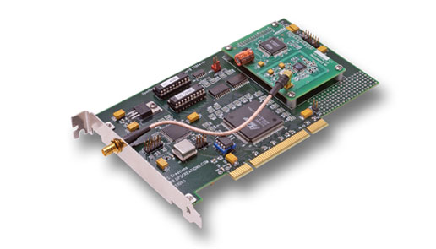
OpenSource GPS
Dr. Clifford Kelley's OpenSource GPS
  ION GPS 2002 Conference Paper: OpenSource GPS: Open Source Software for Learning about GPS by Clifford Kelley, Joel Barnes, Jingrong Cheng
Free and open source software which controls a Zarlink GP2021 correlator mounted on an ISA or PCI card in a x86 PC.

Slide 8
Open Source GNSS Projects
GPSTk
University of Texas at Austin
Applied Research Laboratories
Others
(also: Open Hardware)
OpenGPS@CU
University of Colorado
OpenGPSRec
OpenGPSSim
Georg Beyerle (Germany)
RTLinux port
GPL-GPS
For Embedded Systems
OpenSource GPS

Slide 9
GPL-GPS Basic Concept
Take a inexpensive commercial, off-the-shelf (COTS) GPS receiver.
Erase its original proprietary software.
Using only free and open source software development tools, program the receiver with our own open source code.

Slide 10
Motivations behind GPL-GPS

Slide 11
Why Bother?
COTS receivers generate pseudoranges and satellite navigation data
COTS receivers have development kits
What’s special about a a COTS receiver running open source software?

Slide 12
Motivation
GPS chipset development kits are restrictive:
  Prohibitively expensive (> US $20,000)
  Non-disclosure agreements prevent sharing code
Want access to correlators, not just pseudoranges
  for high dynamics, aiding, research, etc.
Reduce barriers to entry:
  Extremely Low-cost: uses inexpensive COTS receivers and small carrier boards
  High participation: Linux, Windows and Mac OS development environments

Slide 13
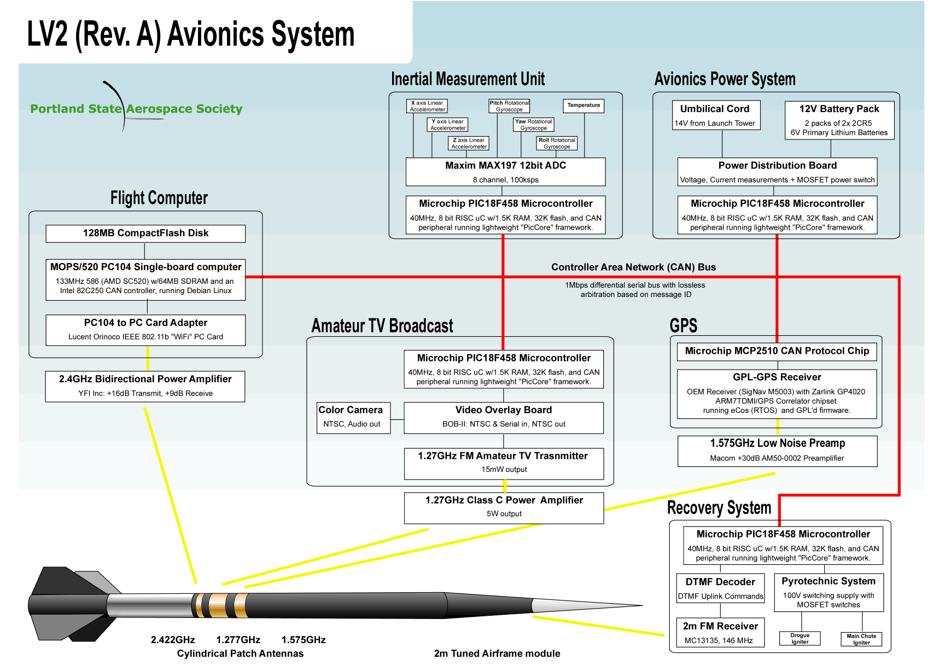
Original Motivation: Sounding Rockets

Slide 14
Further Motivations
Lower barrier to entry for:
  Nanosatellites
  UAVs
  Pseudolite receiver (dynamic PRN codes)
  Precision timing
  Novell applications…
Creates an open reference system, and a platform for comparing receiver and navigation algorithms in the “real world”.

Slide 15
Choosing a Chipset and Receiver

Slide 16
Choosing a Chipset
Only one GPS chipset manufacturers has
open documentation.
Why? Especially on older chipsets?
Zarlink (AKA Mitel AKA GEC Plessey) Semi.
  GP2021 (GPS correlator)
  GP4020 (ARM7TDMI and GPS correlator)
  Both 12 channel single frequency L1 C/A chipsets

Slide 17
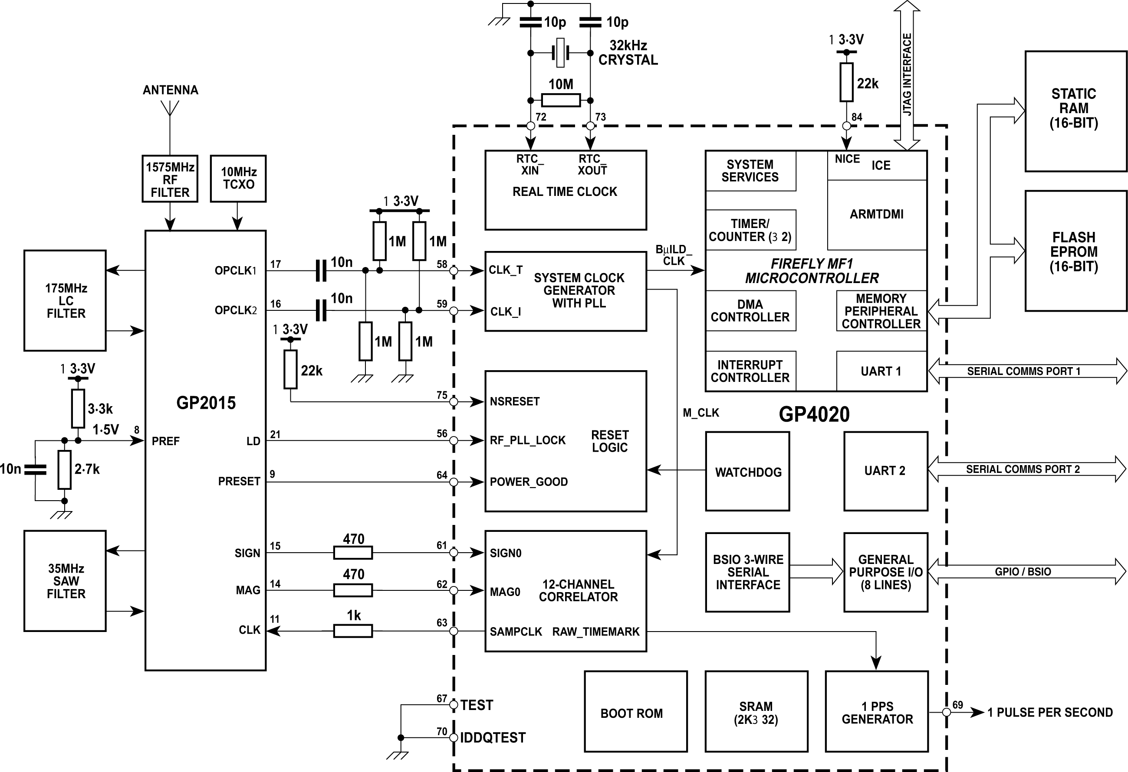
Zarlink GP4020-based Receiver
From: Zarlink GP4020 Baseband Processor Design Manual

Slide 18
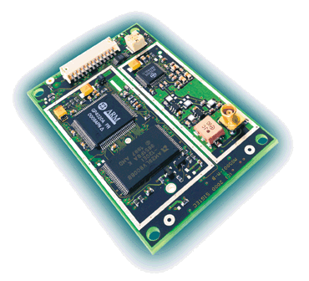
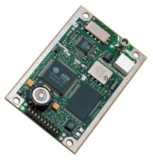
Choosing a GP4020-based Receiver
Only two COTS GP4020-based receivers:
  SigNav MG5001 and MG5003
    DLR “Phoenix” receiver
    SSTL “SGR-05” receiver
  NovAtel SuperStar II

Slide 19
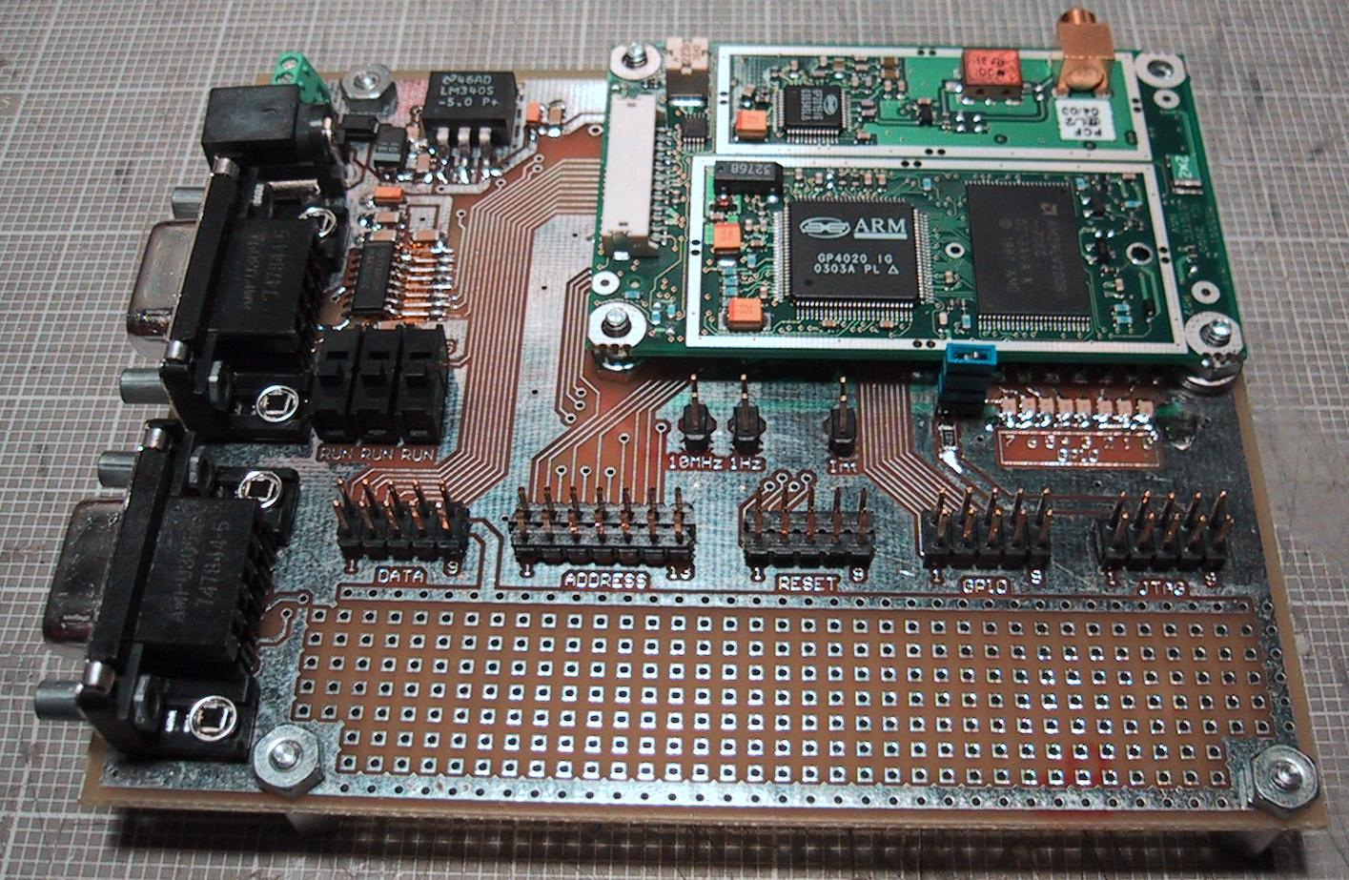
GPL-GPS Development Board
< $50 including parts
Open hardware: Schematics, board files, parts lists online.

Slide 20
Choosing a RTOS

Slide 21
Real-time operating system (RTOS)
Why even bother with an RTOS?
Once ported, has great advantages:
  Multi-threaded abstraction greatly simplifies software
  Provides common routines and interfaces:
    Timers, peripheral drivers, threads, IPC, etc.
    Insulates the developer from the specific hardware
  Takes care of “housekeeping” tasks
  Makes embedded code development and debugging sane and manageable

Slide 22
RTOS Comparison (Top 7)
HRT = Hard Real Time, Small = Less than 256KB, Free = No fee or licensing conflicts,
OSS = Open Source Software, x86,PPC,ARM = works on all three targets,
POSIX = POSIX compatibility layer, Effort = effort to port, based on ucLinux port = 1x effort

Slide 23
eCos: embedded Configurable OS
Uses the open source GNU toolchain
  gcc, gdb, ld, make, objcopy, etc.
Works under:
  Linux (native)
  Windows (via Cygwin project)
  Mac OS (requires tool chain compilation)
Supports almost every 32bit processor,
and many 16 bit
Very light weight (~80 KB), very low interrupt latencies and task switch times.

Slide 24
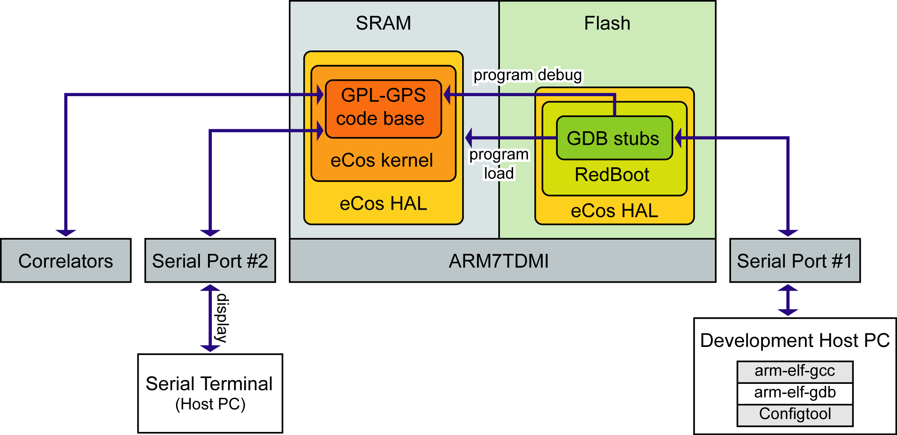
eCos Infrastructure

Slide 25
GPL-GPS Development System
Minimal Hardware
  SigNav MG5001
  GPL-GPS Carrier Board
  Host PC (Linux, Windows or Mac OS X)
Free and Open Source Software
  eCos RTOS
  GNU tool chain
  GPL-GPS Software

Slide 26
GPL-GPS Software

Slide 27
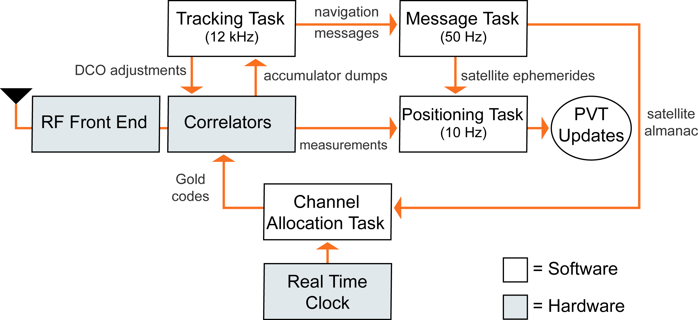
Generic GPS Receiver Tasks

Slide 28
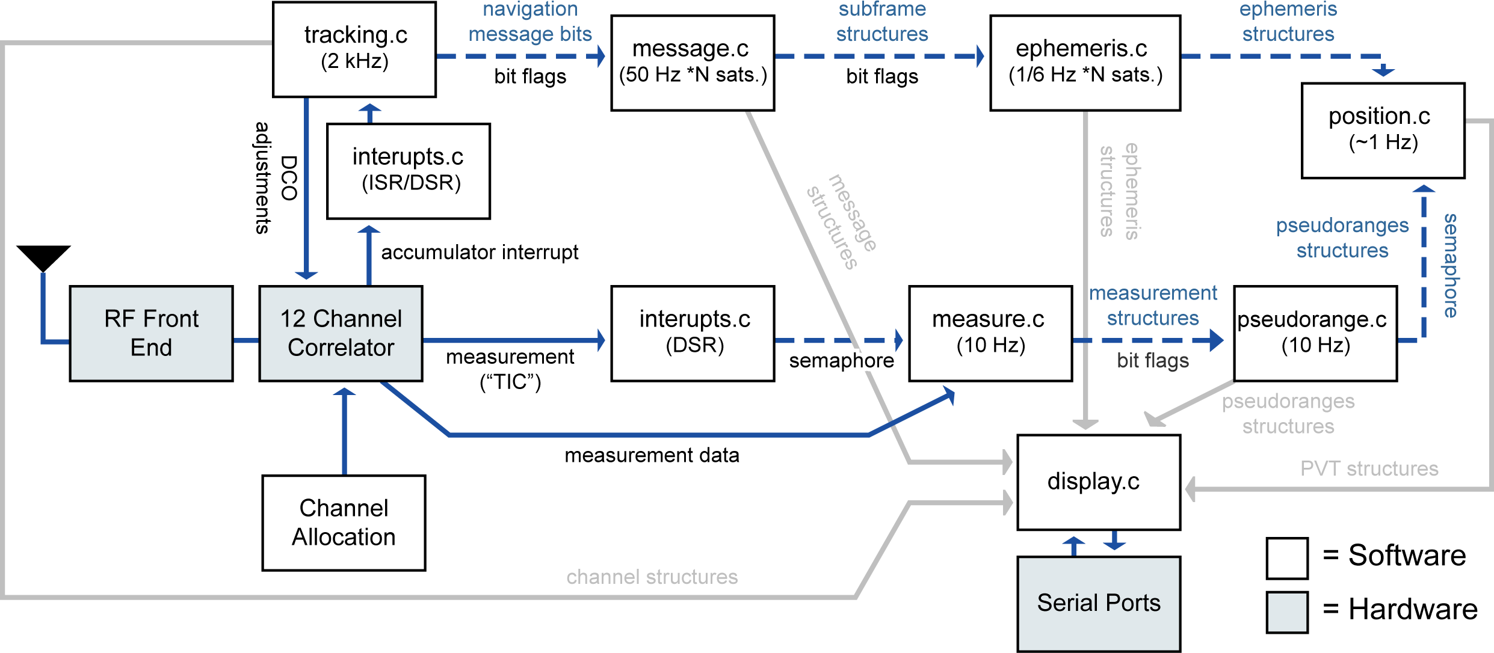
GPL-GPS Tasks

Slide 29
Status and Initial Results

Slide 30
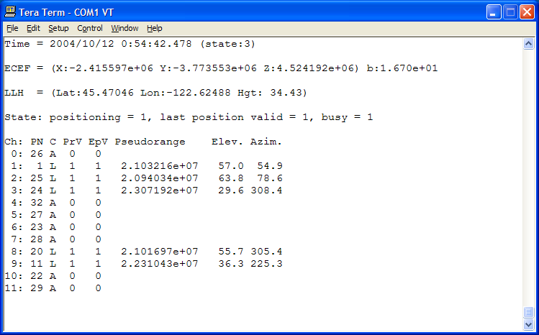
First Fix May 2nd, 2005

Slide 31
GPL-GPS Current Status
It works!
But:
  Lacks atmospheric correction
  Lacks carrier phase
  Poor tracking loops (2nd order PLL)
  Poor acquisition and search on loss-of-signal
  Almanac not stored in non-volatile memory
  eCos infrastructure needs more tuning

Slide 32
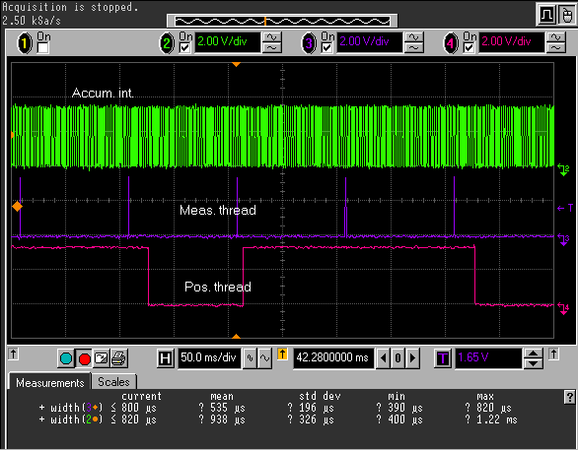
Processor Performance

Slide 33
Static Performance (2000 pts., 36.4m)

Slide 34
Static Performance: 3D

Slide 35
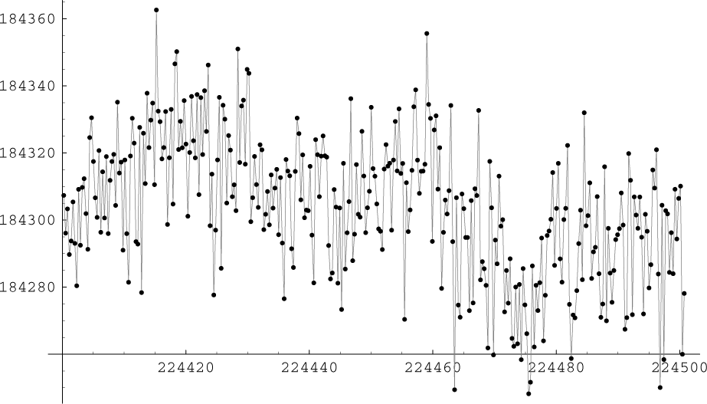
Static Performance: Time Series

Slide 36
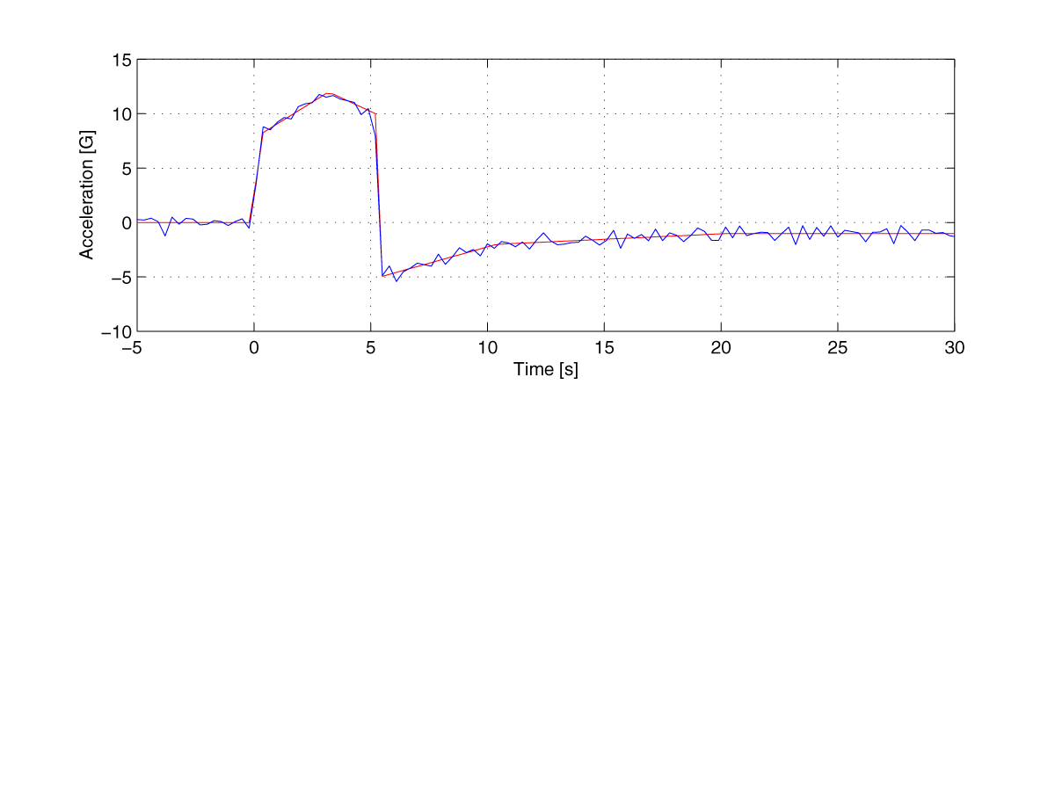
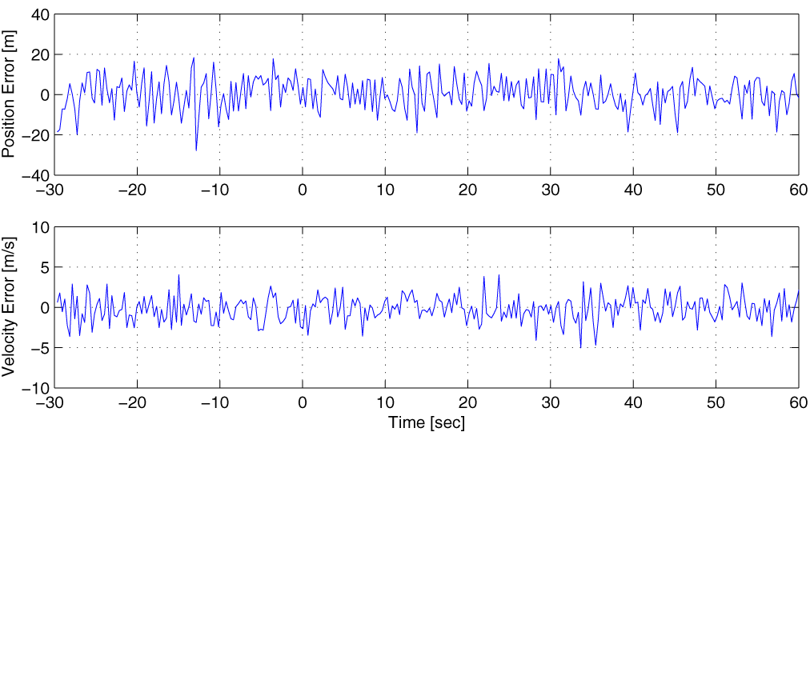
Simulated High Dynamics Performance

Slide 37
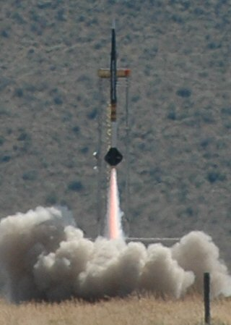
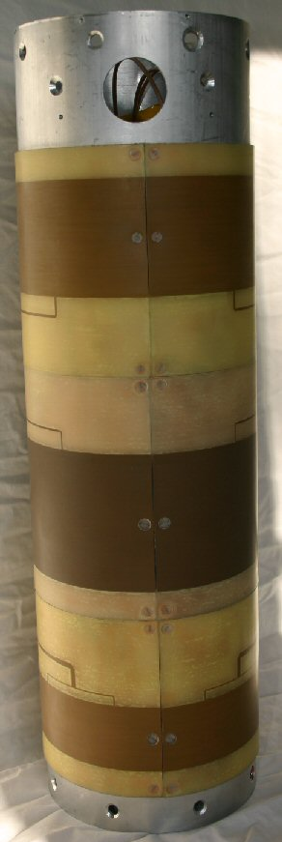
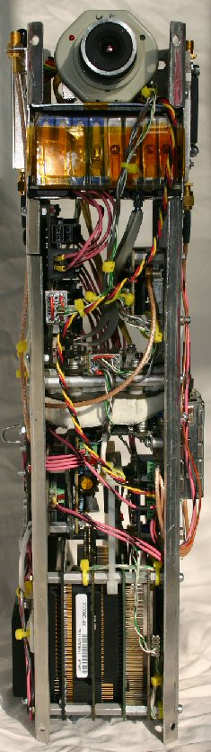
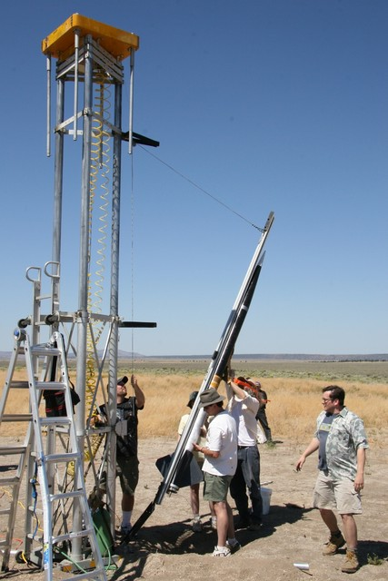
High Dynamics Test Platform

Slide 38
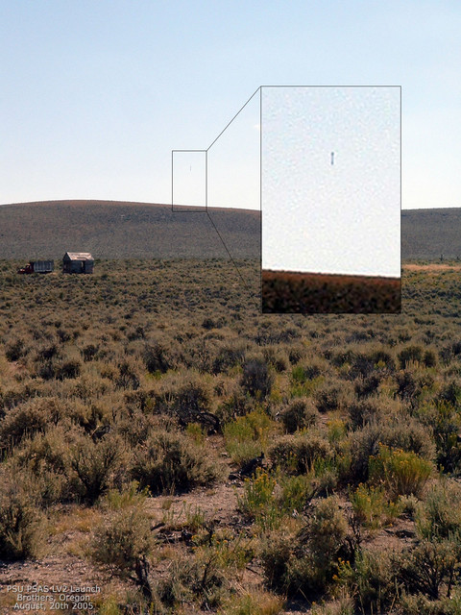
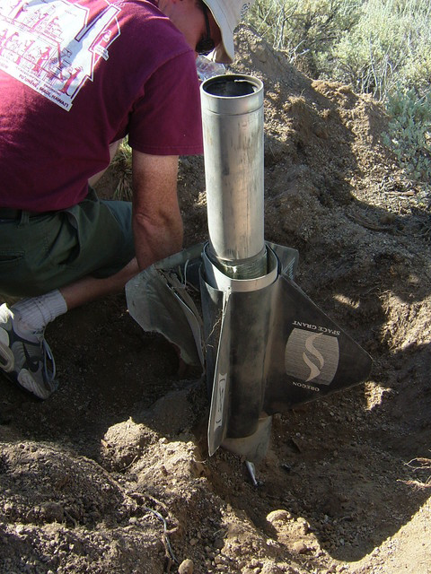
HD Test Flight… slightly delayed

Slide 39
Future Work
Infrastructure work
  Fix bugs. Probably lots of them
  Move interrupts & tracking to internal fast SRAM
  Implement GP4020 PPS hardware
  Network API for external PC interface
Reimplement current OSGPS features
  Atmospheric correction
  Carrier phase
  Almanac load/save and processing (via Flash)
  Faster/better cold acquisition

Slide 40
Conclusion

Slide 41
Conclusion
Created an open source software development system for commercial off-the-shelf GPS receivers
GPL-GPS promises to dramatically lower the high barrier to entry for GPS development
The GPL-GPS Project http://gps.psas.pdx.edu/

