Slide 1
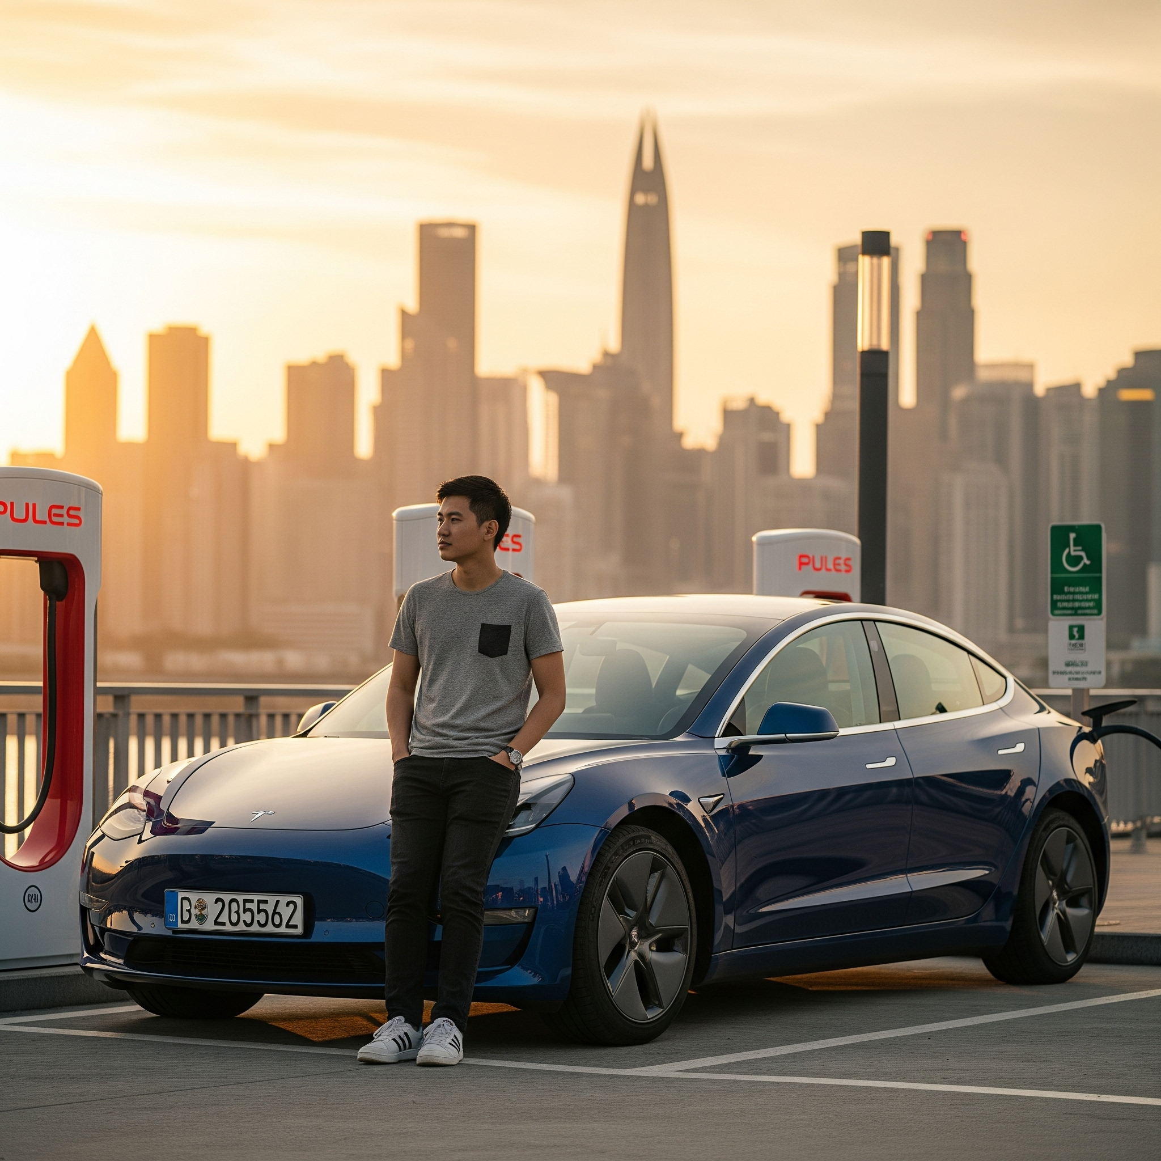
Buying an EV
Understand electric vehicle benefits
Explore available EV models
Research charging options
Consider government incentives

