Slide 1
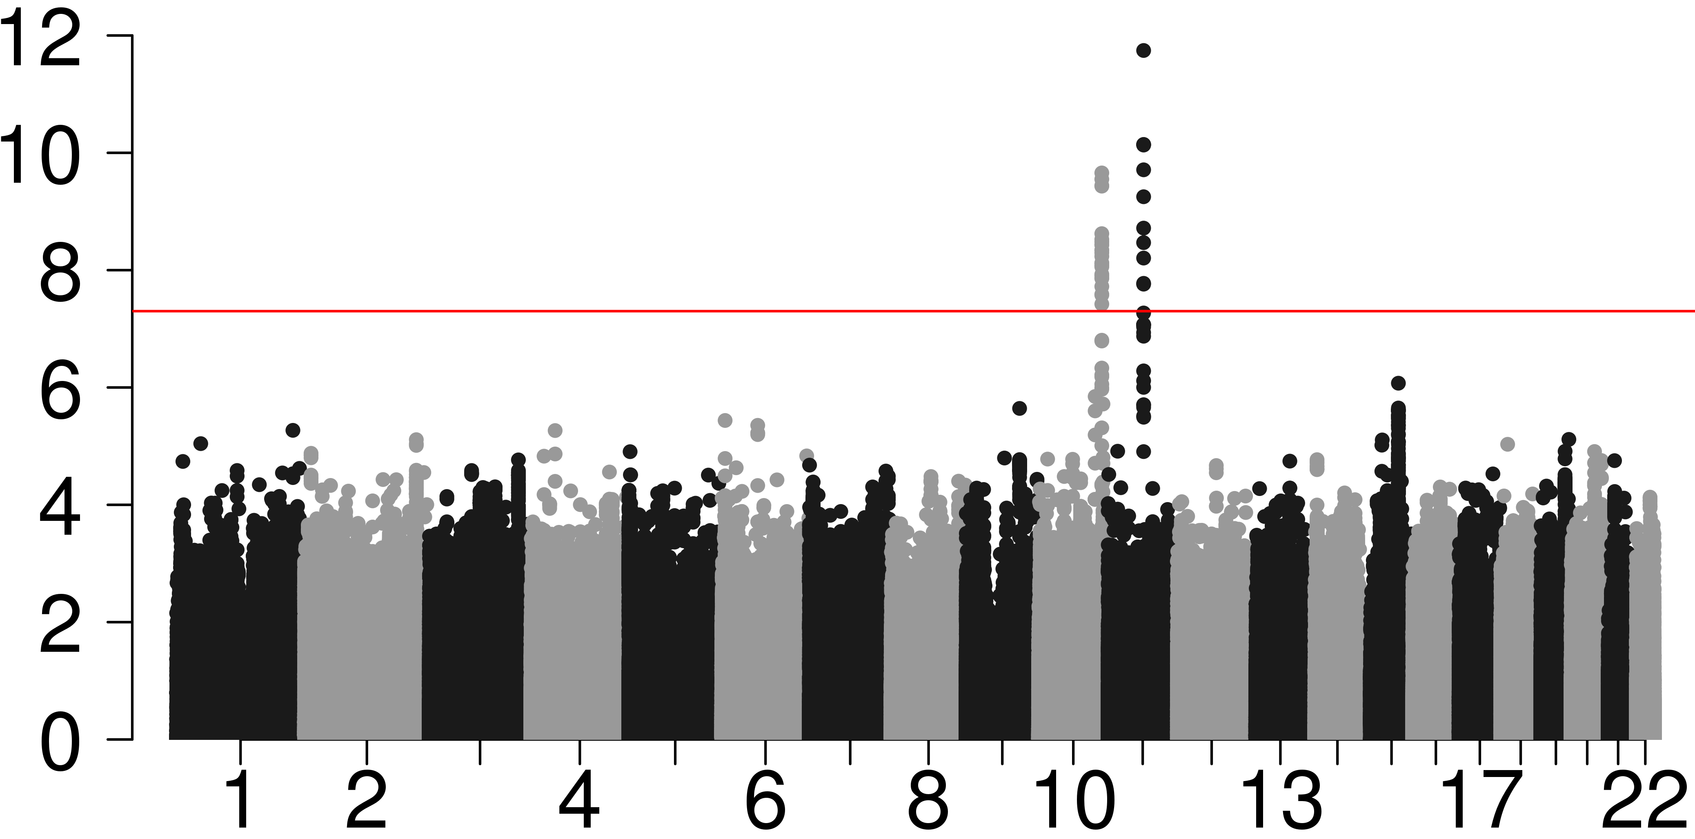
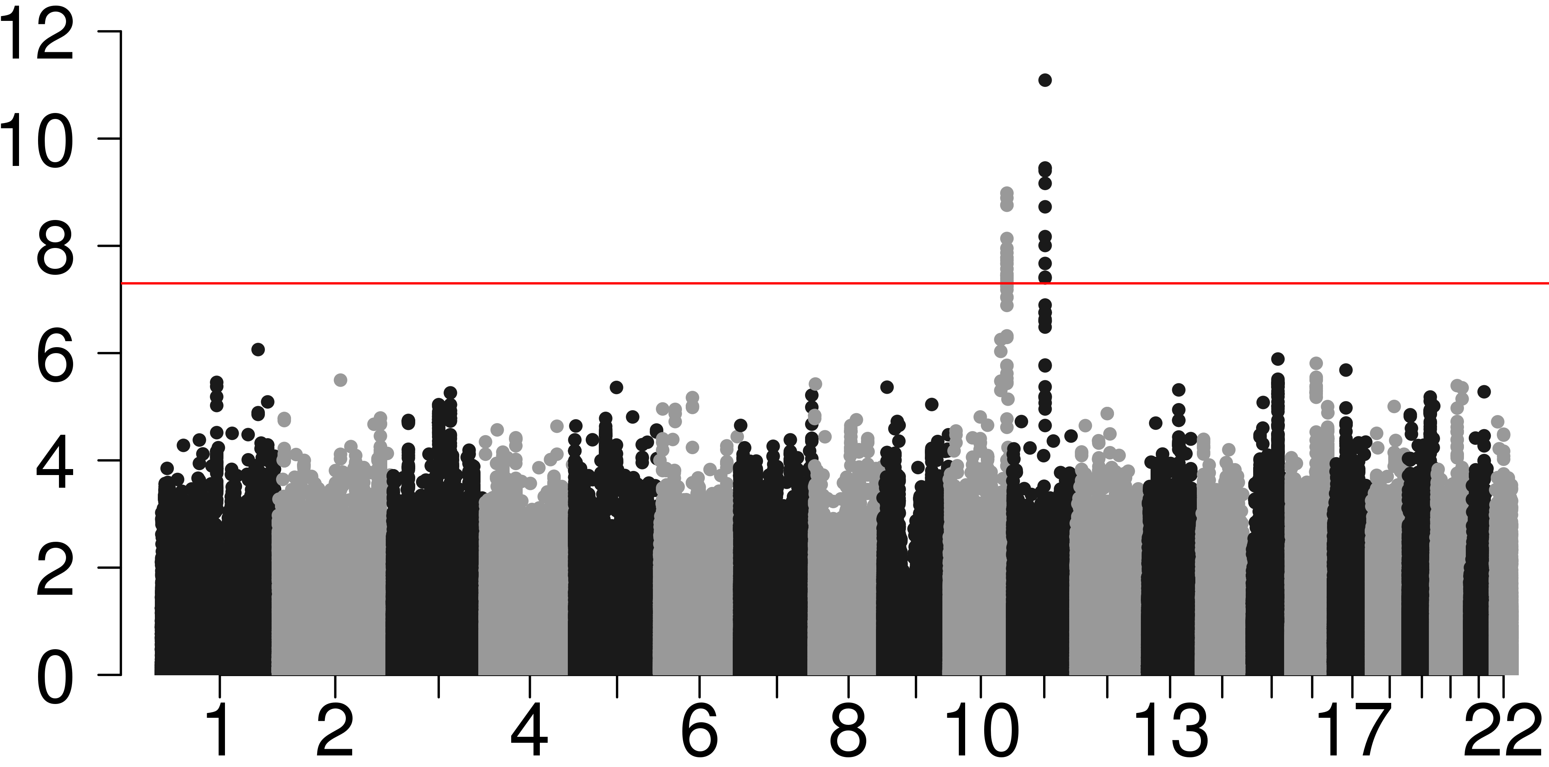
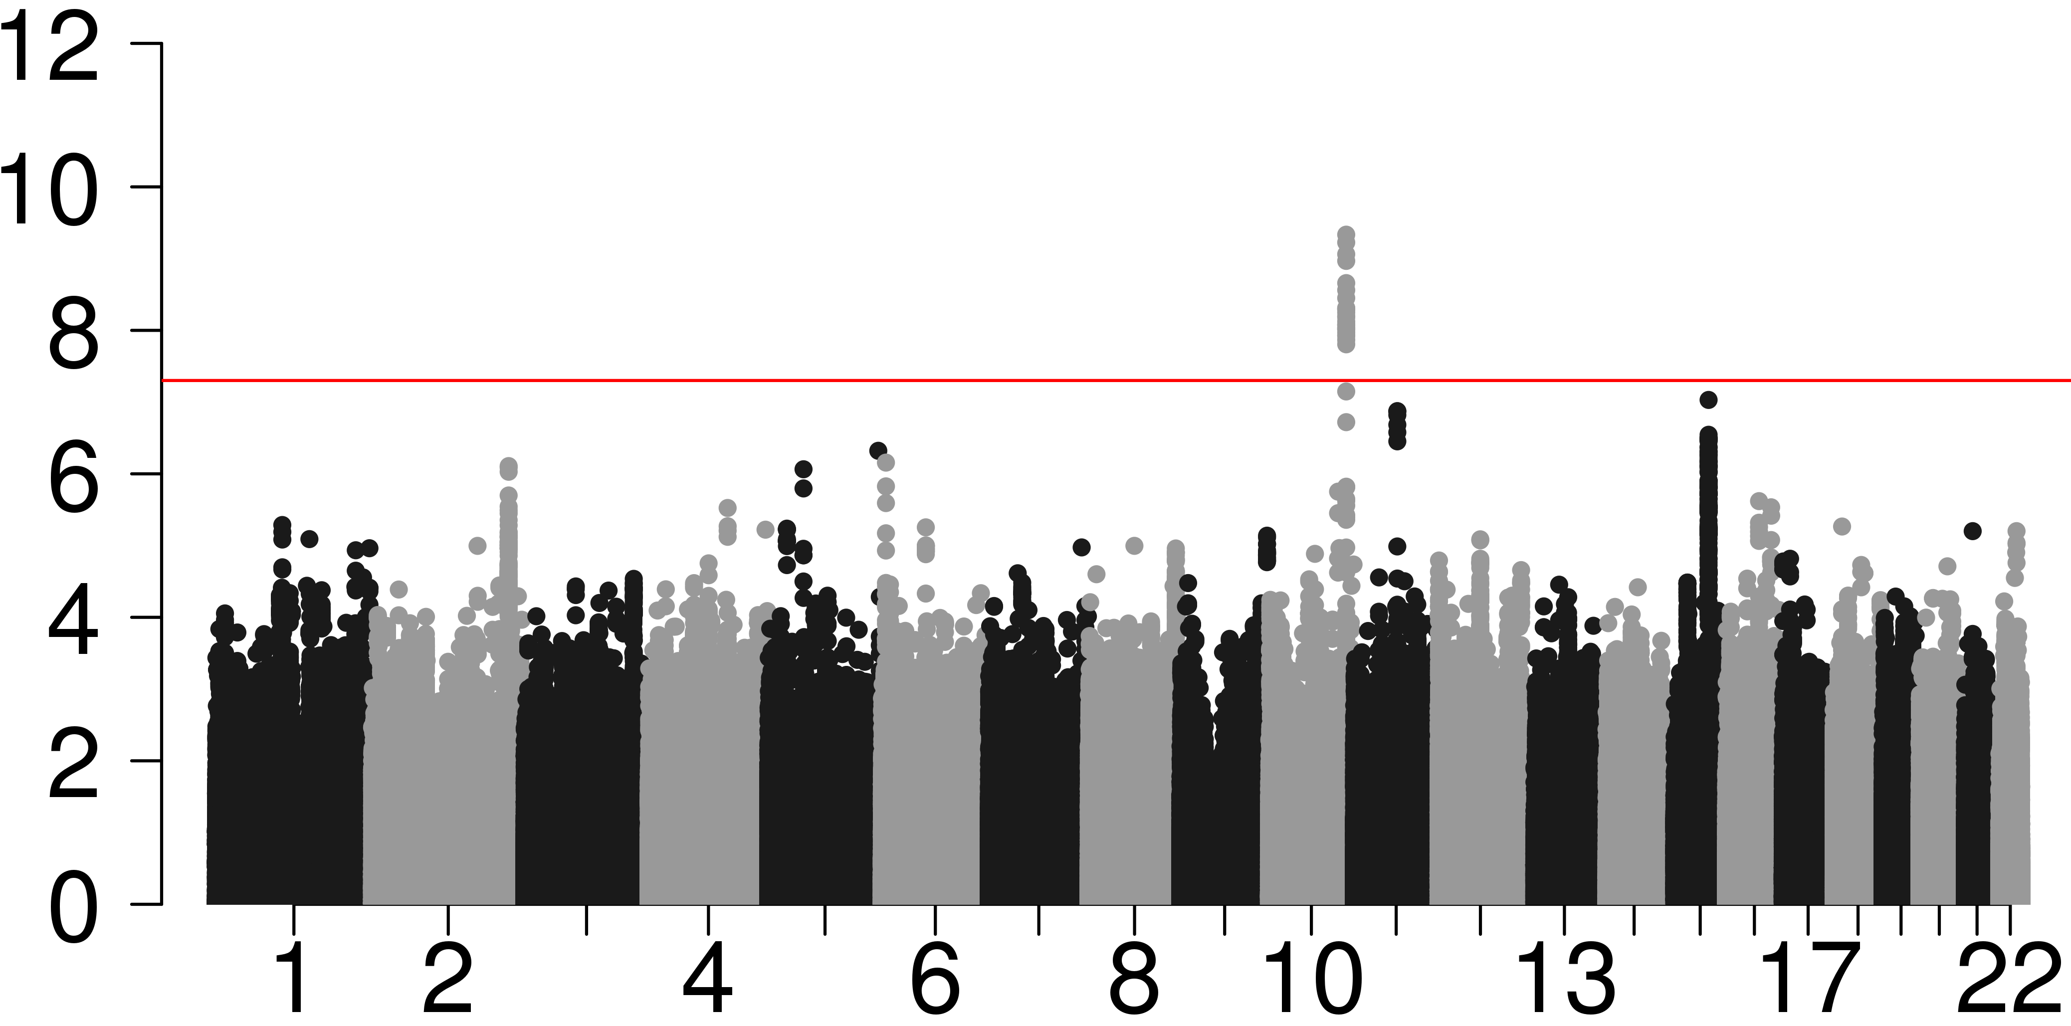
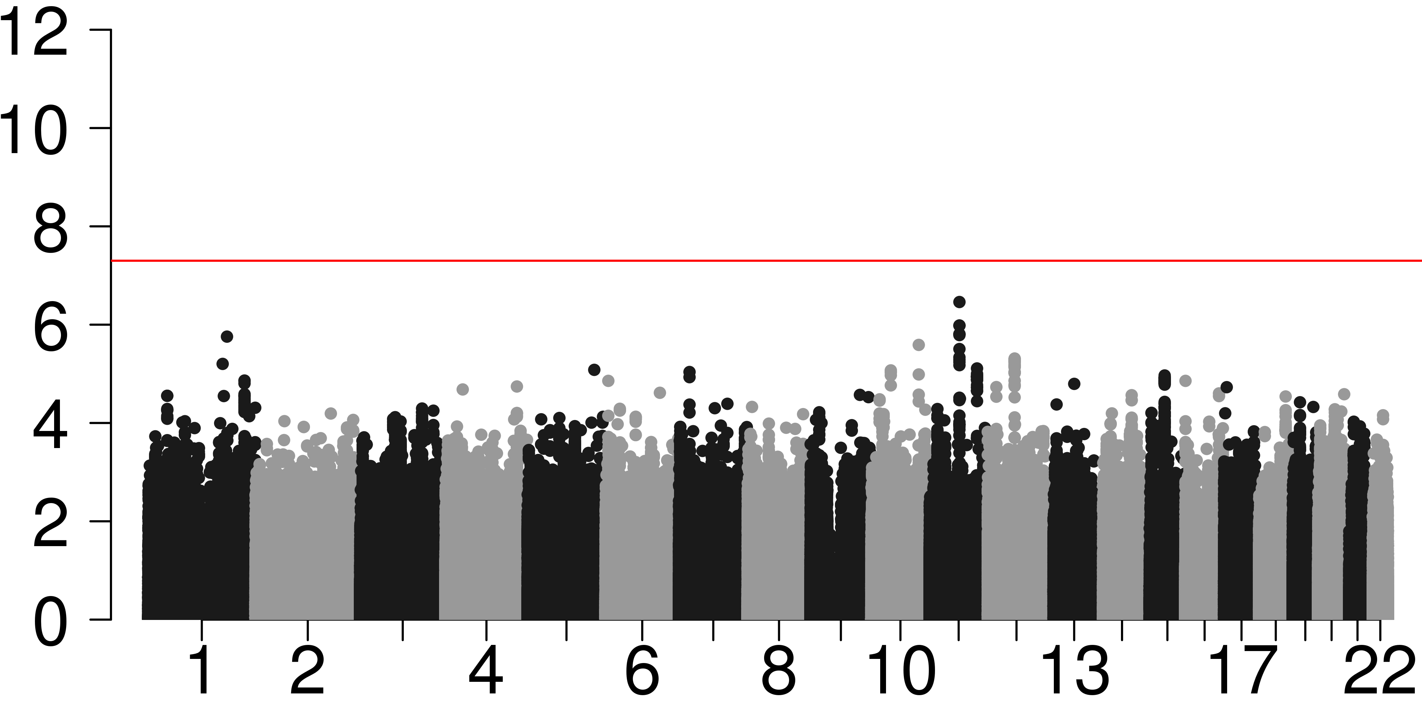


GWAS results on Polish Women Breast Cancer Data Set (2,078 cases, 2,219 controls)
a.) MTOP global test for association
b.) FTOP global test for association
$$−\log_{10}{P}$$
$$−\log_{10}{P}$$
c.) Standard logistic regression
d.) Polytomous logistic regression
$$−\log_{10}{P}$$
$$−\log_{10}{P}$$
Haoyu Zhang, et. al, Biostatistics, 2020;

