Slide 1
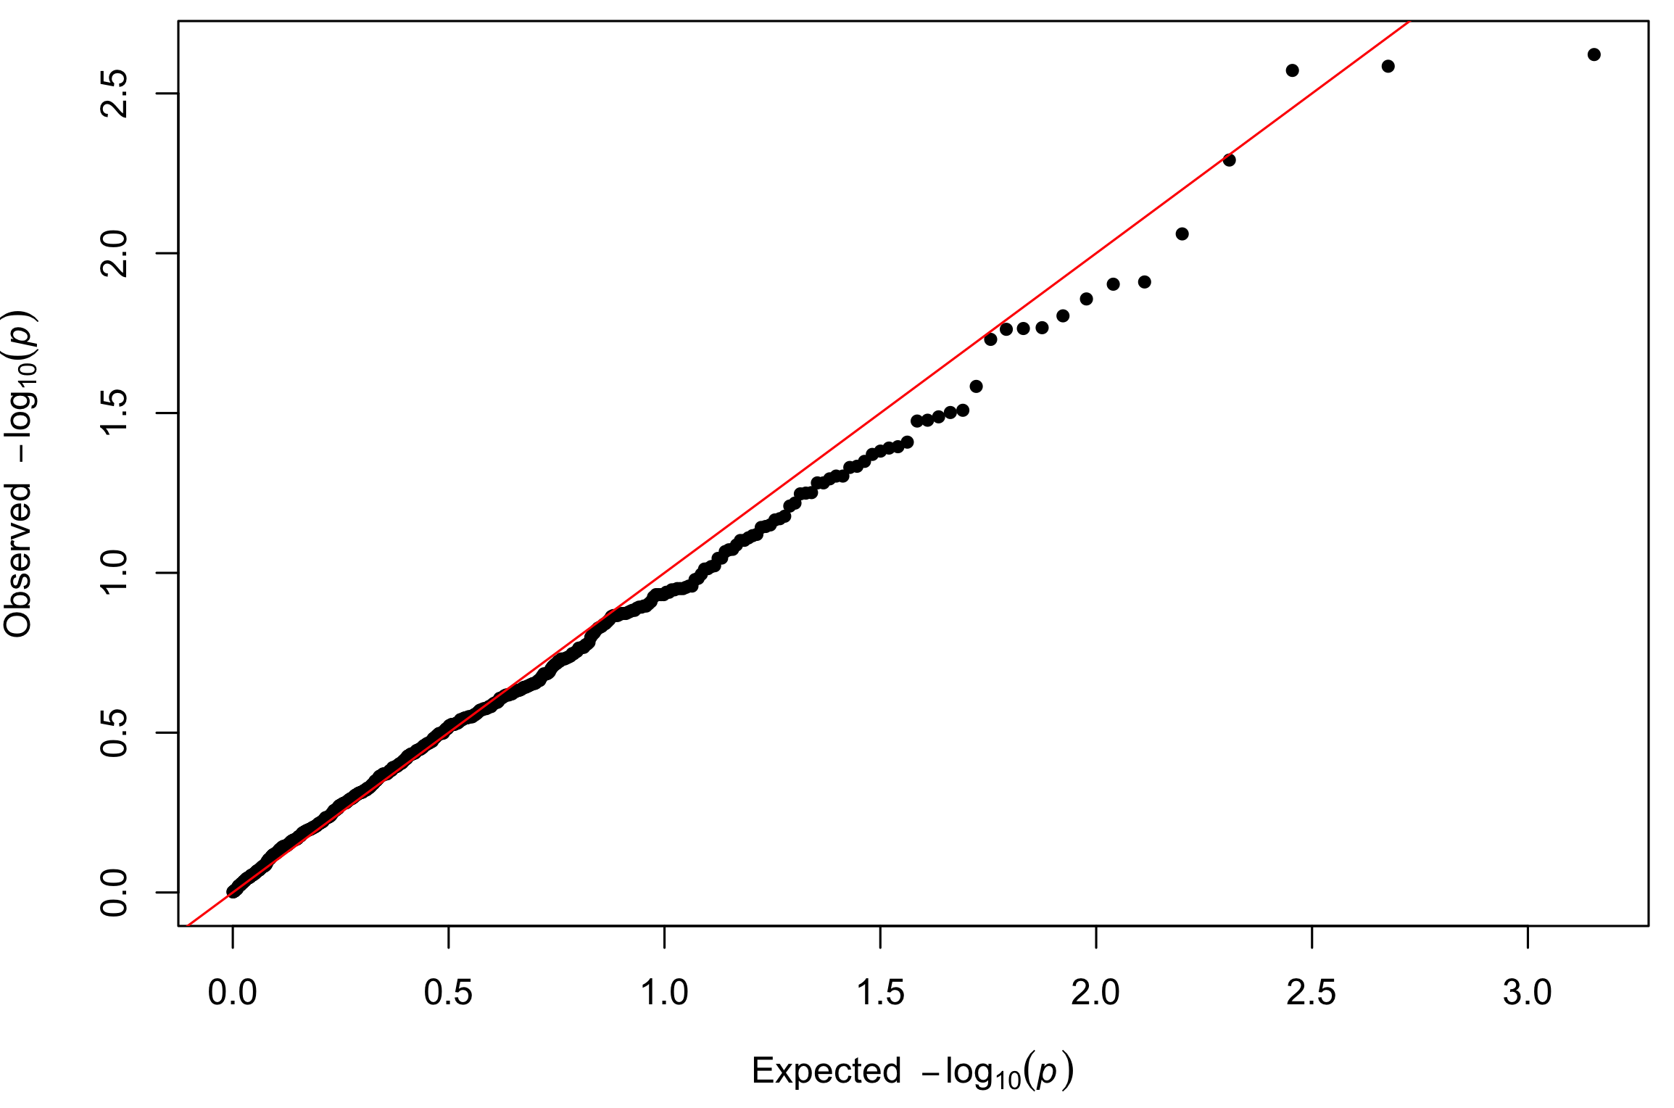
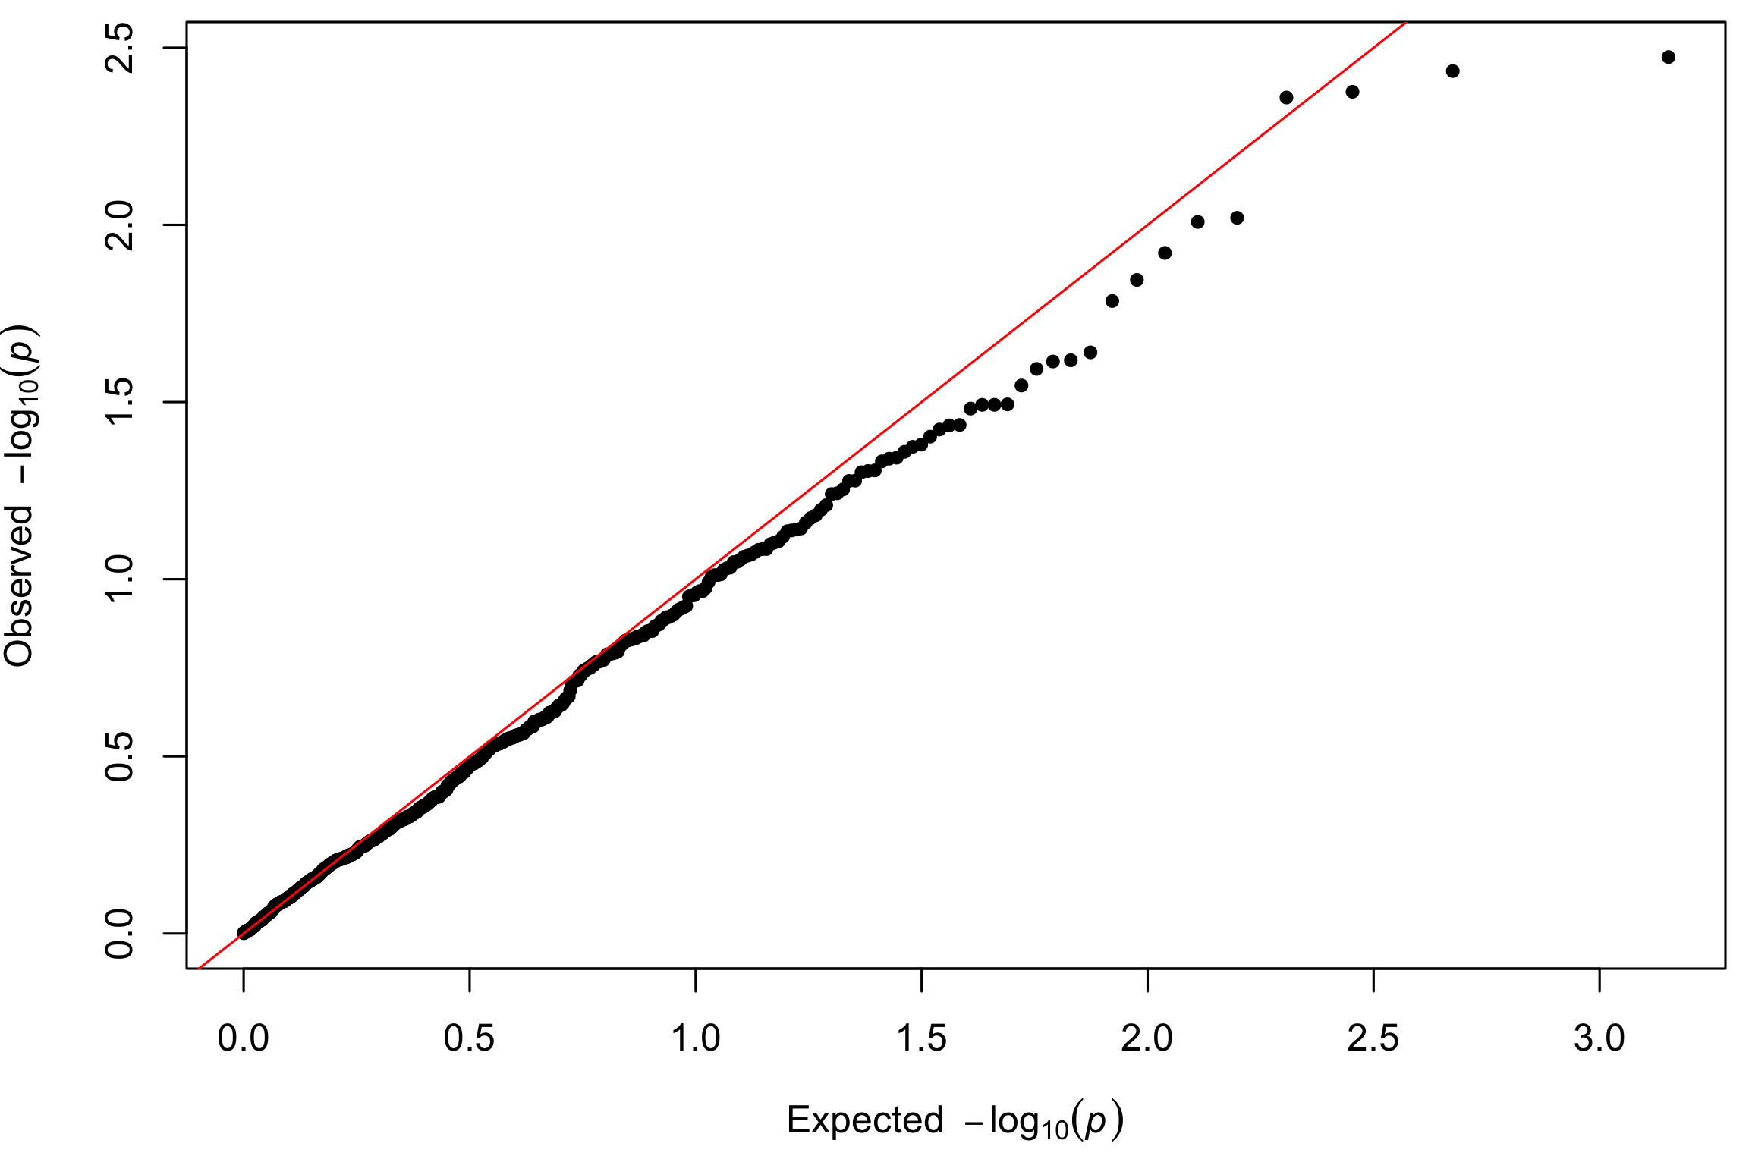
Permutation analysis of genotypes of all individuals
Permutation analysis of genotypes in breast cancer cases

