Slide 1
“WHY WON’T THIS RUN AGAIN?!”
Andrew Heiss, PhD
Brigham Young University
May 14, 2018
@andrewheiss
andhs.co/rr

Slide 2
PLAN FOR TONIGHT
Why focus on reproducibility?
Reproducibility vs. replicability
The continuum of reproducibility
Demonstrations

Slide 3
WHY FOCUS ON REPRODUCIBILITY?

Slide 4
Andrew,
The models you ran look great but my RA just found a newer version of the data. Can you make all the figures again? Sorry!
Judith

Slide 5
The results in Table 1 aren’t the same as what’s in Figure 2

Slide 6
Where did we get this data file?

Slide 7
Why did I filter out those rows?

Slide 8
How did I make that figure?

Slide 9
In what order do I run these scripts?

Slide 10
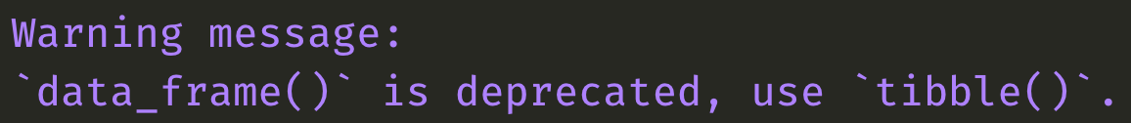

Slide 11
REPRODUCIBILITY VS. REPLICABILITY

Slide 12
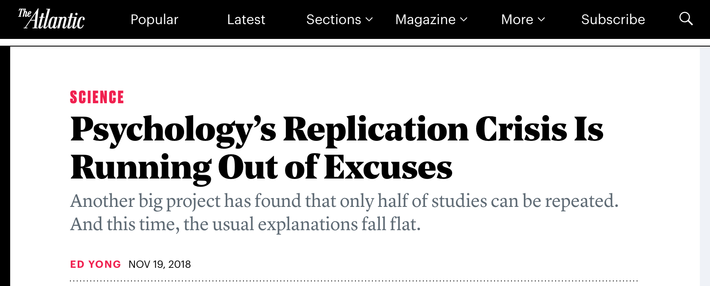

Slide 13
Reproducibility
Replicability
Someone with the same code and data can recreate your findings
Someone who conducts another study with the same methods will find similar results

Slide 14
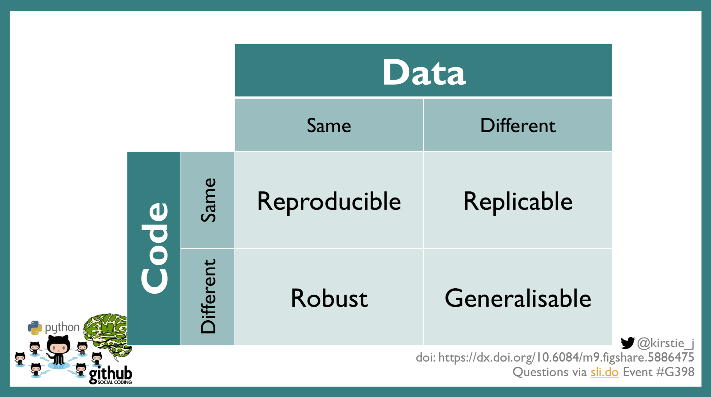
Notes:
https://figshare.com/articles/A_how_to_guide_to_reproducible_research/5886475

Slide 15
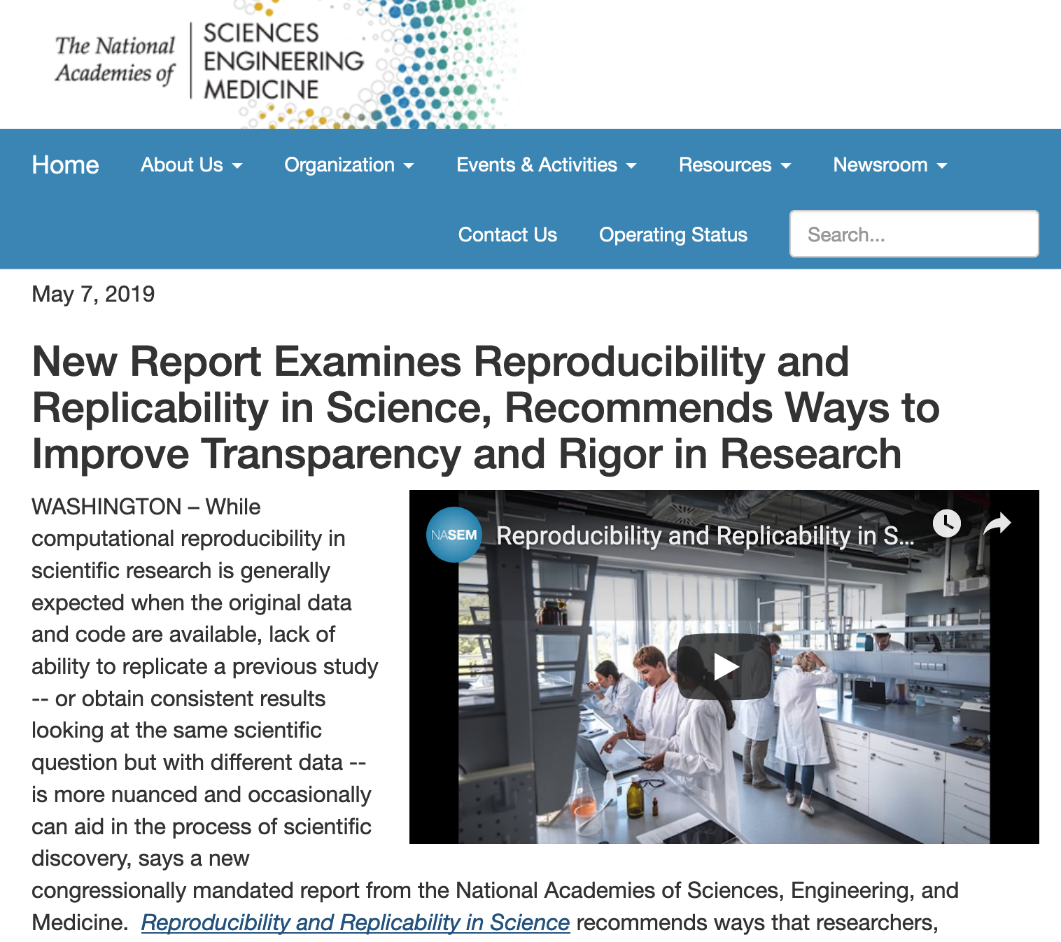


Slide 16
THE CONTINUUM OF REPRODUCIBILITY

Slide 17
Gold standard of reproducibility
Anyone* can recreate your results at any point in the future on any computing platform
* yourself included

Slide 18
This is hard!
A little bit reproducible is better than not reproducible
Try to make each project a bit better organized and reproducible than the last

Slide 19
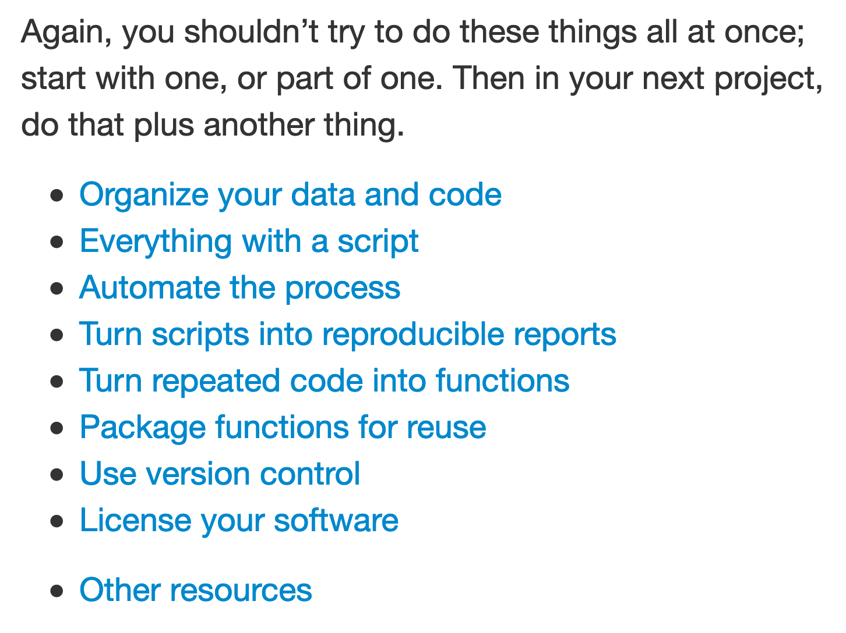
http://kbroman.org/steps2rr/

Slide 20
The Reproducibility Continuum
Point-and-click in SPSS, Stata, or Excel
Code only
Code, data, and Makefiles
Research compendia
renv
Docker and Binder
Code and data
R Markdown
R Markdown websites
Not reproducible
Reproducible

Slide 21
There’s no one right way to do this

Slide 22
DEMONSTRATIONS

Slide 23
https://andhs.co/rr

