Slide 1
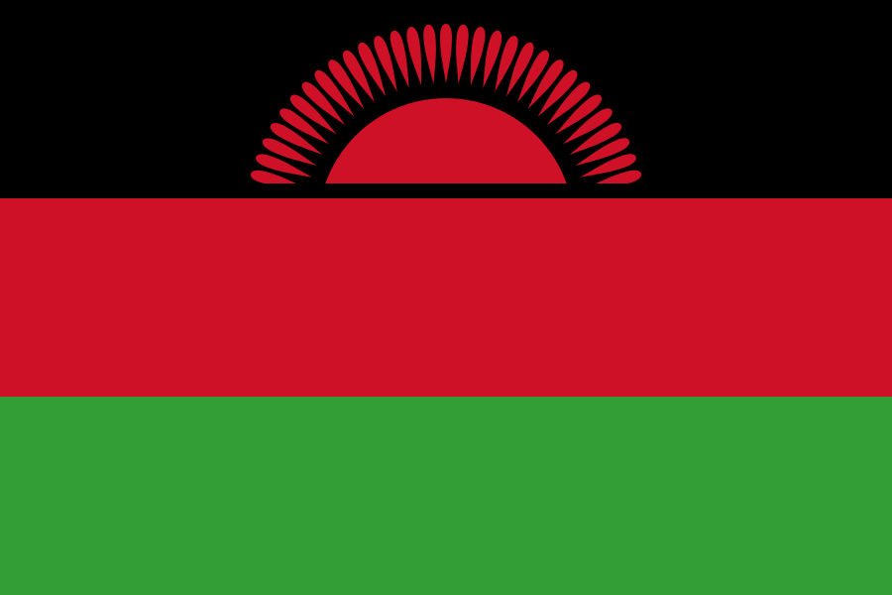
Malawi
Economic and civil society development
John Smith and Jane Doe
September 12, 2013

Slide 2
Malawi GDP growth
Malawi is a country in south-east Africa. It has borders with the countries of Tanzania, Zambia, and Mozambique. The capital of Malawi is Lilongwe and the spoken languages are English and the official language Chichewa. The total size is about 118480 km² and there are about 100 people per km². The official language of Malawi is English. Malawi is one of the poorest countries in the world.
Year | GNI per capita, PPP (current international $)
2003 | 2424656666
2004 | 2625127098
2005 | 2754995877
2006 | 3116789658
2007 | 3647817219
2008 | 4276769712
2009 | 5030639934
2010 | 5398616985
2011 | 5621000678
2012 | 4263794984
Malawi is among the world's least-developed and most-densely populated countries. Around 85% of the population live in rural areas. The economy is based on agriculture, and more than one-third of GDP and 90% of export revenues come from this. In the past, the economy has been dependent on substantial economic aid from the World Bank, the International Monetary Fund (IMF), and other countries. Malawi was ranked the 119th safest investment destination in the world in the March 2011 Euromoney Country Risk rankings.

