Slide 1
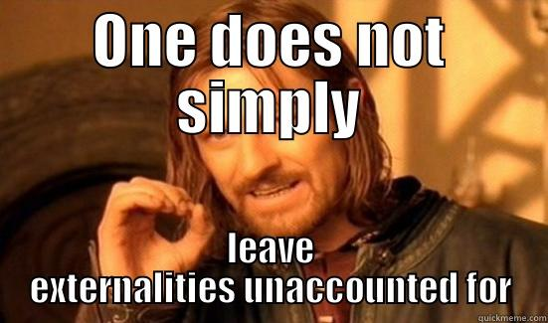

Slide 2
Concept Check
What’s an externality?
What’s the difference between positive and negative externalities?
What are solutions to externalities?
What is the difference between a Pigovian tax and a sin tax?
When is a Pigovian tax regressive?
Which is better, Coasian solutions, Quantity solutions, Pigovian tax, or Cap and Trade?
Under which conditions?
Could you hold an intelligent conversation about these topics?

Slide 3
Negative Externalities
Pollution
Cigarette Smoking
Binge Drinking
Litter, Gum litter
Video Games
Pornography
Super Bowl
March Madness
Food Waste
Noise
Math/airplane
Plastic Bags
Inefficient cart return
Children on airplanes
Water conservation
Food in libraries

Slide 4
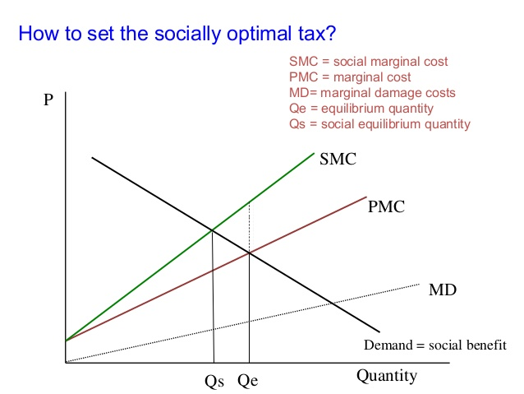
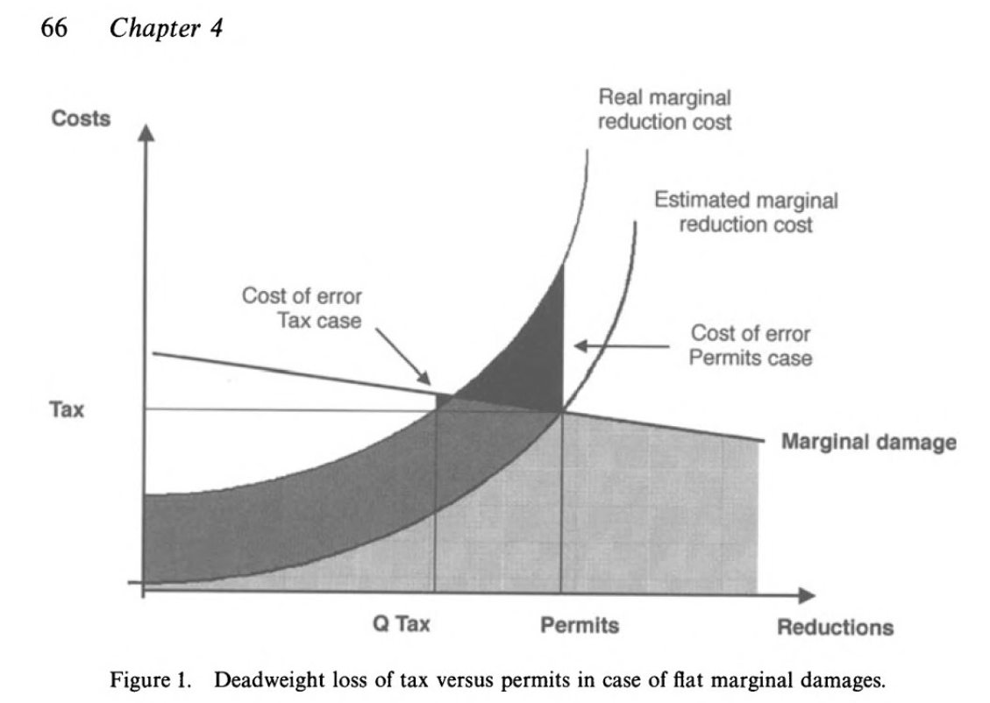
Marginal DAmage
Economics of Environmental Regualtion
Maggiewinslow
https://www.slideshare.net/maggiewinslow/economics-of-environmental-reguation
Efficiency and Equity of Climate Change Policy
edited by Carlo Carraro
https://books.google.com/books?id=VqXqCAAAQBAJ&pg=PA66&lpg=PA66&dq=steepness+of+marginal+damage&source=bl&ots=Tt-g5JIOKK&sig=uaegRHLLVesCdQsYhQS132-2yAI&hl=en&sa=X&ved=0ahUKEwj1lYCblYPaAhUGFHwKHemmB8wQ6AEISjAD#v=onepage&q&f=false

Slide 5
Pigovian Tax or Cap and Trade?
Pigovian Tax
Cap and Trade
Costs must be known and not vary too much
Preferred when MD curve is flat
Initial permit allocation has consequences
Preferred when MD curve is steep
Notes:
Sell vs. give-away

Slide 6
Khan Academy
https://www.khanacademy.org/economics-finance-domain/microeconomics/consumer-producer-surplus/externalities-topic/v/taxes-for-factoring-in-negative-externalities

