Slide 1
Lab 4
February 1, 2019

Slide 2
Lab Hours
Monday (Joint TA Hours) - 3:30 PM - 4:30 PM
Tuesday (Henry; Evening; Call 801-358-2430 or Google Hangouts) - 8:00 PM - 9:00 PM
Wednesday (Henry) - 11:00 AM - 12:30 PM
Friday (Meg; Before Lab) - 11:30 AM - 12:30 PM
*If you can’t make these times, send us a message.

Slide 3
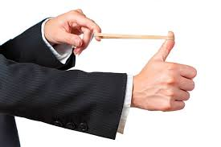
Elasticity
Think of a rubber band
High Elasticity = More Change
Low Elasticity = Less Change

Slide 4



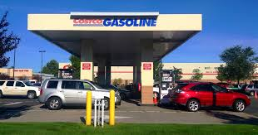


Is this elastic or inelastic?
Talk with your neighbor. Do you both get the same answer?

Slide 5


Let’s go through this.
Price of Gas Goes Up
Demand Stays Even?
Demand Goes Down?
The price of gas has gone up. I’ll buy the same amount as before.
The price of gas has gone up. I think I’ll skip out on the gas.

Slide 6
Effect of Taxes
Tax Inelastic Demand
Raise Government Revenue
Tax Elastic Demand
Change Consumer Behavior

Slide 7


Nash Equilibrium (Another Way)
(12, 20)
(9, 25)
(8, 10)
(15,18)

Slide 8
Nash Equilibrium (Another Way)
(12, 20)
(9, 25)
(8, 10)
(15,18)

Slide 9
Differing Perceptions of Fairness

Slide 10

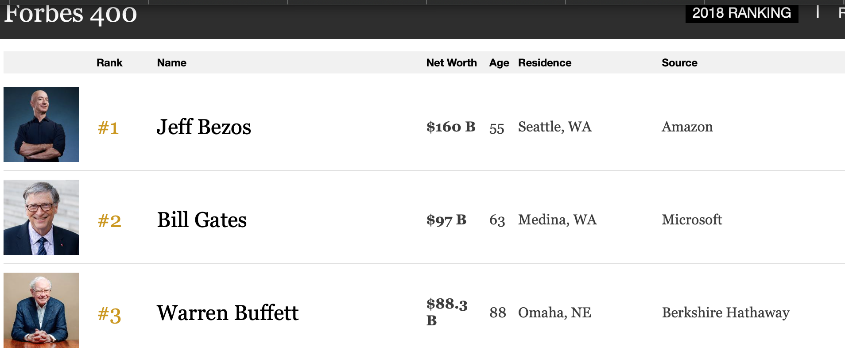
Substantive Fairness
To make a substantive judgement about fairness, all you need to know is the allocation itself.

Slide 11
Procedural Fairness
Procedural fairness focuses on “instead on why the person is poor or rich.”
Free Choice (Were things allocated without coercion?)
Equal Opportunity for Economic Advantage (Did people have an equal opportunity to acquire a large share of the total)
Deservingness

Slide 12
Jeff Bezos
https://www.youtube.com/watch?v=TEEBvqouuyw

Slide 13
Jeff Bezos
Is there anything procedurally unfair about how he amassed his wealth?
Free Choice (Were things allocated without coercion?)
Equal Opportunity for Economic Advantage (Did people have an equal opportunity to acquire a large share of the total)
Deservingness
Discuss with your neighbor.

Slide 14
For Problem 4
https://www.youtube.com/watch?v=u94oFWZCTCU
https://www.youtube.com/watch?v=IpWQlHapifU

Slide 15
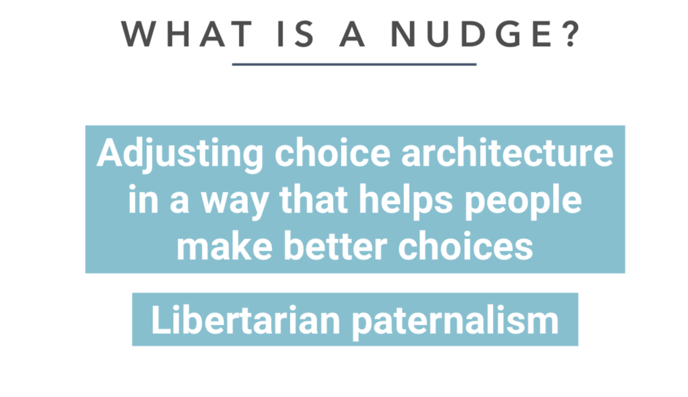
Nudges
https://www.youtube.com/watch?v=jsy1E3ckxlM
Libertarian = A person who believes in the doctrine of free will
Paternal = Characteristic of a father

