Slide 1
Lab 2
January 25, 2019

Slide 2
5 Main Games
Invisible Hand
Bach or Stravinsky
Chicken
Prisoner’s Dilemma
Stag Hunt

Slide 3
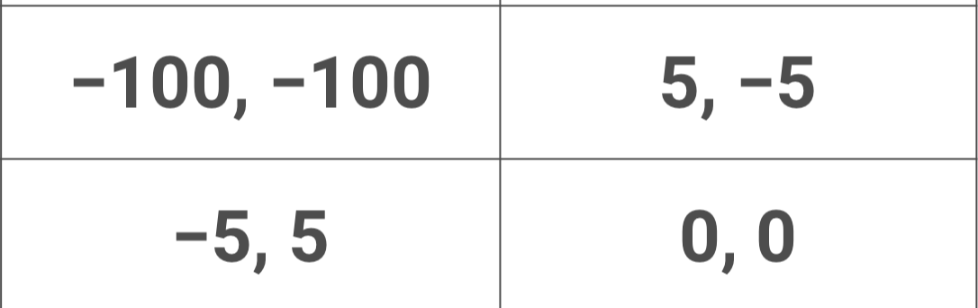
What game is this?

Slide 4
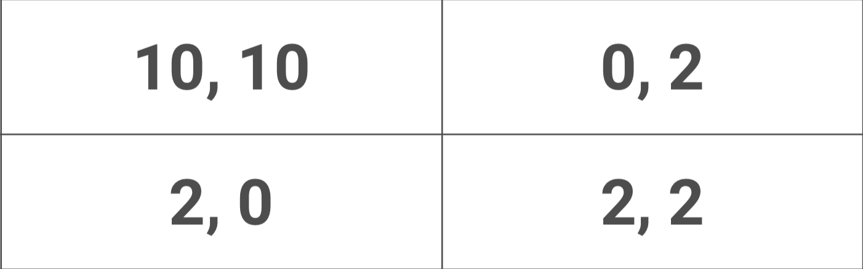
What game is this?

Slide 5
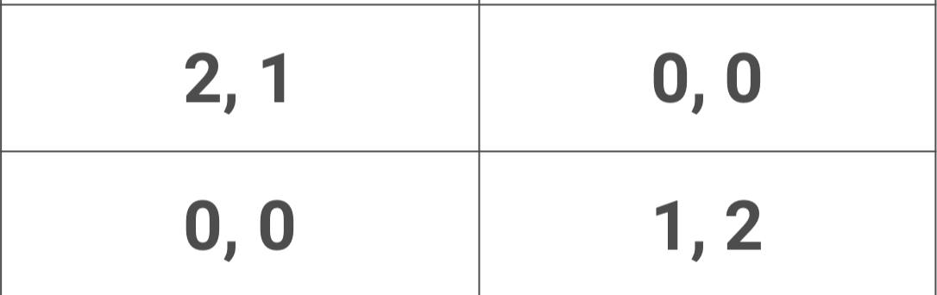
What game is this?

Slide 6
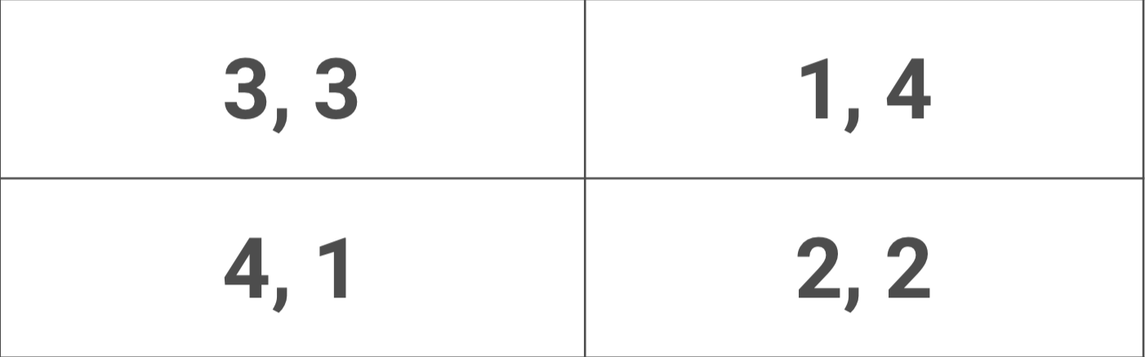
What game is this?

Slide 7
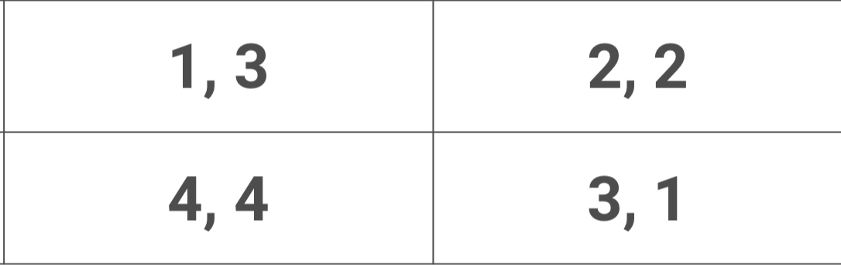
What game is this?

Slide 8

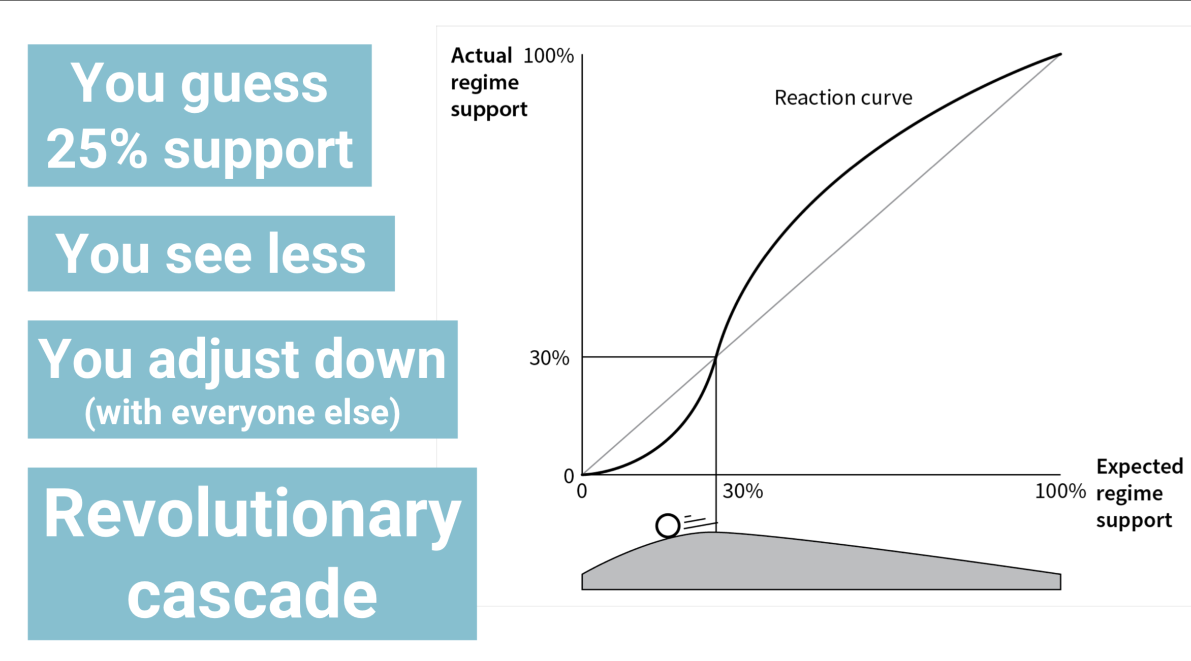
Preference Falsification
Tipping Point
“I don’t support the government that much.”
“It looks like others don’t either. They support it less than I do.”
”Maybe things are worse than I thought. Maybe I should do something.”
(25,10) instead of (25,25)
https://www.youtube.com/watch?v=Fgcd5ZcxDys

Slide 9
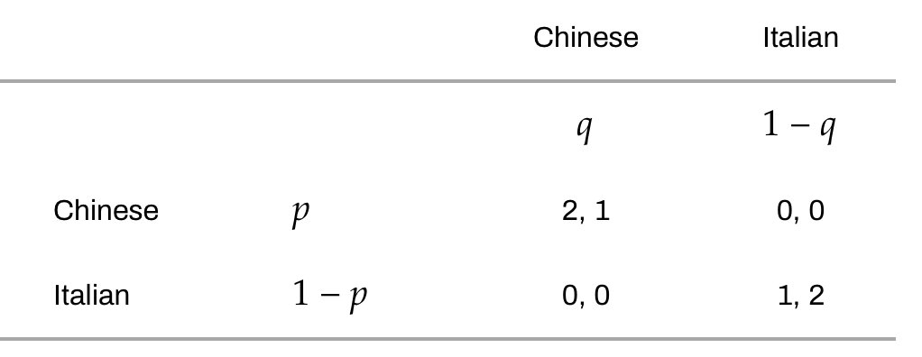
Calculate Expected Payoffs
How happy (utils) you are DEPENDS on the other person’s actions
 | My Payoff | Other’s Probability |  | My Payoff | Other’s Probability
Happiness (1) | 2 | q | + | 0 | (1-q) | 2q
Happiness (1) |  |  | +
Happiness (2) | 1 |  | + | 0
Happiness (2) |  |  | +

Slide 10



Does this make sense?
My happiness is 2q. The more likely my friend chooses Chinese food, I will be happier choosing Chinese food.

Slide 11
Solve for P & Q
Set equations equal to each other to find where we can be indifferent
Q = 1/3
P = 2/3

Slide 12
Does this make sense?
My indifference line is at 1/3. If my friend isn’t likely to choose Chinese food, then I should eat Italian food. It’s better than nothing.

Slide 13
Fill in the P & Q
 | 1/3 | 2/3
2/3
1/3
2/9

Slide 14
Fill in the P & Q
What is my expected payoff?
2/3
 | 2/9 * 2 | 4/9 * 0
 | 1/9 * 0 | 2/9 * 1

Slide 15
What is significant about the expected payoff?
I expect to get 2/3. They expect to get 2/3. I would much rather compromise to get the (1,2).
2/3
Expected < Actual = Compromise

